Slide 1
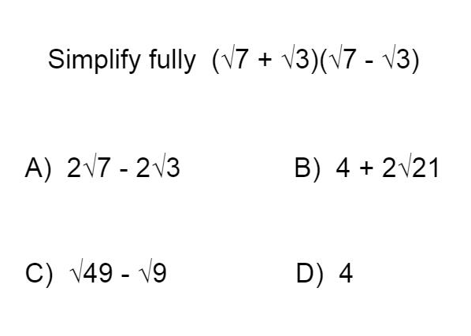
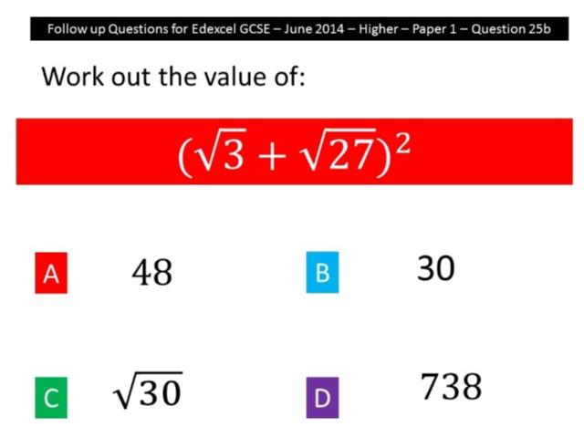
Worst answered question?
Most common wrong answer?

Slide 2
ANSWERS

Slide 3
Worst answered question?

Slide 4
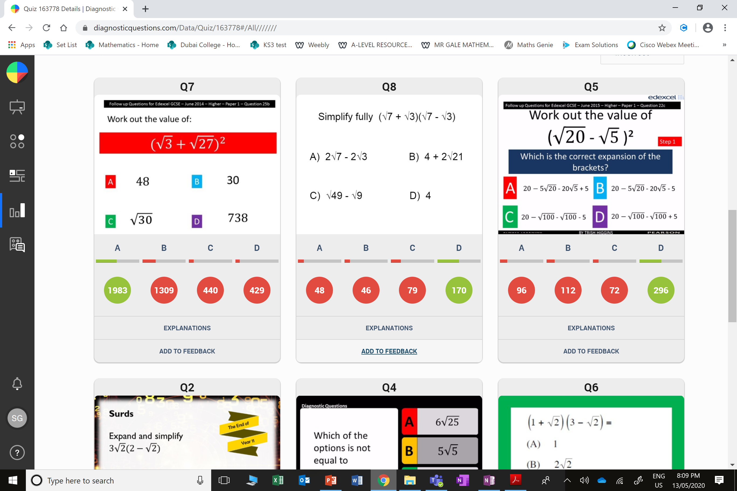
B
They squared the term individually and added. They did not expand double brackets.

Slide 5
C
They did not expand all the terms.

