Slide 1
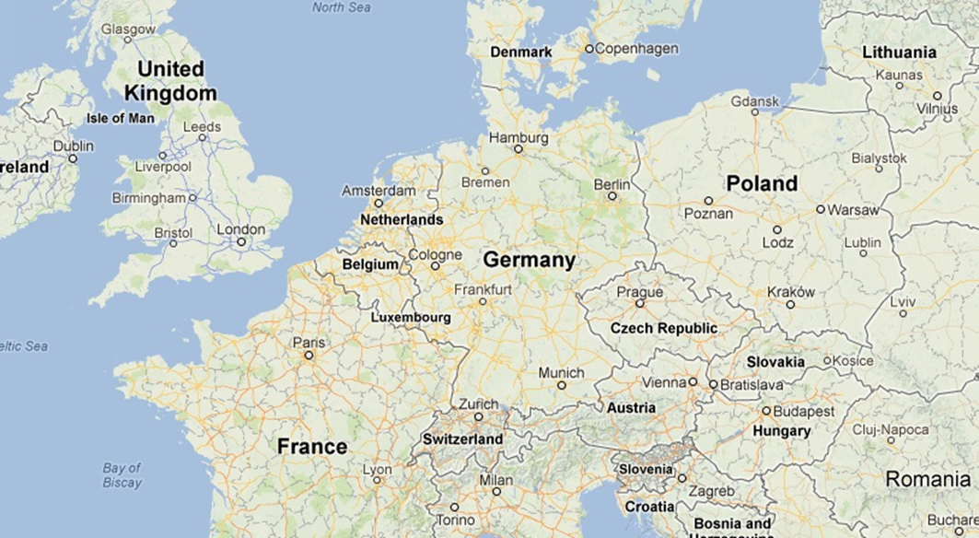
Liverpool to Paris
London to Munich
Birmingham to Krakow
Liverpool to Milan
Copenhagen to Berlin
Amsterdam to Zagreb
Zurich to Budapest
Lyon to Torino
Cologne to Prague
Liverpool to Dublin
Glasgow to London

Slide 2
ANSWERS

Slide 3
 | Distance on the map | Distance in real life
Liverpool to Paris | 3.1 | 629.3km
London to Munich | 4.5 | 913.5km
Birmingham to Krakow | 7.7 | 1563.1km
Liverpool to Milan | 6 | 1218km
Copenhagen to Berlin | 2 | 406km
Amsterdam to Zagreb | 5.2 | 1055.6km
Zurich to Budapest | 3.7 | 751.1km
Lyon to Torino | 1.1 | 223.3km

