Slide 1

Senior Challenge 5
BRONZE

Slide 2
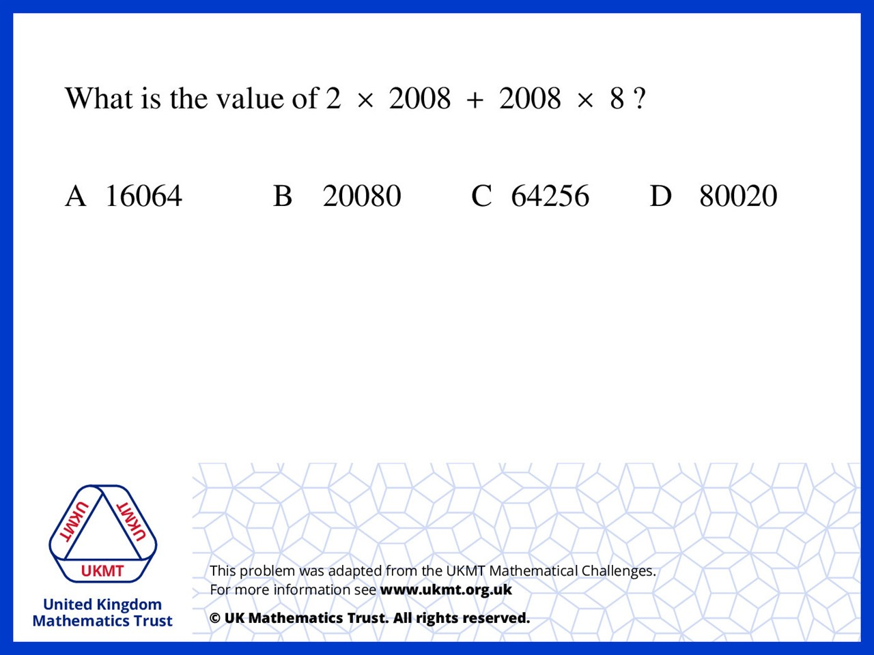
Q1.
4016 + 16064 = 20080

Slide 3
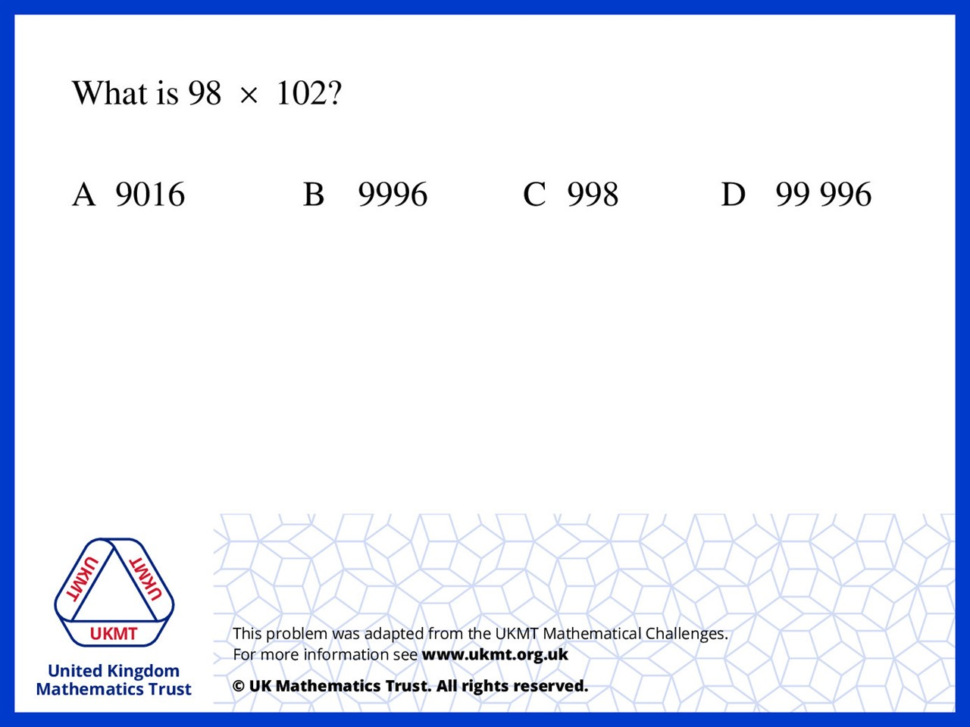
Q2.
98 x 100 = 9800 and 98 x 102 is
just a little bit bigger then 9800

Slide 4
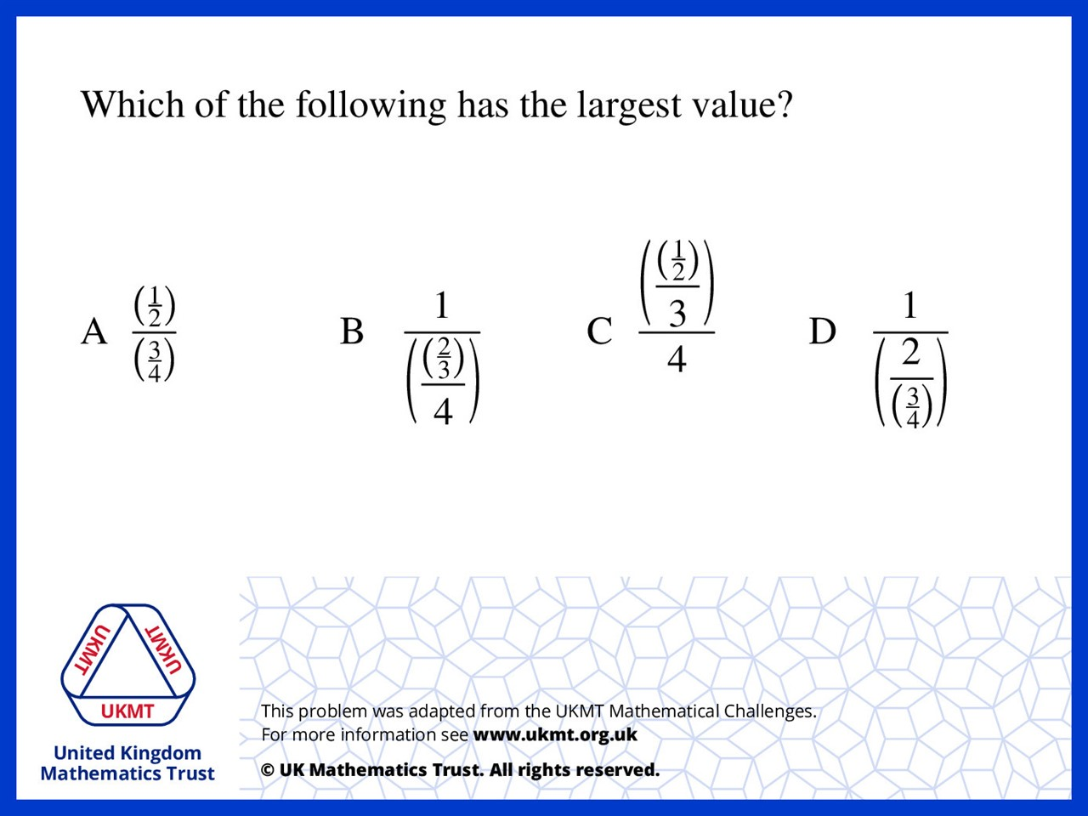
Q3.
A will equal to 2/3 which is 16/24.
B is equal to 6 (6/1) which is 24.
C is equal to 1/24.
D is equal to 3/8 which is 9/24.

Slide 5
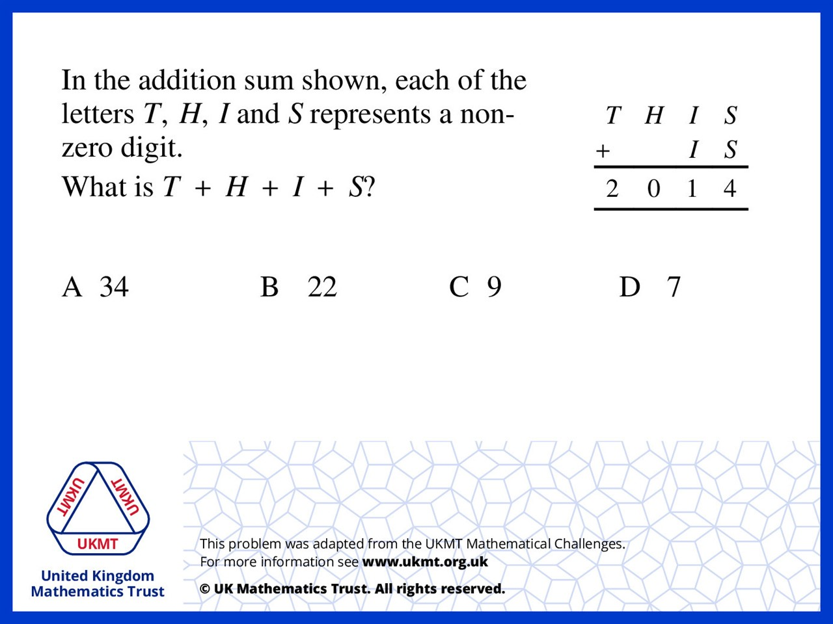
Q4.
Worked S' out to be 7 to get 14 then carried the 1.
I had to be 2 5's to make 11 then carry the 1 again
H has got to be 9 to make 10 then carry one over so T has to be 1
making 1957 and hide numbers added together make 22

Slide 6
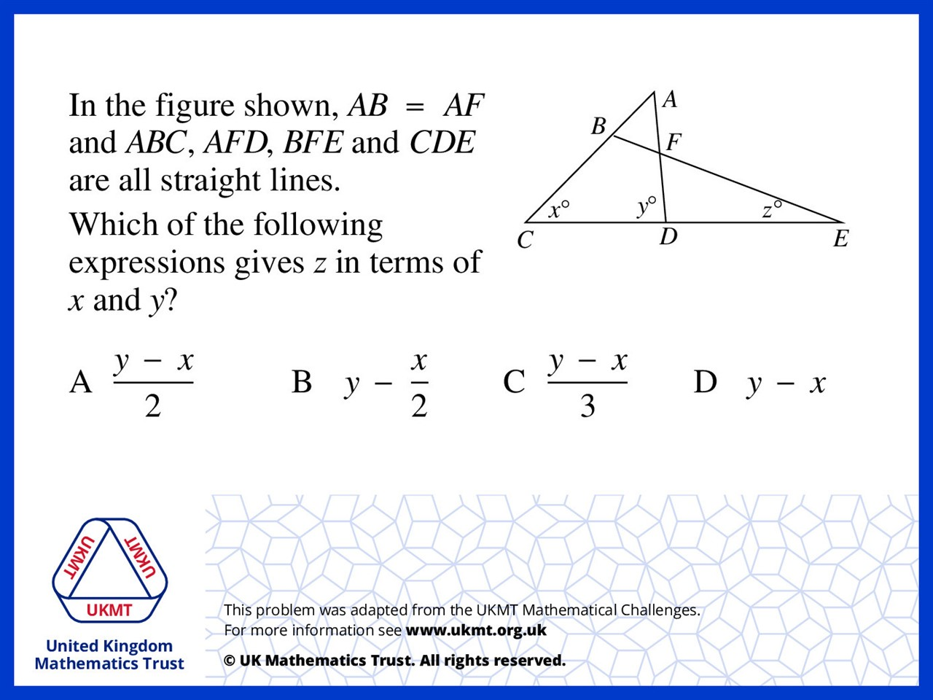
Q5.
BAF is equal to 180 – x – y.
AFB is isosceles so AFB is (180 – (180 – x – y) ) ÷ 2 = (x + y) ÷ 2.
AFB = EFD as they are vertically opposite angles. DFE = 180 – y
Z is therefore 180 - (x + y) / 2 - (180 - y)
= y – x/2 – y/2
= y/2 – x/2
= (y – x) / 2

