Slide 1
Work, Energy and Power
The law of Conservation of Energy
Chapter 2
(Part 3 of 4)

Slide 2
The Law of Conservation of Energy
The law of Conservation of Energy: the total energy of a system remains constant.
Initial Energy = Final Energy

Slide 3
What makes up the Initial Energy?
Work In + Initial K.E. + Initial P.E.
External source:
Some of the initial energy might come from
a engine or battery that then does work.
Work In = External Driving Force x Distance

Slide 4
What makes up the Final Energy?
Work Out + Final K.E. + Final P.E.
Some of the energy may be ‘lost’ if the object does work against a resistive force which transfers some energy into heat (maybe sound).
Work Out = Resistance Force x Distance

Slide 5
Initial Energy = Final Energy
Work in + Initial K.E. + Initial .P.E. = Final K.E. + Final .P.E. + Work out
Driving Force x Distance + $\frac{1}{2}mu^{2}$+ $mgh_{I}$ = $\frac{1}{2}mv^{2}$+ $mgh_{F}$ + Resistance x Distance
The idea underlying this formula is the
‘work energy principle’.

Slide 7

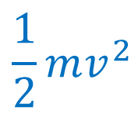








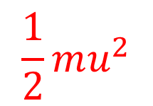






Smooth Slope
$v{ ms}^{−1}$
m
$u {ms}^{−1}$
$$h\sin{θ}$$
$$h$$
m
$$θ°$$
$$Work In=$$
$$0$$
$$Work Out=$$
$$0$$
$$\frac{1}{2}mu^{2}$$
$$\frac{1}{2}mv^{2}$$
$$K.E.=$$
$$K.E.=$$
$$P.E.=$$
$$0$$
$$P.E.=$$
$$mg(h\sin{θ)}$$

Slide 8

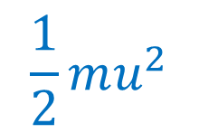








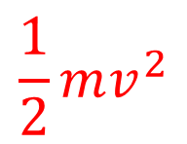






Smooth Slope
$u{ ms}^{−1}$
m
$v {ms}^{−1}$
$$h\sin{θ}$$
$$h$$
m
$$θ°$$
$$Work Out=$$
$$0$$
$$Work In=$$
$$0$$
$$\frac{1}{2}mv^{2}$$
$$\frac{1}{2}mu^{2}$$
$$K.E.=$$
$$K.E.=$$
$$P.E.=$$
$$0$$
$$P.E.=$$
$$mg(h\sin{θ)}$$

Slide 9










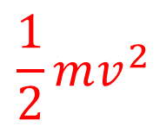






Smooth Slope
$0{ ms}^{−1}$
m
$v {ms}^{−1}$
$$h\sin{θ}$$
$$h$$
m
$$θ°$$
$$Work Out=$$
$$0$$
$$Work In=$$
$$0$$
$$\frac{1}{2}mv^{2}$$
$$K.E.=$$
$$K.E.=$$
$$0$$
$$P.E.=$$
$$0$$
$$P.E.=$$
$$mg(h\sin{θ)}$$

Slide 10

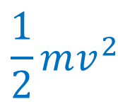















$v{ ms}^{−1}$
Smooth Slope
m
$0 {ms}^{−1}$
$$h\sin{θ}$$
$$h$$
m
F
$$θ°$$
$$Work In=$$
$$Fh$$
$$Work Out=$$
$$0$$
$$K.E.=$$
$$0$$
$$\frac{1}{2}mv^{2}$$
$$K.E.=$$
$$P.E.=$$
$$0$$
$$P.E.=$$
$$mg(h\sin{θ)}$$

Slide 11

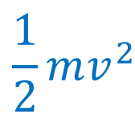








Rough Slope
$v{ ms}^{−1}$
m
$u {ms}^{−1}$
$$h\sin{θ}$$
$$h$$
m
$$θ°$$
$$Work In=$$
$$0$$
$$Work Out=$$
$$μRh$$
$$\frac{1}{2}mu^{2}$$
$$\frac{1}{2}mv^{2}$$
$$K.E.=$$
$$K.E.=$$
$$P.E.=$$
$$0$$
$$P.E.=$$
$$mg(h\sin{θ)}$$

Slide 12

$v{ ms}^{−1}$
Rough Slope
m
$0 {ms}^{−1}$
$$h\sin{θ}$$
$$h$$
m
F
$$θ°$$
$$Work In=$$
$$Fh$$
$$Work Out=$$
$$μRh$$
$$K.E.=$$
$$0$$
$$\frac{1}{2}mv^{2}$$
$$K.E.=$$
$$P.E.=$$
$$0$$
$$P.E.=$$
$$mg(h\sin{θ)}$$

Slide 13
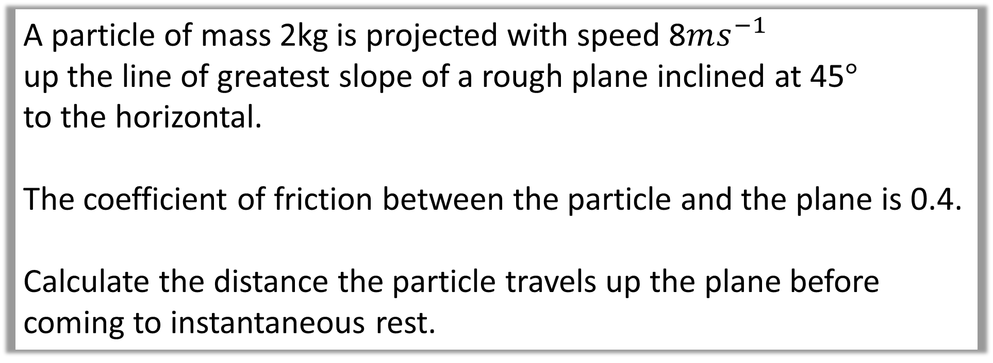
Example A: Distance Travelled
A particle of mass 2kg is projected with speed 8$ms^{−1}$
up the line of greatest slope of a rough plane inclined at 45$°$
to the horizontal.
The coefficient of friction between the particle and the plane is 0.4.
Calculate the distance the particle travels up the plane before coming to instantaneous rest.

Slide 14
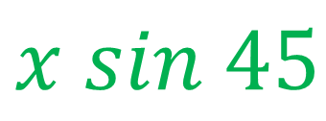


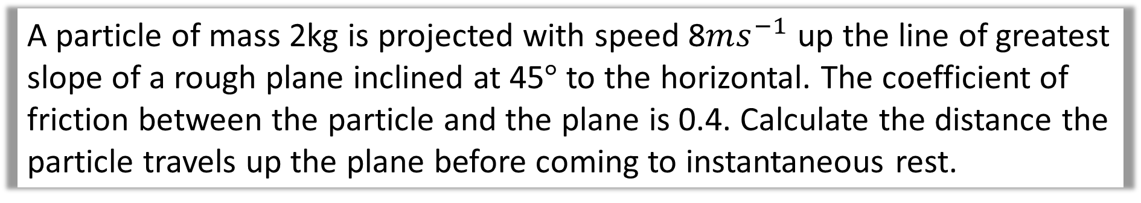


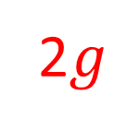
A particle of mass 2kg is projected with speed 8$ms^{−1}$ up the line of greatest slope of a rough plane inclined at 45$°$ to the horizontal. The coefficient of friction between the particle and the plane is 0.4. Calculate the distance the particle travels up the plane before coming to instantaneous rest.
Diagram
0
8
$$R$$
$$x sin 45$$
$$x$$
$$F_{r}$$
$$45°$$
2$g$

Slide 15
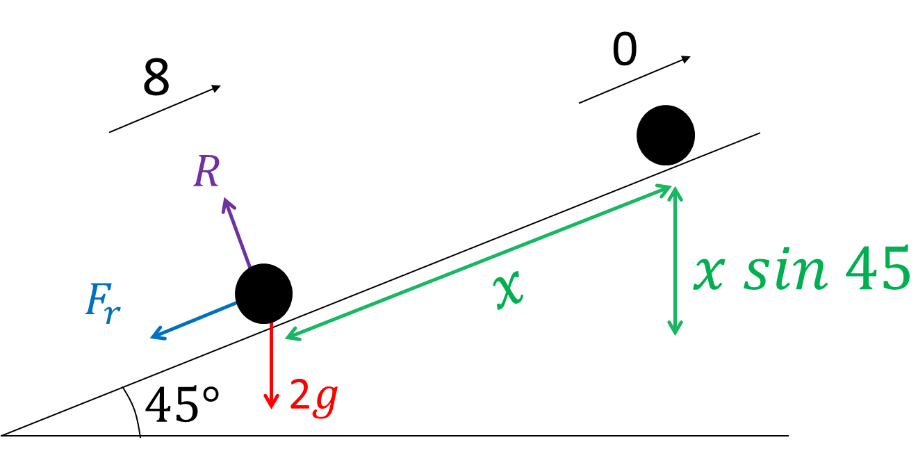
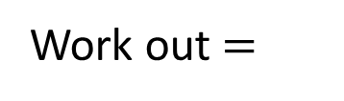
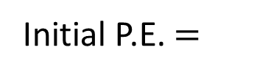

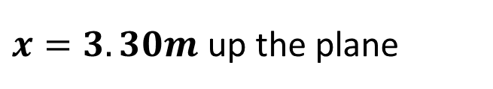

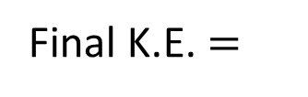

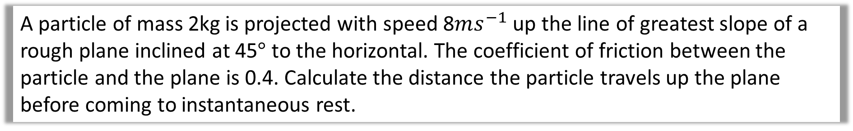



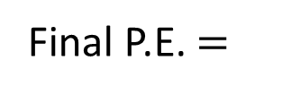
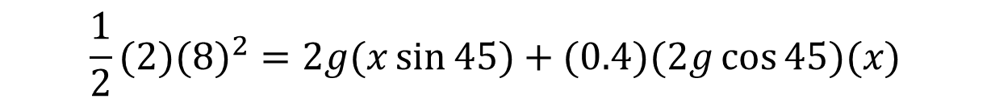




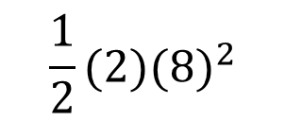
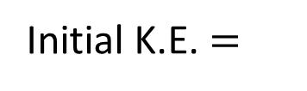

A particle of mass 2kg is projected with speed 8$ms^{−1}$ up the line of greatest slope of a rough plane inclined at 45$°$ to the horizontal. The coefficient of friction between the particle and the plane is 0.4. Calculate the distance the particle travels up the plane before coming to instantaneous rest.
Initial Energy
Final Energy
$$0$$
Work in $=$
Work out $=$
$$F_{r}\left(x\right)=$$
$$μRx=$$
$$(0.4)(2g\cos{45})(x)$$
$$\frac{1}{2}mu^{2}=$$
$$\frac{1}{2}(2){(8)}^{2}$$
$$0$$
Initial K.E. $=$
Final K.E. $=$
Initial P.E. $=$
Final P.E. $=$
$mgh_{F}=$
$$(2g)(\sin{45})(x)$$
$$0$$
$$\frac{1}{2}(2)({8)}^{2}=2g(x\sin{45})+(0.4)(2g\cos{45})(x)$$
$$x=\frac{64}{2gsin45+2×0.4gcos45}$$
$x=3.30m$ up the plane

Slide 16
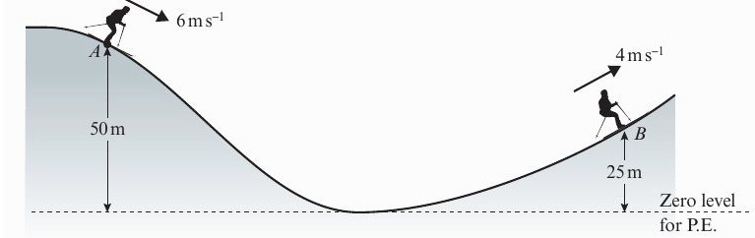
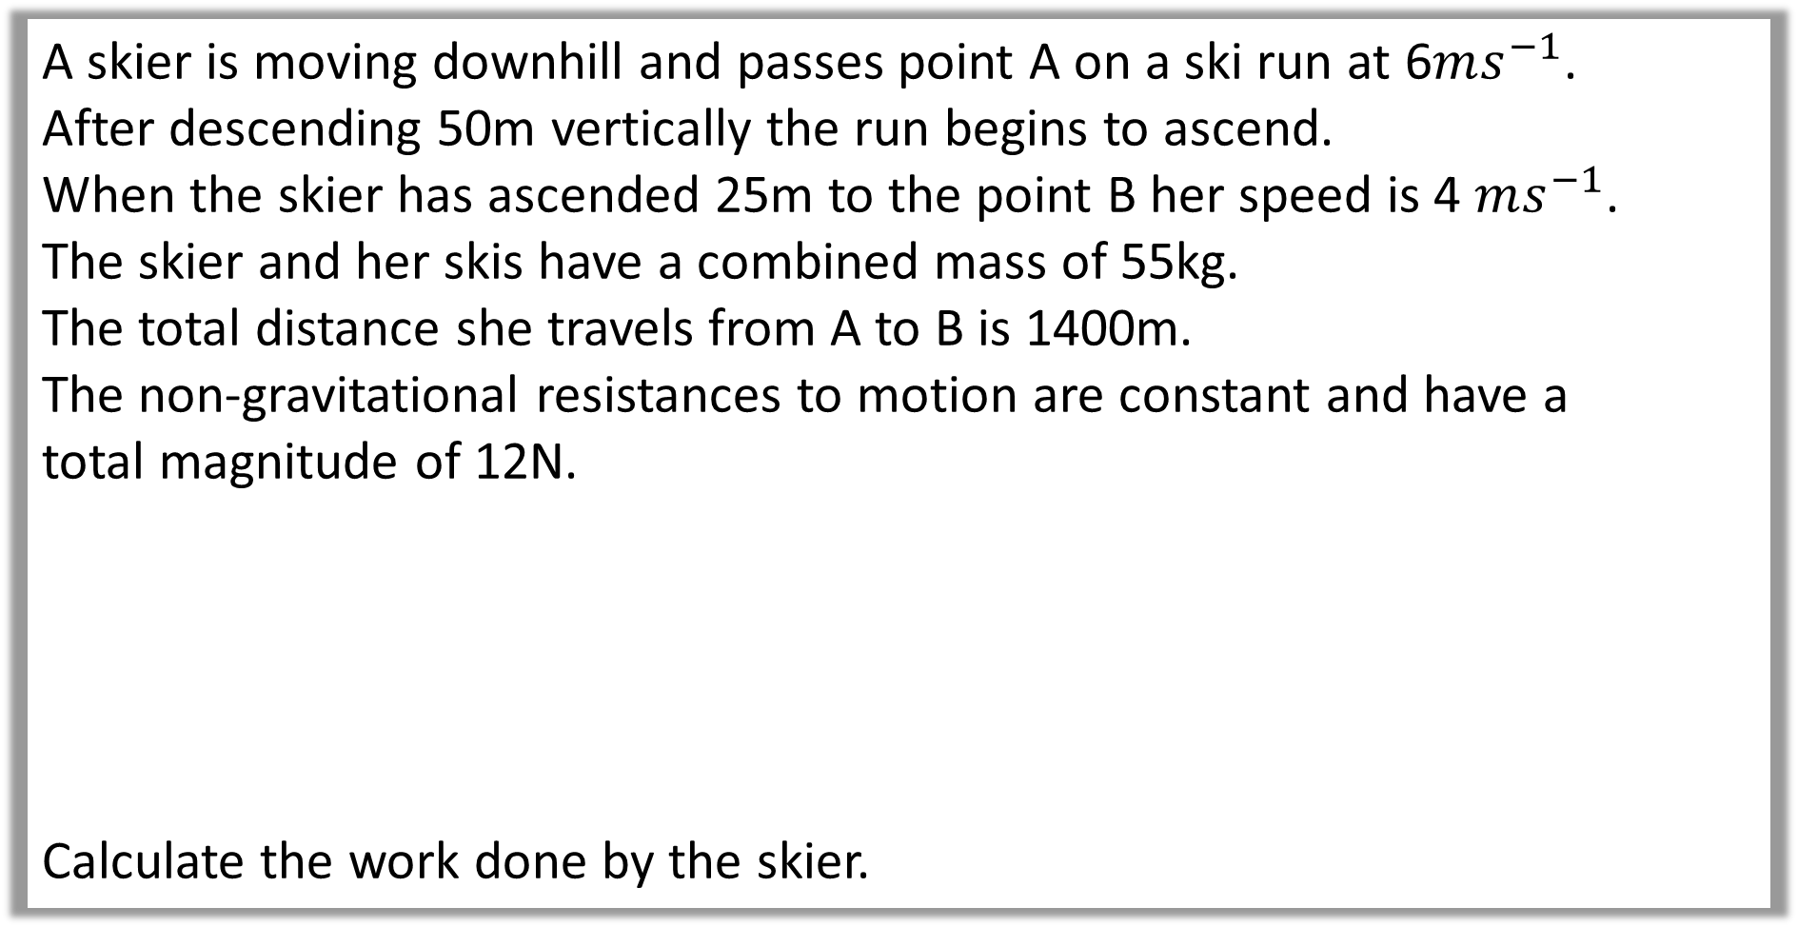
Example B: Work Done
A skier is moving downhill and passes point A on a ski run at 6$ms^{−1}$.
After descending 50m vertically the run begins to ascend.
When the skier has ascended 25m to the point B her speed is 4 $ms^{−1}$.
The skier and her skis have a combined mass of 55kg.
The total distance she travels from A to B is 1400m.
The non-gravitational resistances to motion are constant and have a
total magnitude of 12N.
Calculate the work done by the skier.

Slide 17
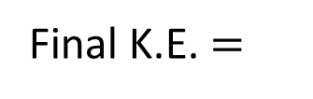

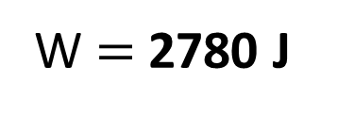
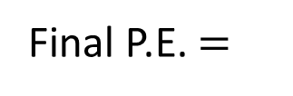

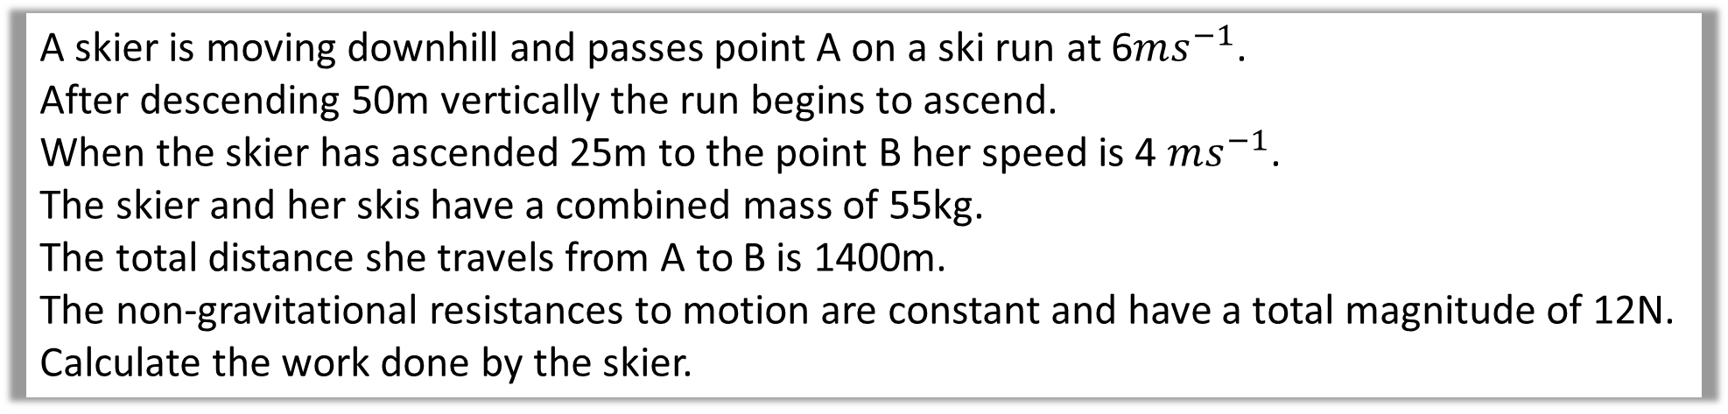

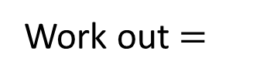

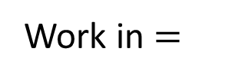
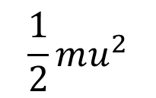
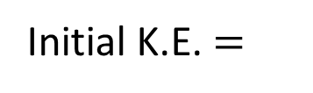
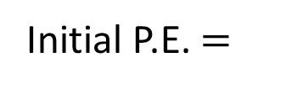

A skier is moving downhill and passes point A on a ski run at 6$ms^{−1}$.
After descending 50m vertically the run begins to ascend.
When the skier has ascended 25m to the point B her speed is 4 $ms^{−1}$.
The skier and her skis have a combined mass of 55kg.
The total distance she travels from A to B is 1400m.
The non-gravitational resistances to motion are constant and have a total magnitude of 12N.
Calculate the work done by the skier.
Initial Energy
Final Energy
Work in $=$
$$W$$
$$Rx$$
Work out $=$
$$\frac{1}{2}mu^{2}$$
$$\frac{1}{2}mv^{2}$$
Initial K.E. $=$
Final K.E. $=$
Initial P.E. $=$
$$mgh_{I}$$
Final P.E. $=$
$mgh_{F}$
$$W+\frac{1}{2}(55)({6)}^{2}+55\left(9.8\right)50=12\left(1400\right)+\frac{1}{2}(55)({4)}^{2}+55(9.8)(25)$$
W $=$ 2780 J

Slide 18
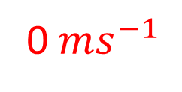



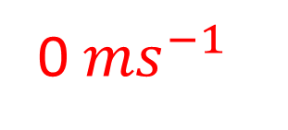





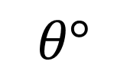








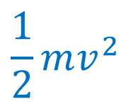
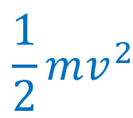










m
$$Work In=$$
$$0$$
Smooth Slope
$v{ ms}^{−1}$
$$K.E.=$$
$$0$$
m
m
$$P.E.=$$
$$mg(h)$$
0${ms}^{−1}$
0${ ms}^{−1}$
$$h\sin{θ}$$
$$h$$
m
m
$v{ ms}^{−1}$
$$θ°$$
$$Work Out=$$
$$0$$
$$Work In=$$
$$0$$
$$Work Out=$$
$$0$$
$$\frac{1}{2}mv^{2}$$
$$\frac{1}{2}mv^{2}$$
$$K.E.=$$
$$K.E.=$$
$$0$$
$$K.E.=$$
$$P.E.=$$
$$0$$
$$P.E.=$$
$$P.E.=$$
$$mg(h\sin{θ)}$$
$$0$$

Slide 19





m
$$Work In=$$
$$0$$
Rough Slope
$v{ ms}^{−1}$
$$K.E.=$$
$$0$$
m
m
$$P.E.=$$
$$mg(h)$$
0${ms}^{−1}$
0${ ms}^{−1}$
$$h\sin{θ}$$
$$h$$
m
m
$v{ ms}^{−1}$
$$θ°$$
$$Work Out=$$
$$0$$
$$Work In=$$
$$0$$
$$Work Out=$$
$$μR$$
$$\frac{1}{2}mv^{2}$$
$$\frac{1}{2}mv^{2}$$
$$K.E.=$$
$$K.E.=$$
$$0$$
$$K.E.=$$
$$P.E.=$$
$$mg(h\sin{θ)}$$
$$P.E.=$$
$$0$$
$$P.E.=$$
$$0$$

Slide 20
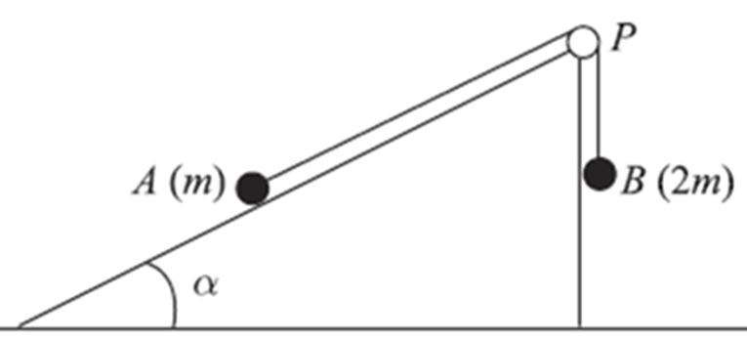
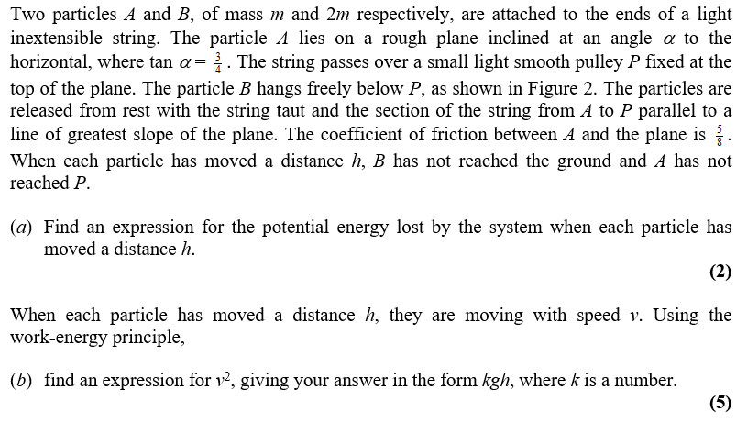
Example C: Exam Question

Slide 21
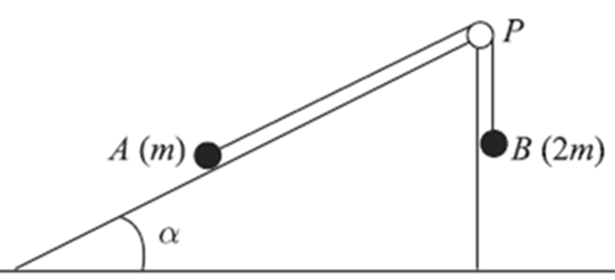

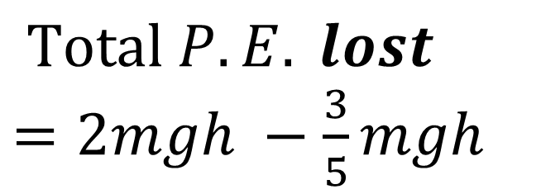

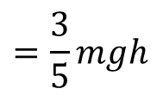







sin $θ$ = $\frac{3}{5}$
cos $θ$ = $\frac{4}{5}$
a)
$$Total P.E. lost$$
$=2mgh −$ $\frac{3}{5}mgh$
$$h$$
$$mg$$
$$h sinα$$
$$=\frac{7}{5}mgh$$
$$2mg$$
$$P.E. gained by A=mg hsinα$$
$$=\frac{3}{5}mgh$$
$$P.E. lost by B=2mgh$$

Slide 22














sin $θ$ = $\frac{3}{5}$
cos $θ$ = $\frac{4}{5}$
b)
Initial Energy A
Initial Energy B
Total Initial Energy
Work in $=$
Work in $=$
$$0$$
$$0$$
$$=2mgh$$
Initial K.E. $=$
$$0$$
Initial K.E. $=$
$$0$$
Initial P.E. $=$
Initial P.E. $=$
$$\left(2m\right)gh$$
$$0$$

Slide 23



















$$=\frac{3}{5}mg$$
b)
Final Energy A
Final Energy B
Work in $=$
$$μ(R)h$$
Work in $=$
$$0$$
$$=\frac{5}{8}\left(mg cos{α}\right)h$$
$$\frac{1}{2}(2m)v^{2}$$
Final K.E. $=$
$$=\frac{5}{8}\left(\frac{4}{5}mg\right)h$$
Final P.E. $=$
$$0$$
Total Final Energy
$$\frac{1}{2}mv^{2}$$
Final K.E. $=$
$$=\frac{5}{8}\left(\frac{4}{5}mg\right)h+\frac{1}{2}mv^{2}+\frac{3}{5}mg+mv^{2}$$
Final P.E. $=$
$$mg(h sin{α})$$
$$=\frac{3}{5}mgh$$
$$=\frac{11}{10}mgh+\frac{3}{2}mv^{2}$$

Slide 24



sin $θ$ = $\frac{3}{5}$
cos $θ$ = $\frac{4}{5}$
b)
Total Initial Energy = Total Final Energy
$$2mgh=\frac{11}{10}mgh+\frac{3}{2}mv^{2}$$
$$\frac{9}{10}mgh=\frac{3}{2}mv^{2}$$
$$v^{2}=\frac{3}{5}gh$$

