Slide 1
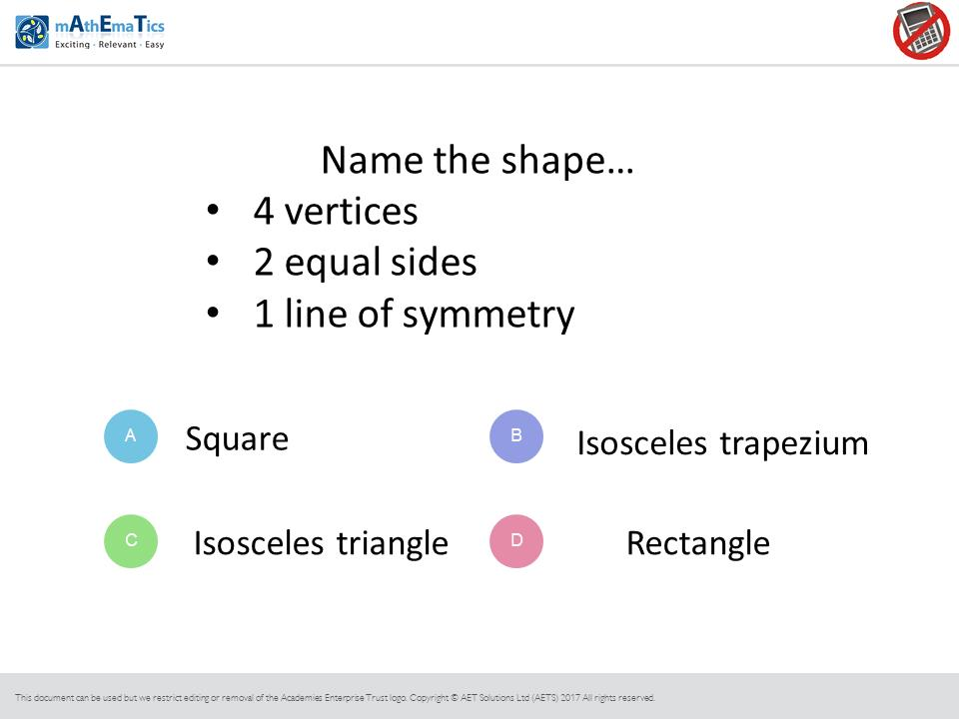
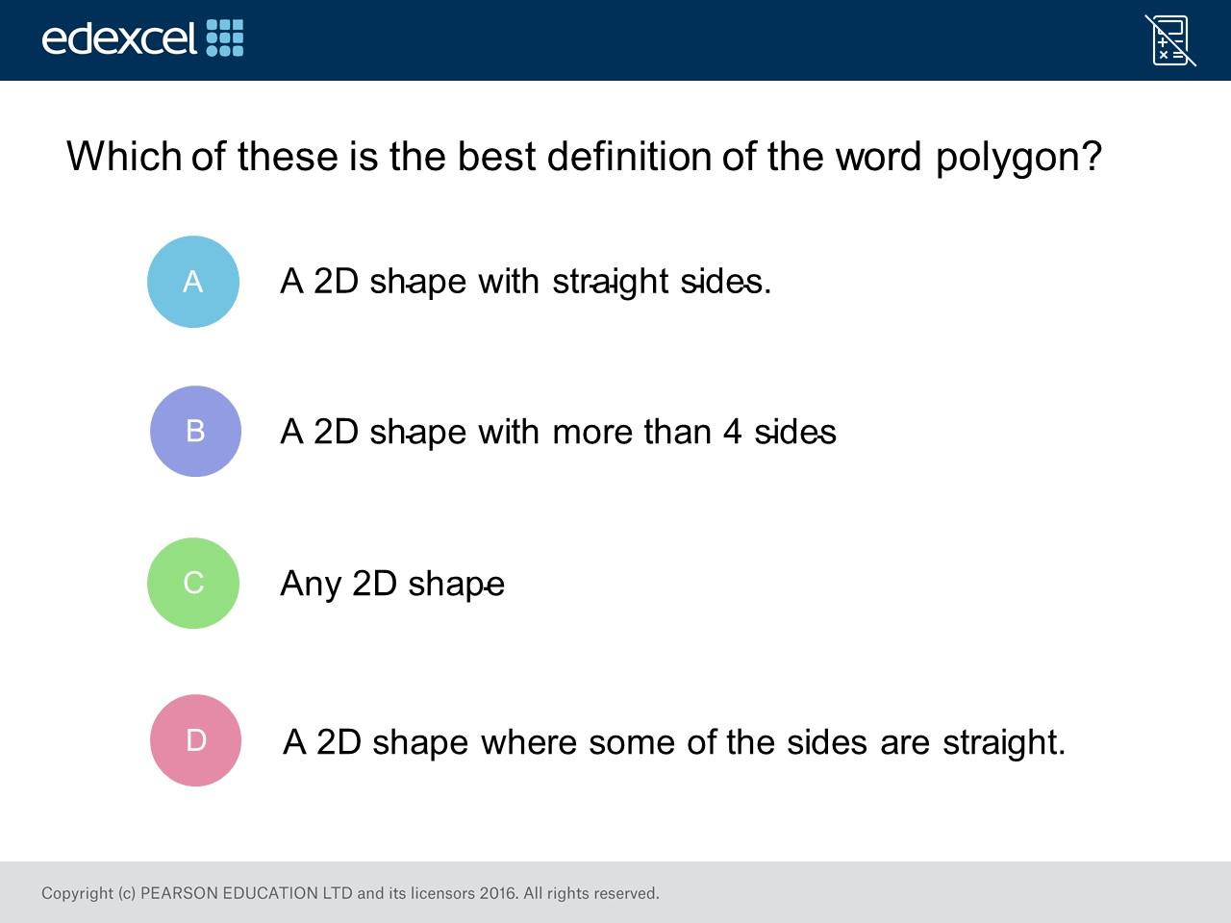
Worst answered question?
Most common wrong answer?

Slide 2
ANSWERS

Slide 3
Worst answered question?

Slide 4
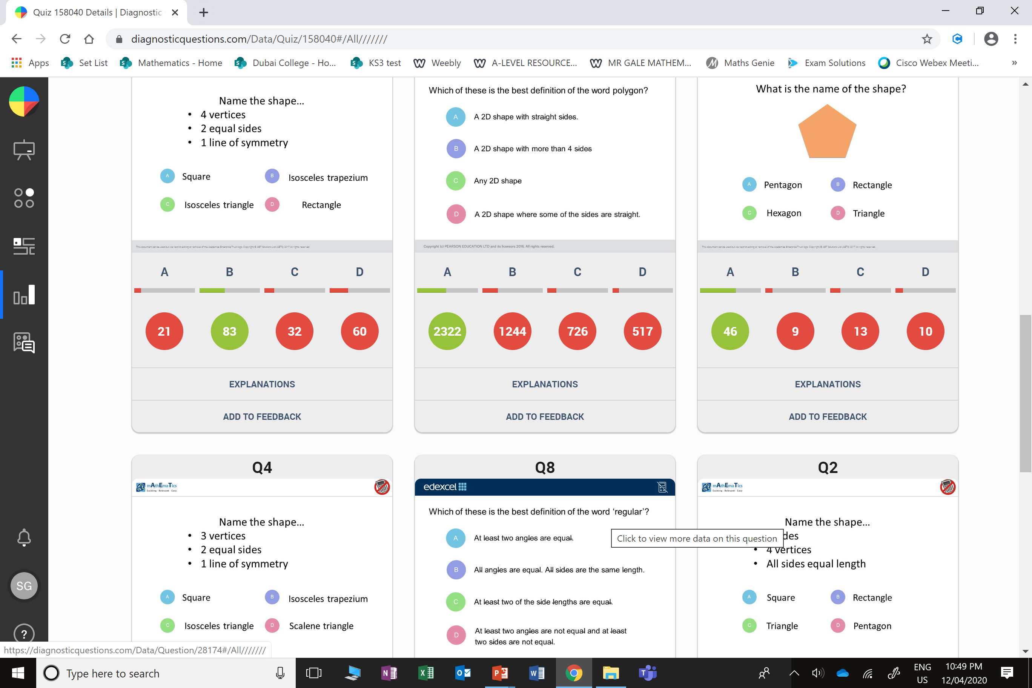
D
A rectangle has 2 lines of symmetry.

Slide 5
B
A polygon can have 4 sides.

