Slide 1
LO: Reflecting Shapes

Slide 2
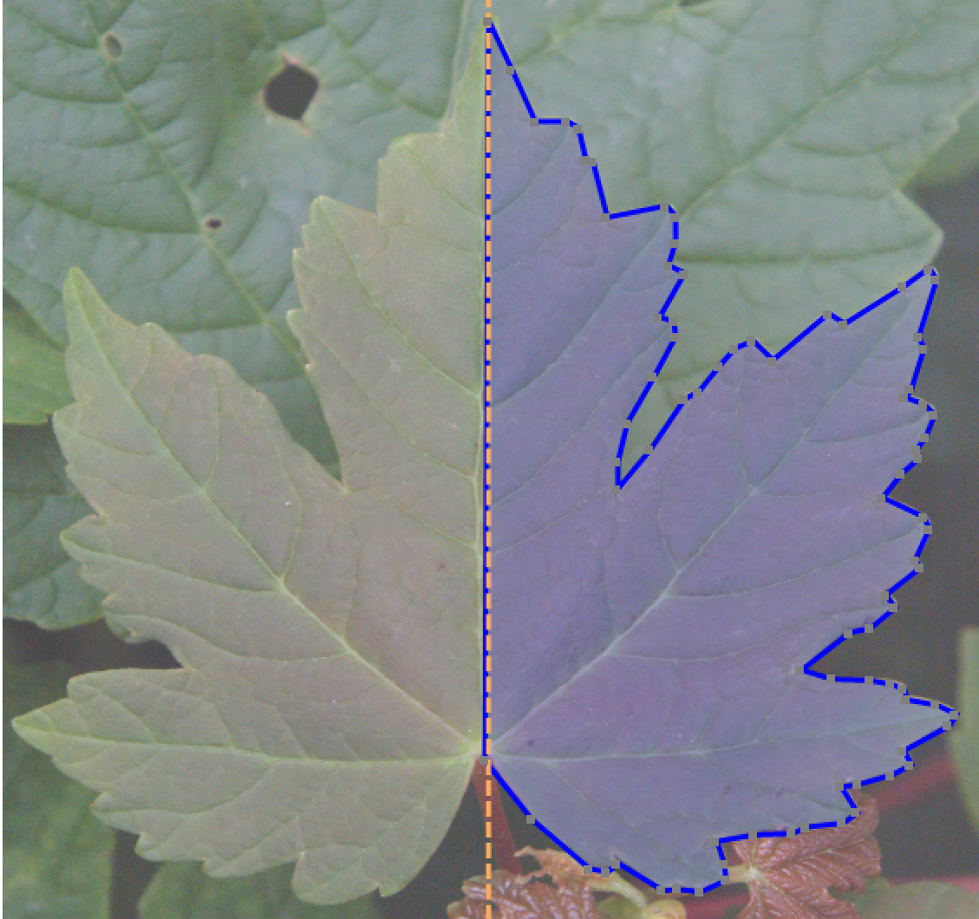
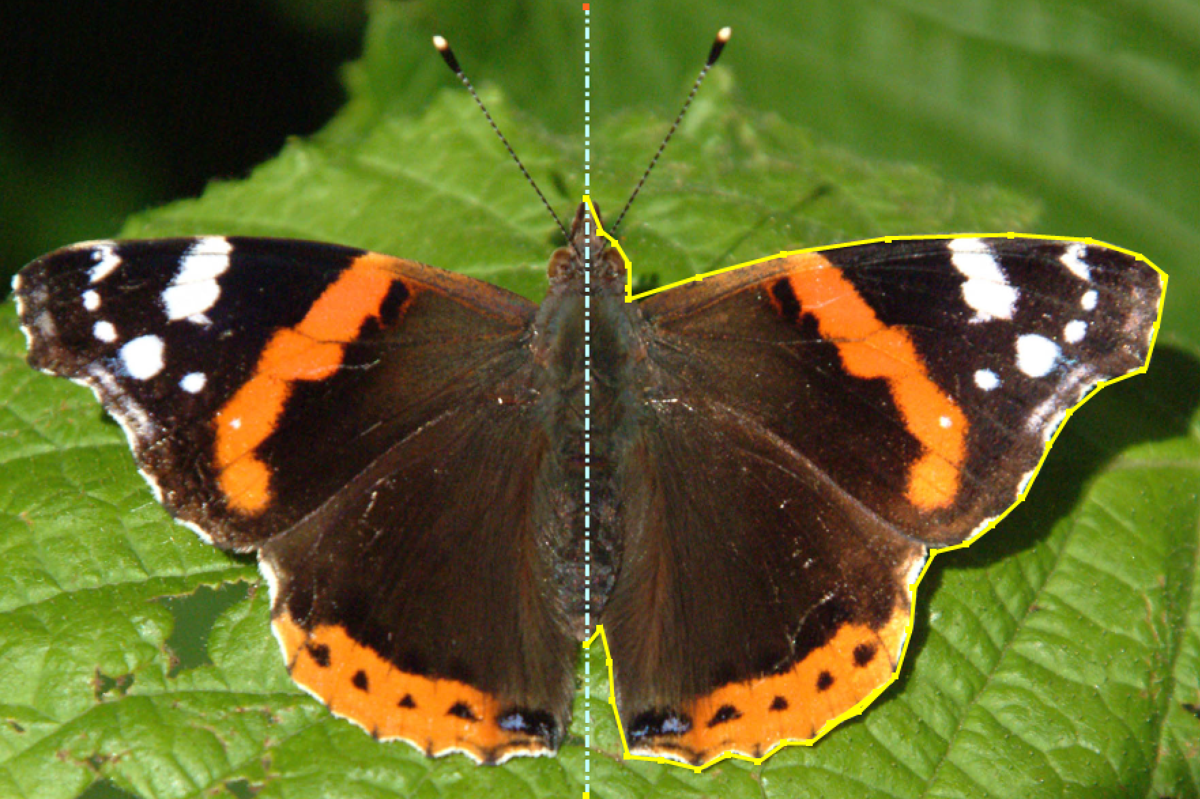
Symmetry is everywhere.
Line of Symmetry
Mirror Line

Slide 3
Pick points on the shape and reflect them.
Then join those points together.

Slide 4
Planes of Symmetry
A plane of symmetry
is a plane that divides
a 3D shape in half.
Can you draw a plane of symmetry for a cube?

Slide 5
