Slide 1
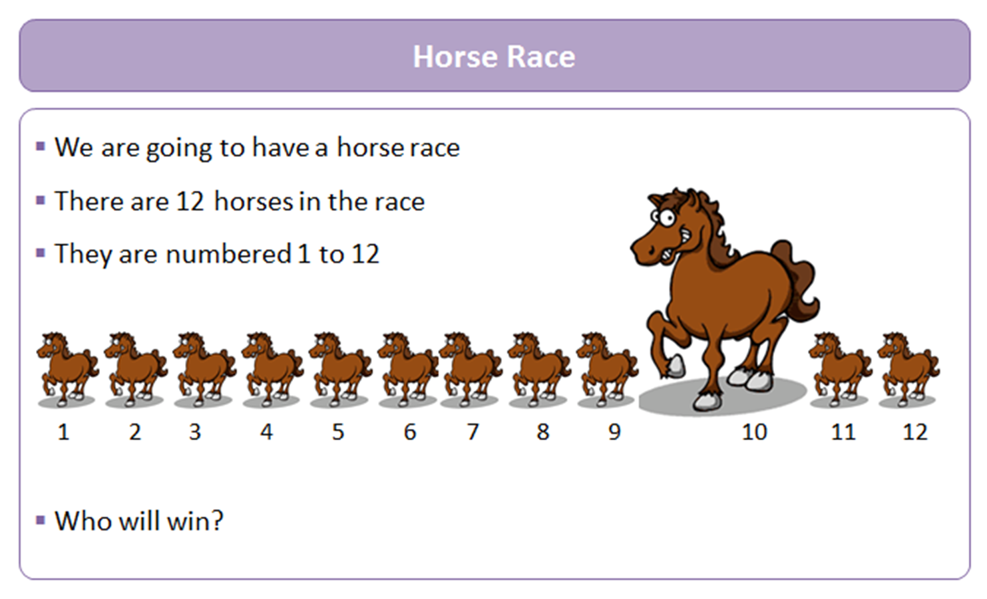

Slide 2
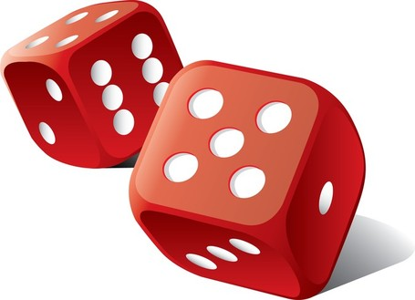
Race 1 |  |  |  |  |  |  |  |  |  | Finish
1
2
3
4
5
6
7
8
9
10
11
12
Roll two dice and add up the scores.
Colour each square as each total appears.
The first number to get to the finish line wins.
Predict which number you think is going to win before starting.
Play the game 4 times. Use the grids given.

Slide 3
Total Wins
1
2
3
4
5
6
7
8
9
10
11
12

Slide 4

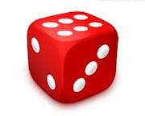
Fill in the table showing all possible totals of adding two dice together.
+ | 1 | 2 | 3 | 4 | 5 | 6 |  | Write down the probability of getting each total. (simplify if possible)
1 |  |  |  |  |  |  |  | P(1) = |  | P(2) = |  | P(3) = |  | P(4) =
2
3
4 |  |  |  |  |  |  |  | P(5) = |  | P(6) = |  | P(7) = |  | P(8) =
5
6
 |  |  |  |  |  |  |  | P(9) = |  | P(10) = |  | P(11) = |  | P(12) =

Slide 5
ANSWERS

Slide 6
+ | 1 | 2 | 3 | 4 | 5 | 6
1 | 2 | 3 | 4 | 5 | 6 | 7
2 | 3 | 4 | 5 | 6 | 7 | 8
3 | 4 | 5 | 6 | 7 | 8 | 9
4 | 5 | 6 | 7 | 8 | 9 | 10
5 | 6 | 7 | 8 | 9 | 10 | 11
6 | 7 | 8 | 9 | 10 | 11 | 12
Write down the probability of getting each total. (simplify if possible)
P(1) = | 0 | P(2) = | 1 | P(3) = | 1 | P(4) = | 1
 | 36 |  | 36 |  | 18 |  | 12
P(5) = | 1 | P(6) = | 5 | P(7) = | 1 | P(8) = | 5
 | 9 |  | 36 |  | 6 |  | 36
P(9) = | 1 | P(10) = | 1 | P(11) = | 1 | P(12) = | 1
 | 9 |  | 12 |  | 18 |  | 36

Slide 7
Write down the probability the following events.
1) P(less than 5) = |  |  | 1 |  | 6) P(more than 12) = |  |  | 0
 |  |  | 6 |  |  |  |  | 36
2) P(even) = |  |  | 1 |  | 7) P(squared number) = |  |  | 7
 |  |  | 2 |  |  |  |  | 36
3) P(more than 6) = |  |  | 7 |  | 8) P(between 4 and 8) = |  |  | 7
 |  |  | 12 |  |  |  |  | 18
4) P(4 or more) = |  |  | 5 |  | 9) P(10 or less) = |  |  | 5
 |  |  | 6 |  |  |  |  | 6
5) P(prime number) = |  |  | 7 |  | 10) P(multiple of 3) = |  |  | 1
 |  |  | 18 |  |  |  |  | 3
+ | 1 | 2 | 3 | 4 | 5 | 6
1 | 2 | 3 | 4 | 5 | 6 | 7
2 | 3 | 4 | 5 | 6 | 7 | 8
3 | 4 | 5 | 6 | 7 | 8 | 9
4 | 5 | 6 | 7 | 8 | 9 | 10
5 | 6 | 7 | 8 | 9 | 10 | 11
6 | 7 | 8 | 9 | 10 | 11 | 12

