Slide 1
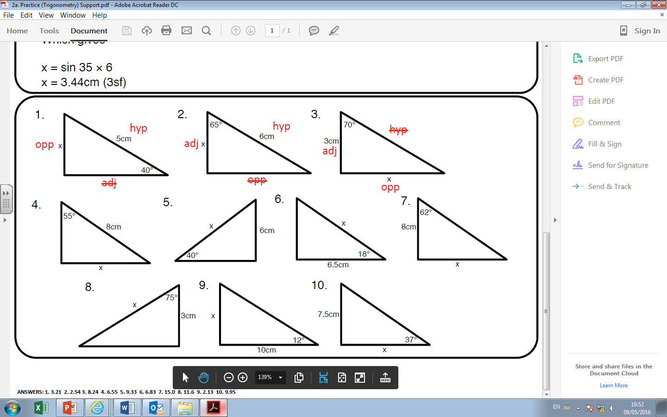
Find the values of x. Give your answers to 1 decimal place.

Slide 2
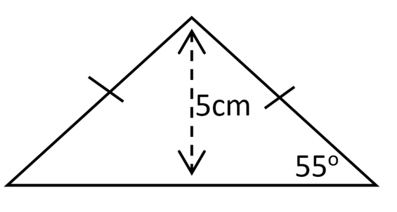
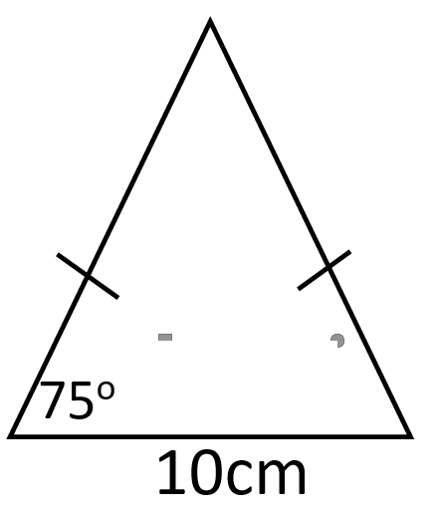
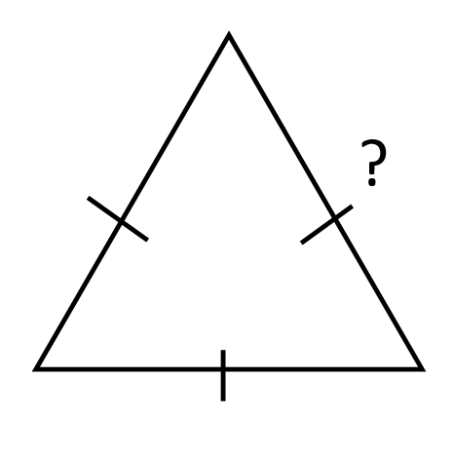
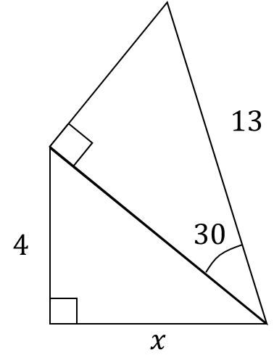
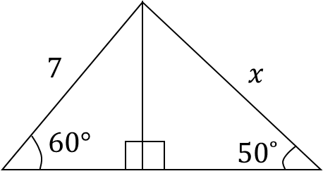
1) Find the height of the triangle
2) Find the length of the base
3) Given that the height is 10 cm find the length of the sides.
?
5) Find the length of x
4) Find the length of x

Slide 3
ANSWERS

Slide 4




5 sin 40 = 3.2
6 cos 65 = 2.5
3 tan 70 = 8.2
$\frac{6}{sin 40}$ = 9.3
$\frac{6.5}{cos 18}$ = 6.8
8 sin 55 = 6.6
8 tan 62 = 15.0
$\frac{3}{cos 75}$ = 11.6
10 tan 12 = 2.1
$\frac{7.5}{ tan 37}$ = 10.0

Slide 5
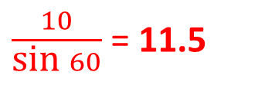
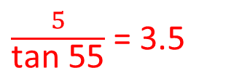
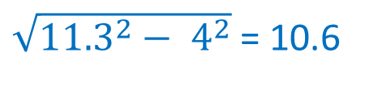
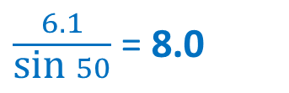
1) Find the height of the triangle
2) Find the length of the base
3) Given that the height is 10 cm find the length of the sides.
?
$\frac{5}{\text{tan} \text{5}\text{5}}$ = 3.5
3.5 x 2 = 7
5 tan 75 = 18.7
$\frac{10}{\text{sin} 60}$ = 11.5
5) Find the length of x
4) Find the length of x
13 cos 30 = 11.3
$\frac{6.1}{\text{sin} 50}$ = 8.0
$\sqrt{{11.3}^{2}− 4^{2}}$= 10.6
7 sin 60 = 6.1

