Slide 1

Junior Challenge 2
Silver

Slide 2
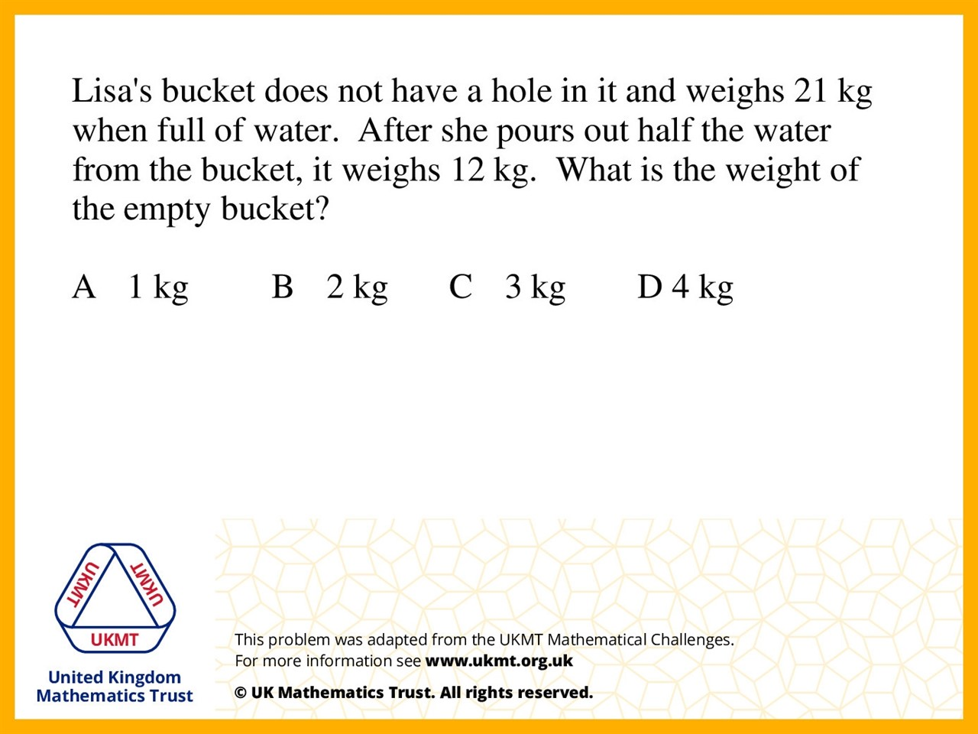
Q1.
Half of the water = 9kg.
Therefore 18kg of water in the bucket.
So the bucket has a weight of 21kg – 18kg = 3kg

Slide 3
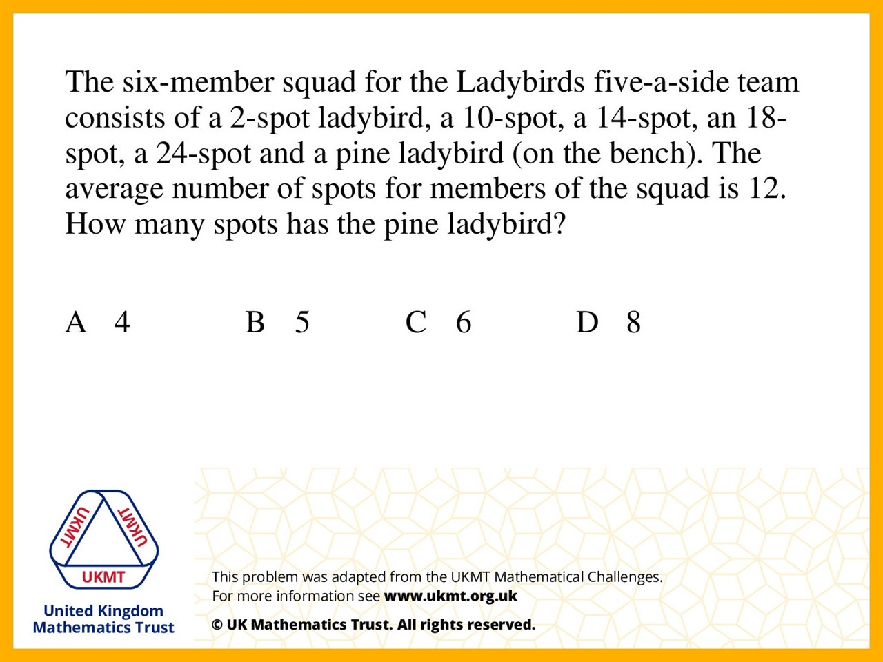
Q2.
The spots on the other ladybirds add up to 68. 6 x 12 = 72 so you need 4 to get from 68 to 72.

Slide 4
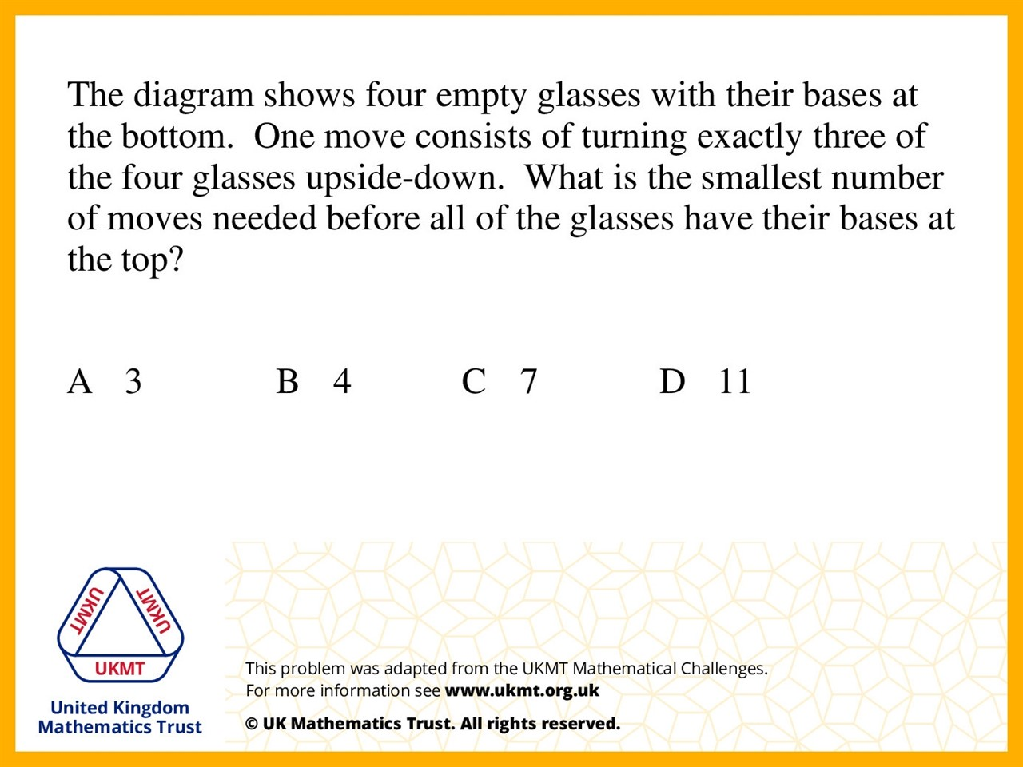
Q3.
Start BBBB. Move 1 BTTT. Move 2 TBBT. Move 3 BTBB. Move 4 TTTT.

Slide 5
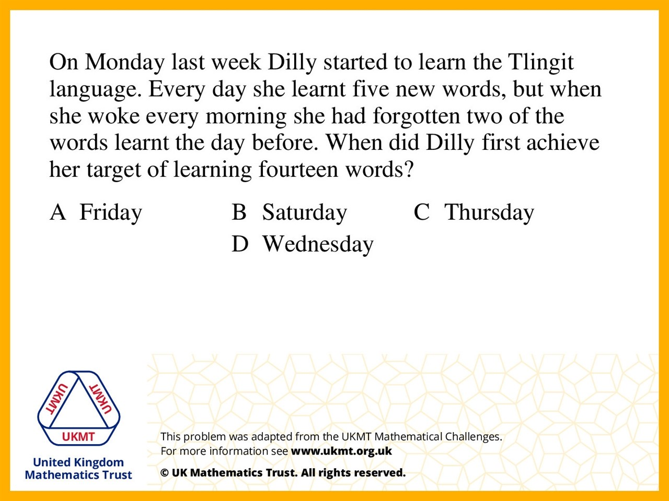
Q4.
Monday = 5 Tuesday = 8 Wednesday = 11 Thursday = 14

Slide 6
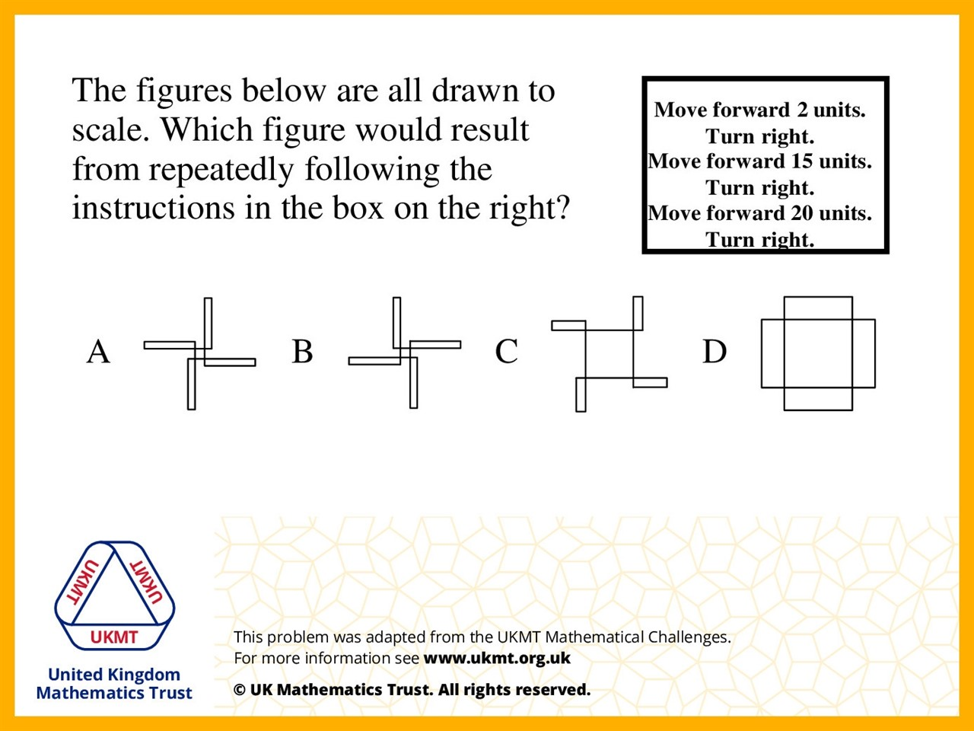
Q5.
B is wrong because the second move is bigger than the third move. C is wrong because the second move is too small. D is wrong because the 1st move is too big. Only A is left.

