Slide 1
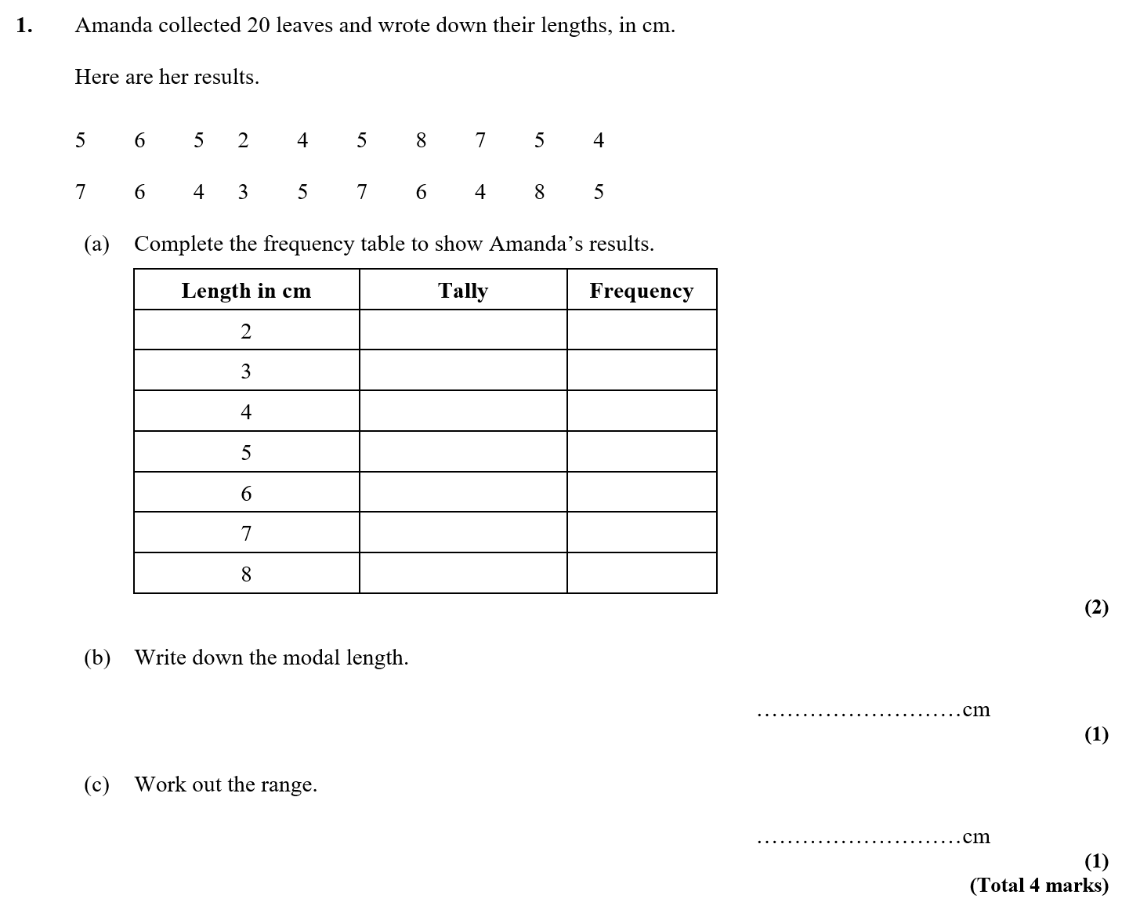

Slide 2
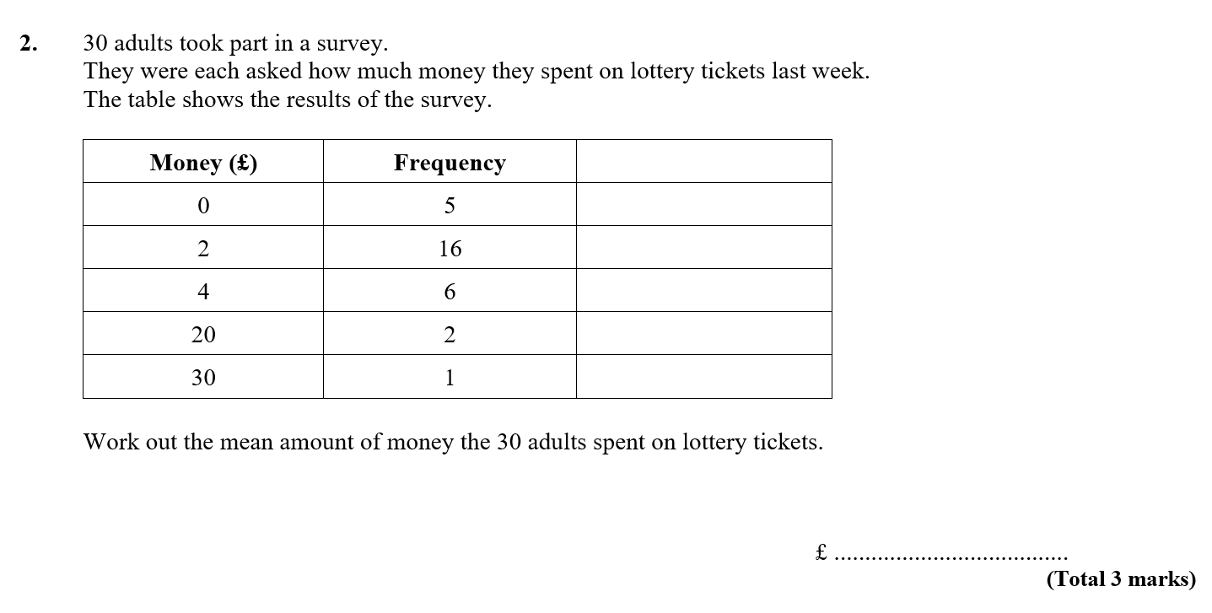

Slide 3
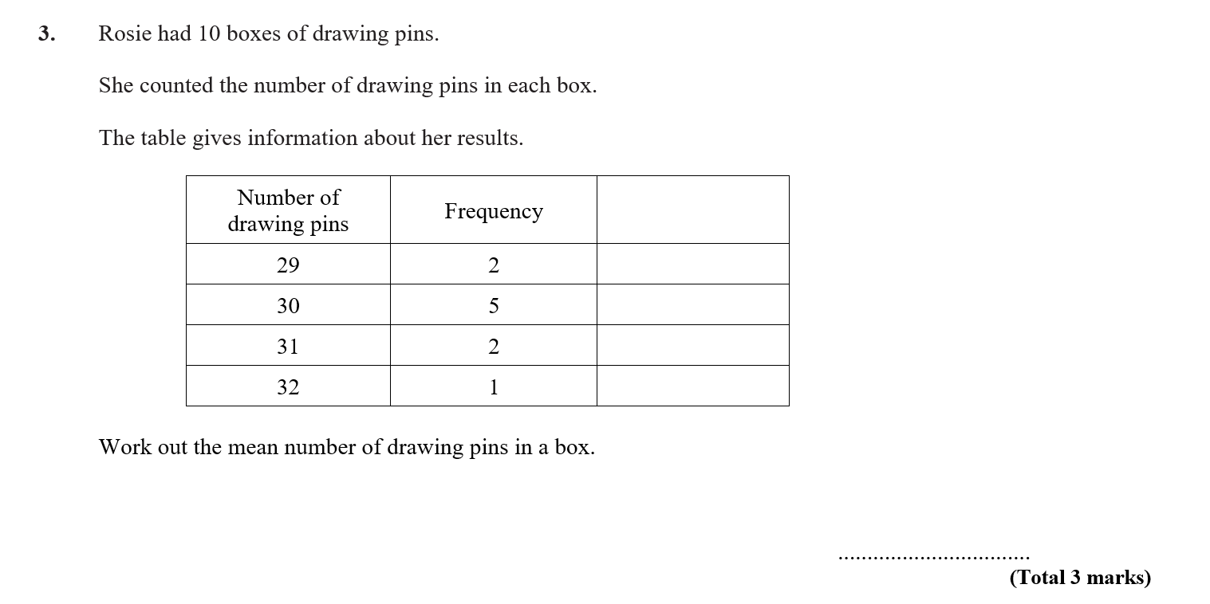

Slide 4
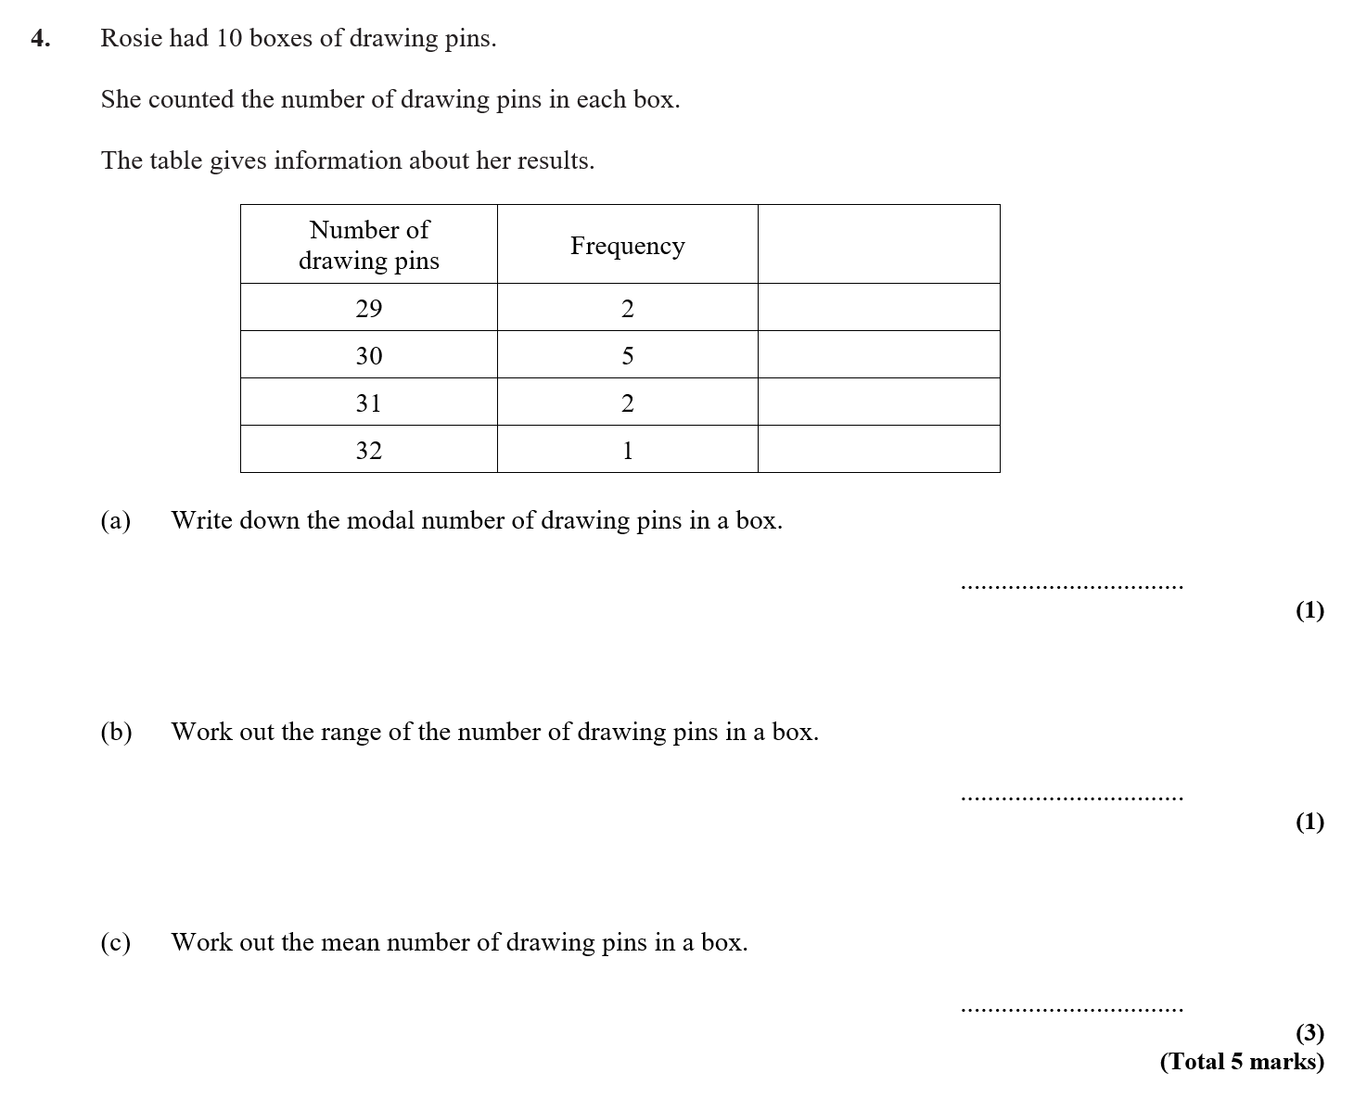

Slide 5
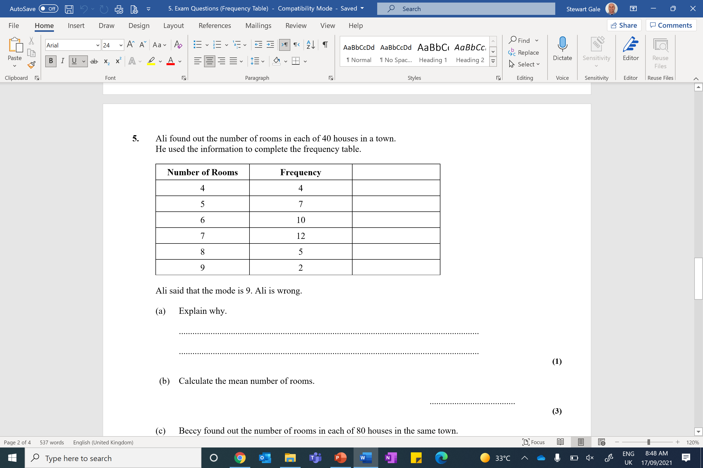
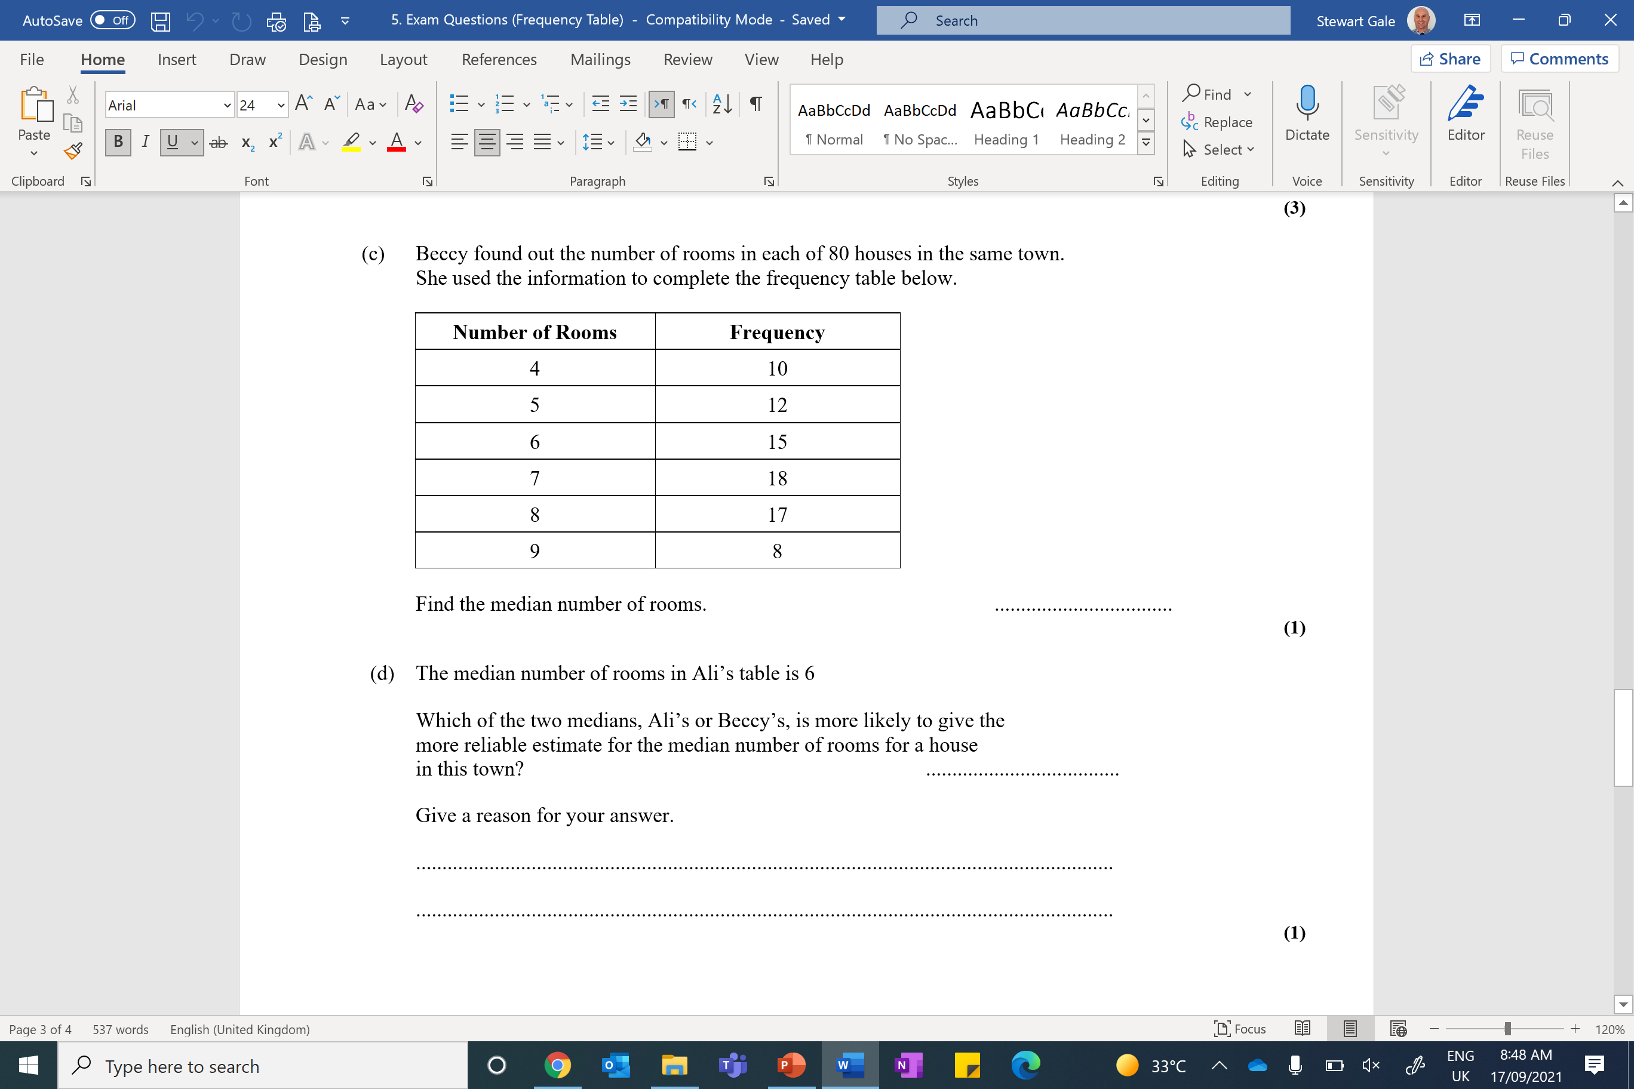

Slide 6


Slide 7
ANSWERS

Slide 8
1
1
4
6
3
3
2
5
6

Slide 9
0 × 5 + 2 × 16 + 4 × 6 + 20 × 2 + 30 × 1
= 0 + 32 + 24 + 40 + 30
=126
Mean = 126 ÷ 30 = 4.2(0)

Slide 10
2 x 29 = 58
5 x 30 = 150
2 x 31 = 62
1 × 32 = 32
Mean 302 ÷ 10 = 30.2

Slide 11
30
3
2 x 29 = 58
5 x 30 = 150
2 x 31 = 62
1 × 32 = 32
Mean 302 ÷ 10 = 30.2

Slide 12
7
“mode is 7”
“the mode is the one of which there is the most”
“because its got the lowest frequency”
4 × 4 = 16
5 × 7 = 35
6 × 10 = 60
7 × 12 = 84
8 × 5 = 40
9 × 2 = 18
Beccy has a bigger sample
Mean 253 ÷ 40 = 6.325

Slide 13
1 + 3 + 5 + 8 + 5 = 22
No, ‘average cannot be bigger than 6’ OR
‘Average must be less than 6’

