Slide 1
LO: Multiplication
Strategies

Slide 2
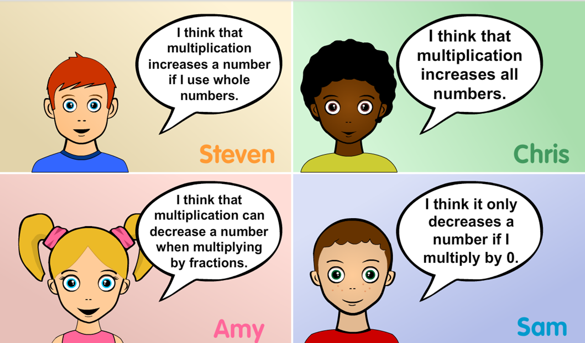
Multiplication always increases a number.
Who is right and why?

Slide 3
How many different methods
can you use to multiply 26 by 39?
26 x 39 = 1014

Slide 4
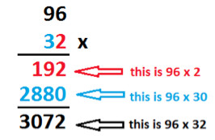

Slide 5
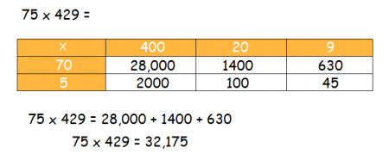

Slide 6
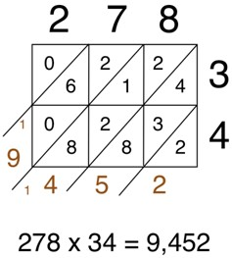

Slide 7
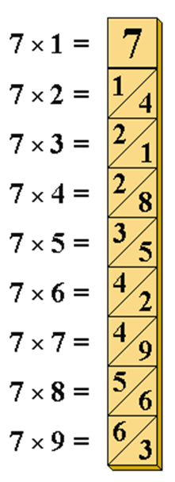
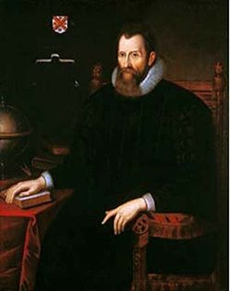
John Napier (1550 – 1617) was a Scottish mathematician, physicist, astronomer and astrologer.
Napier is the inventor of the so-called "Napier's Bones"

Slide 8
By the end of the lesson you will be able to
do the following calculation without a calculator!
457381 x 35726

Slide 9
23 | x | 25 | =
 |  | 2 |  | 3
 |  |  |  |  |  | 2
 |  |  |  |  |  | 5
 | 5 | 7 | 5
0
0
0
4
6
1
1
0
5
5
7
5

Slide 10
87 | x | 75 | =
 |  | 8 |  | 7
 |  |  |  |  |  | 7
 |  |  |  |  |  | 5
6 | 5 | 2 | 5
5
4
6
9
6
4
3
0
5
5
2
5

