Slide 1
Trigonometric Ratios
Trigonometric Ratios
Chapter 9
(Part 1 of 2)

Slide 2
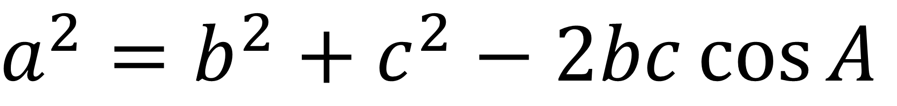
Can you write down
the cosine rule
for calculating a side?
$$a^{2}=b^{2}+c^{2}−2bc\cos{A}$$

Slide 3
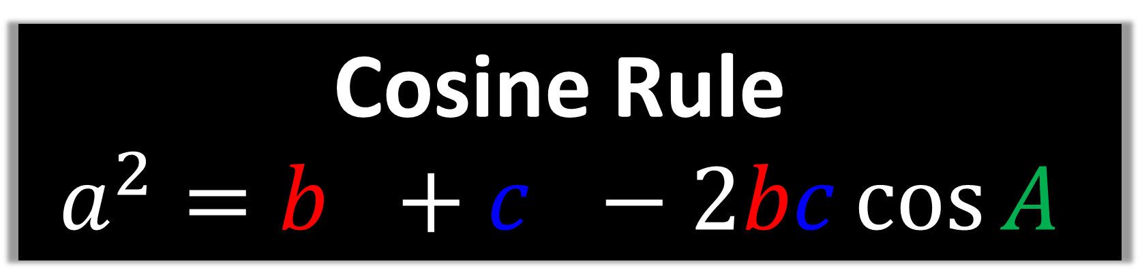
Cosine Rule
$$a^{2}=b^{2}+c^{2}−2bc\cos{A}$$
You need two sides
either side of an angle.

Slide 4
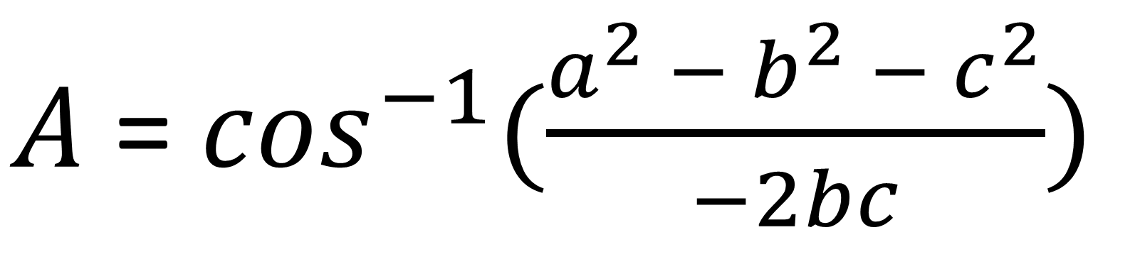
Can you write down
the cosine rule
for calculating an angle?
$A$ = $\cos^{−1}(\frac{a^{2} − b^{2} − c^{2}}{−2bc})$

Slide 5
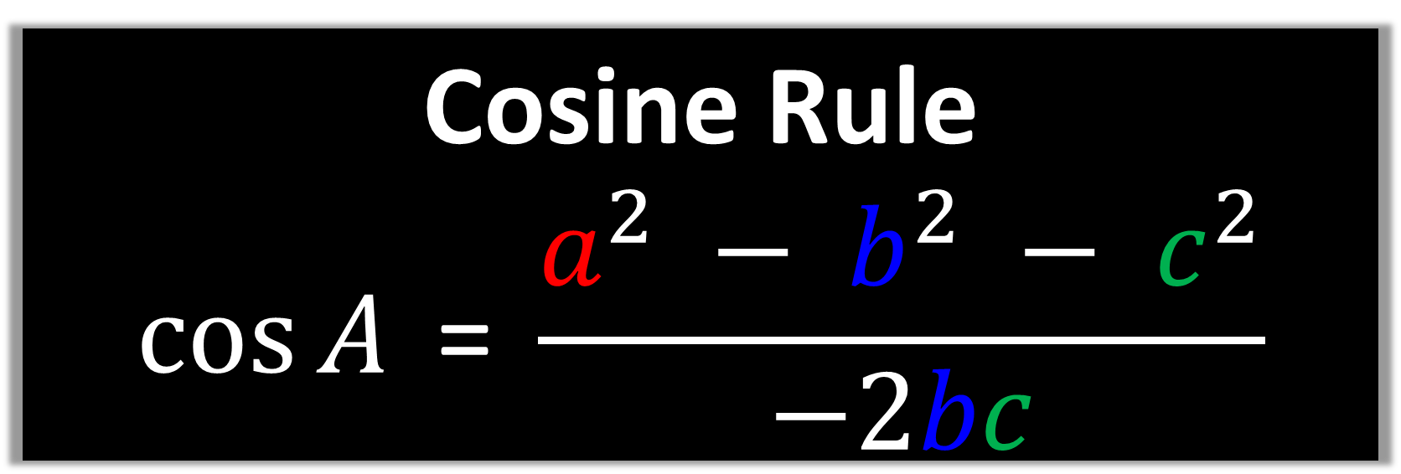
Cosine Rule
$$\cos{A}\text{ = }\frac{a^{2} − b^{2} − c^{2}}{−2bc}$$
You need three sides.

Slide 6
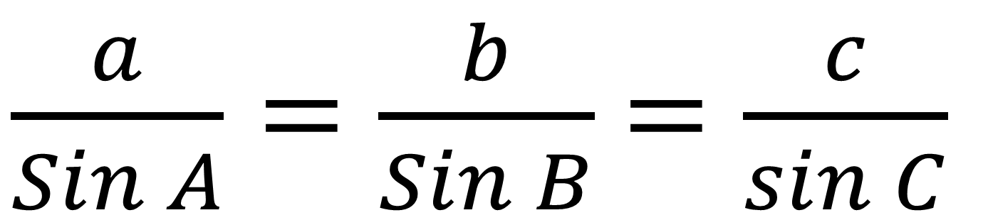
Can you write down
the sine rule
for calculating an side?
$\frac{a}{Sin A}=\frac{b}{Sin B}$ $=\frac{c}{sin C}$

Slide 7
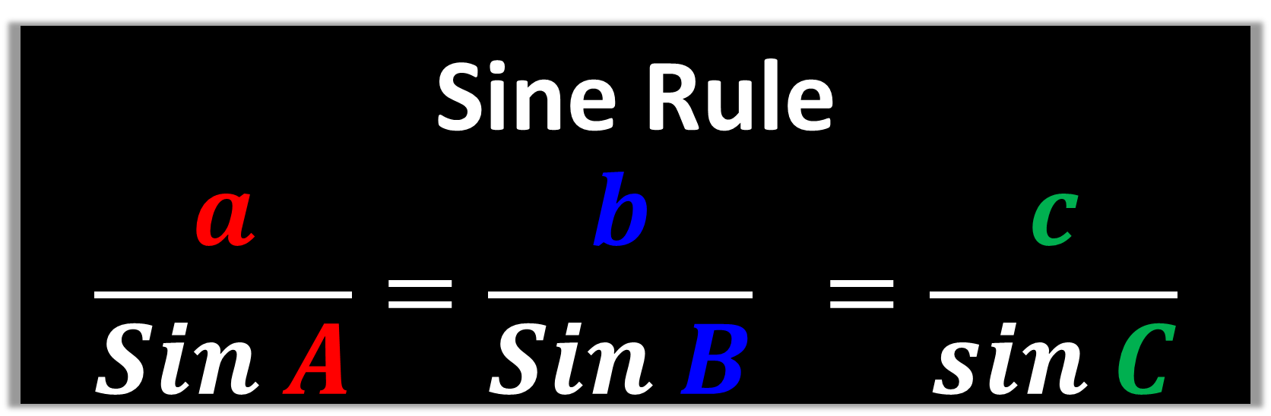
Sine Rule
$$\frac{a}{Sin A}=\frac{b}{Sin B} =\frac{c}{sin C}$$
You need two pairs of
sides and angles.

Slide 8
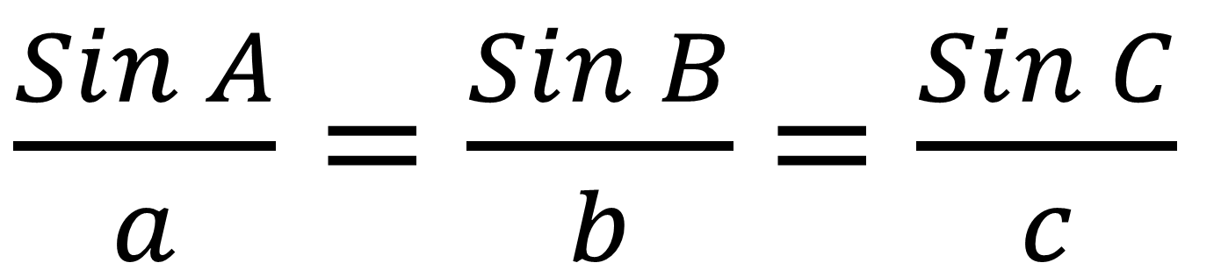
Can you write down
the sine rule
for calculating an angle?
$\frac{Sin A}{a}=\frac{Sin B}{b}$ $=\frac{Sin C}{c}$

Slide 9
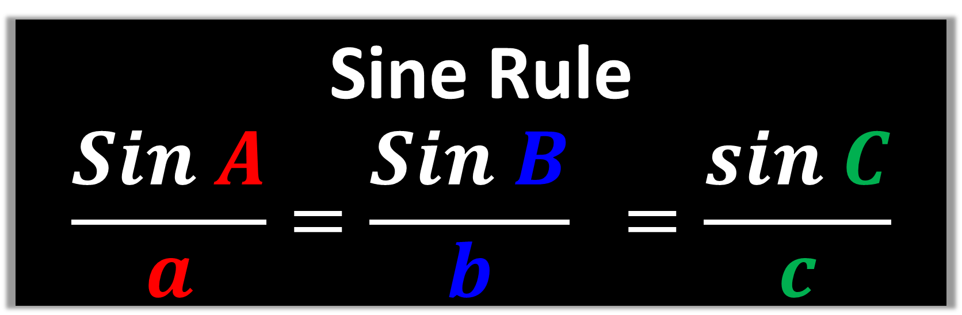
Sine Rule
$$\frac{Sin A}{a}=\frac{Sin B}{b} =\frac{sin C}{c}$$
You need two pairs of
sides and angles.

Slide 10






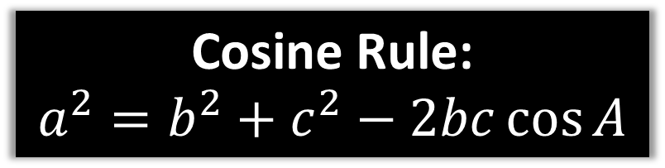




Find the missing side x
Cosine Rule:
$$a^{2}=b^{2}+c^{2}−2bc\cos{A}$$
$$b$$
$$15$$
$$A$$
$$115°$$
$$x^{2}={15}^{2}+{12}^{2}−\left(2×15×12×\cos{115}\right)$$
$$a$$
$$c$$
$$x$$
$$x^{2}=521.14257…$$
$$12$$
$$x=22.83$$

Slide 11
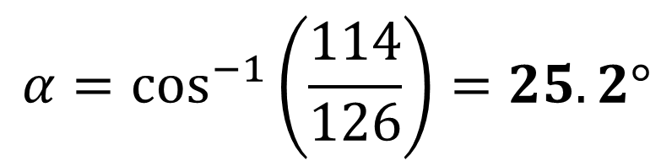

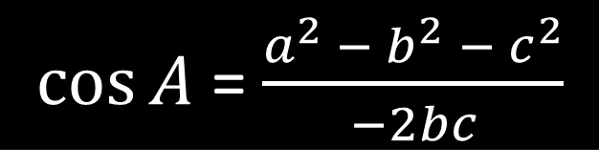

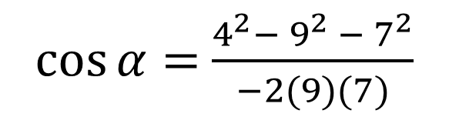


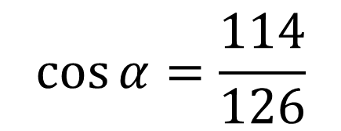
Find the missing side x
$\cos{A}$ = $\frac{a^{2} − b^{2} − c^{2}}{−2bc}$
$$7$$
$$α$$
$\cos{α}=$ $\frac{4^{2}−{ 9}^{2} − 7^{2}}{−2(9)(7)}$
$$4$$
$$9$$
$$\cos{α}=\frac{114}{126}$$
$$α=\cos^{−1}\left(\frac{114}{126}\right)=25.2°$$

Slide 12

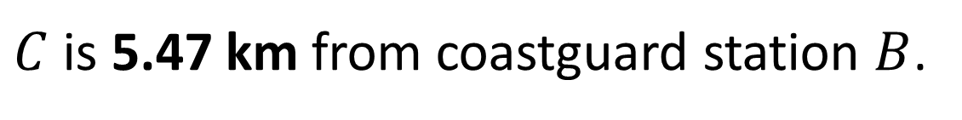


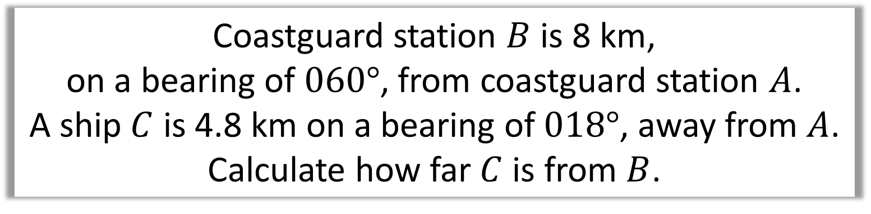







Coastguard station $B$ is 8 km,
on a bearing of $060°$, from coastguard station $A$.
A ship $C$ is 4.8 km on a bearing of $018°$, away from $A$.
Calculate how far $C$ is from $B$.
$$N$$
$$a^{2}={4.8}^{2}+8^{2}−\left(2×4.8×8×\cos\left(42°\right)\right)$$
$$C$$
$$a km$$
$$a=5.47 (3sf)$$
$$B$$
$$18°$$
$$4.8km$$
$C$ is 5.47 km from coastguard station $B$.
$$60°$$
$$8 km$$
$$A$$

Slide 13
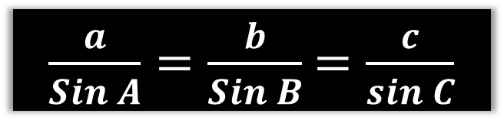
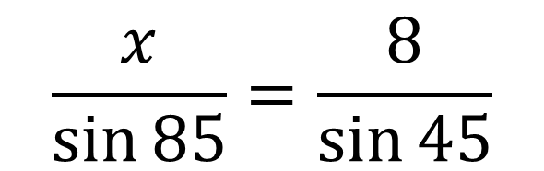
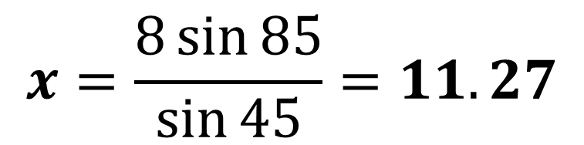
Find the missing side x
$\frac{a}{Sin A}=\frac{b}{Sin B}$ $=\frac{c}{sin C}$
8
85°
$$\frac{x}{\sin{85}}=\frac{8}{\sin{45}}$$
45°
x
$$x=\frac{8\sin{85}}{\sin{45}}=11.27$$

Slide 14


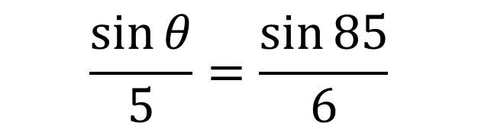
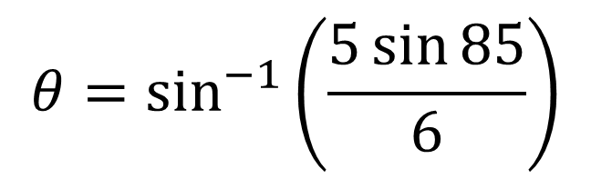
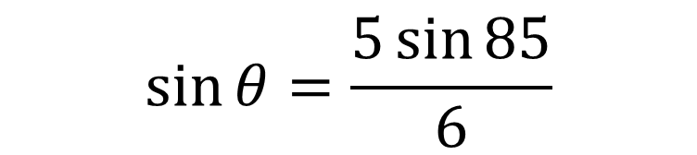
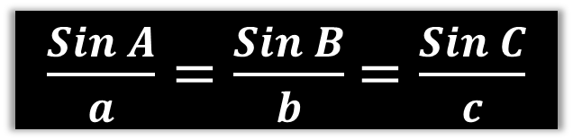
Find the missing side x
$\frac{Sin A}{a}=\frac{Sin B}{b}$ $=\frac{Sin C}{c}$
$$\frac{\sin{θ}}{5}=\frac{\sin{85}}{6}$$
5
$$\sin{θ}=\frac{5\sin{85}}{6}$$
85°
$$θ=\sin^{−1}\left(\frac{5\sin{85}}{6}\right)$$
6
$$θ$$
$$θ=56.11°$$

Slide 15








The ‘Special Case’
Watch out for a special case where the calculator will only give one of two answers.
$$A$$
$$4$$
$$3$$
$$3$$
The clue in the question will be that they are asking for the acute or obtuse angle.
$$44°$$
$$B$$
$$C_{1}$$
$$C_{2}$$
Obtuse
Acute

Slide 16



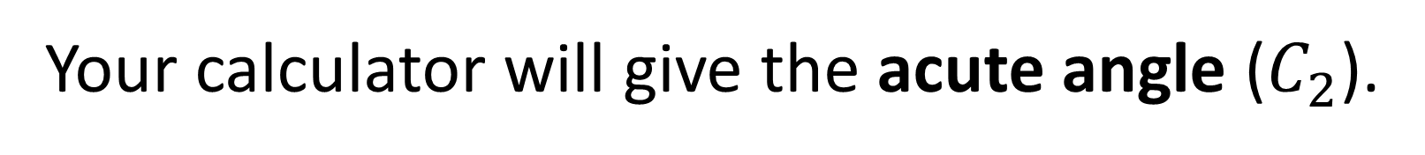





$$A$$
$$4$$
The ‘Special Case’
$$3$$
$$3$$
$$44°$$
$$B$$
$$C_{1}$$
$$C_{2}$$
Your calculator will give the acute angle ($C_{2}$).
However, it could be the obtuse angle ($C_{1}$) needed.

Slide 17

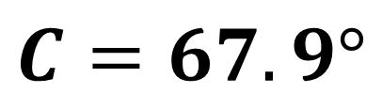
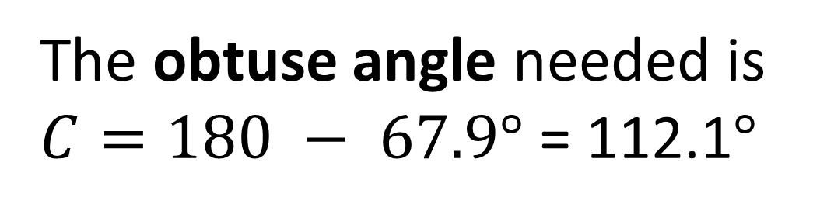

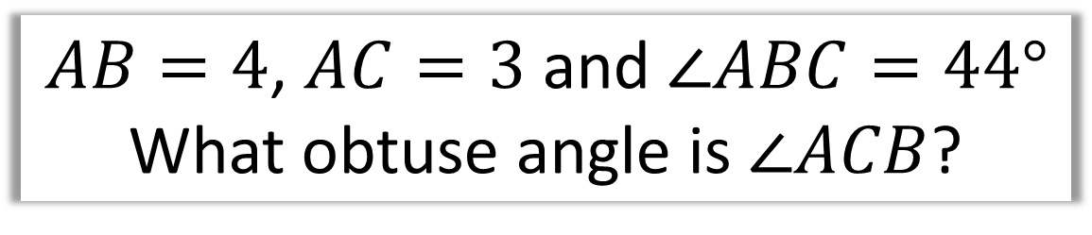
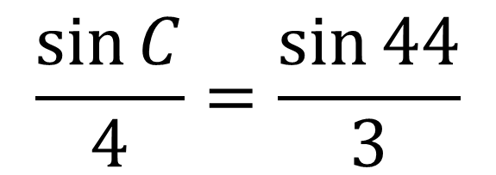






$$A$$
$AB=4$, $AC=3$ and $∠ABC=44°$
What obtuse angle is $∠ACB$?
$$4$$
$$\frac{\sin{C}}{4}=\frac{\sin{44}}{3}$$
$$3$$
$$3$$
$$44°$$
$$C=67.9°$$
$$B$$
$$C_{1}$$
$$C_{2}$$
The obtuse angle needed is
$C=180 − 67.9°$ = 112.1$°$

Slide 18
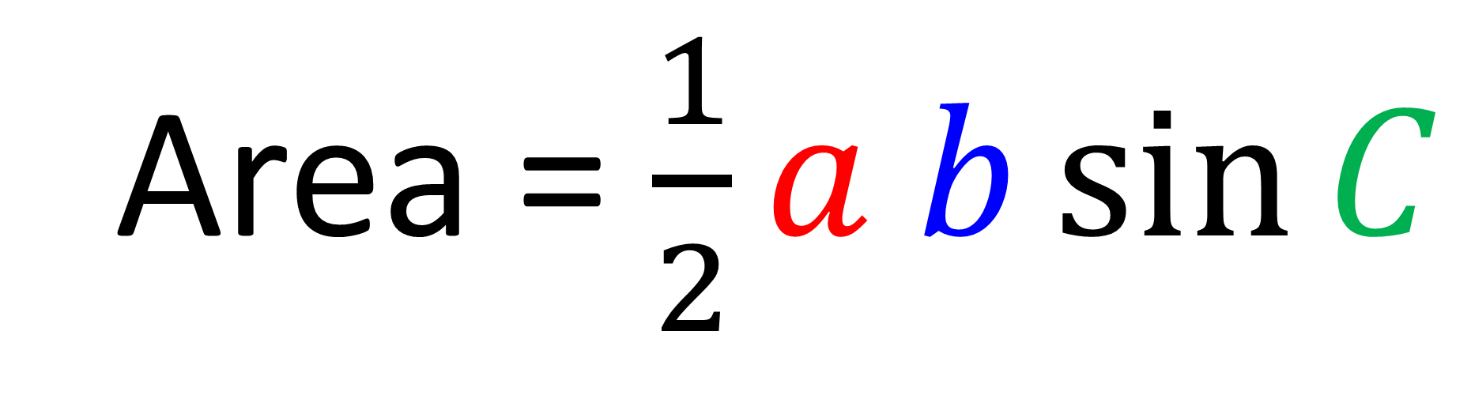
Area of Non-Right Angle Triangle
Area = $\frac{1}{2}a b\sin{C}$
𝐶 is the angle between two sides 𝑎 and 𝑏.

Slide 19
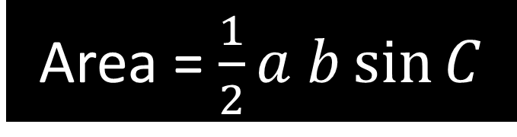
Find the area of the triangle.
Area = $\frac{1}{2}a b\sin{C}$
3cm
59°
Area = 0.5 x 3 x 7 x sin(59)
= 9.00 cm²
7cm

Slide 20
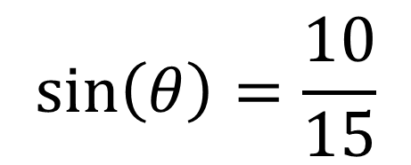

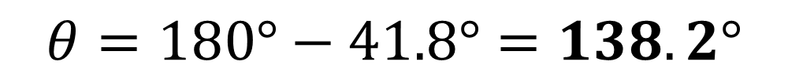
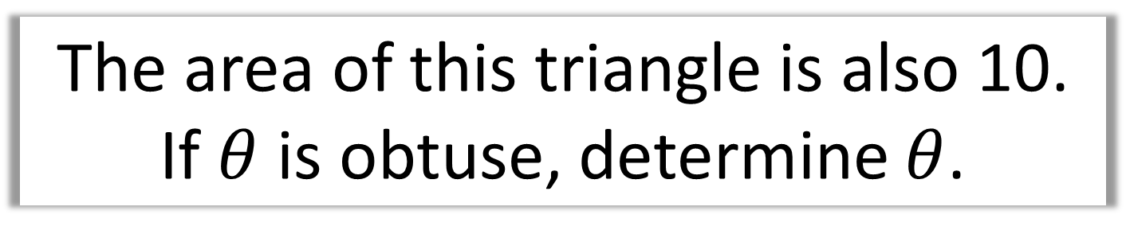
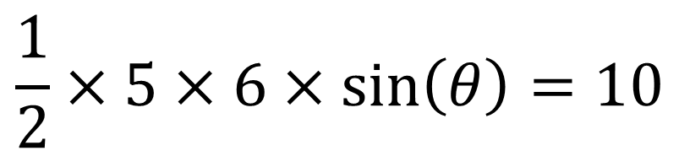


The area of this triangle is also 10.
If $θ$ is obtuse, determine $θ$.
$$\frac{1}{2}×5×6×\sin\left(θ\right)=10$$
$$5$$
$$θ$$
$$6$$
$$\sin\left(θ\right)=\frac{10}{15}$$
$$θ=180°−41.8°=138.2°$$

Slide 21
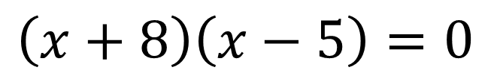

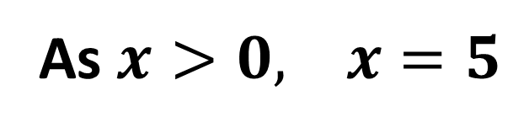

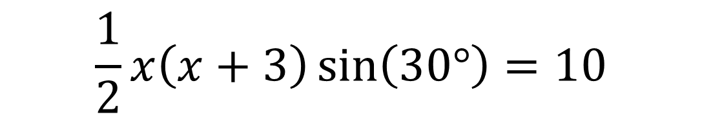
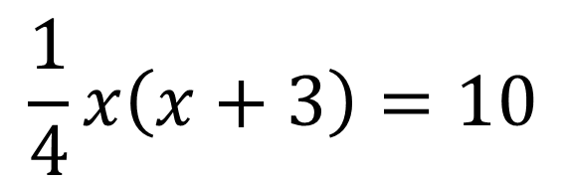
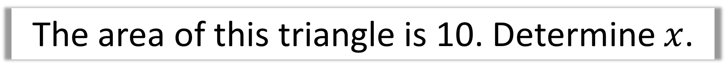
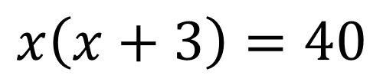

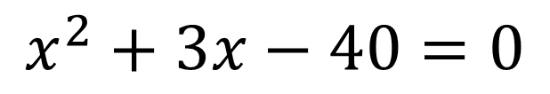
The area of this triangle is 10. Determine $x$.
$$\frac{1}{2}x\left(x+3\right)\sin\left(30°\right)=10$$
$$x$$
$$\frac{1}{4}x\left(x+3\right)=10$$
$$30°$$
$$x\left(x+3\right)=40$$
$$x+3$$
$$x^{2}+3x−40=0$$
$$\left(x+8\right)\left(x−5\right)=0$$
As $x>0, x=5$

