Slide 1



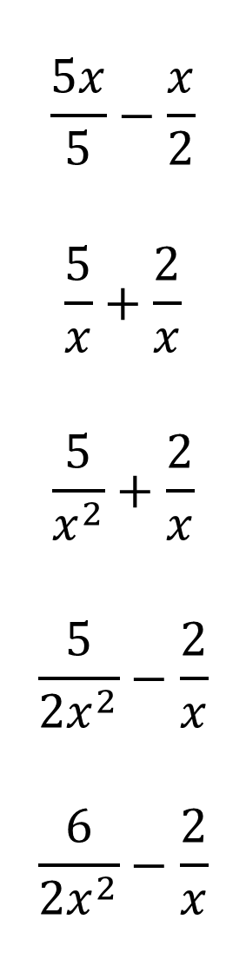
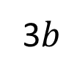



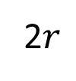
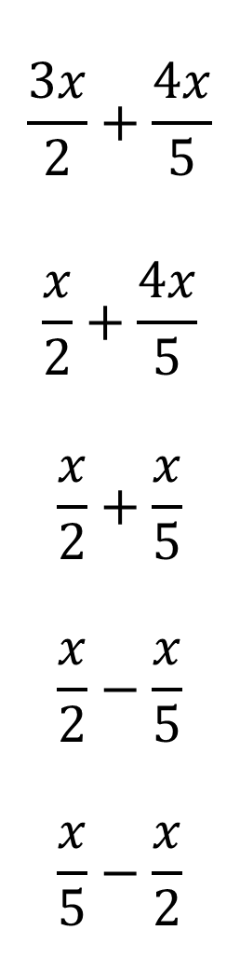


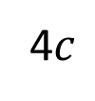







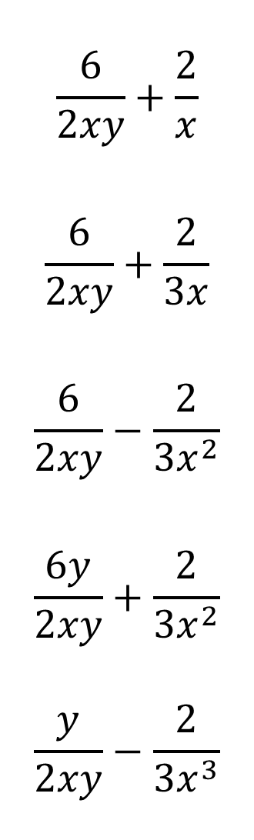


Write each expression as a single fraction. Simplifying Fractions.
$$\frac{5x}{5}−\frac{x}{2}$$
$$\frac{5}{x}+\frac{2}{x}$$
$$\frac{5}{x^{2}}+\frac{2}{x}$$
$$\frac{5}{{2x}^{2}}−\frac{2}{x}$$
$$\frac{6}{{2x}^{2}}−\frac{2}{x}$$
$$\frac{6}{2xy}+\frac{2}{x}$$
$$\frac{6}{2xy}+\frac{2}{3x}$$
$$\frac{6}{2xy}−\frac{2}{3x^{2}}$$
$$\frac{6y}{2xy}+\frac{2}{3x^{2}}$$
$$\frac{y}{2xy}−\frac{2}{3x^{3}}$$
$$\frac{3x}{2}+\frac{4x}{5}$$
$$\frac{x}{2}+\frac{4x}{5}$$
$$\frac{x}{2}+\frac{x}{5}$$
$$\frac{x}{2}−\frac{x}{5}$$
$$\frac{x}{5}−\frac{x}{2}$$
1)
6)
11)
1
2
3
16)
$+$
$+$
$x$
$y$
$z$
2)
7)
12)
5
4
1
17)
$+$
$+$
$m$
$n$
$p$
3)
8)
13)
1
2
3
18)
$+$
$+$
4)
2$r$
$s$
2$t$
9)
14)
1
2
3
19)
$+$
$+$
5)
2$a$
3$b$
4$c$
10)
15)

Slide 2
ANSWERS

Slide 3
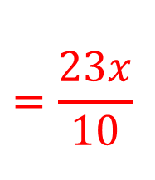
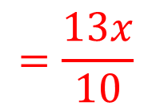
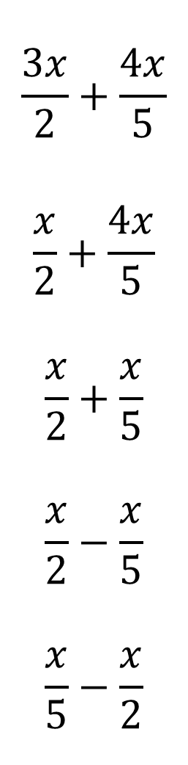
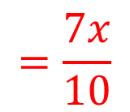
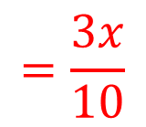
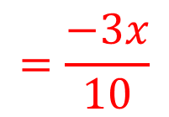
Write each expression as a single fraction. Simplifying Fractions.
$$\frac{3x}{2}+\frac{4x}{5}$$
$$\frac{x}{2}+\frac{4x}{5}$$
$$\frac{x}{2}+\frac{x}{5}$$
$$\frac{x}{2}−\frac{x}{5}$$
$$\frac{x}{5}−\frac{x}{2}$$
$$=\frac{23x}{10}$$
1)
2)
$$=\frac{13x}{10}$$
3)
$$=\frac{7x}{10}$$
4)
$$=\frac{3x}{10}$$
5)
$$=\frac{−3x}{10}$$

Slide 4
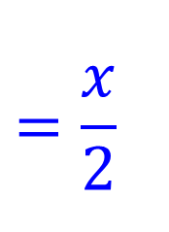
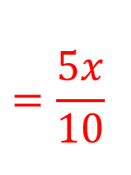
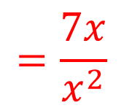
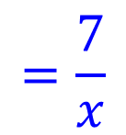
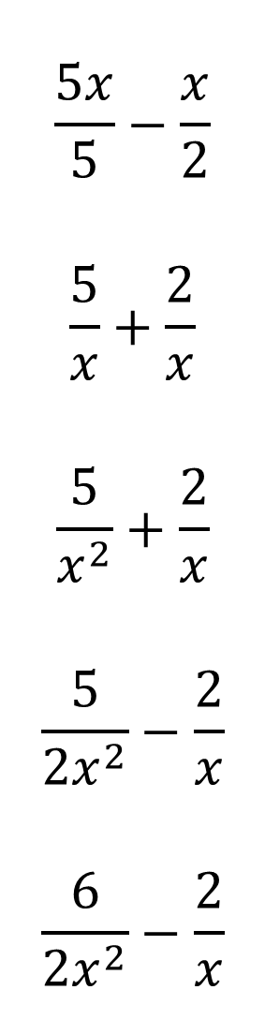
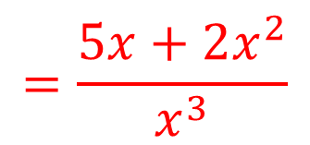
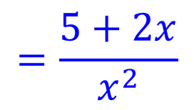
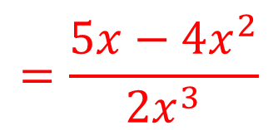
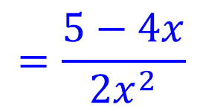
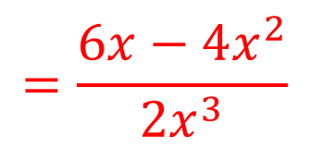
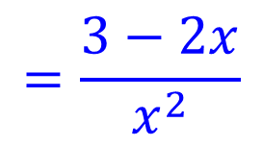
$$\frac{5x}{5}−\frac{x}{2}$$
$$\frac{5}{x}+\frac{2}{x}$$
$$\frac{5}{x^{2}}+\frac{2}{x}$$
$$\frac{5}{{2x}^{2}}−\frac{2}{x}$$
$$\frac{6}{{2x}^{2}}−\frac{2}{x}$$
$$=\frac{5x}{10}$$
$$=\frac{x}{2}$$
6)
$$=\frac{7x}{x^{2}}$$
$$=\frac{7}{x}$$
7)
$$=\frac{5x+2x^{2}}{x^{3}}$$
$$=\frac{5+2x}{x^{2}}$$
8)
$$=\frac{5x−4x^{2}}{{2x}^{3}}$$
$$=\frac{5−4x}{{2x}^{2}}$$
9)
$$=\frac{6x−4x^{2}}{{2x}^{3}}$$
$$=\frac{3−2x}{x^{2}}$$
10)

Slide 5
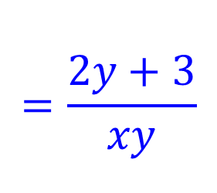
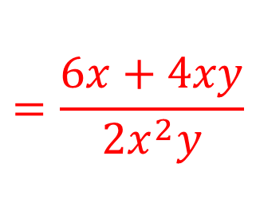
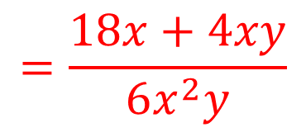
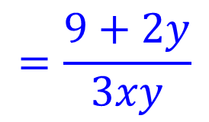
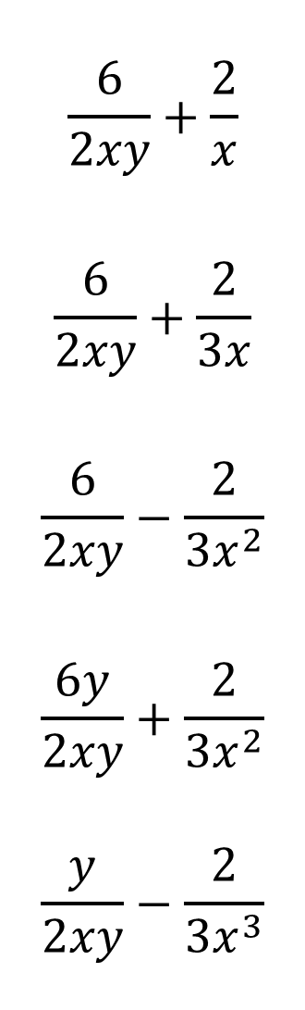
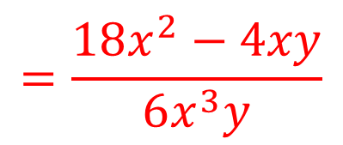
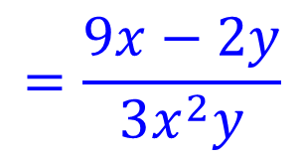
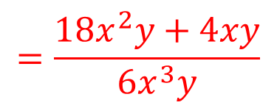
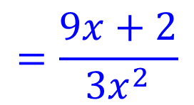
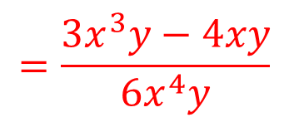
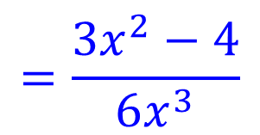
$$\frac{6}{2xy}+\frac{2}{x}$$
$$\frac{6}{2xy}+\frac{2}{3x}$$
$$\frac{6}{2xy}−\frac{2}{3x^{2}}$$
$$\frac{6y}{2xy}+\frac{2}{3x^{2}}$$
$$\frac{y}{2xy}−\frac{2}{3x^{3}}$$
$$=\frac{6x+4xy}{2x^{2}y}$$
$$=\frac{2y+3}{xy}$$
11)
12)
$$=\frac{18x+4xy}{6x^{2}y}$$
$$=\frac{9+2y}{3xy}$$
13)
$$=\frac{18x^{2}−4xy}{6x^{3}y}$$
$$=\frac{9x−2y}{3x^{2}y}$$
$$=\frac{18x^{2}y+4xy}{6x^{3}y}$$
$$=\frac{9x+2}{3x^{2}}$$
14)
$$=\frac{3x^{3}y−4xy}{6x^{4}y}$$
$$=\frac{3x^{2}−4}{6x^{3}}$$
15)

Slide 6
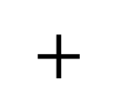
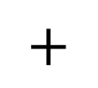
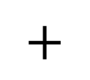
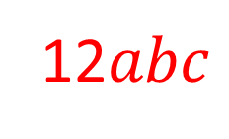
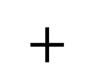
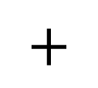

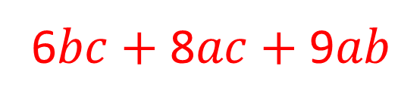
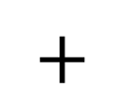
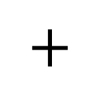
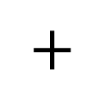
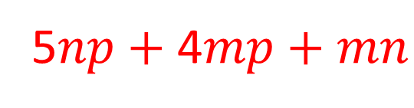
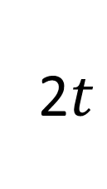
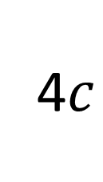




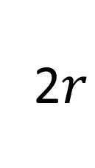
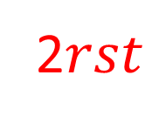

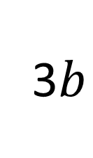






1
2
3
$+$
$+$
$yz$ $+$ 2$xz$ $+$ 3$xy$
16)
$=$
$x$
$y$
$z$
$xyz$
5
4
1
5$np$ $+$ 4$mp$ $+$ $mn$
17)
$+$
$+$
$=$
$m$
$n$
$p$
$mnp$
1
2
3
2$r$
$+$
$+$
2$t$
2$st$ $+$ 4$rt$ $+$ 3$rs$
18)
$=$
$s$
2$rst$
1
2
3
6$bc$ $+$ 8$ac$ $+$ 9$ab$
$+$
3$b$
$+$
4$c$
19)
$=$
2$a$
12$abc$

