Slide 1
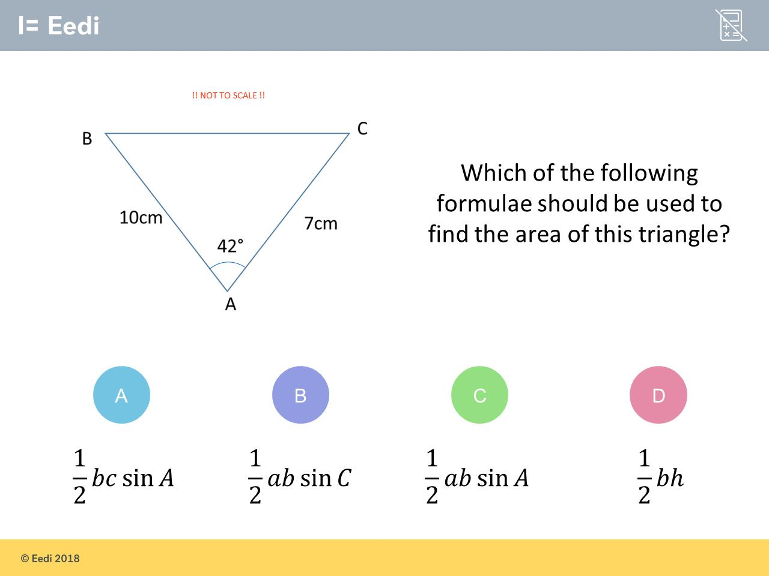
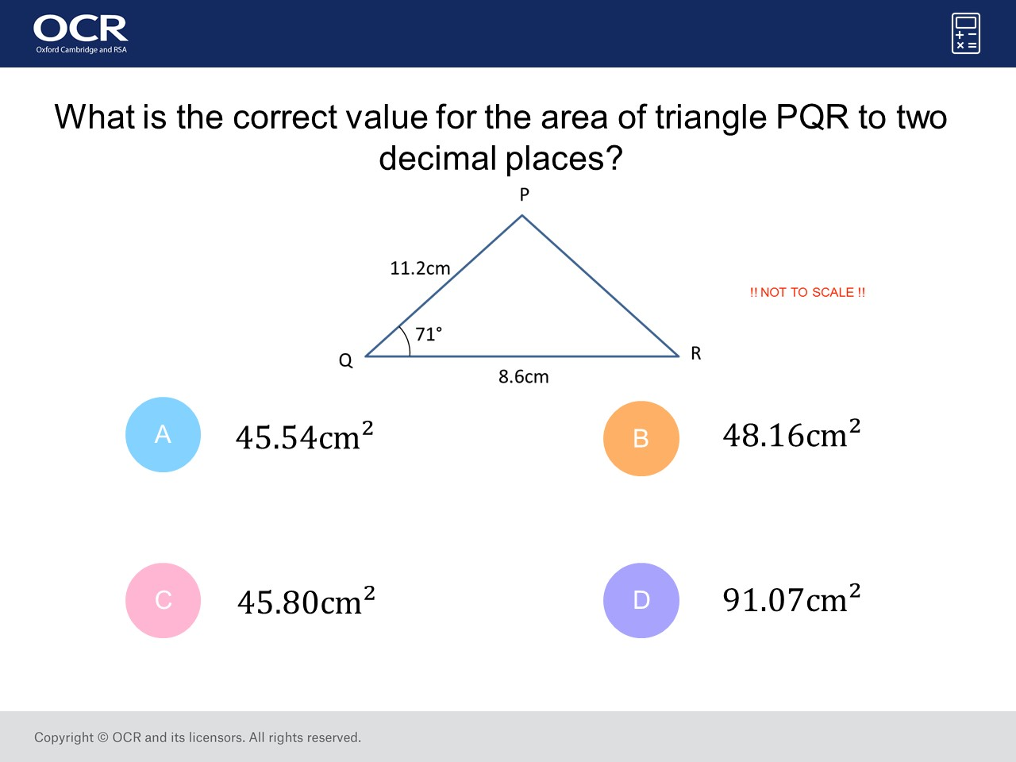
Worst answered question?
Most common wrong answer?

Slide 2
ANSWERS

Slide 3
Worst answered question?

Slide 4
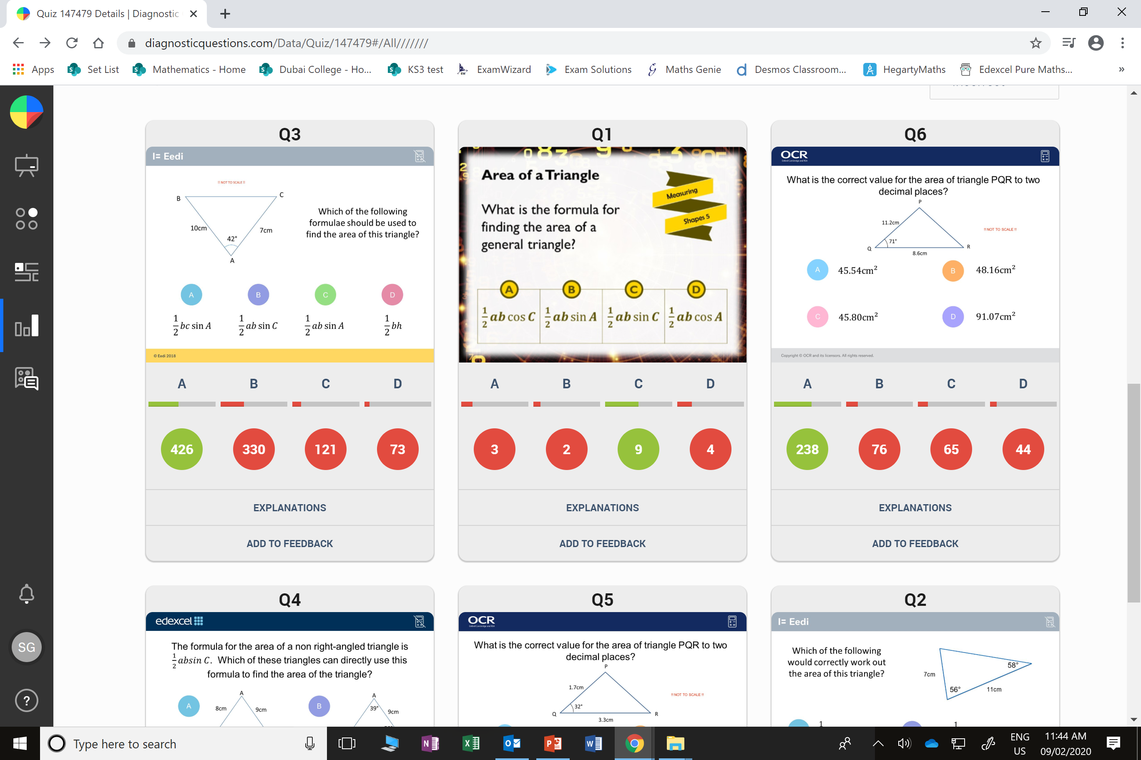
B
The student has identified the correct formula but in this question, the letters are the wrong way around for the triangle.

Slide 5
B
he student has incorrectly used the formula of base x height divided by 2.

