Slide 1
LO: Order of
Operations

Slide 2


Which one is correct?
3 + 4 x 7 = 49
3 + 4 x 7 = 31

Slide 3
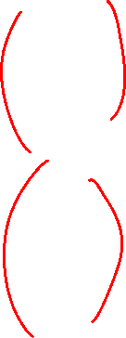
Order matters!
B
RACKETS
I
NDICES
D
IVISION
M
ULTIPLY
A
DDITION
S
UBTRACTION

Slide 4
B
RACKETS
I
NDICES
D
M
IVISION
ULTIPLY
A
S
DDITION
UBTRACTION
If they have the same importance,
then do the questions from left to right.

Slide 5
2 + 4 x 5 =
B
4 x 5
I
D M
2 + 20 =
22
A S

Slide 6
10 ÷ 5
B
12 – 10 ÷ 5 =
I
D M
12 – 2 =
10
A S

Slide 7
(2 + 7) ÷ 2 =
B
2 + 7
I
D M
9 ÷ 2 =
4.5
A S

Slide 8

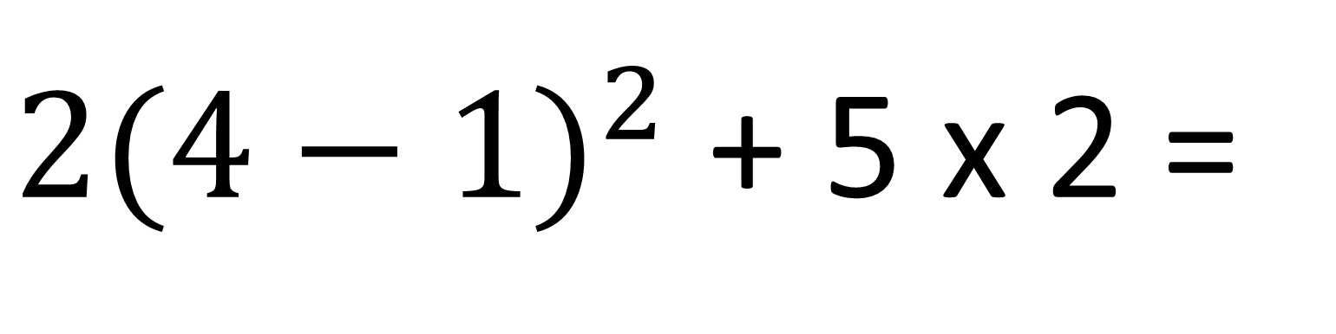
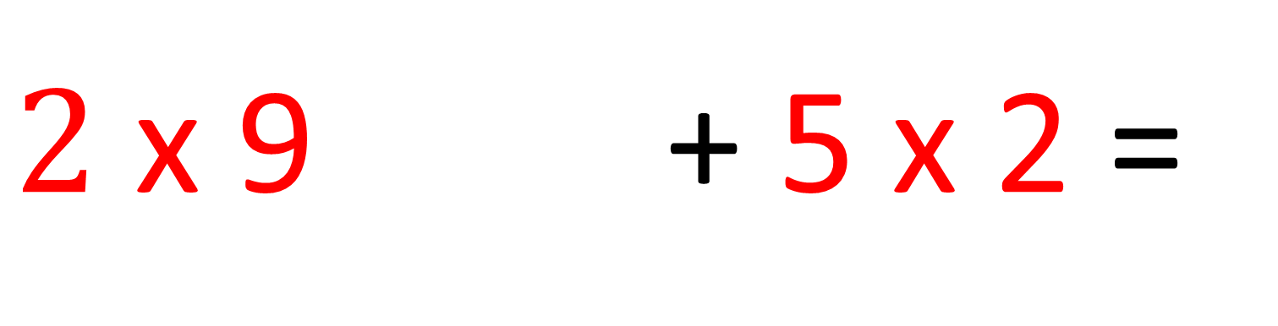
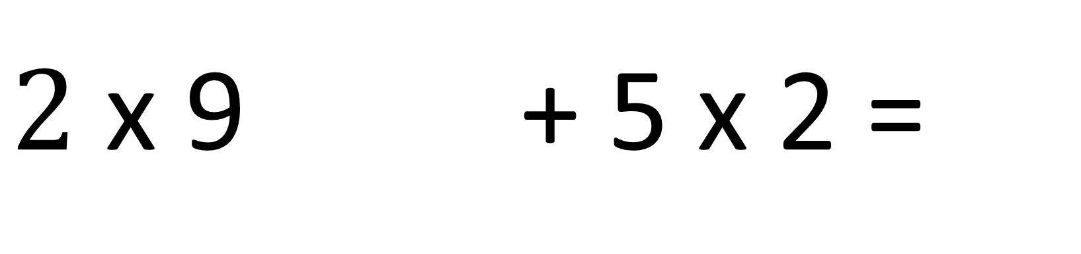
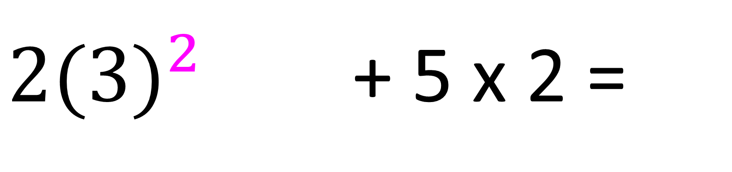
${2(4−1)}^{2}$ + 5 x 2 =
$$4−1$$
B
I
${2(3)}^{2}$ + 5 x 2 =
D M
$2$ x 9 + 5 x 2 =
$2$ x 9 + 5 x 2 =
A S
18 + 10 =
28

Slide 9
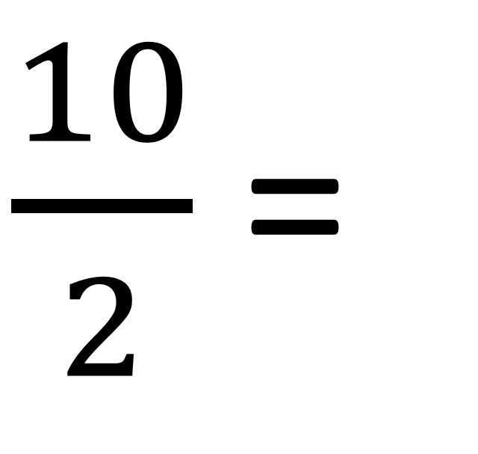
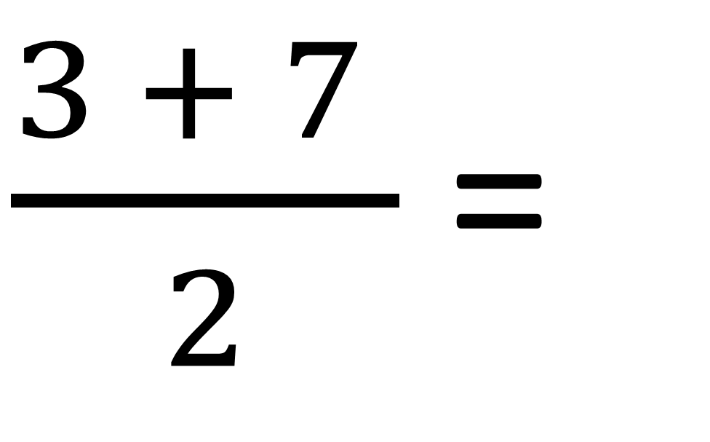
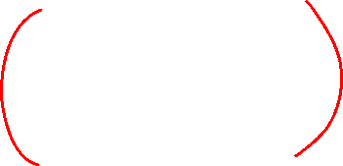
B
$\frac{3 + 7 }{2}$ =
$\frac{10}{2}$ =
I
5
D M
A S

Slide 10
6 ÷ 2 x (1+2) =
B
I
6 ÷ 2 x 3 =
D M
A S
9
3 x 3 =

Slide 11
The Fours Problem
Using exactly four 4s and any operations you wish,
including brackets, make the numbers form 1 to 10.
1 | = |  |  | 6 | =
2 | = |  |  | 7 | =
3 | = |  |  | 8 | =
4 | = |  |  | 9 | =
5 | = |  |  | 10 | =
44 ÷ 44
(4 + 4) ÷ 4 + 4
(4 + 4) ÷ (4 + 4)
44 ÷ 4 – 4
(4 + 4 + 4) ÷ 4
4 + 4 + 4 – 4
(4 – 4) x 4 + 4
4 ÷ 4 + 4 + 4
(4 x 4 + 4) – 4
(44 – 4) ÷ 4

