Slide 1
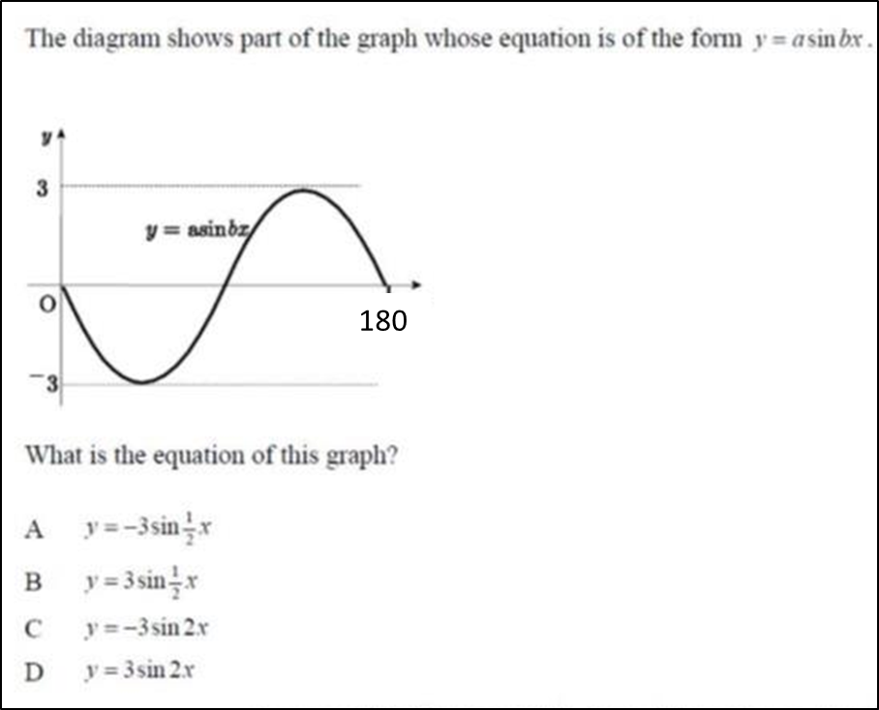
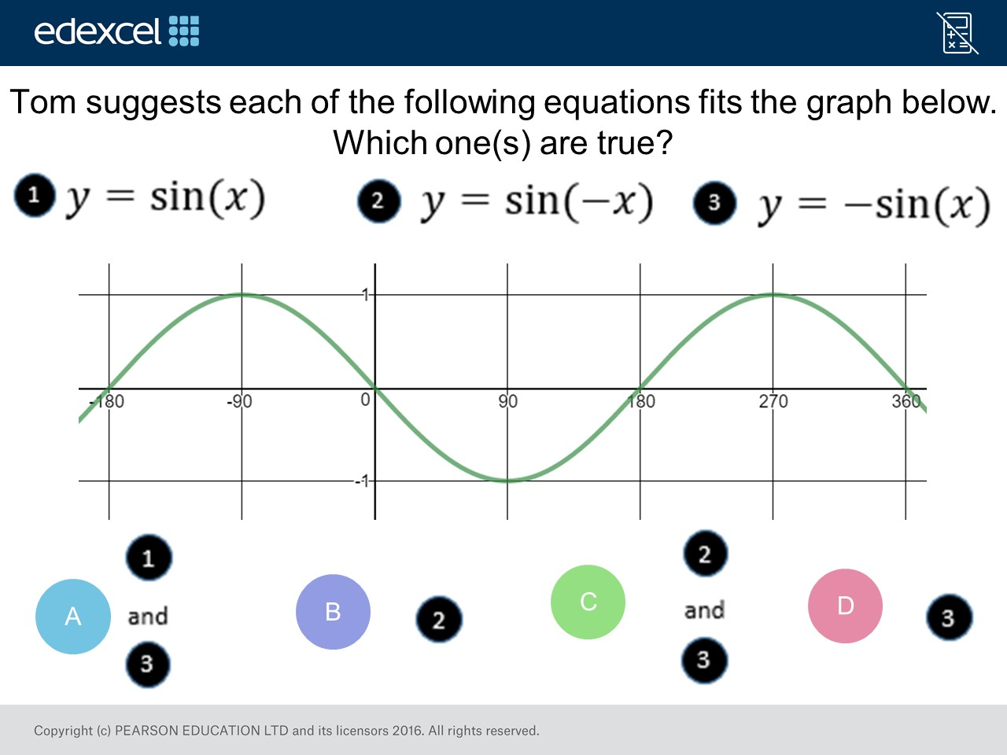
Worst answered question?
Most common wrong answer?

Slide 2
ANSWERS

Slide 3
Worst answered question?

Slide 4
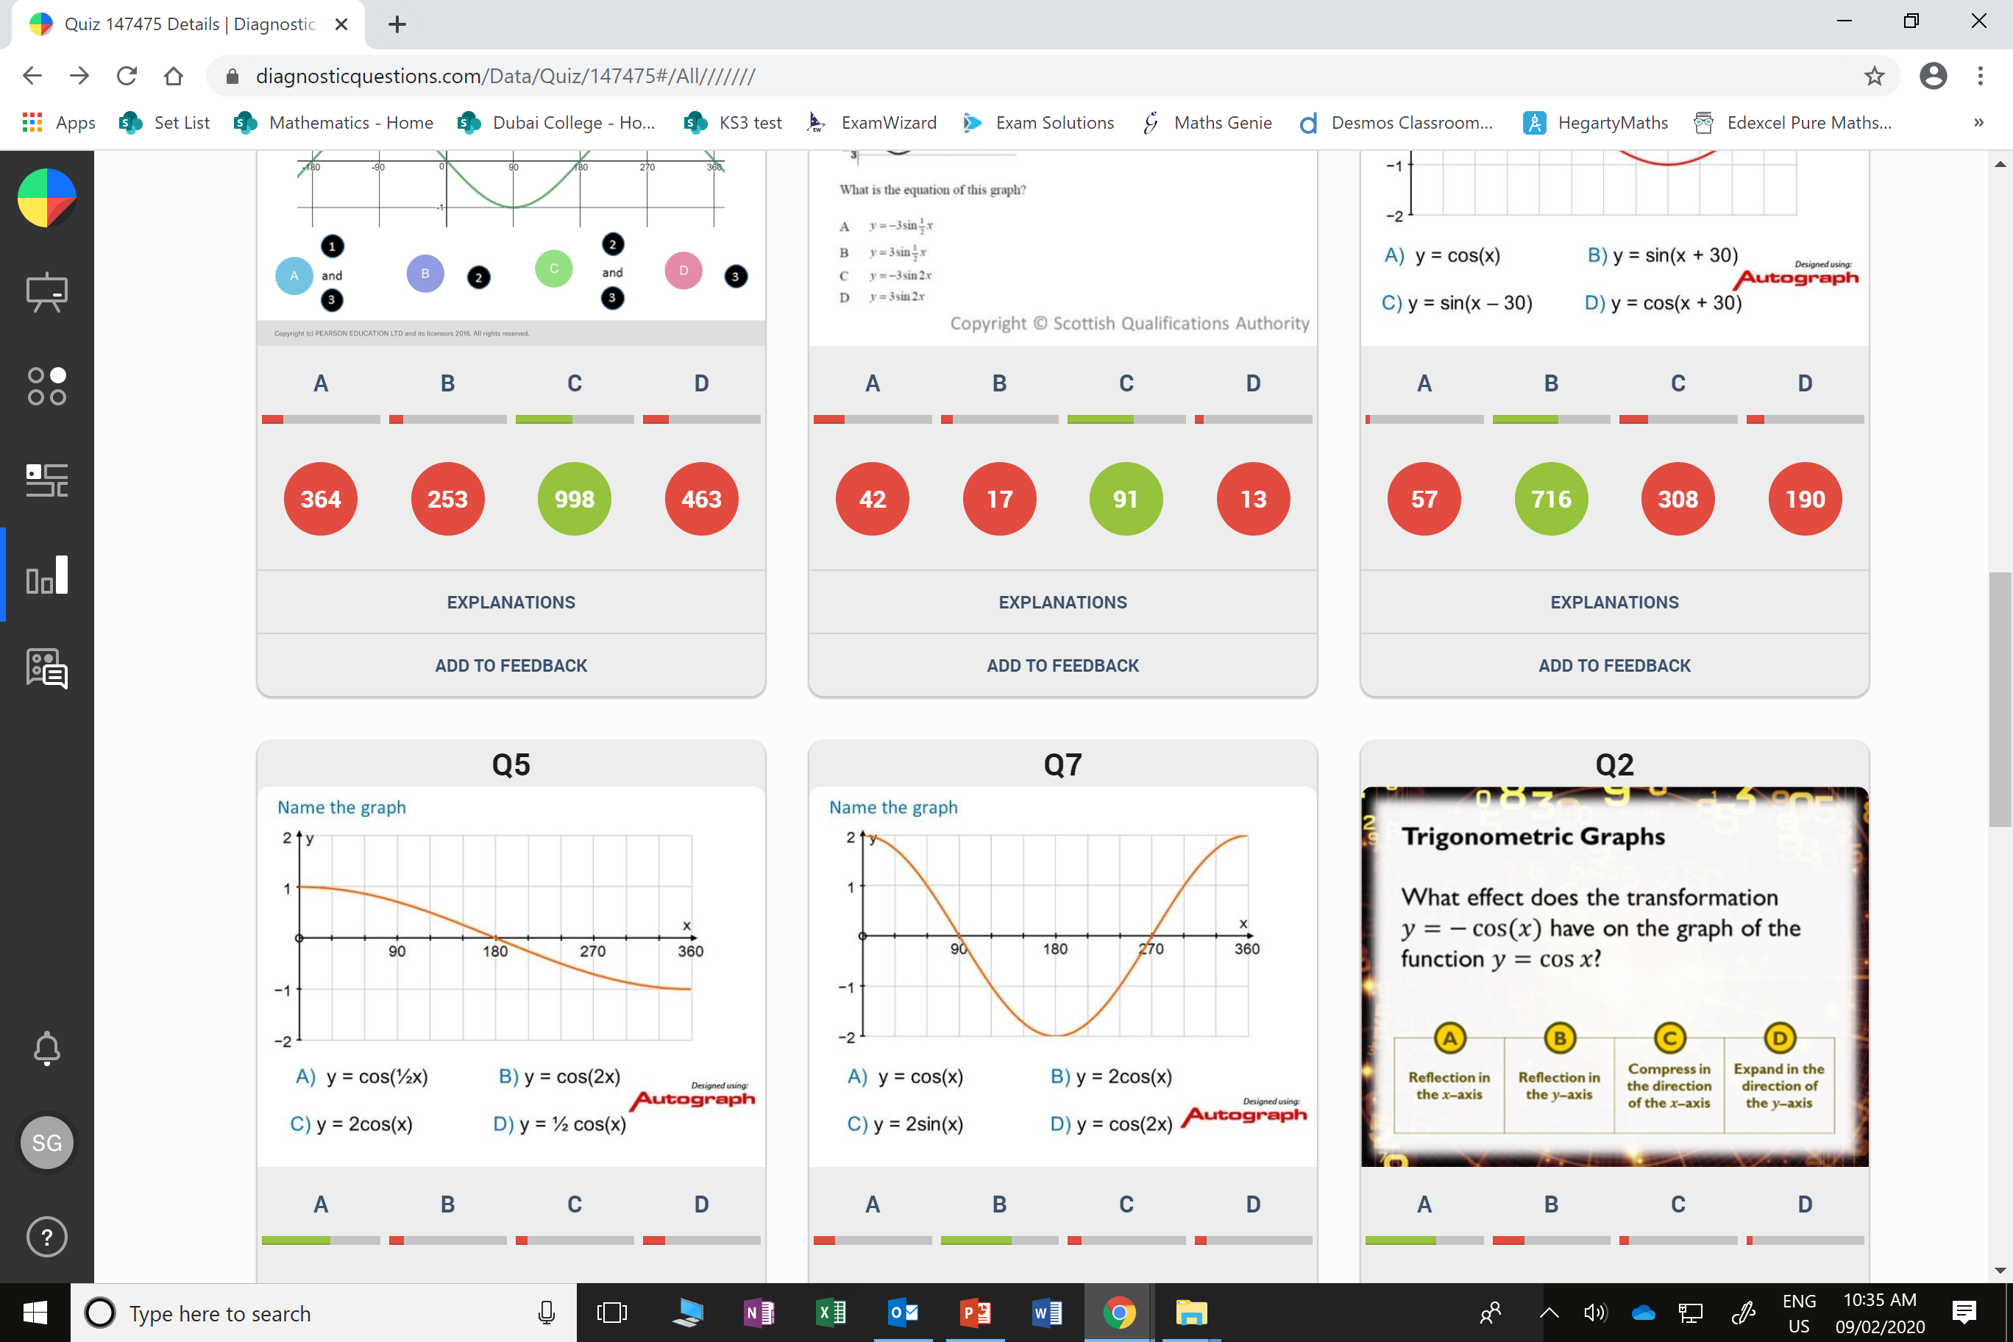
D
Reflecting sin x
in the x axis
and y axis
gives the same graph

Slide 5
A
They graph will complete 2 full circles in 360˚.

