Slide 1
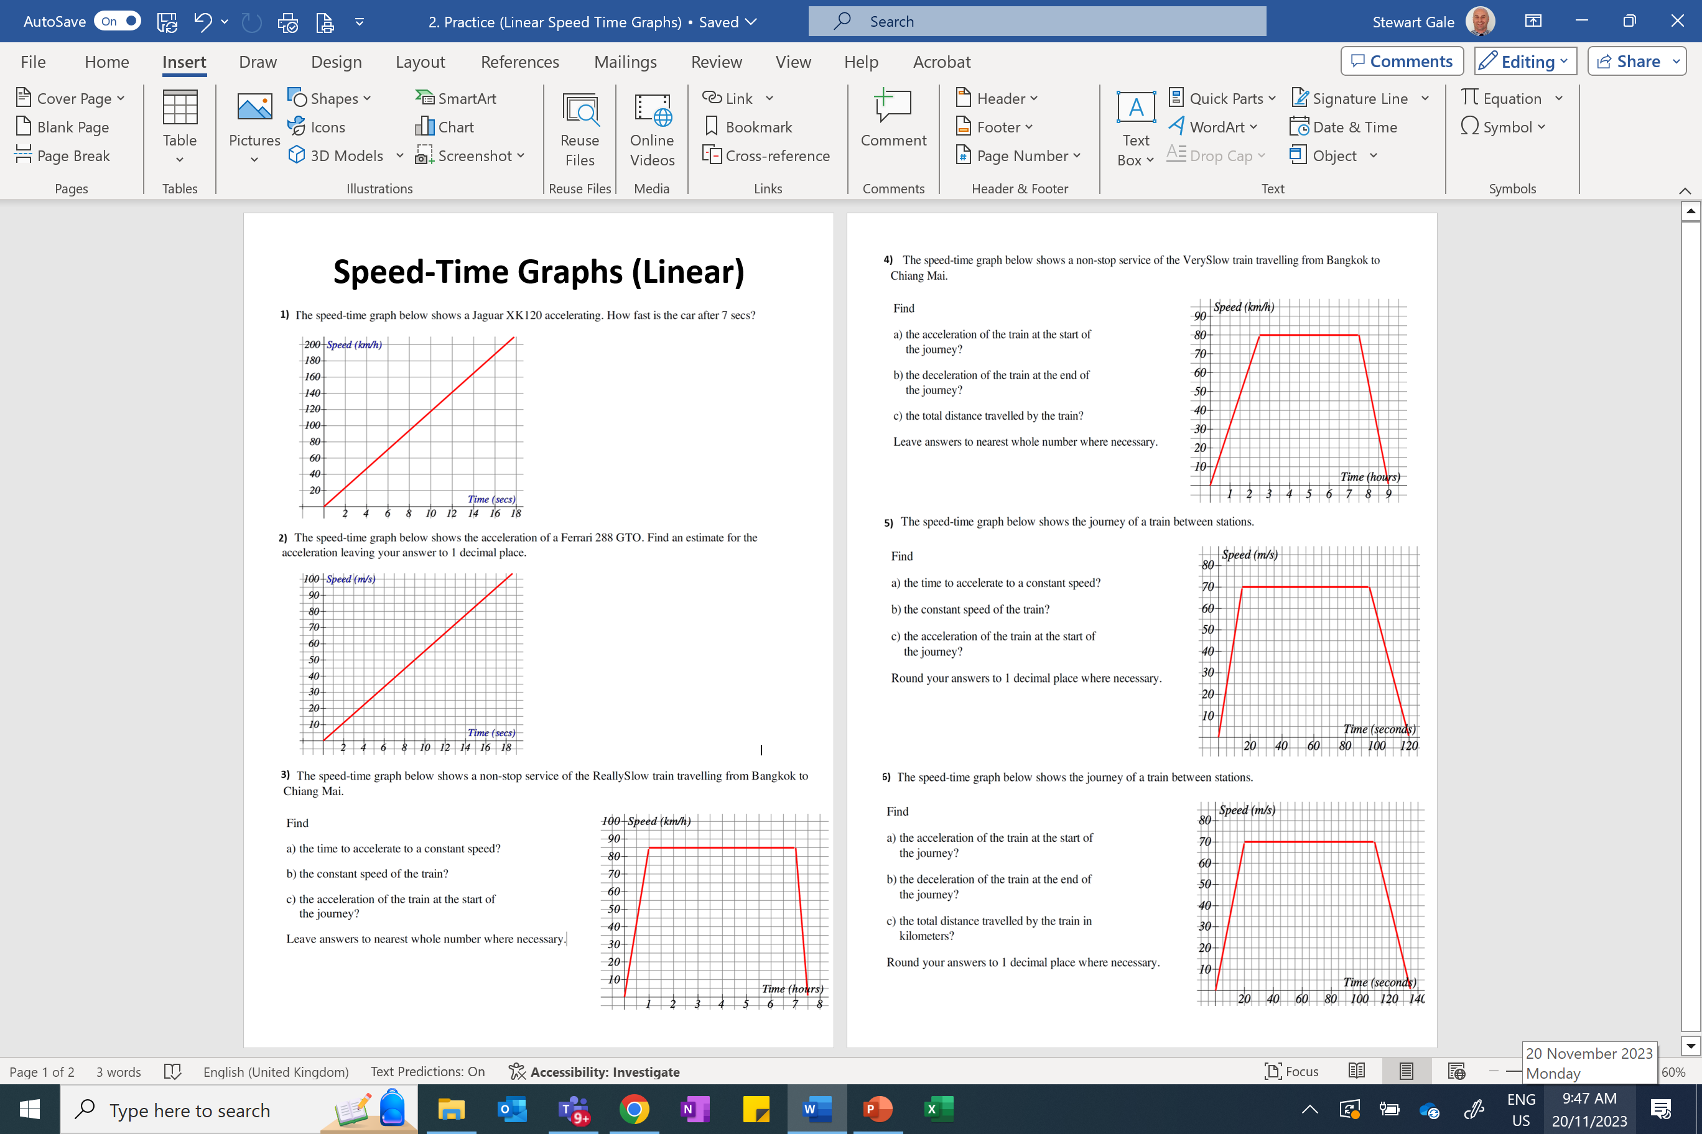

Slide 2
ANSWERS

Slide 3
32
81 to 83
53
560
15
5.5 to 5.7
70
4.7
1hour
3.5
85
2.8
85
7.9

