Slide 1
LO: Probability Tree
Diagrams
(with replacement)

Slide 2
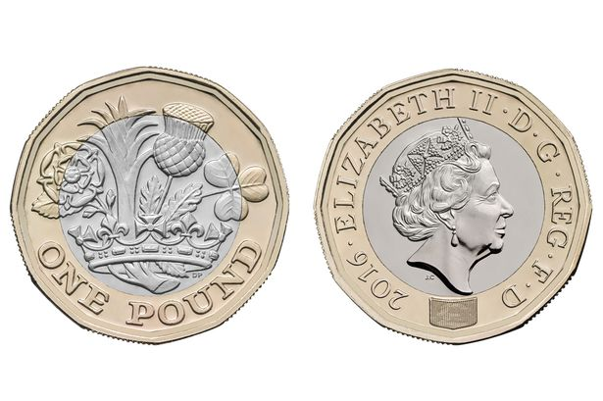
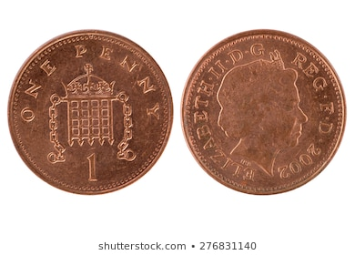
Two coins are thrown.
What are all the possible outcomes?

Slide 3
Head and Head
Head and Tail
Tail and Head
Tail and Tail

Slide 4
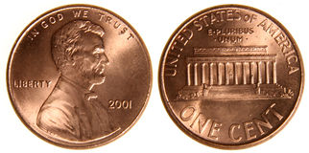
Three coins are flipped.
What are all the possible outcomes?

Slide 5
Head and Head and Head
Head and Head and Tail
Head and Tail and Head
Head and Tail and Tail
Tail and Head and Head
Tail and Head and Tail
Tail and Tail and Head
Tail and Tail and Tail

Slide 6




Blue | Blue
Blue | Yellow
Yellow | Blue
Yellow | Yellow
True or False
The probability of getting two blue counters is $\frac{1}{4}$

Slide 7


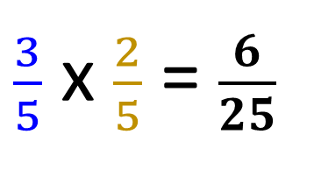

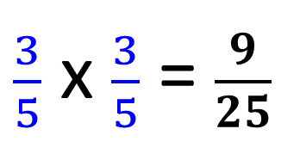


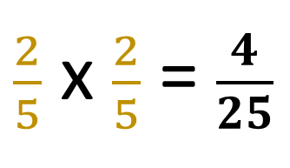


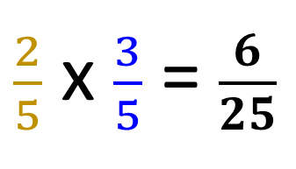
Take a counter
Replace it
Take another counter
$$\frac{3}{5}$$
P(BB) =
$\frac{3}{5}$ x $\frac{3}{5}$ = $\frac{9}{25}$
$$\frac{3}{5}$$
$$\frac{2}{5}$$
P(BY) =
$\frac{3}{5}$ x $\frac{2}{5}$ = $\frac{6}{25}$
$$\frac{3}{5}$$
P(YB) =
$\frac{2}{5}$ x $\frac{3}{5}$ = $\frac{6}{25}$
$$\frac{2}{5}$$
$$\frac{2}{5}$$
P(YY) =
$\frac{2}{5}$ x $\frac{2}{5}$ = $\frac{4}{25}$

