Slide 1
Algebraic Expressions
Surds
Chapter 1
(Part 3 of 3)

Slide 2
Surds
What is a surd?
First there is two other questions we need to ask!

Slide 3
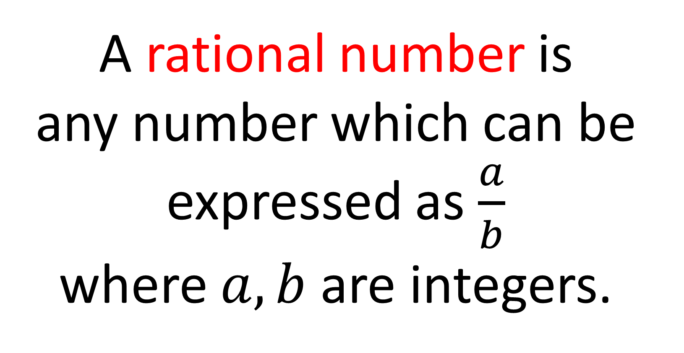
What is a rational number?
A rational number is
any number which can be
expressed as $\frac{a}{b}$
where $a,b$ are integers.

Slide 4
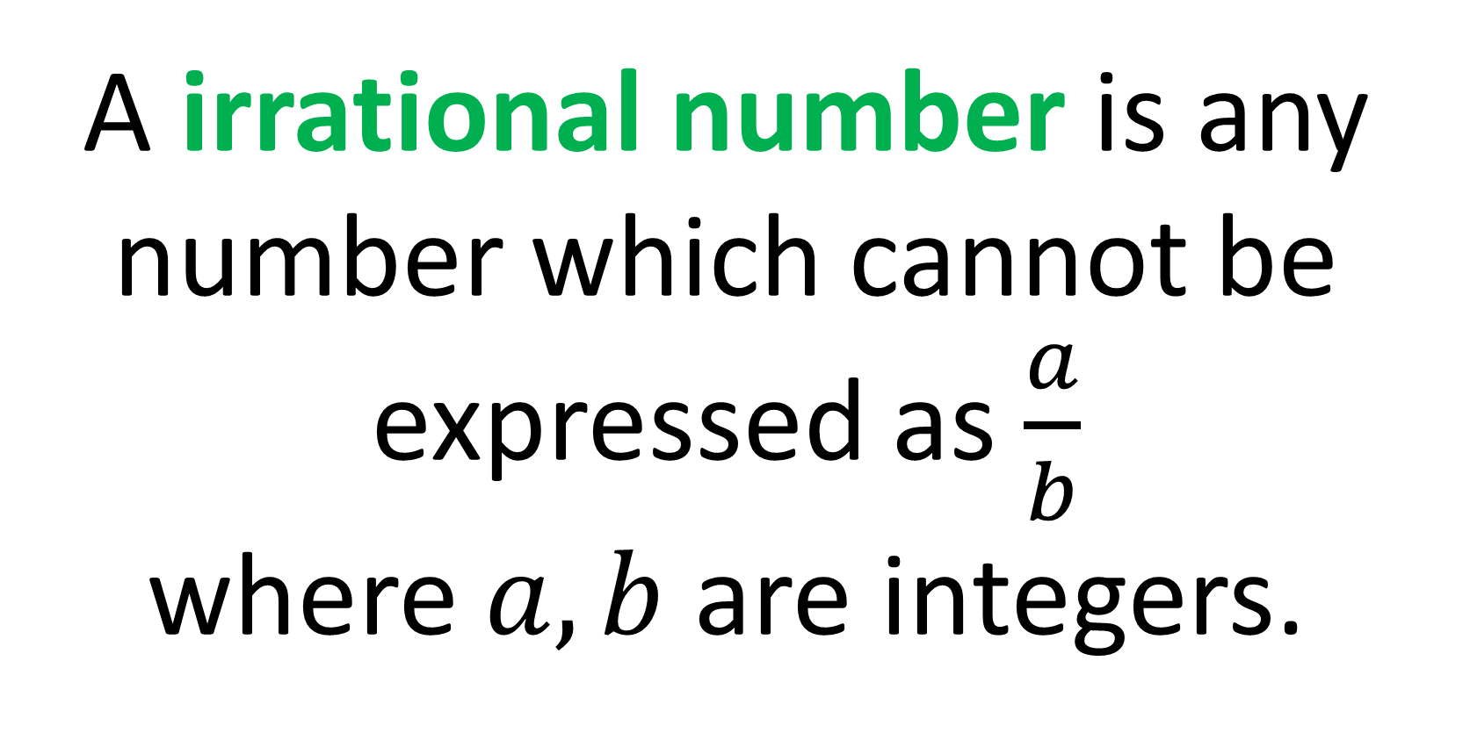
What is an irrational number?
A irrational number is any number which cannot be
expressed as $\frac{a}{b}$
where $a,b$ are integers.

Slide 5
What is a surd?
A square root that is irrational

Slide 6
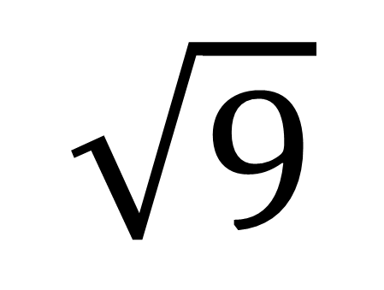
$$\sqrt{9}$$
Surd or Not a Surd?
Not a Surd

Slide 7
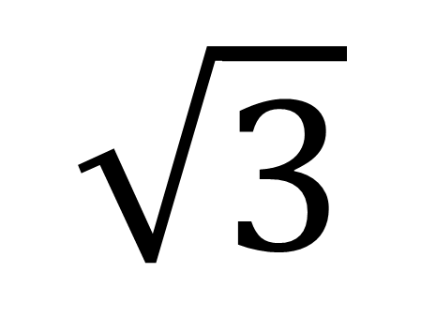
$$\sqrt{3}$$
Surd or Not a Surd?
Surd

Slide 8
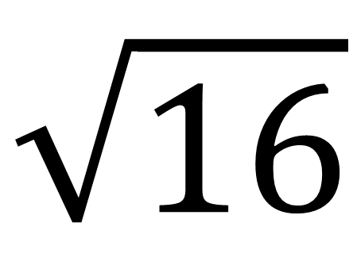
$$\sqrt{16}$$
Surd or Not a Surd?
Not a Surd

Slide 9
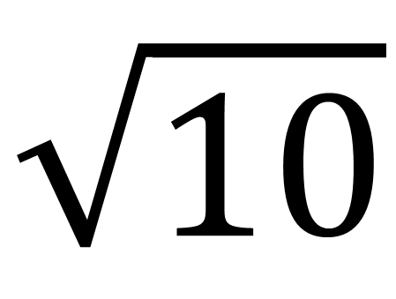
$$\sqrt{10}$$
Surd or Not a Surd?
Surd

Slide 10
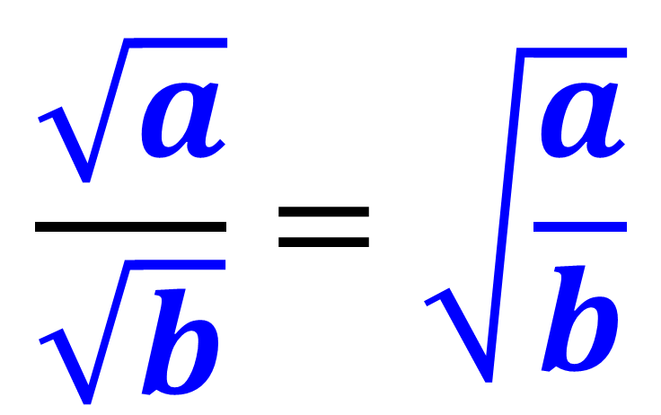
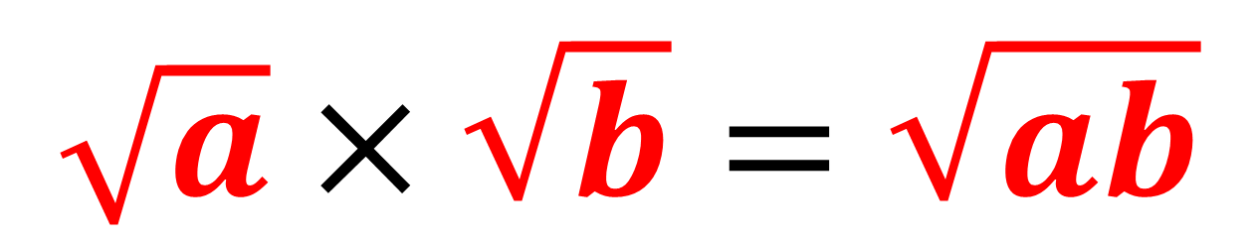
Surds – Calculating
$$\sqrt{a}×\sqrt{b}=\sqrt{ab}$$
$$\frac{\sqrt{a}}{\sqrt{b}}=\sqrt{\frac{a}{b}}$$

Slide 11
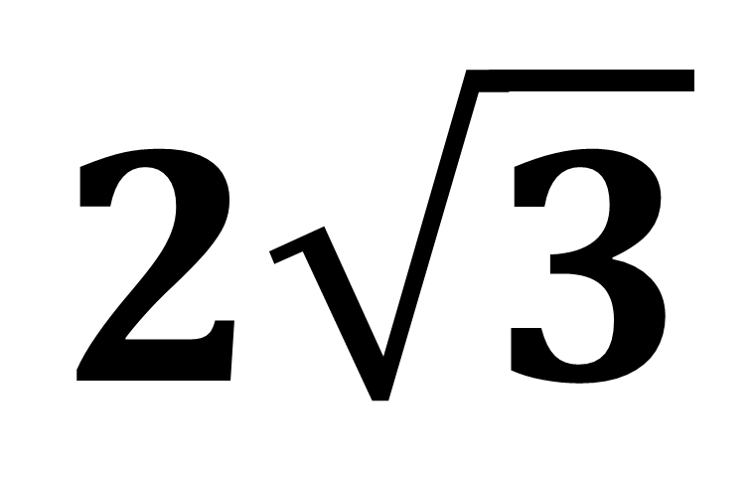
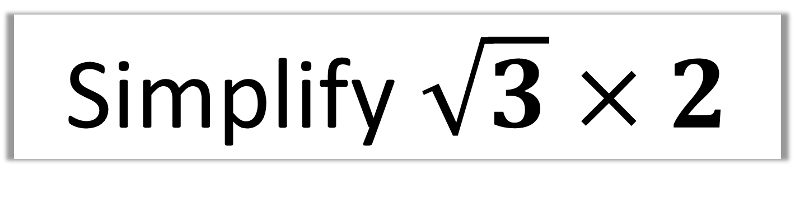
Simplify $\sqrt{3}×2$
$$2\sqrt{3}$$

Slide 12
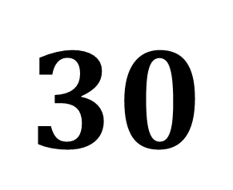
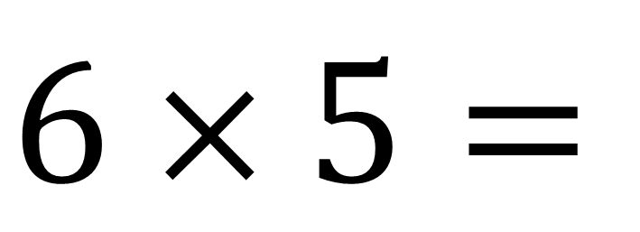
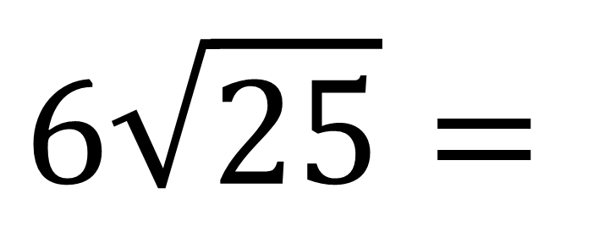
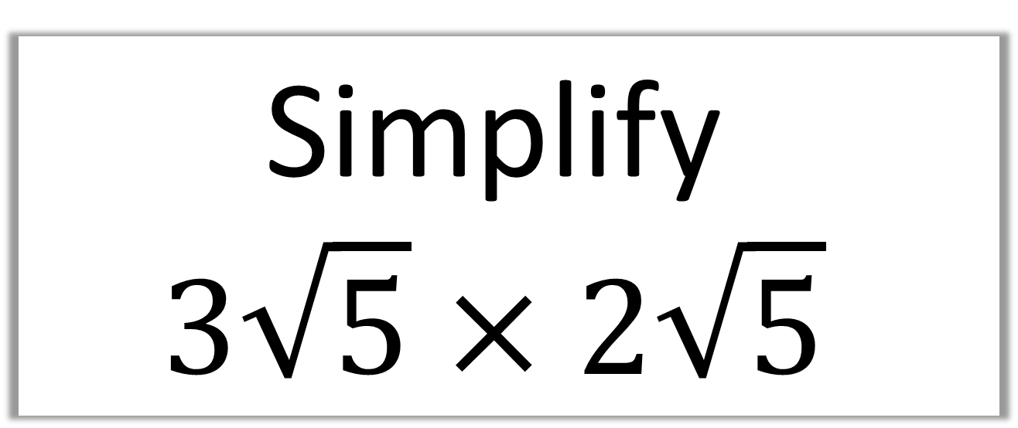
Simplify
$$3\sqrt{5}×2\sqrt{5}$$
$$6\sqrt{25}=$$
$$6×5=$$
$$30$$

Slide 13
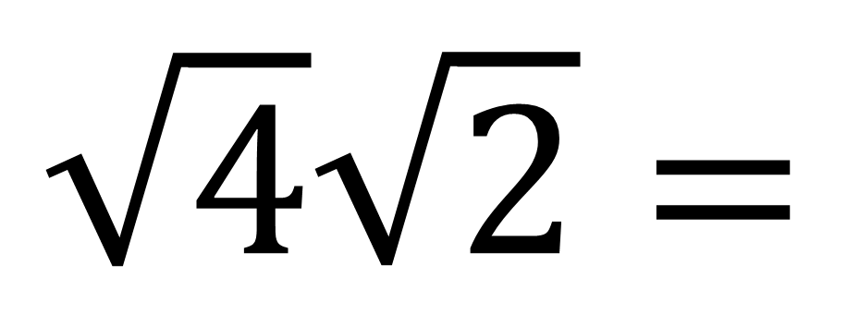
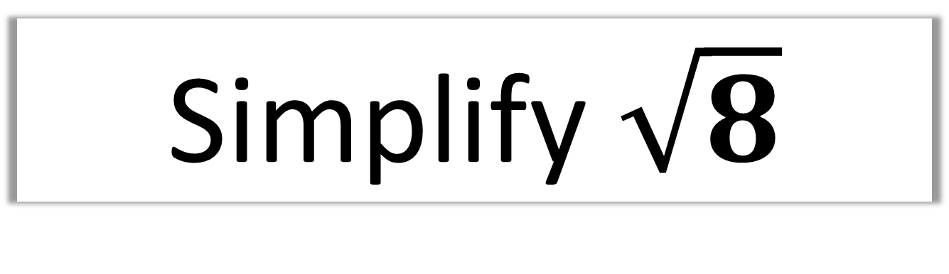
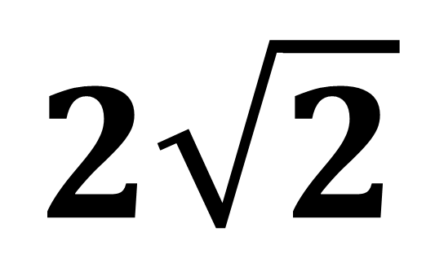
Simplify $\sqrt{8}$
$$\sqrt{4}\sqrt{2}=$$
$$2\sqrt{2}$$

Slide 14
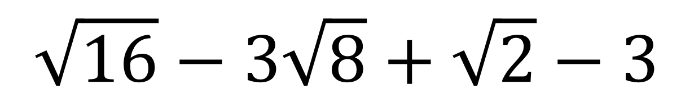
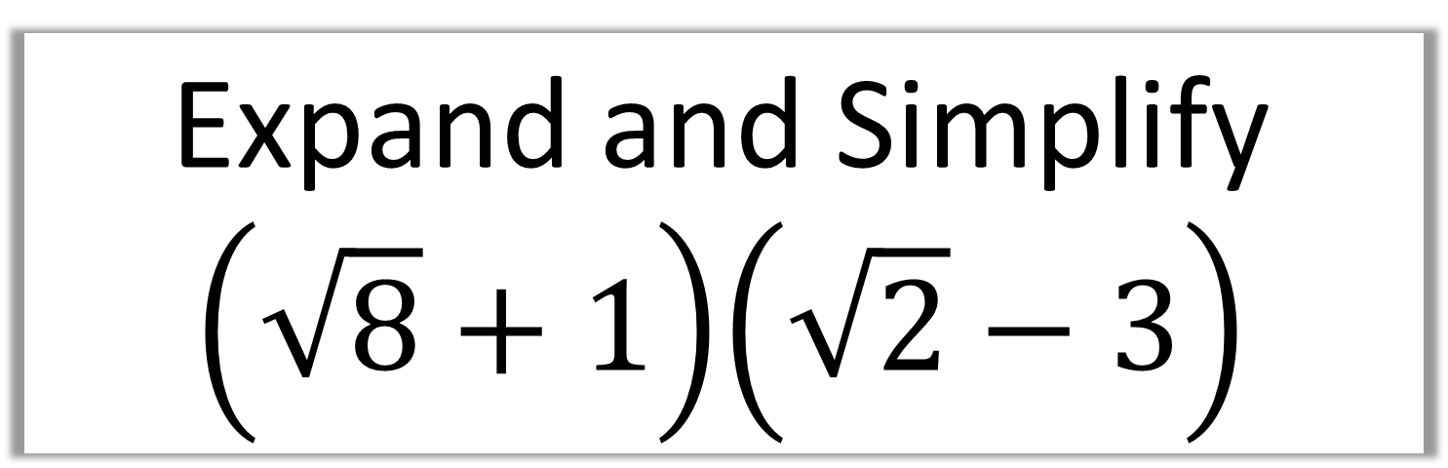
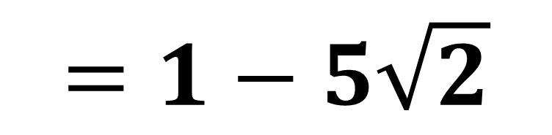
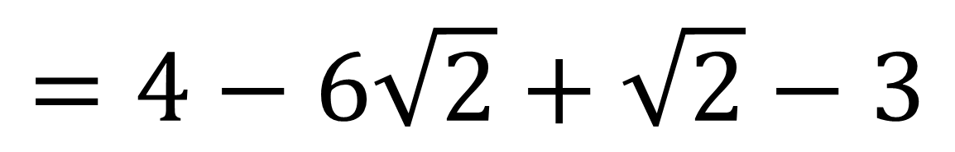
Expand and Simplify
$$\left(\sqrt{8}+1\right)\left(\sqrt{2}−3\right)$$
$$\sqrt{16}−3\sqrt{8}+\sqrt{2}−3$$
$$=4−6\sqrt{2}+\sqrt{2}−3$$
$$=1−5\sqrt{2}$$

Slide 15
Surds
Rationalising The Denominator
Making the denominator
of a fraction rational
(not a Surd).

Slide 16
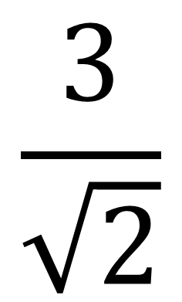
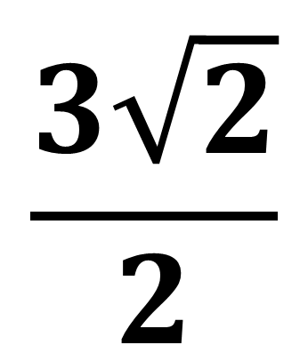
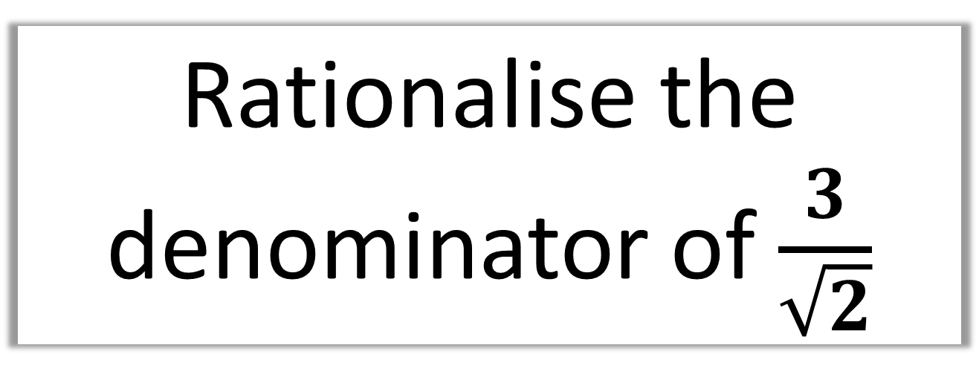
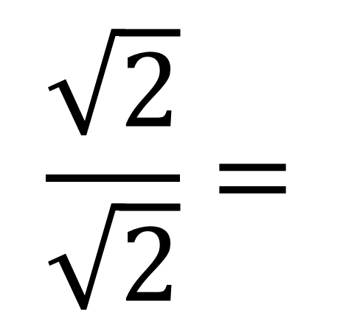
Rationalise the denominator of $\frac{3}{\sqrt{2}}$
$$\frac{\sqrt{2}}{\sqrt{2}}=$$
$$\frac{3\sqrt{2}}{2}$$
$$\frac{3}{\sqrt{2}}$$
X

Slide 17
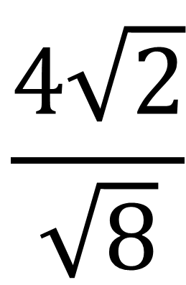
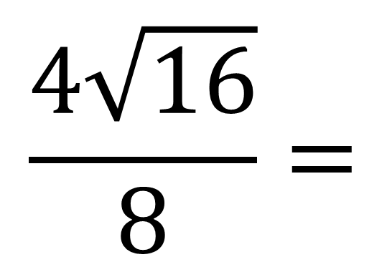
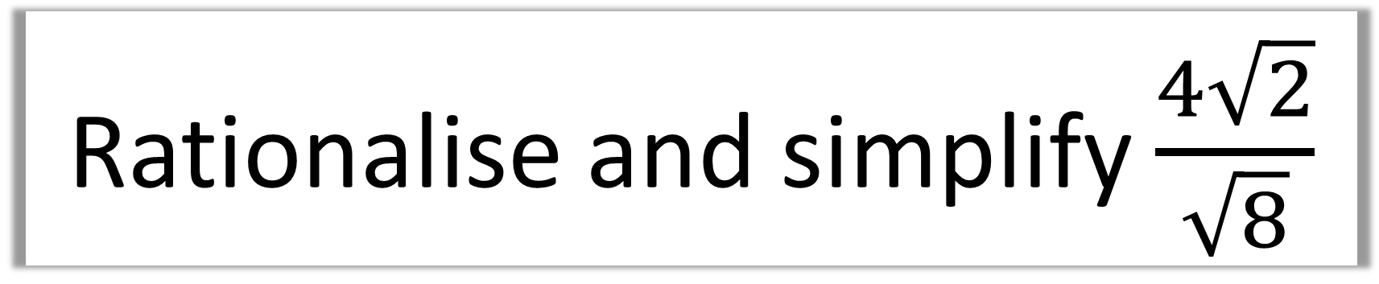
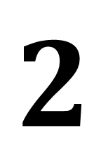
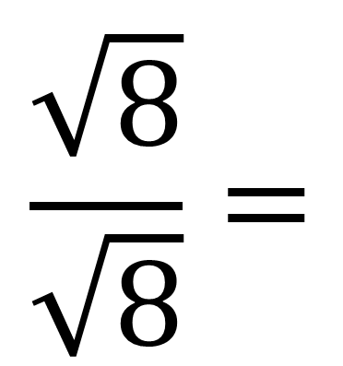
Rationalise and simplify $\frac{4\sqrt{2}}{\sqrt{8}}$
$$\frac{4\sqrt{2}}{\sqrt{8}}$$
$$\frac{\sqrt{8}}{\sqrt{8}}=$$
$$\frac{4\sqrt{16}}{8}=$$
$$2$$
X

Slide 18
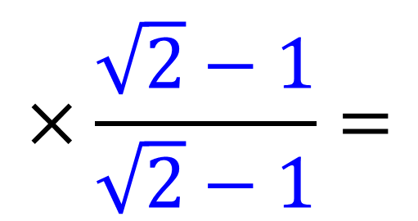
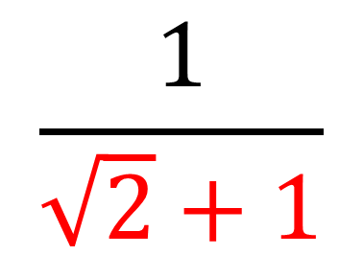
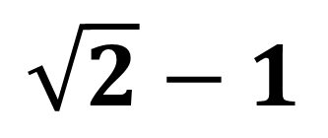
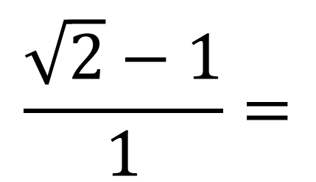
More complicated denominator!
Multiply by the same expression
but with the opposite sign.
$$\frac{1}{\sqrt{2}+1}$$
$$×\frac{\sqrt{2}−1}{\sqrt{2}−1}=$$
$$\frac{\sqrt{2}−1}{1}=$$
$$\sqrt{2}−1$$

Slide 19
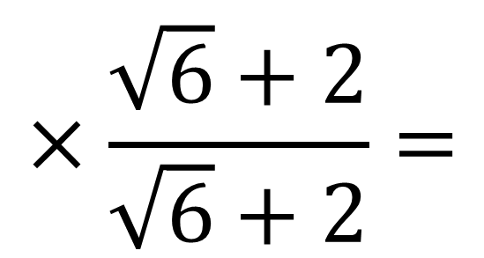
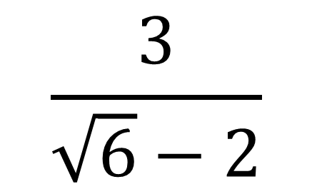
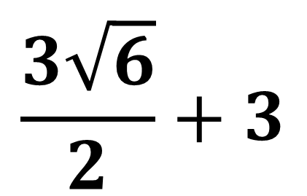
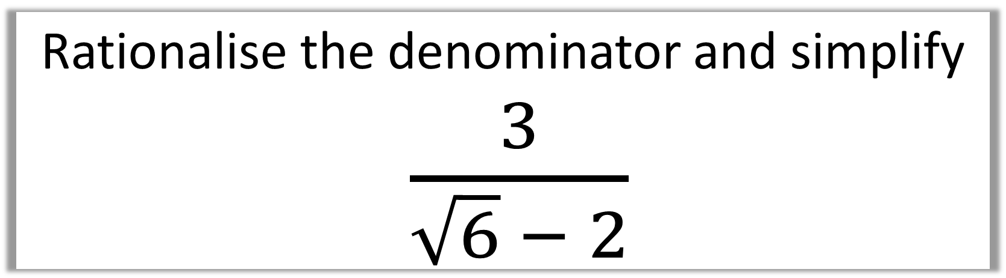
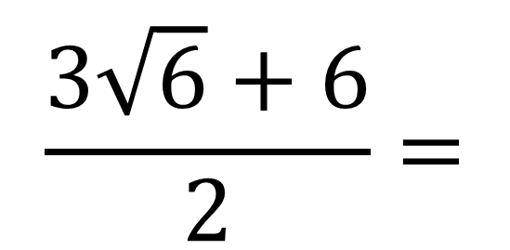
Rationalise the denominator and simplify
$\frac{3}{\sqrt{6} − 2}$
$$\frac{3}{\sqrt{6}−2}$$
$$×\frac{\sqrt{6}+2}{\sqrt{6}+2}=$$
$$\frac{3\sqrt{6}+6}{2}=$$
$$\frac{3\sqrt{6}}{2}+3$$

Slide 20
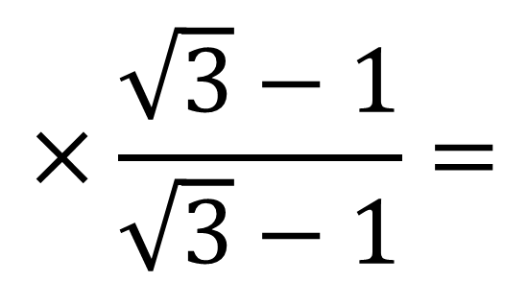
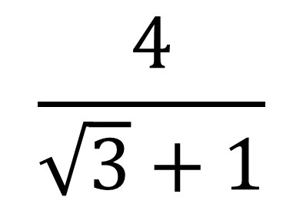
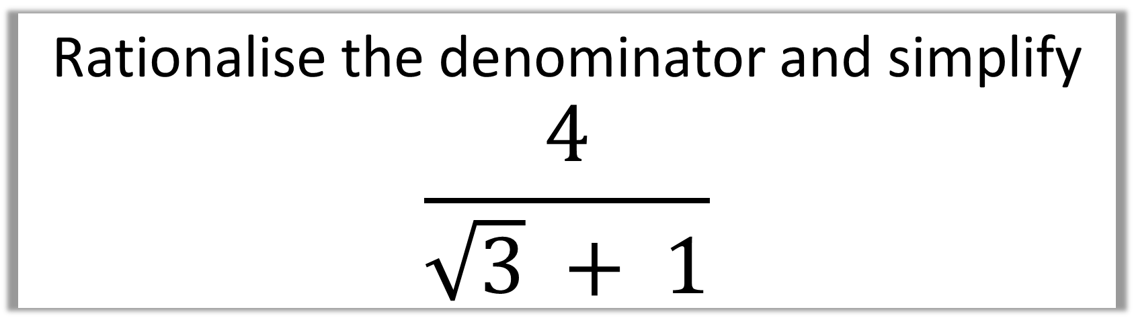
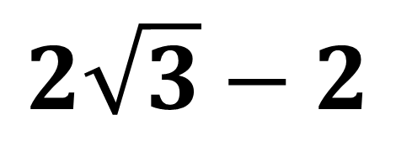
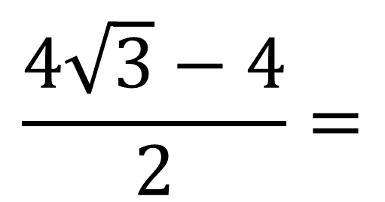
Rationalise the denominator and simplify
$$\frac{4}{\sqrt{3} + 1}$$
$$\frac{4}{\sqrt{3}+1}$$
$$×\frac{\sqrt{3}−1}{\sqrt{3}−1}=$$
$$\frac{4\sqrt{3}−4}{2}=$$
$$2\sqrt{3}−2$$

Slide 21
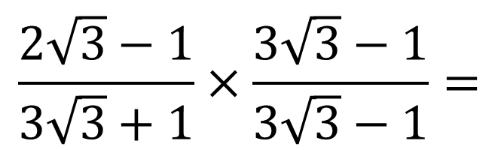
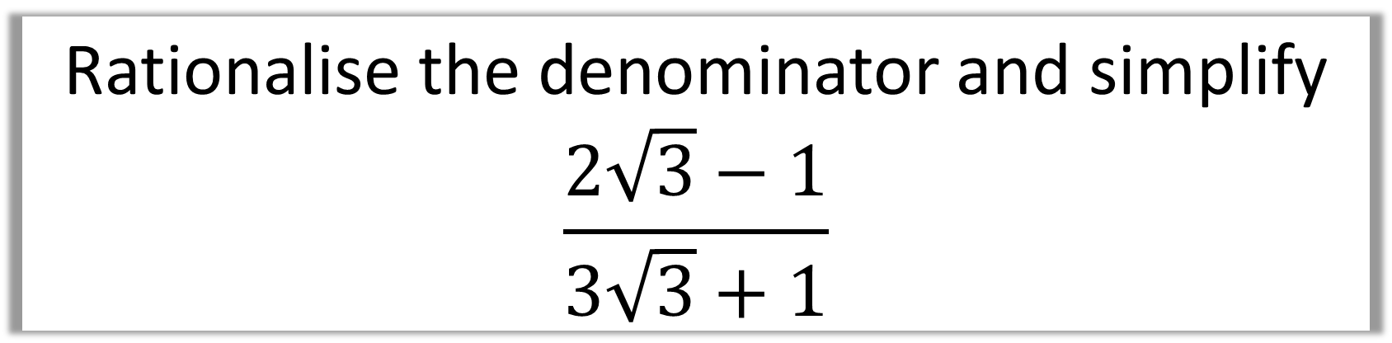
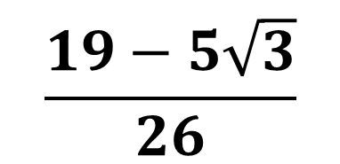
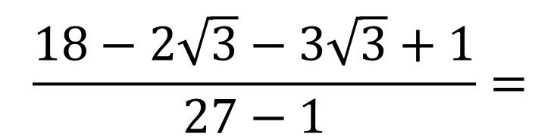
Rationalise the denominator and simplify
$$\frac{2\sqrt{3}−1}{3\sqrt{3}+1}$$
$$\frac{2\sqrt{3}−1}{3\sqrt{3}+1}×\frac{3\sqrt{3}−1}{3\sqrt{3}−1}=$$
$$\frac{18−2\sqrt{3}−3\sqrt{3}+1}{27−1}=$$
$$\frac{19−5\sqrt{3}}{26}$$

Slide 22
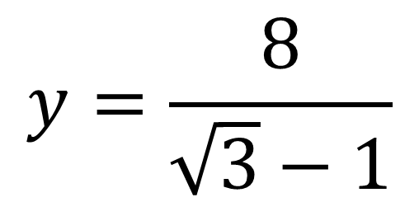
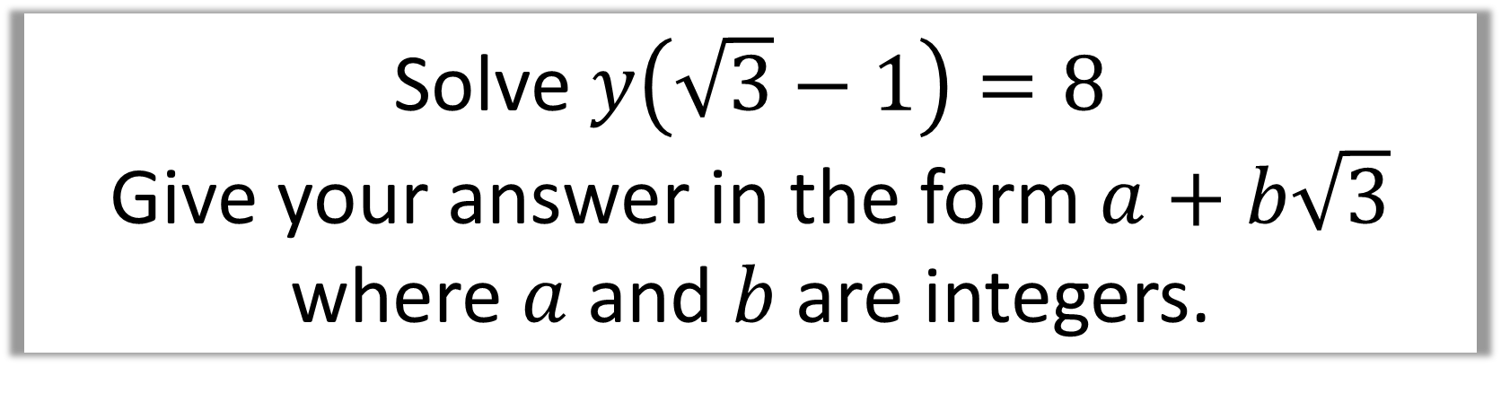



Solve $y\left(\sqrt{3}−1\right)=8$
Give your answer in the form $a+b\sqrt{3}$
where $a$ and $b$ are integers.
$$×\frac{\sqrt{3}+1}{\sqrt{3}+1}=$$
$$\frac{8\sqrt{3}+8}{2}=$$
$$y=\frac{8}{\sqrt{3}−1}$$
$$4+4\sqrt{3}$$

