Slide 1
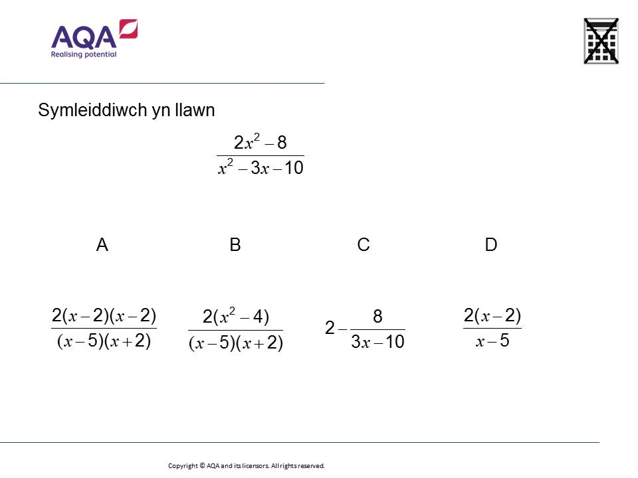
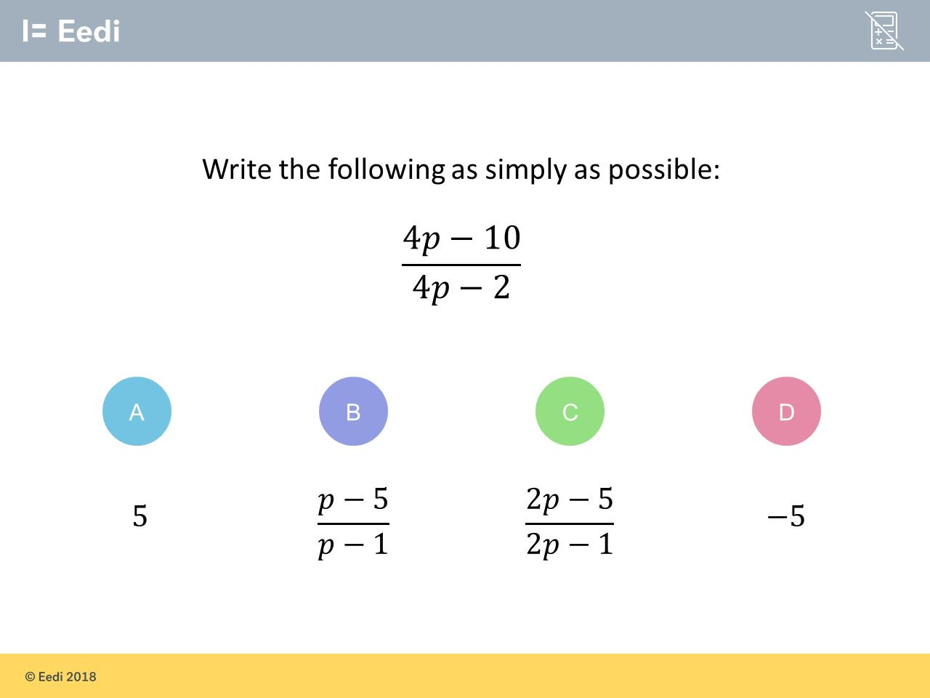
Worst answered question?
Most common wrong answer?

Slide 2
ANSWERS

Slide 3
Worst answered question?

Slide 4
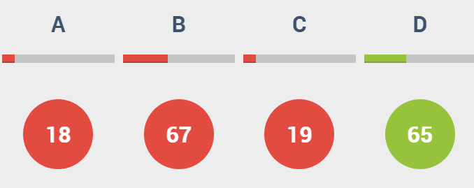
B
They did not recognsie that
you can factorise
x² – 4
into (x + 2)(x – 2)

Slide 5
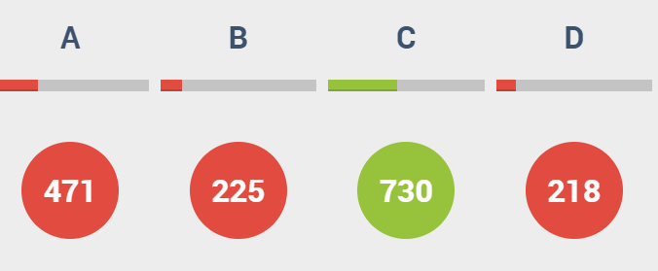
A
The student appears to have calculated the value of the expression when p = 0.

