Slide 1

Diagnostic Assessment
Delta 1
Unit 6
Rounding Decimals
Adding and Subtracting Decimals
Multiplying and Dividing Decimals
Percentages of an Amount
Percentage Increase Decrease

Slide 2
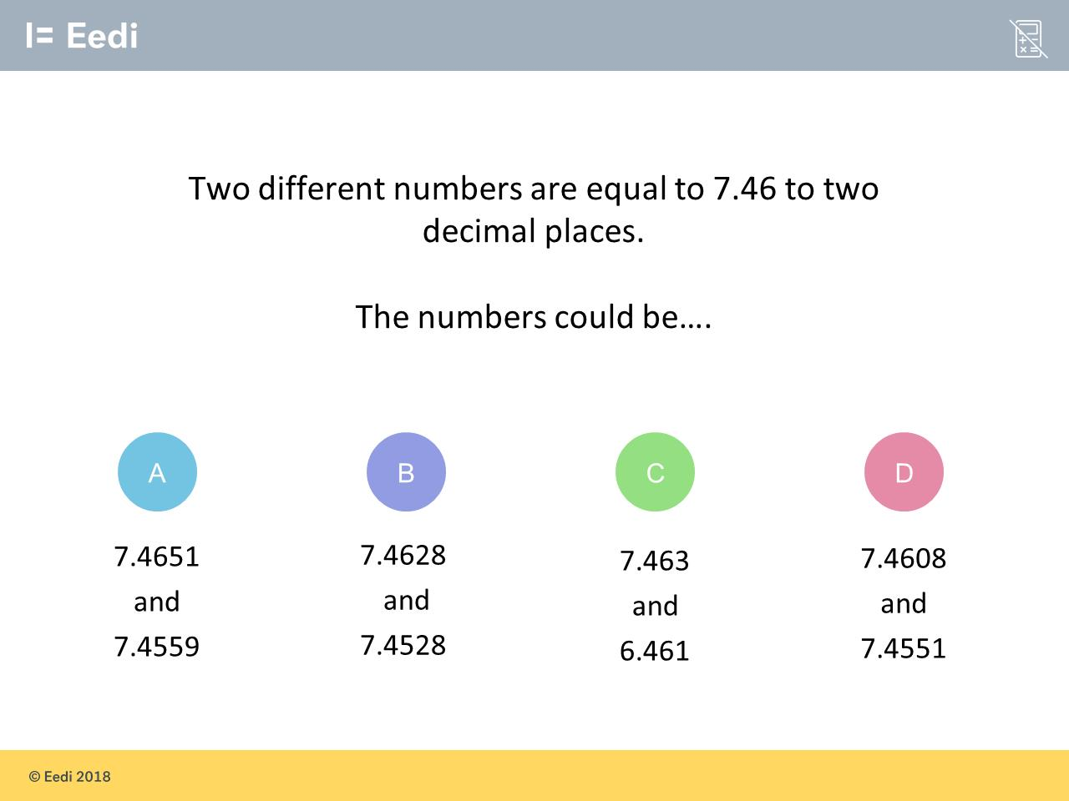
Question 1 – Rounding Decimals

Slide 3
Answer 1 – Rounding Decimals
CORRECT ANSWER | CORRECT EXPLANATION
D | Both of these numbers round to 7.46 to 2 d.p.
COMMON MISTAKES | WHAT MIGHT BE YOUR MISTAKE
A | The student has rounded the first number incorrectly.
B | The student has rounded the second number up, instead of down.
C | The student has rounded the ones in the second number.

Slide 4
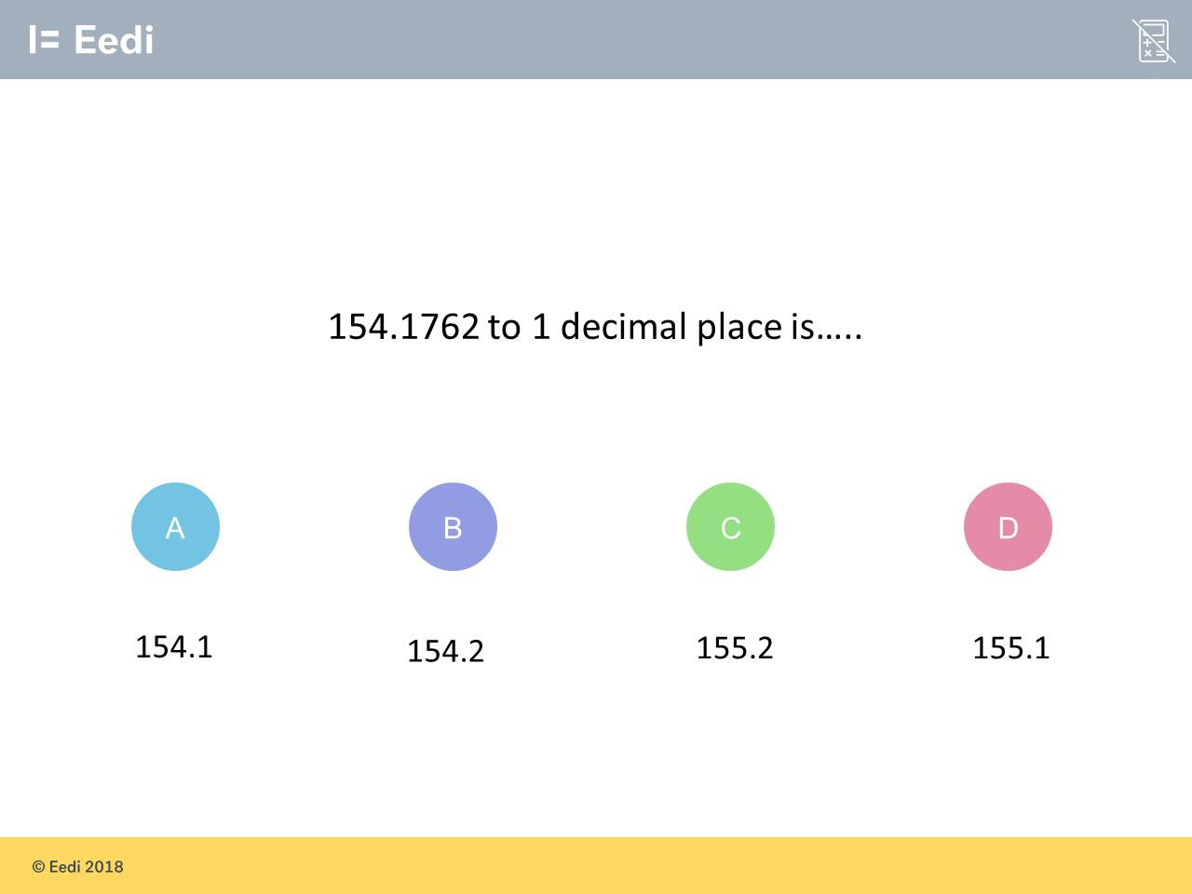
Question 2 – Rounding Deciamls

Slide 5
Answer 2 – Rounding Decimals
CORRECT ANSWER | CORRECT EXPLANATION
154.2 | The 2nd decimal digit is 7, so we have round up to 154.2.
COMMON MISTAKES | WHAT MIGHT BE YOUR MISTAKE
154.1 | The student has rounded down, instead of up.
155.2 | The student has rounded the ones, as well as the tenths.
155.1 | The student has rounded the ones, instead of the tenths.

Slide 6
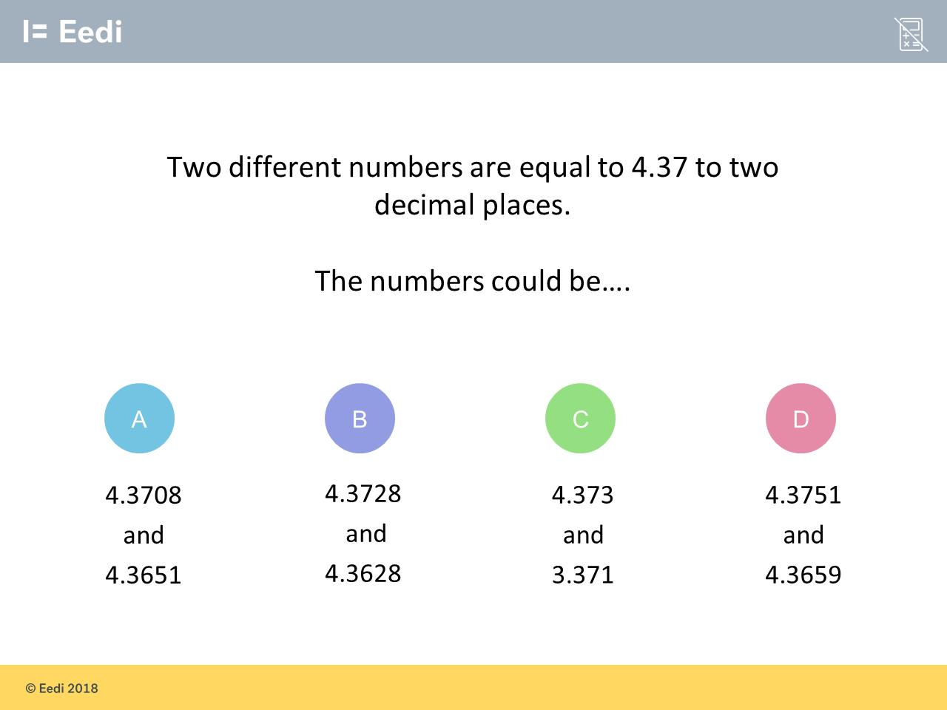
Question 3 – Rounding Decimals

Slide 7
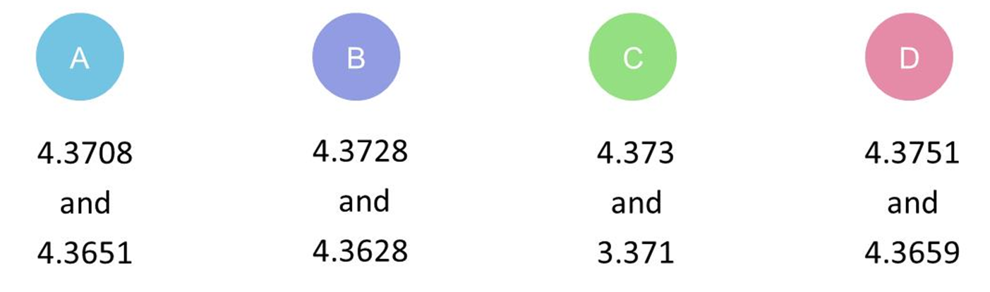
Answer 3 – Rounding Decimals
CORRECT ANSWER | CORRECT EXPLANATION
A | Both of the numbers round to 4.37 to two decimal places.
COMMON MISTAKES | WHAT MIGHT BE YOUR MISTAKE
B | The student has rounded the second number incorrectly.
C | The student has rounded the second number incorrectly.
D | The student has rounded the first number incorrectly.

Slide 8
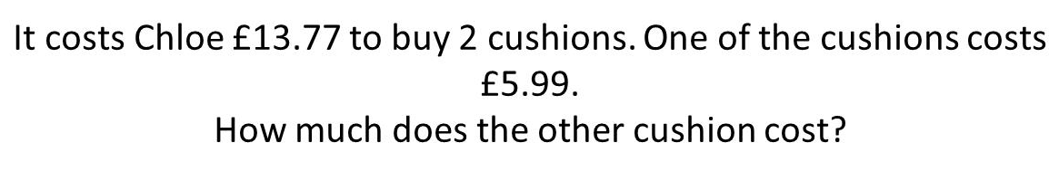
Question 4 – Adding and Subtracting Decimals

Slide 9
Answer 4 – Adding and Subtracting Decimals
CORRECT ANSWER | CORRECT EXPLANATION
£7.78 | We have 13.77 - 5.99 = 7.78. This is easiest done by subtracting 6 and adding 1.
COMMON MISTAKES | WHAT MIGHT BE YOUR MISTAKE
£19.76 | The student has added the two values, rather than subtracting.
£8.22 | The student has subtracted the smaller digits from the larger digits.
£7.88 | The student hasn't exchanged a hundred from the column when using column subtraction.

Slide 10
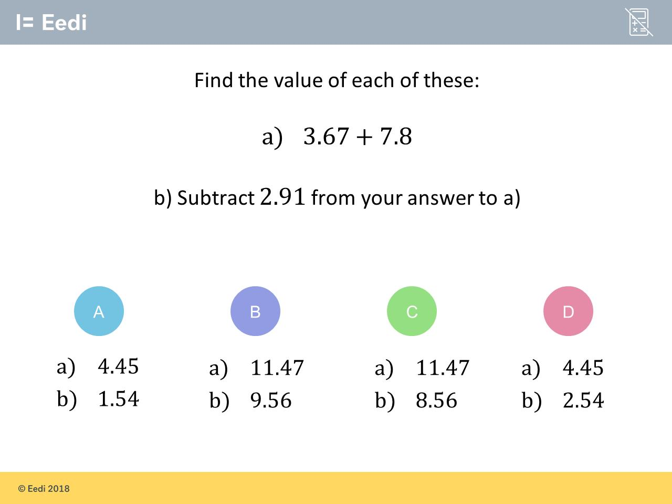
Question 5 – Adding and Subtracting Decimals

Slide 11
Answer 5 – Adding and Subtracting Decimals
CORRECT ANSWER | CORRECT EXPLANATION
a) 11.47 b) 8.56 | We have 3.67 + 7.8 = 11.47. Then we have 11.47 - 2.91 = 8.56. This can be found using the column method.
COMMON MISTAKES | WHAT MIGHT BE YOUR MISTAKE
a) 4.45 b) 1.54 | The student has made a place value error when adding for a).
a) 11.47 b) 9.56 | The student has made an error exchanging when subtracting.
a) 4.45 b) 2.54 | The student has miscalculated both parts. They may benefit from revising this topic.

Slide 12
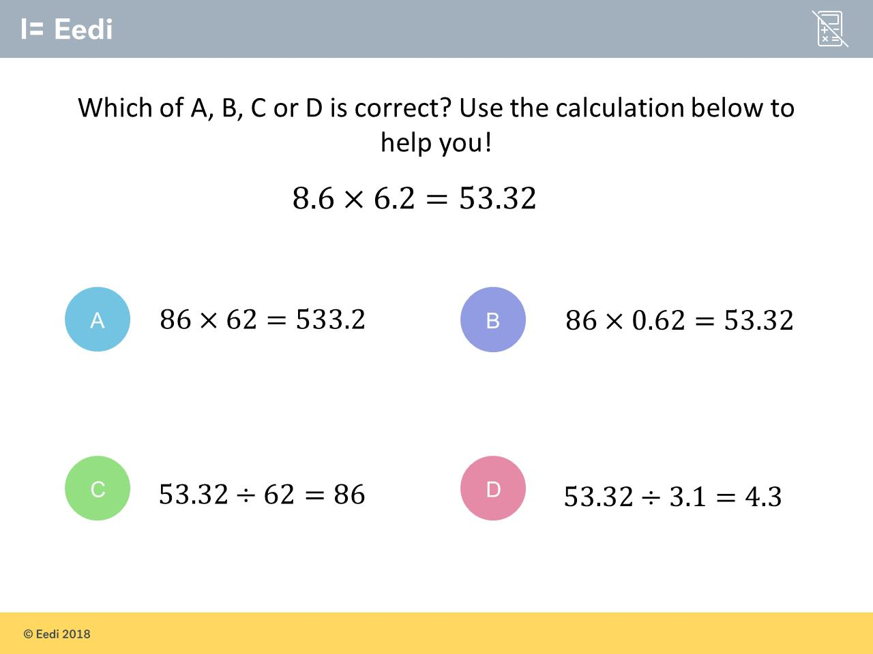
Question 6 – Multiplying and Dividing Decimals

Slide 13
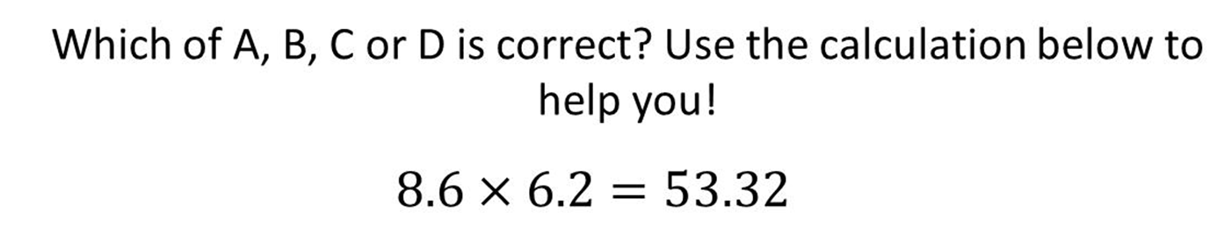
Answer 6 – Multiplying and Dividing Decimals
CORRECT ANSWER | CORRECT EXPLANATION
B | We have multiplied 8.6 by 10 and divided 6.2 by 10. These operations cancel out and the answer remains the same.
COMMON MISTAKES | WHAT MIGHT BE YOUR MISTAKE
A | The student may believe that all numbers need to be multiplied by 10.
C | The student may think that dividing by a value 10 times larger makes the answer 10 times larger.
D | The student may think that dividing by half the amount halves the answer.

Slide 14
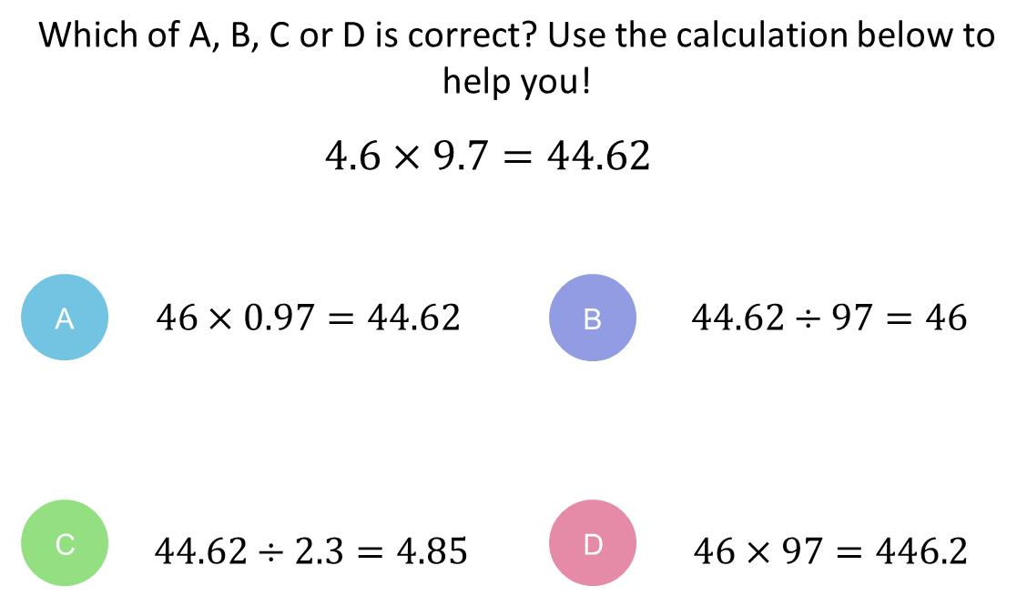
Question 7 – Multiplying and Dividing Decimals

Slide 15
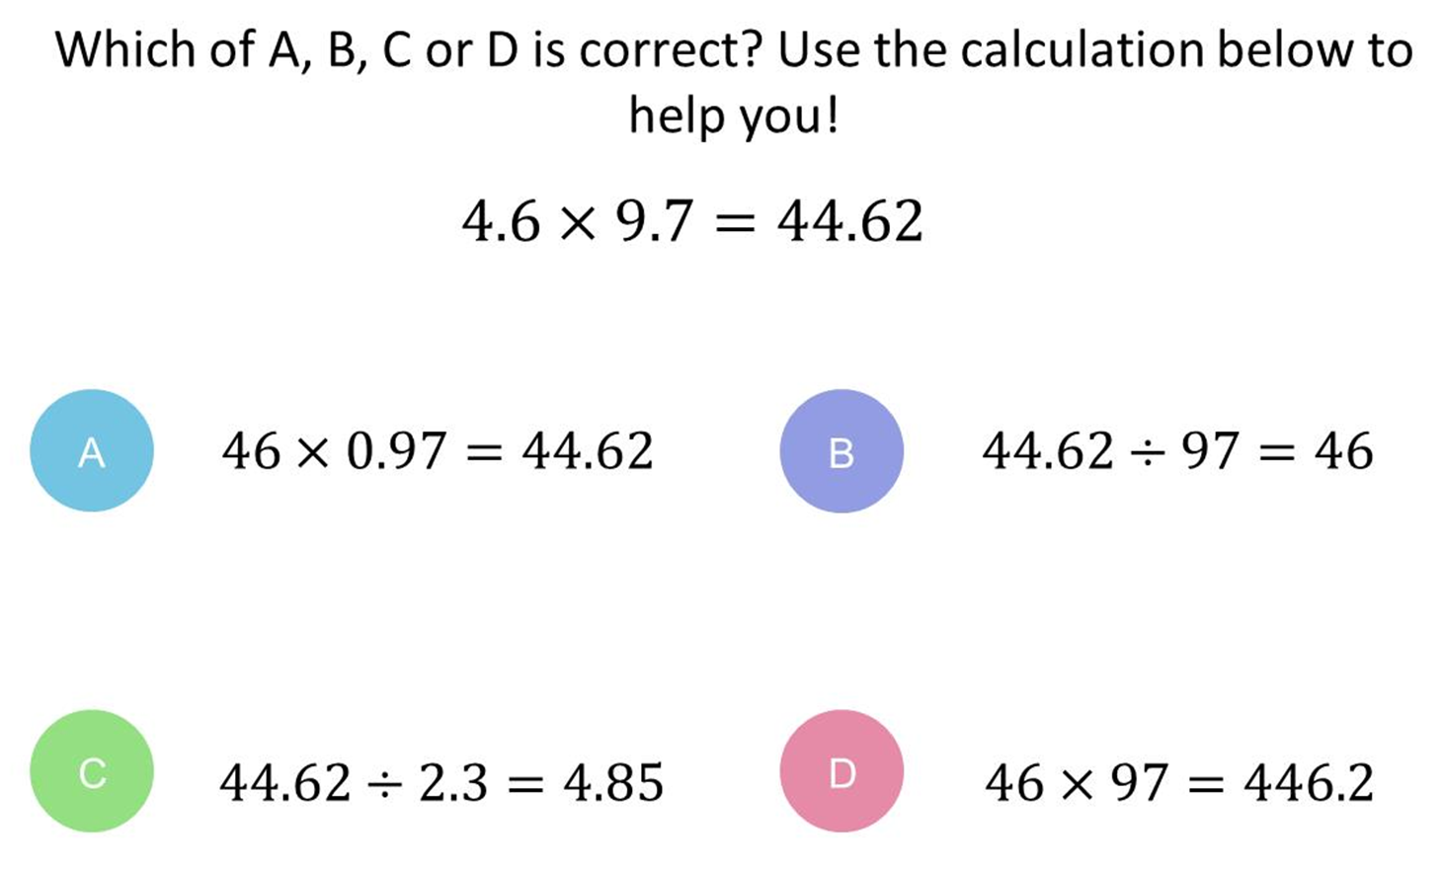
Answer 7 – Multiplying and Dividing Decimals
CORRECT ANSWER | CORRECT EXPLANATION
A | When we multiply 4.6 by 10 to get 46, and divided 9.7 by 10 to get 0.97, these operations cancel out and so the answer remains the same.
COMMON MISTAKES | WHAT MIGHT BE YOUR MISTAKE
B | The student may think that dividing by a value 10 times bigger makes the answer 10 times bigger.
C | The student may think that dividing by half the amount halves the value.
D | The student may think that if both numbers are multiplied by 10, so is the answer.

Slide 16
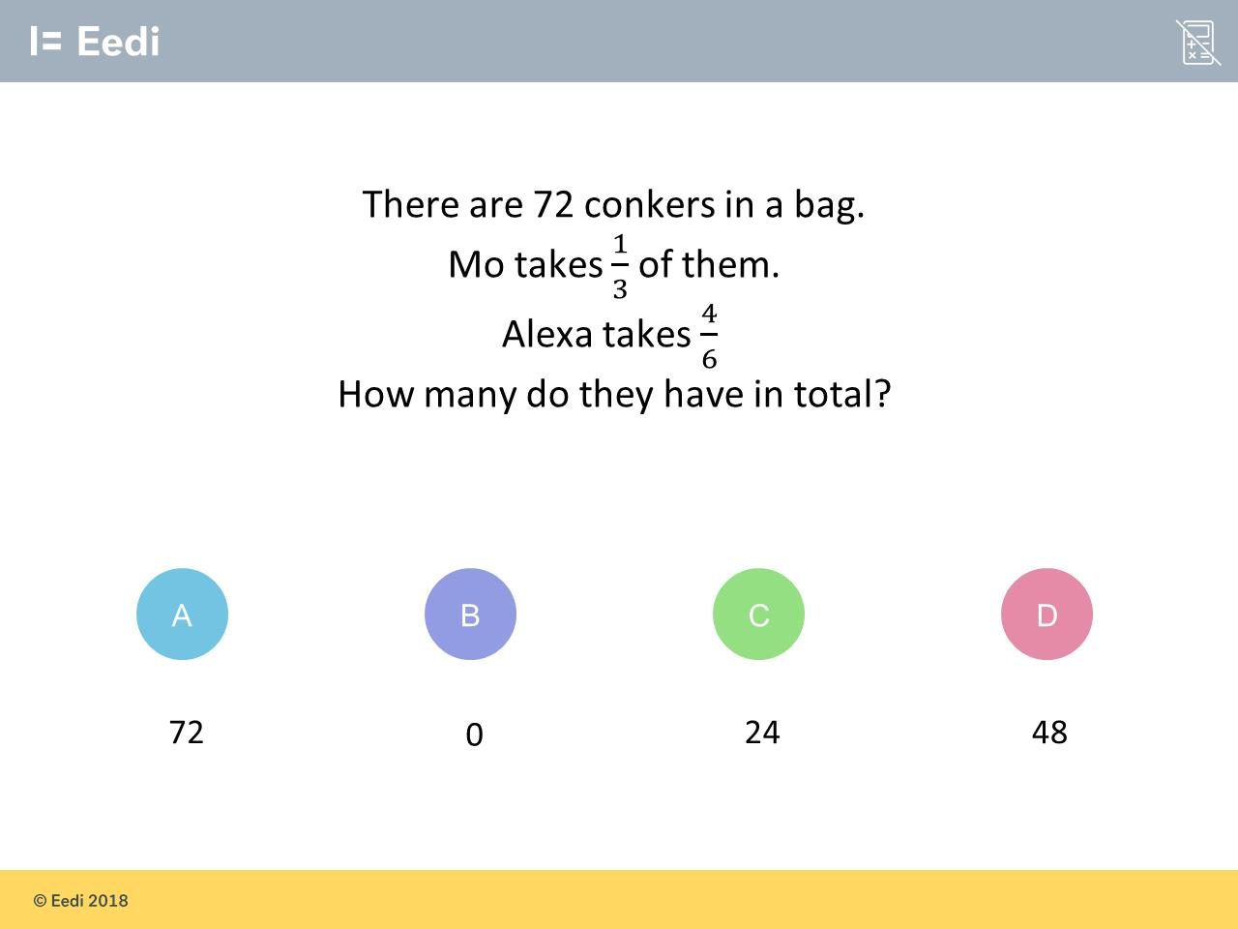
Question 8 – Fractions of an Amount

Slide 17
Answer 8 – Fractions of an Amount
CORRECT ANSWER | CORRECT EXPLANATION
72 | 1/3 + 4/6 = 2/6 + 4/6 = 6/6 = 1, so they have all of the conkers.
COMMON MISTAKES | WHAT MIGHT BE YOUR MISTAKE
0 | The student has given the amount left in the bag.
24 | The student has found a third only.
48 | The student has found 4/6 only.

Slide 18
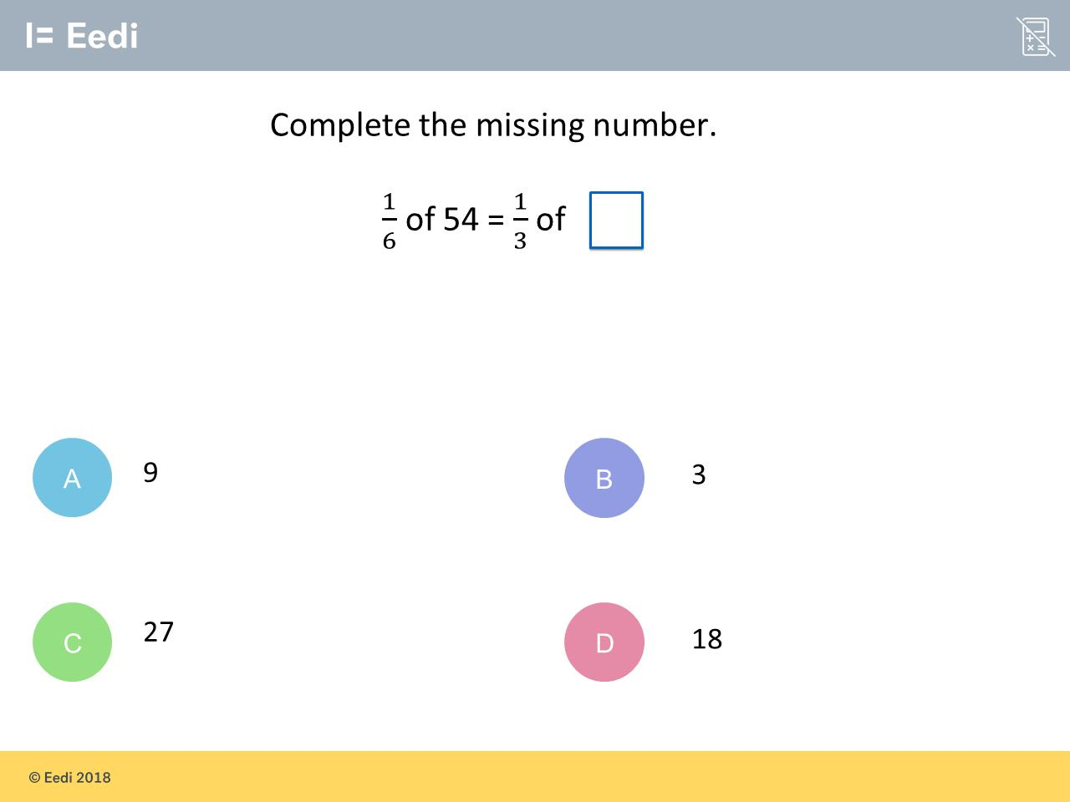
Question 9 – Fractions of an Amount

Slide 19
Answer 9 – Fractions of an Amount
CORRECT ANSWER | CORRECT EXPLANATION
27 | One sixth of 54 is 54/6 = 9, then multiply 9 by 3 gives 27 as the answer.
COMMON MISTAKES | WHAT MIGHT BE YOUR MISTAKE
9 | The student has found one sixth of 54 only.
3 | The student may have interpreted one third as 3.
18 | The student has multiplied the 2 denominators.
A B C
D

Slide 20
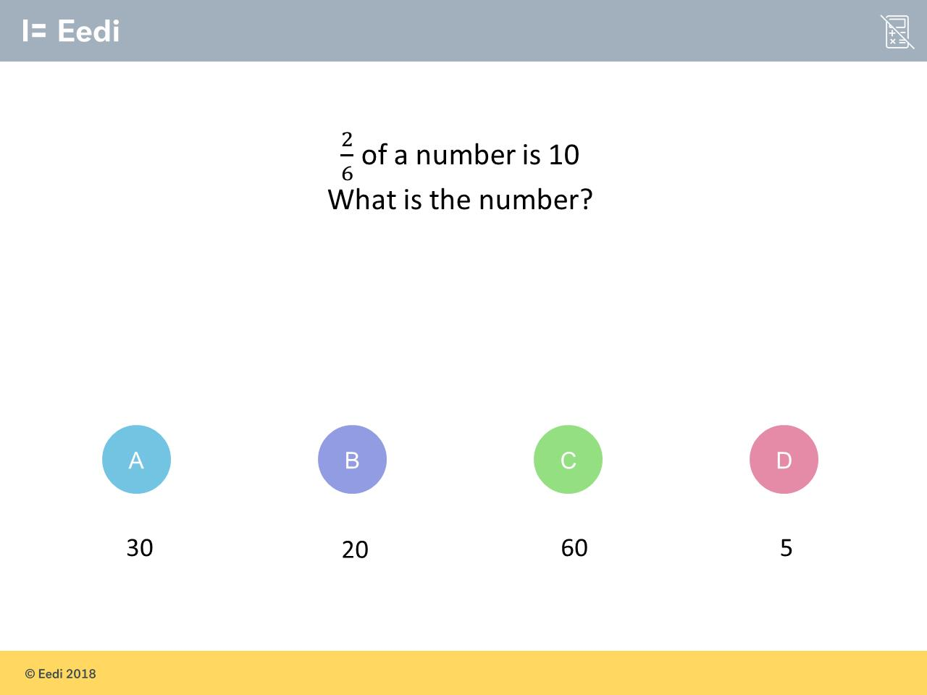
Question 10 – Fractions of an Amount

Slide 21
Answer 10 – Fractions of an Amount
CORRECT ANSWER | CORRECT EXPLANATION
30 | We need to divide 10 by 2/6, which is the same as multiplying by 6/2 = 3. have 12 + 8 = 20 people who bought just food and 4 + 6 = 10 people who just bought drinks. Adding them together gives 30.
COMMON MISTAKES | WHAT MIGHT BE YOUR MISTAKE
20 | The student has multiplied the numerator by 10.
60 | The student has multiplied the denominator by 10.
5 | The student has found one sixth.

Slide 22
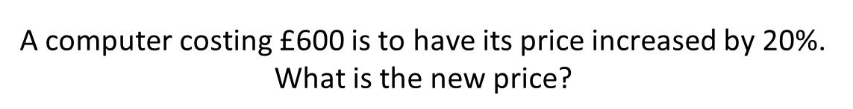
Question 11 – Percentage Increase and Decrease

Slide 23
Answer 11 – Percentage Increase and Decrease
CORRECT ANSWER | CORRECT EXPLANATION
£720 | We need to find 600 × 1.2 = $720
COMMON MISTAKES | WHAT MIGHT BE YOUR MISTAKE
£660 | The student has increased the price by 10%.
£120 | The student has found 20%, but not increased the price.
£620 | The student has increased £600 by £20.

Slide 24
Question 12 – Percentage Increase and Decrease
What is the multiplier need for
decreasing by 30%?

Slide 25
Answer 12 – Percentage Increase and Decrease
What is the multiplier need for
decreasing by 30%?
CORRECT ANSWER | CORRECT EXPLANATION
x 0.7 | We have 1 - 30% = 1 - 0.3 = 0.7
COMMON MISTAKES | WHAT MIGHT BE YOUR MISTAKE
x 1.3 | The student has given the multiplier for increasing by 30%.
x 30 | The student may have repeated the number from the question. They may benefit from revising this topic.
x 0.3 | The student may be finding 30%, but has forgotten to subtract from the original 100%.

Slide 26
Question 13 – Percentage Increase and Decrease
What is the multiplier need for
increasing by 45%?

Slide 27
Answer 13 – Percentage Increase and Decrease
What is the multiplier need for
increasing by 45%?
CORRECT ANSWER | CORRECT EXPLANATION
1.45 | To increase a number by a percentage, the multiplier is 1 followed by the decimal for that percentage.
COMMON MISTAKES | WHAT MIGHT BE YOUR MISTAKE
0.45 | The student has given the multiplier for finding 45%. They have forgotten to include the 1.
145 | The student has forgotten to divide by 100.
0.55 | The student has given the multiplier for decreasing a number by 45%.

