Slide 1
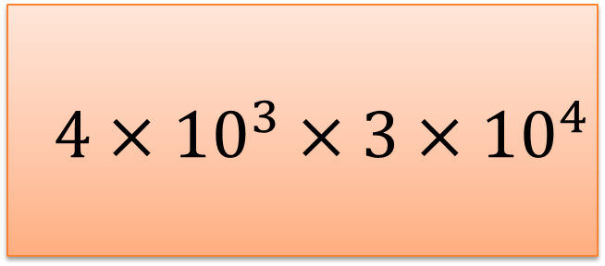

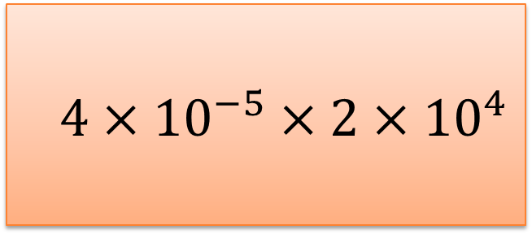

Standard Form Treasure Hunt
Standard Form Treasure Hunt
$$4×{10}^{4}$$
6$×{10}^{6}$
Previous Answer
Previous Answer
$$4×{10}^{3}×3×{10}^{4}$$
$$4×{10}^{−5}×2×{10}^{4}$$
Card 1
?
Card 2
?
To the next clue
To the next clue

Slide 2
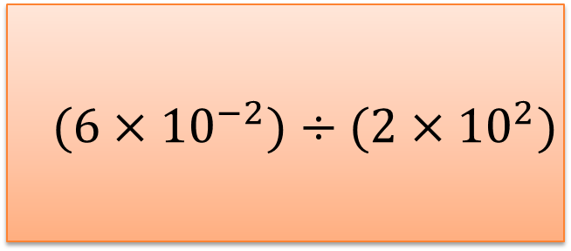

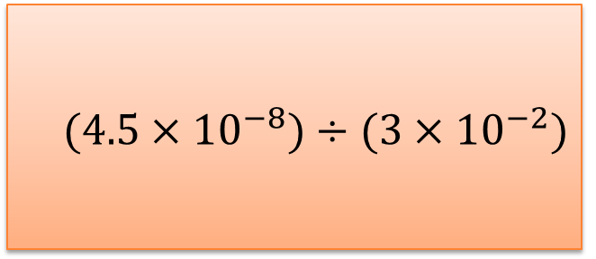

Standard Form Treasure Hunt
Standard Form Treasure Hunt
7.5$×{10}^{2}$
1.7$×{10}^{5}$
Previous Answer
Previous Answer
$$(6×{10}^{−2})÷(2×{10}^{2})$$
$$(4.5×{10}^{−8})÷(3×{10}^{−2})$$
Card 3
?
Card 4
?
To the next clue
To the next clue

Slide 3
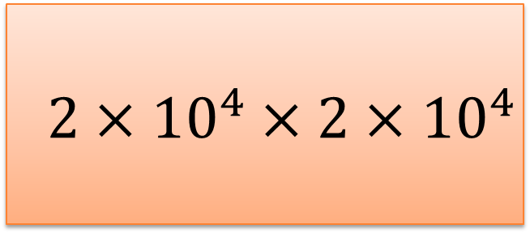

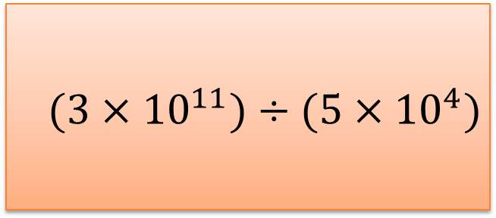

Standard Form Treasure Hunt
Standard Form Treasure Hunt
$$3×{10}^{7}$$
3$×{10}^{16}$
Previous Answer
Previous Answer
$$2×{10}^{4}×2×{10}^{4}$$
$$(3×{10}^{11})÷(5×{10}^{4})$$
Card 5
?
Card 6
?
To the next clue
To the next clue

Slide 4
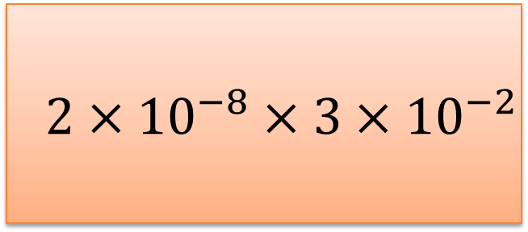

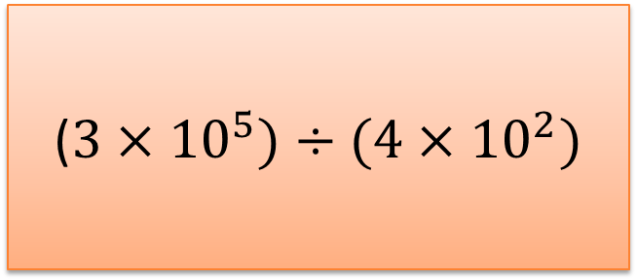

Standard Form Treasure Hunt
Standard Form Treasure Hunt
1.5$×{10}^{8}$
7.5$×{10}^{13}$
Previous Answer
Previous Answer
$$2×{10}^{−8}×3×{10}^{−2}$$
($3×{10}^{5})÷(4×{10}^{2})$
Card 7
?
Card 8
?
To the next clue
To the next clue

Slide 5
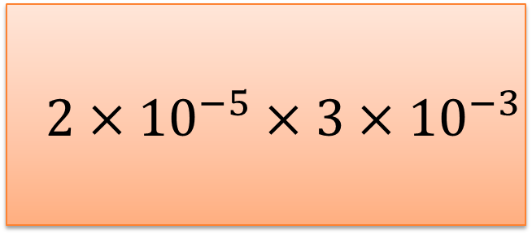

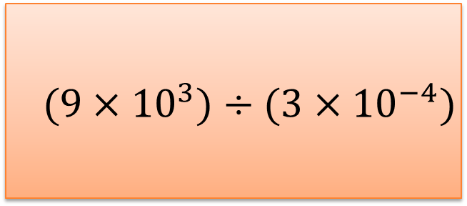

Standard Form Treasure Hunt
Standard Form Treasure Hunt
$$1.5×{10}^{11}$$
6$×{10}^{−2}$
Previous Answer
Previous Answer
$$2×{10}^{−5}×3×{10}^{−3}$$
$$(9×{10}^{3})÷(3×{10}^{−4})$$
Card 9
?
Card 10
?
To the next clue
To the next clue

Slide 6
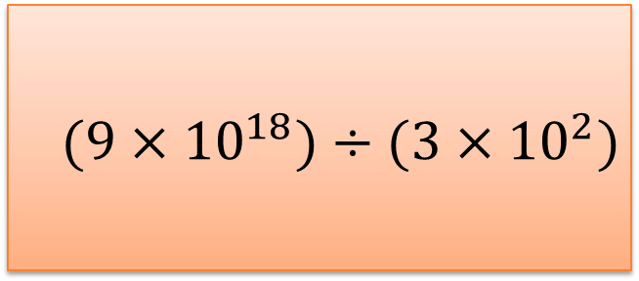

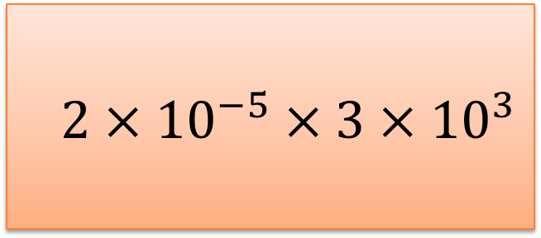

Standard Form Treasure Hunt
Standard Form Treasure Hunt
$$6×{10}^{−10}$$
$$1.7×{10}^{12}$$
Previous Answer
Previous Answer
$$(9×{10}^{18})÷(3×{10}^{2})$$
$$2×{10}^{−5}×3×{10}^{3}$$
Card 11
?
Card 12
?
To the next clue
To the next clue

Slide 7
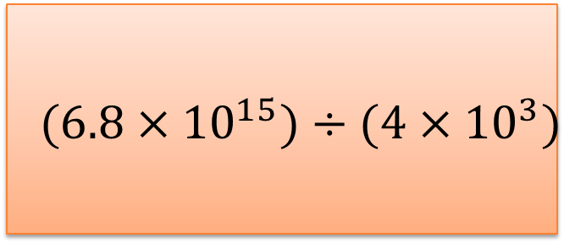

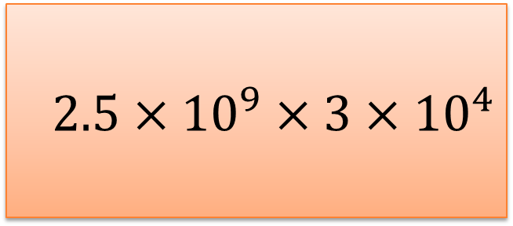

Standard Form Treasure Hunt
Standard Form Treasure Hunt
3$×{10}^{−4}$
8$×{10}^{−1}$
Previous Answer
Previous Answer
$$(6.8×{10}^{15})÷(4×{10}^{3})$$
$$2.5×{10}^{9}×3×{10}^{4}$$
Card 13
?
Card 14
?
To the next clue
To the next clue

Slide 8
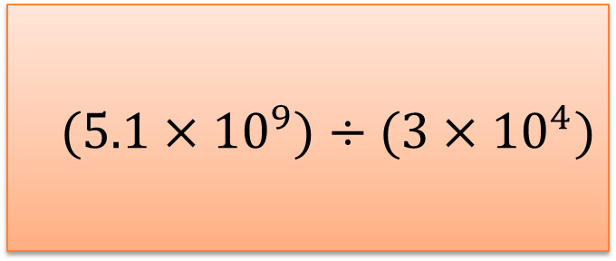

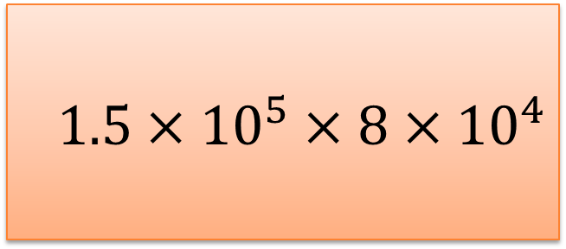

Standard Form Treasure Hunt
Standard Form Treasure Hunt
1.2$×{10}^{10}$
6$×{10}^{−8}$
Previous Answer
Previous Answer
$$(5.1×{10}^{9})÷(3×{10}^{4})$$
$$1.5×{10}^{5}×8×{10}^{4}$$
Card 15
?
Card 16
?
To the next clue
To the next clue

Slide 9


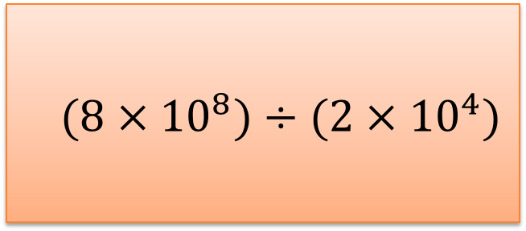

Standard Form Treasure Hunt
Standard Form Treasure Hunt
$$1.5×{10}^{4}$$
$$4×{10}^{8}$$
Previous Answer
Previous Answer
$$3×{10}^{6}×5×{10}^{4}$$
$$(8×{10}^{8})÷(2×{10}^{4})$$
Card 17
?
Card 18
?
To the next clue
To the next clue

Slide 10
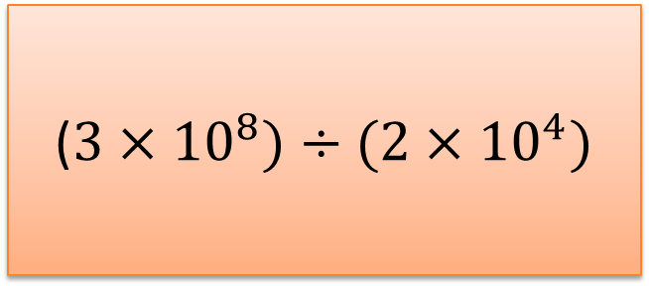



Standard Form Treasure Hunt
Standard Form Treasure Hunt
1.2$×{10}^{8}$
1.5$×{10}^{−6}$
Previous Answer
Previous Answer
($3×{10}^{8})÷(2×{10}^{4})$
$$3×{10}^{5}×5×{10}^{2}$$
Card 19
?
Card 20
?
To the next clue
To the next clue

