Slide 1
LO: Multiplying and Dividing
Algebraic Fractions
(with Factorising)

Slide 2
Before
multiplying or dividing
always see if you can
factorise
any terms.

Slide 3
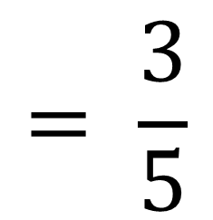
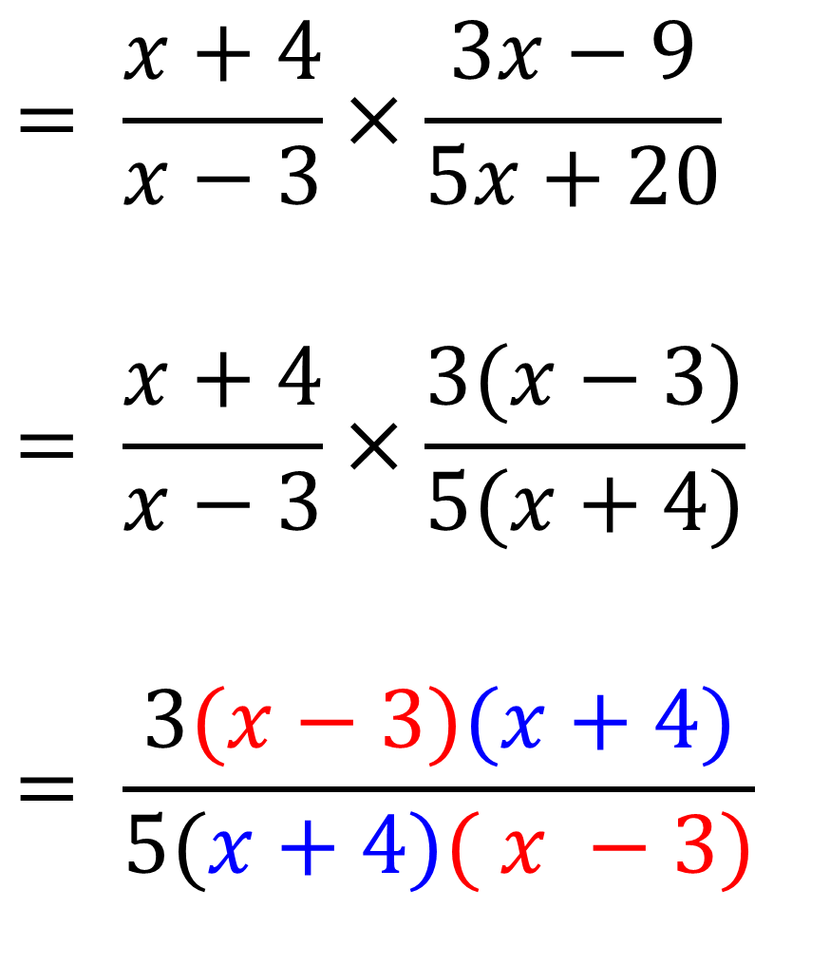
$$= \frac{x+4}{x−3}×\frac{3x−9}{5x+20}$$
$$= \frac{x+4}{x−3}×\frac{3(x−3)}{5(x+4)}$$
$$= \frac{3(x−3)(x+4)}{5(x+4)( x −3)}$$
$$= \frac{3}{5}$$

Slide 4
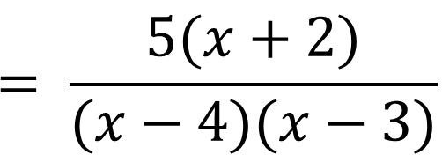
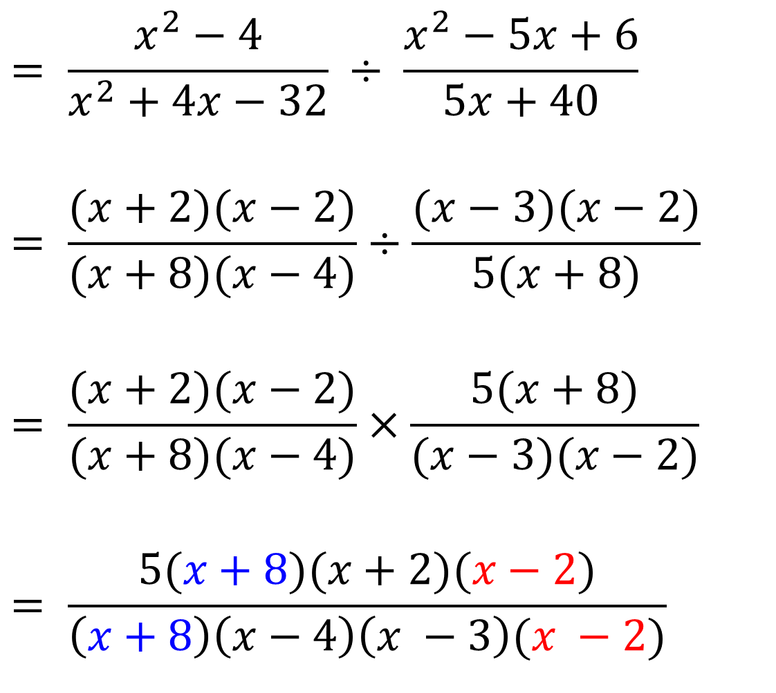
$$= \frac{x^{2}−4}{x^{2}+4x−32} ÷ \frac{x^{2}−5x+6}{5x+40}$$
$$= \frac{(x+2)(x−2)}{(x+8)(x−4)}÷\frac{(x−3)(x−2)}{5(x+8)}$$
$$= \frac{(x+2)(x−2)}{(x+8)(x−4)}×\frac{5(x+8)}{(x−3)(x−2)}$$
$$= \frac{5(x+8)(x+2)(x−2)}{\left(x+8\right)\left(x−4\right)\left(x −3\right)(x −2)}$$
$$= \frac{5(x+2)}{(x−4)(x−3)}$$

