Slide 1
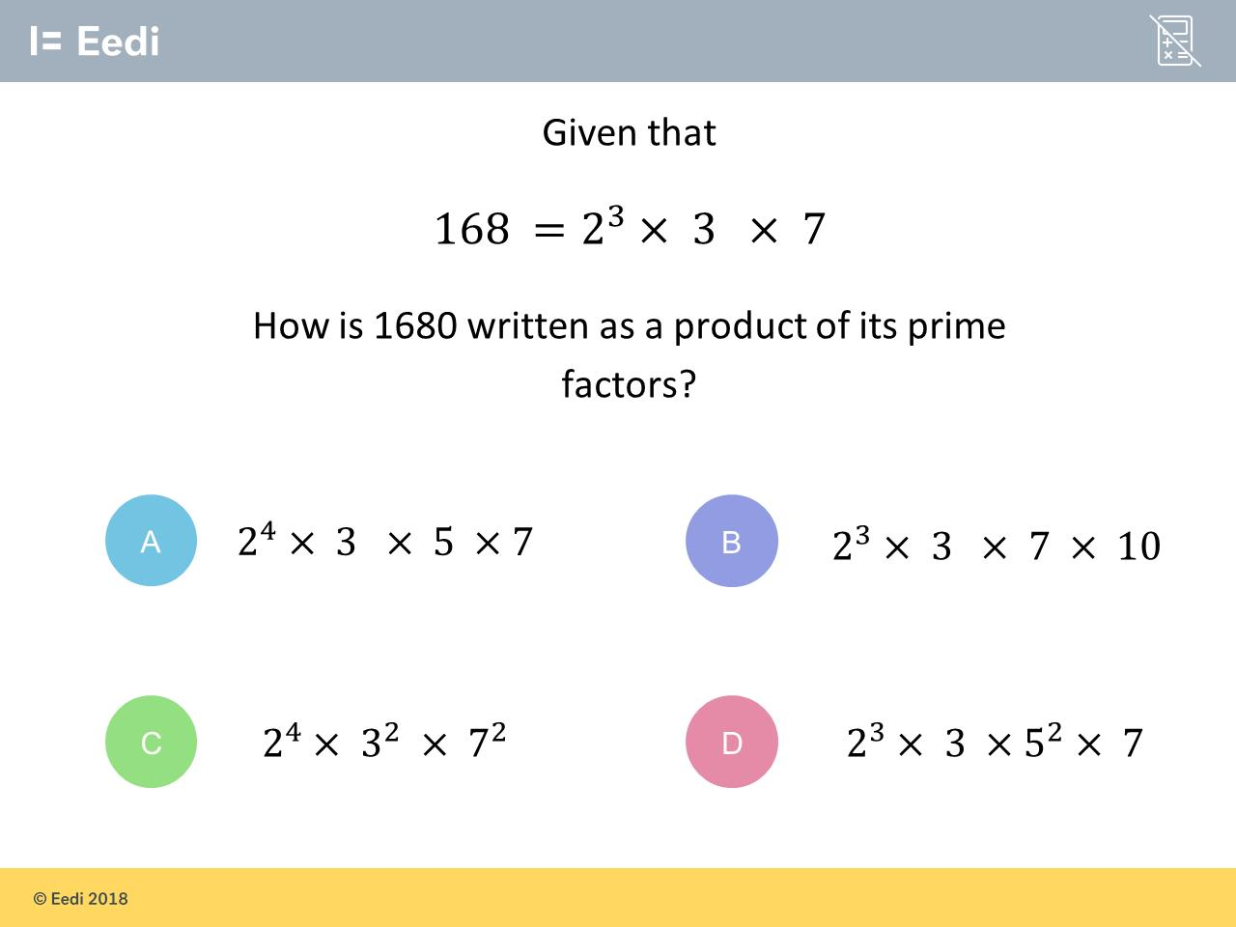
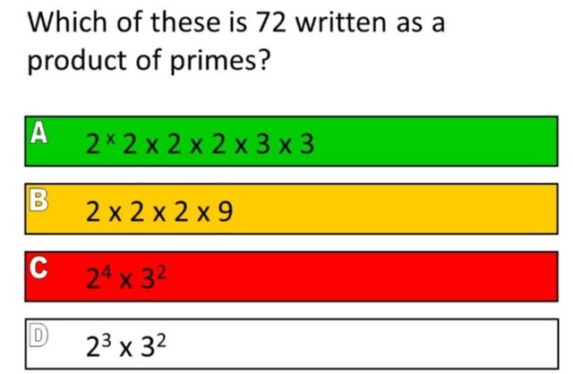
Worst answered question?
Most common wrong answer?

Slide 2
ANSWERS

Slide 3
Worst answered question?

Slide 4
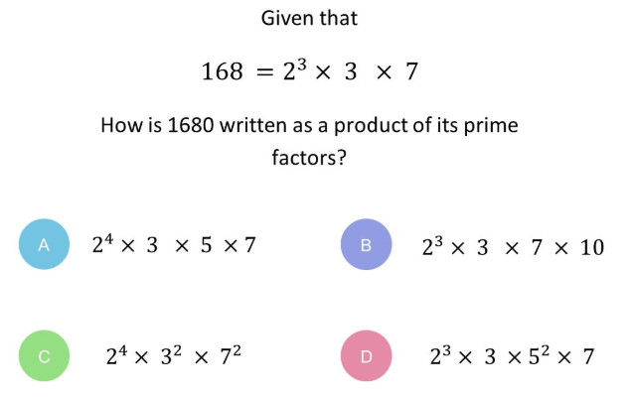
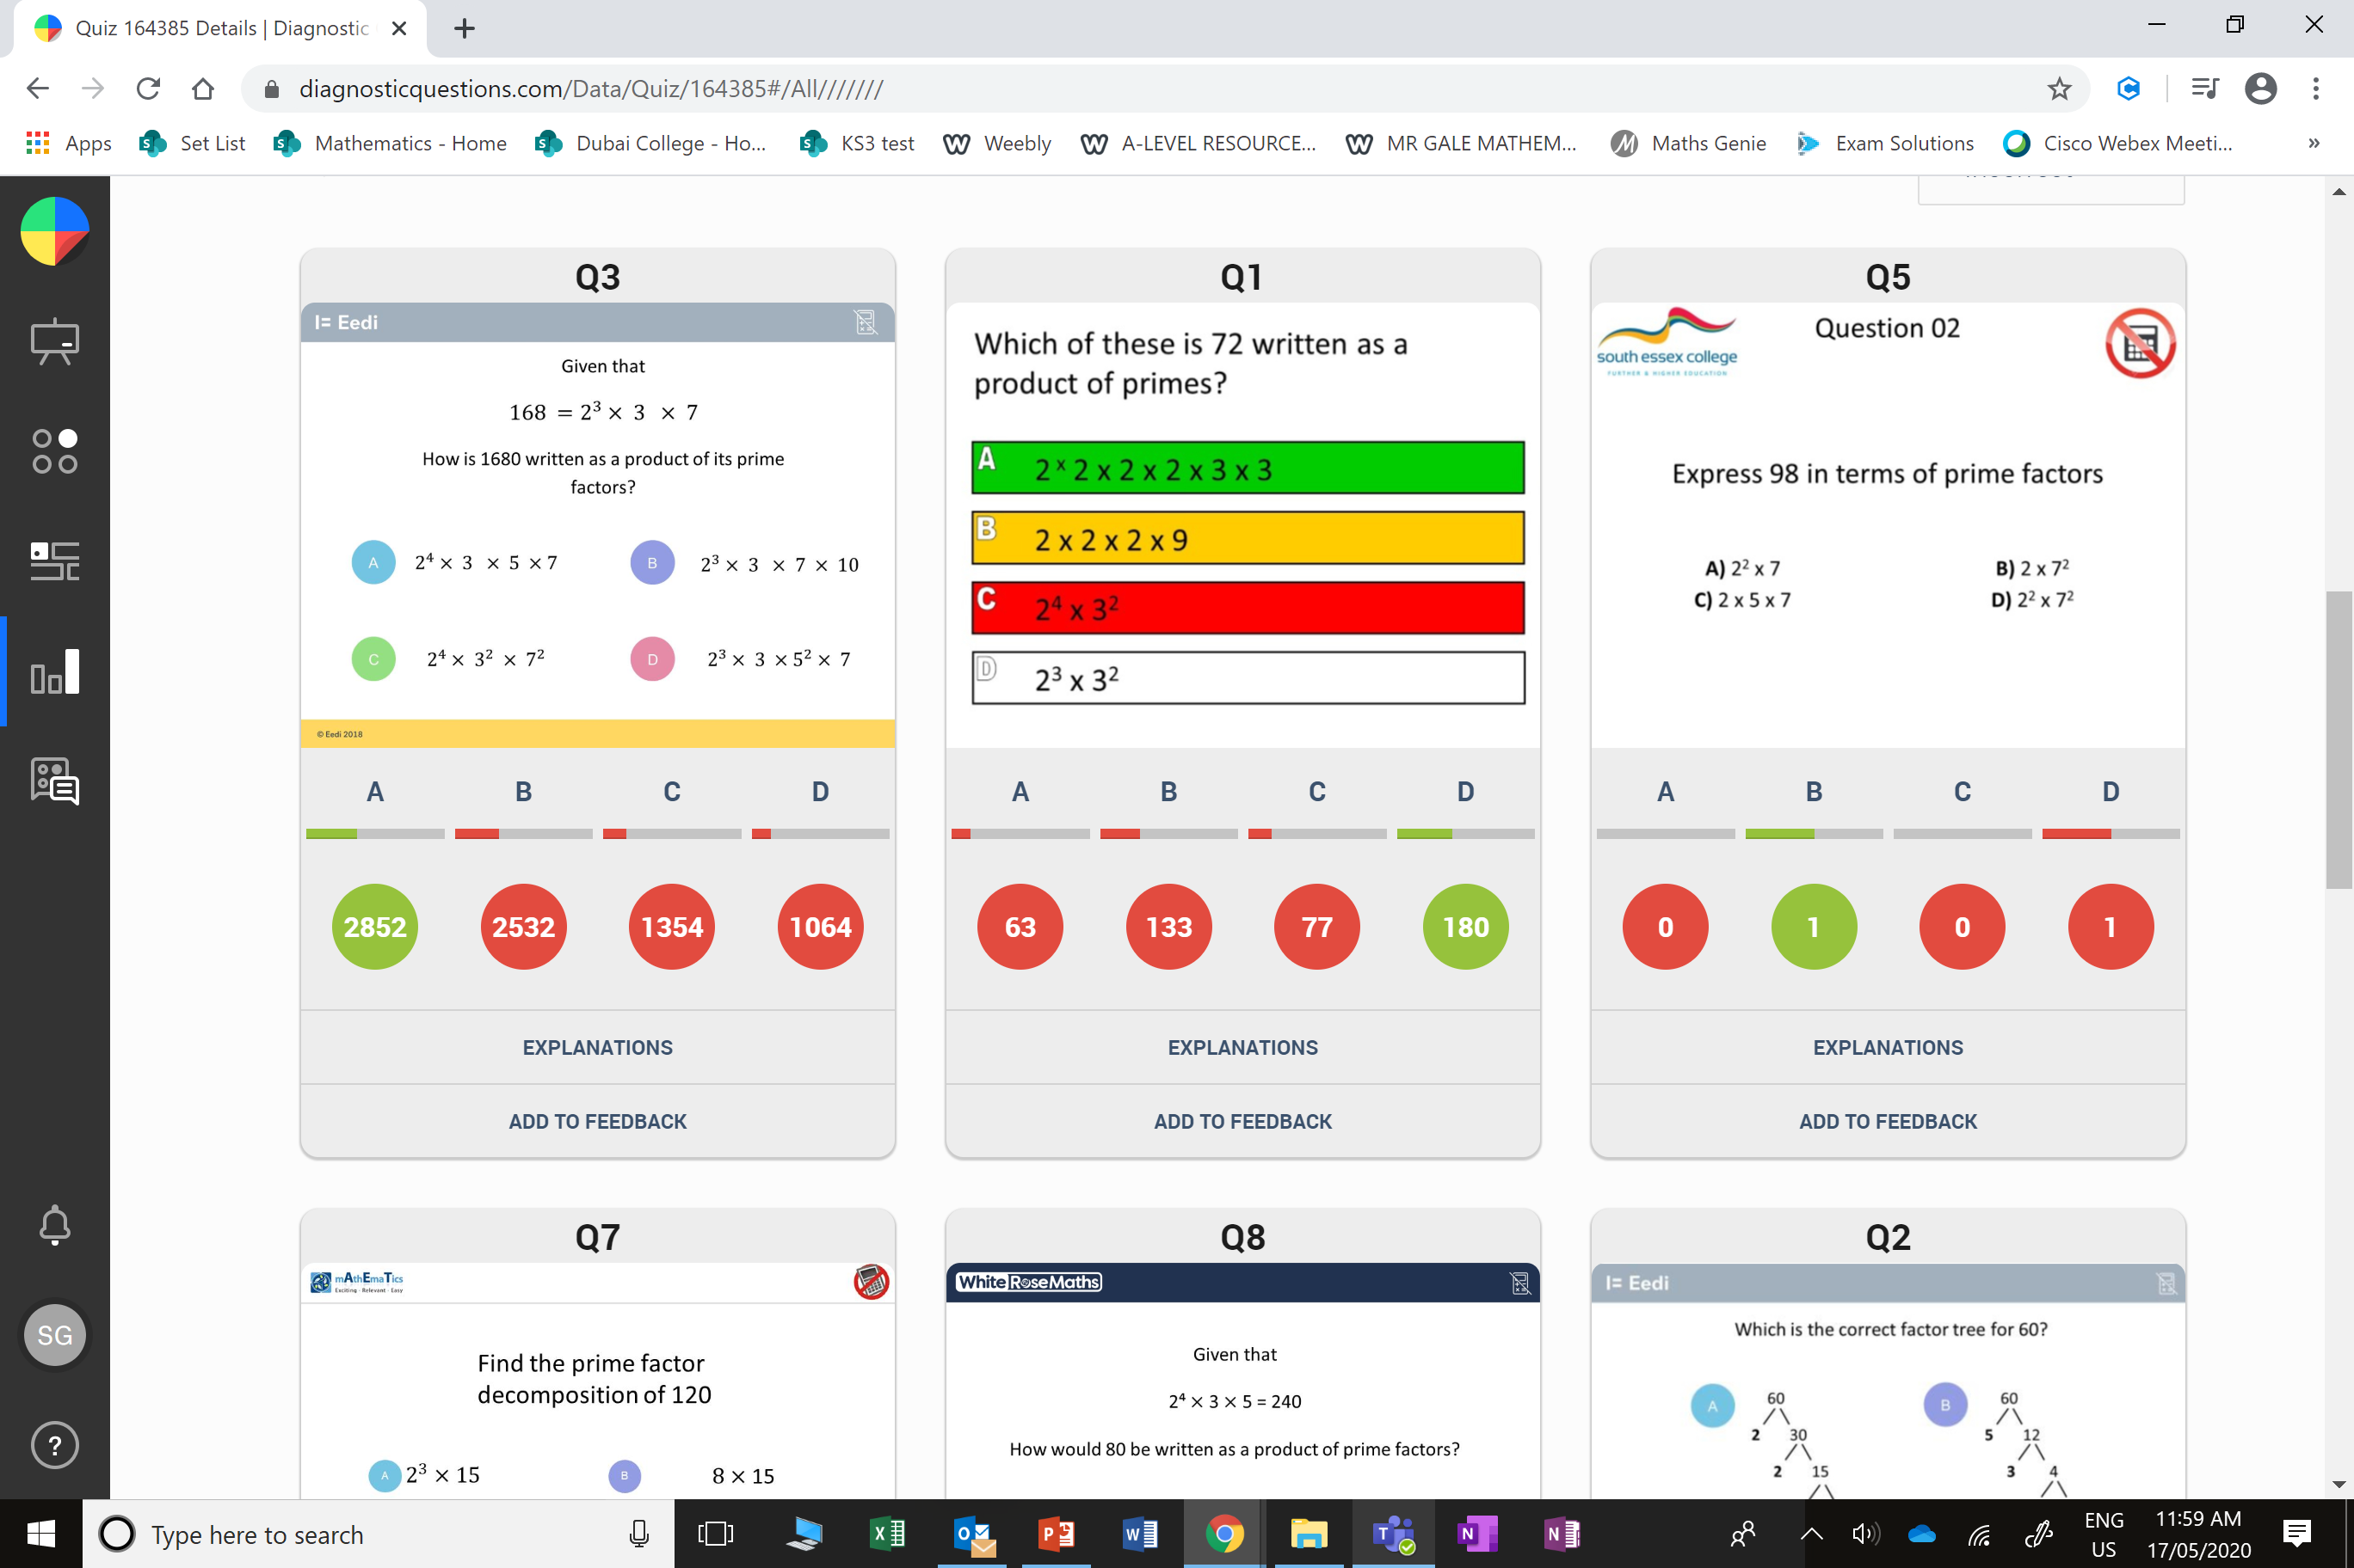
B
Very nearly! They did not split the 10 into prime number (2 x 5)

Slide 5
B
They did not
split 9 into 3 x 3.

