Slide 1
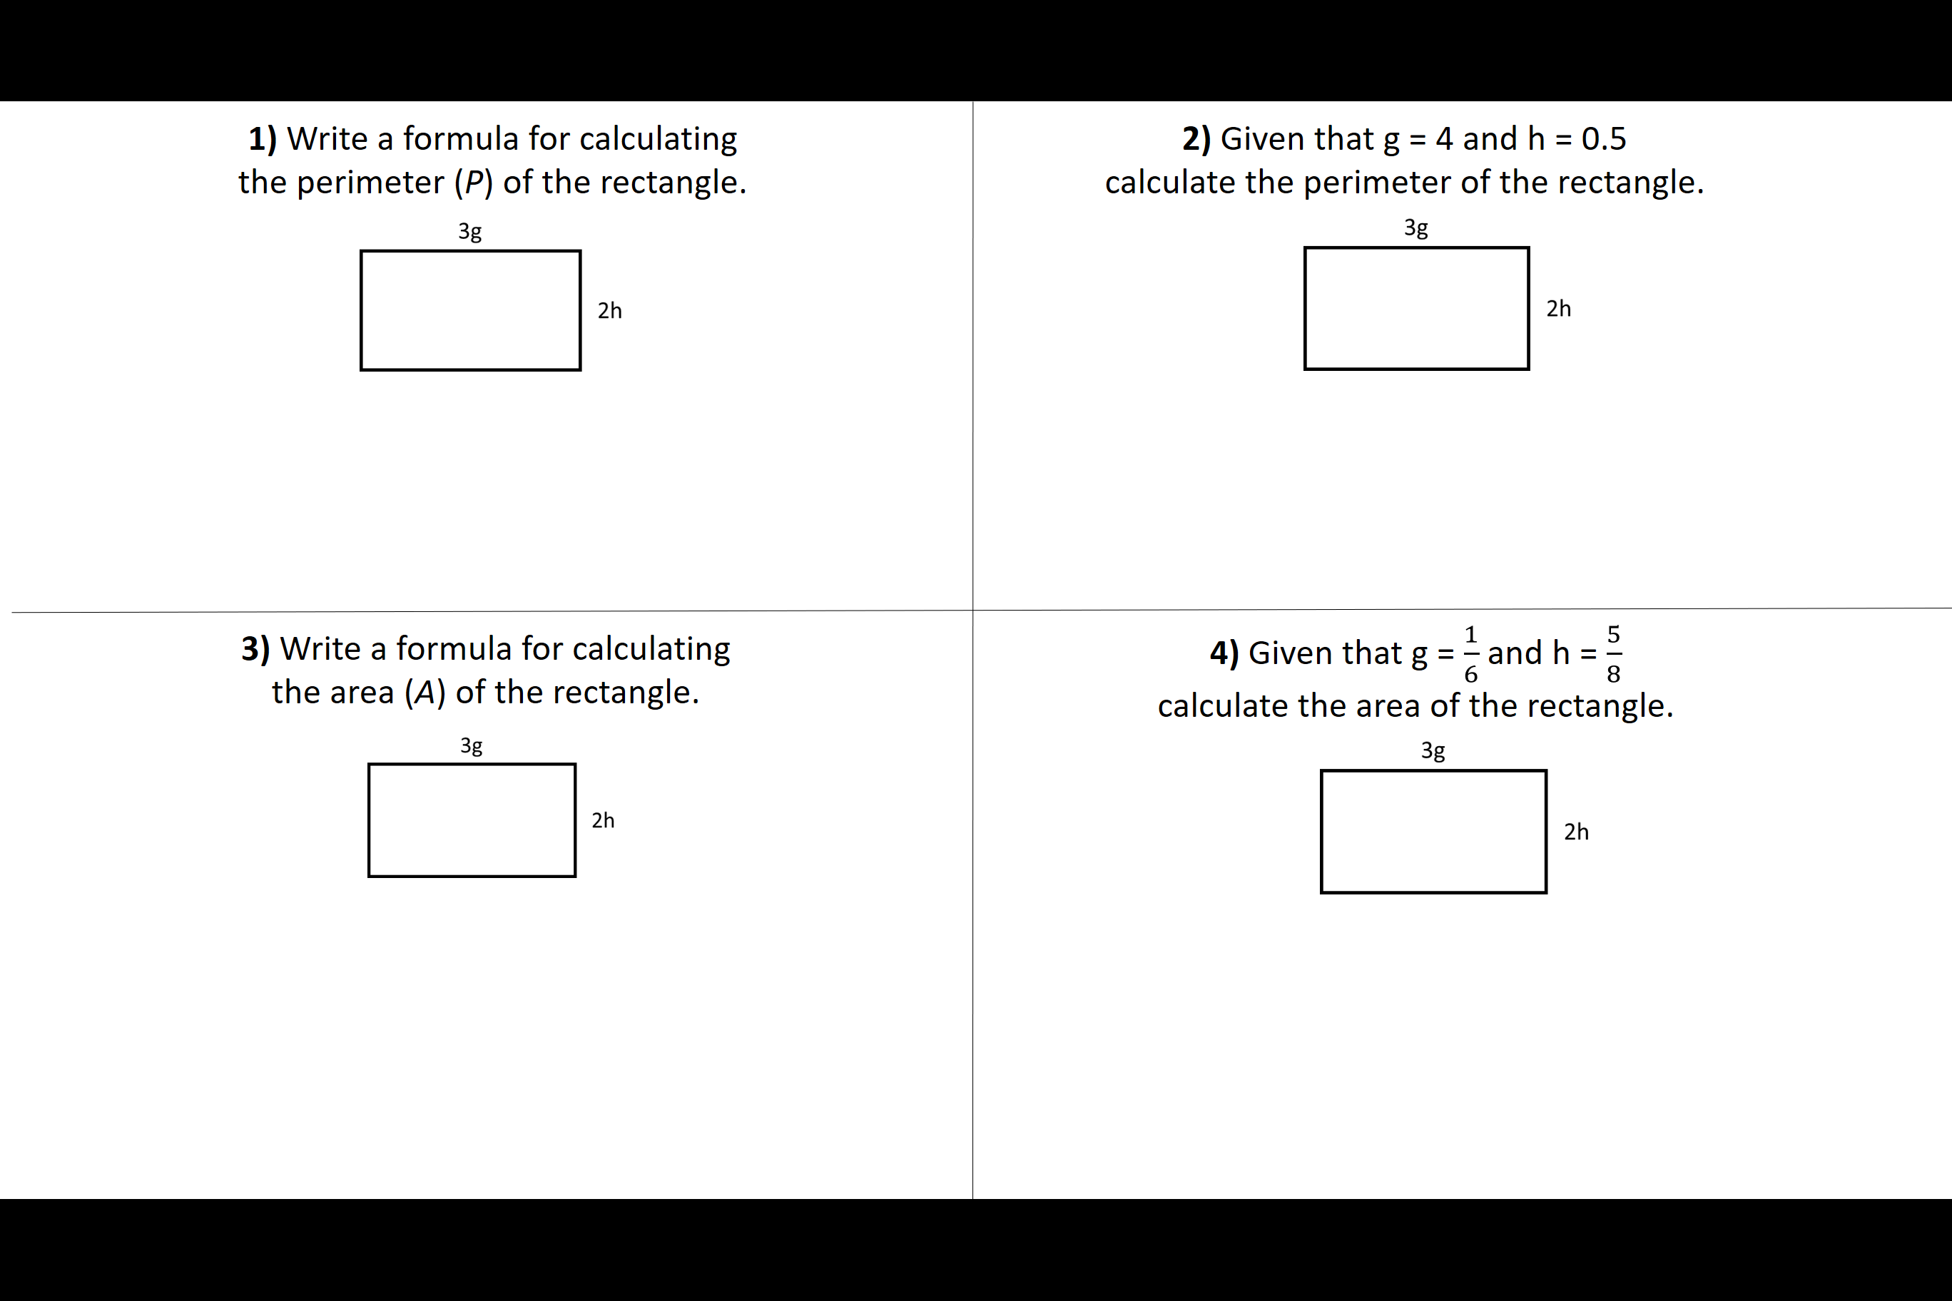

Slide 2
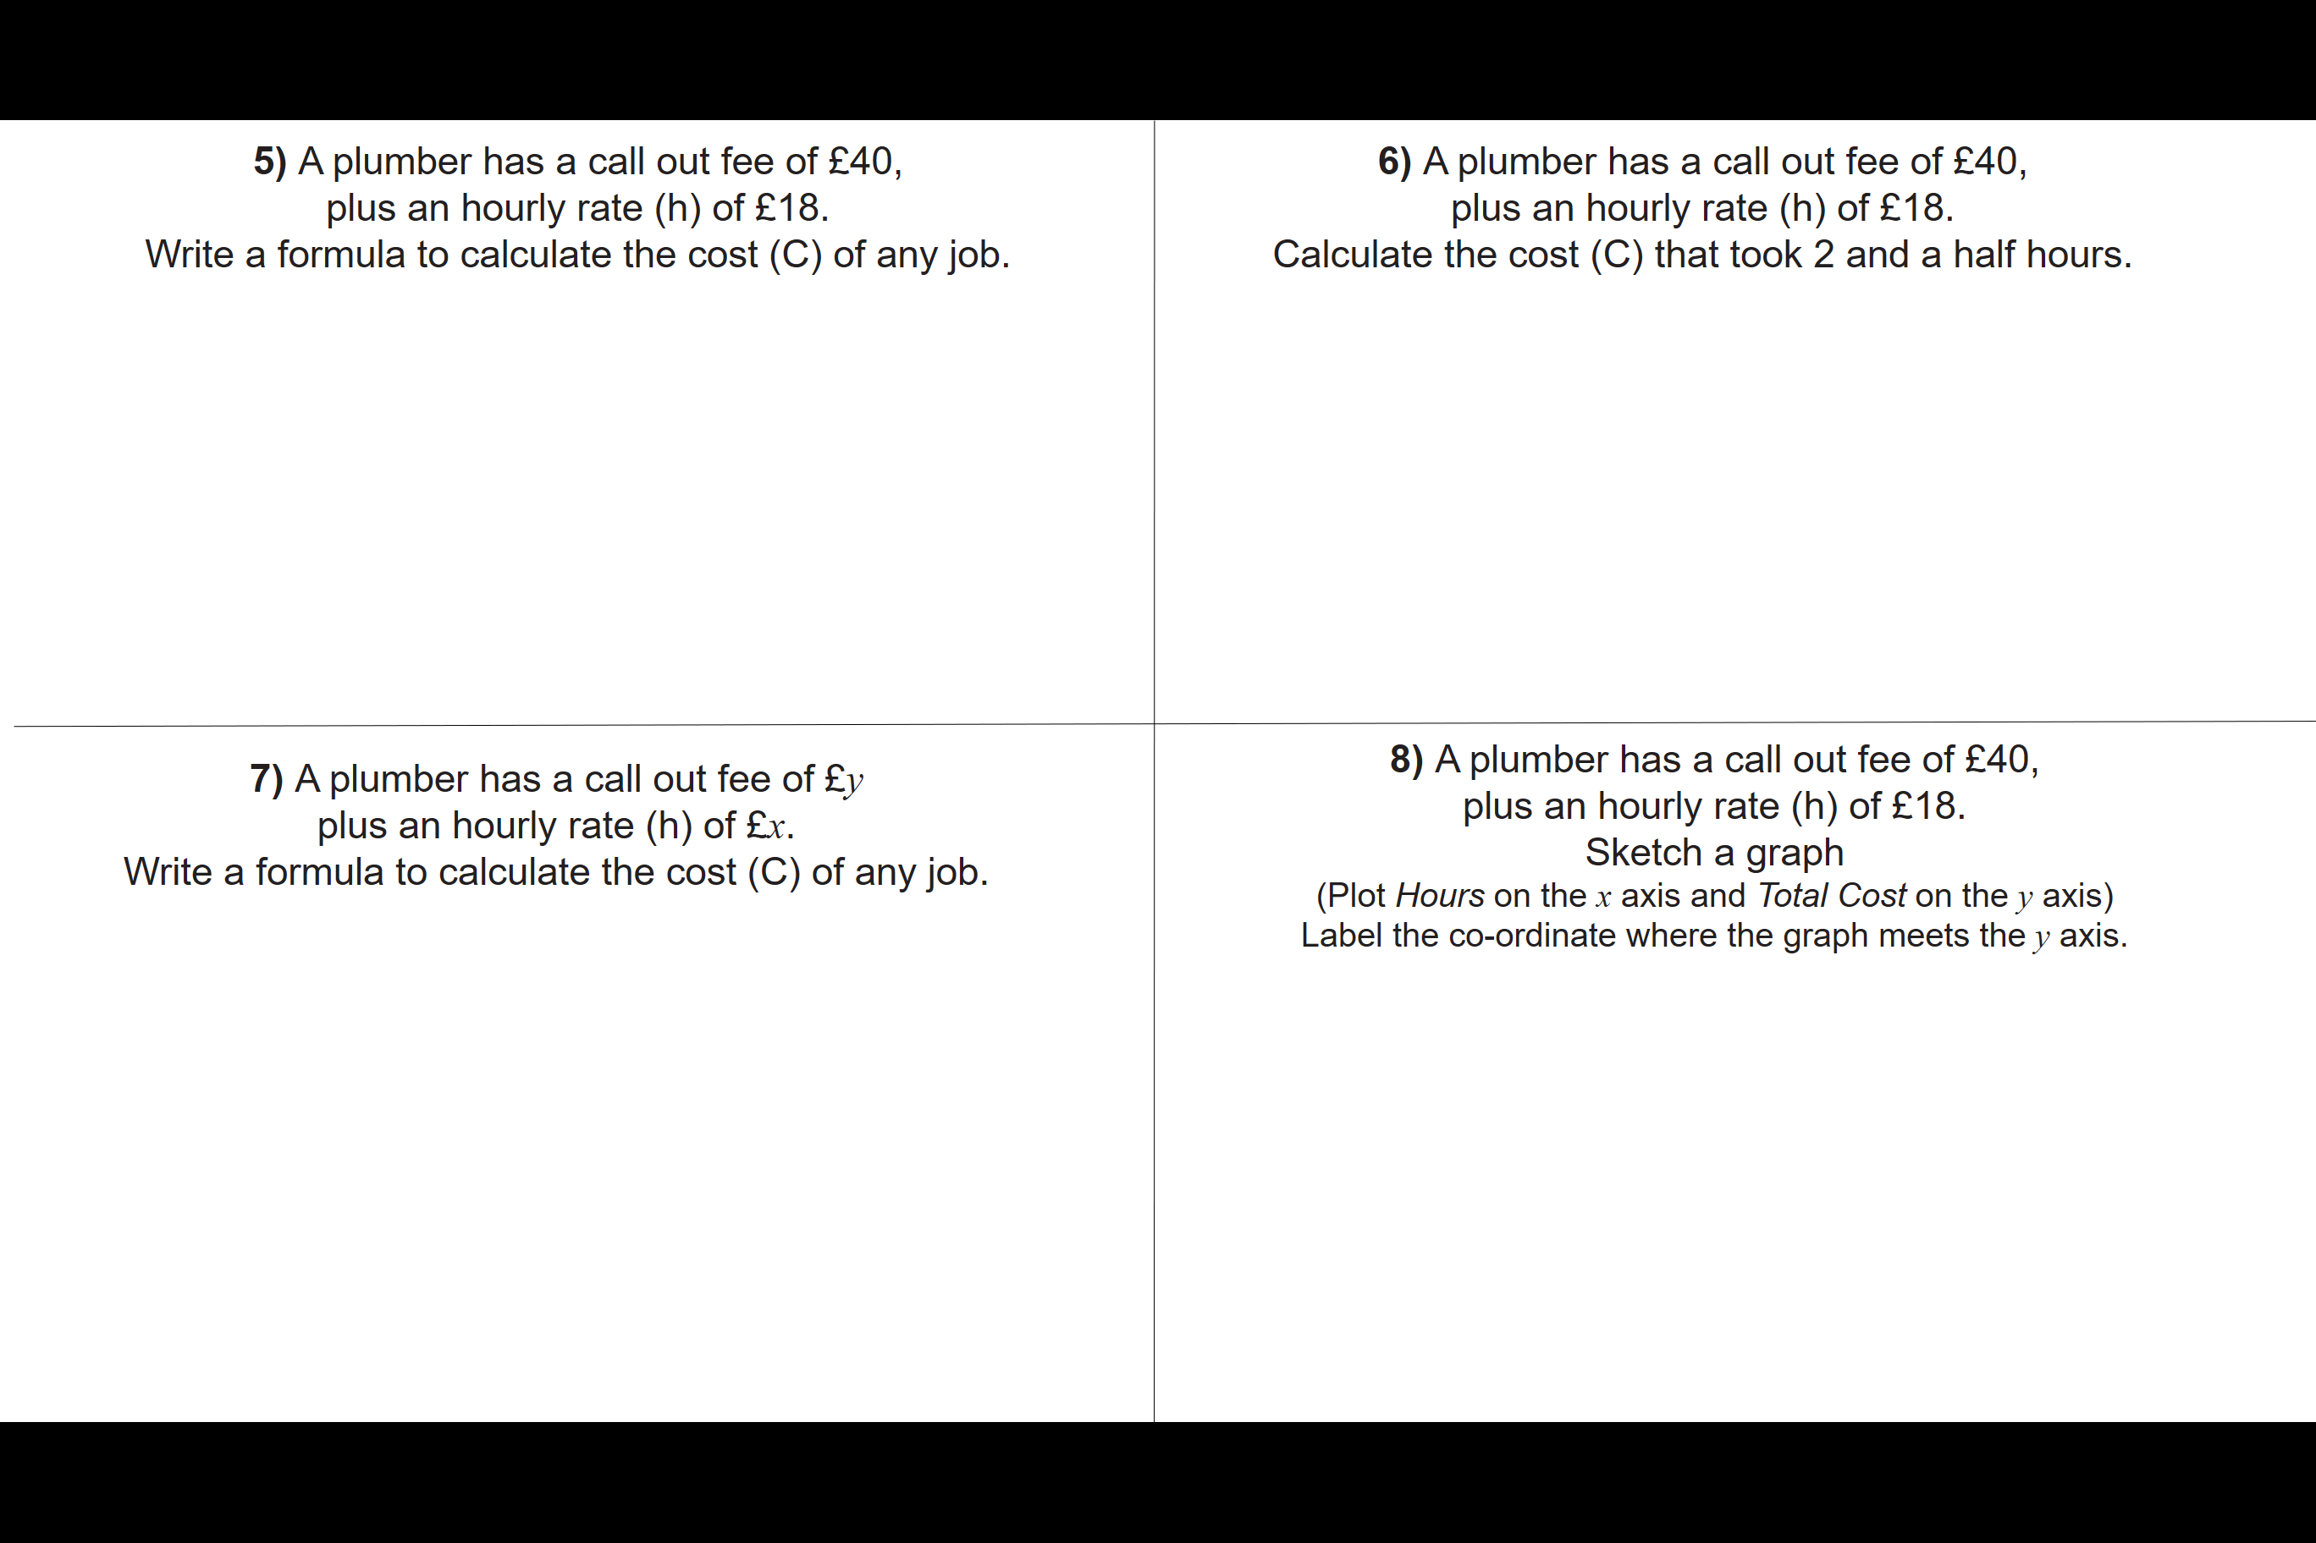

Slide 3
ANSWERS

Slide 4
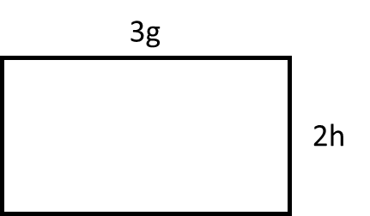
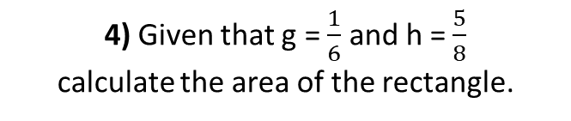
1) Write a formula for calculating
the perimeter (P) of the rectangle.
2) Given that g = 4 and h = 0.5
calculate the perimeter of the rectangle.
P = 6g + 4h
P = 2(12 + 1) = 26
3) Write a formula for calculating
the area (A) of the rectangle.
4) Given that g = $\frac{1}{6}$ and h = $\frac{5}{8}$
calculate the area of the rectangle.
A = 3g x 2h
= 6gh
A = 0.5 x 1.25
= 0.625

Slide 5
5) A plumber has a call out fee of £40,
plus an hourly rate (h) of £18.
Write a formula to calculate the cost (C) of any job.
6) A plumber has a call out fee of £40,
plus an hourly rate (h) of £18.
Calculate the cost (C) that took 2 and a half hours.
C = 18h + 40
C = 18 x 2.5 + 40
C = 85
7) A plumber has a call out fee of £y
plus an hourly rate (h) of £x.
Write a formula to calculate the cost (C) of any job.
8) A plumber has a call out fee of £40,
plus an hourly rate (h) of £18.
Sketch a graph
(Plot Hours on the x axis and Total Cost on the y axis)
Label the co-ordinate where the graph meets the y axis.
C = xh + y
(0,40)

