Slide 1
Differentiation
Tangents and Normal
Chapter 12
(Part 3 of 8)

Slide 2
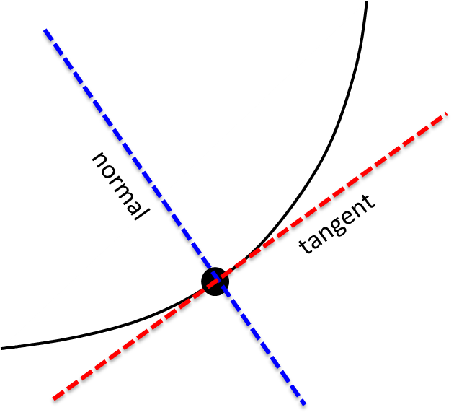
Tangents and Normals
The normal is perpendicular
to the tangent.

Slide 3
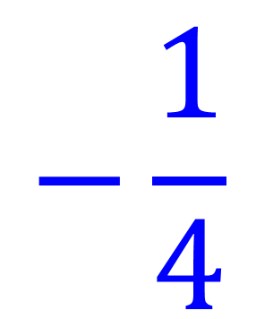
Tangent Gradient = 4
$$−\frac{1}{4}$$
Normal Gradient =

Slide 4
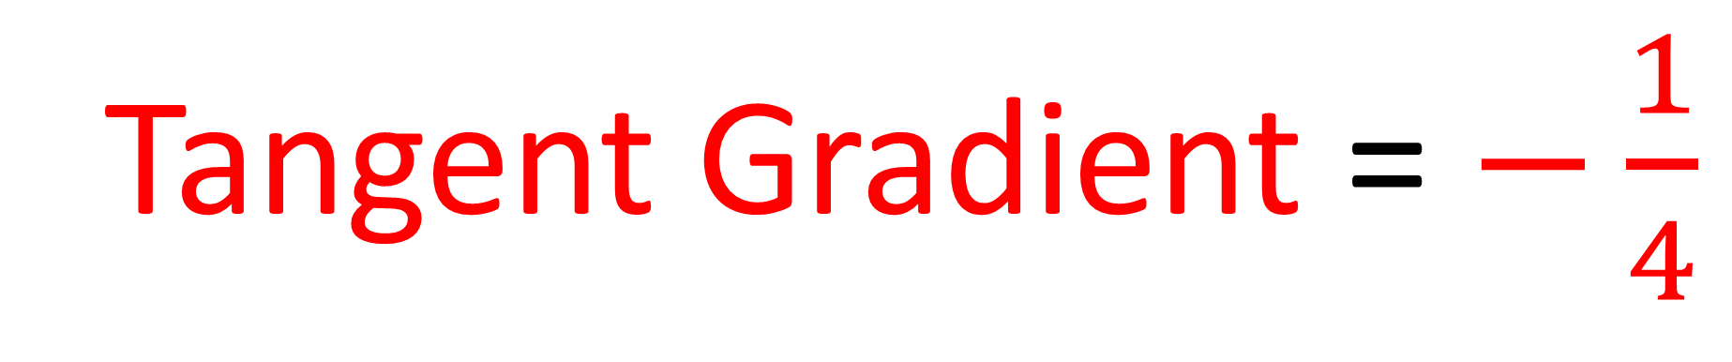
Tangent Gradient = $−\frac{1}{4}$
Normal Gradient =
4

Slide 5
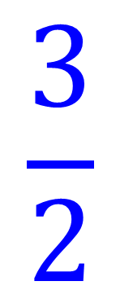
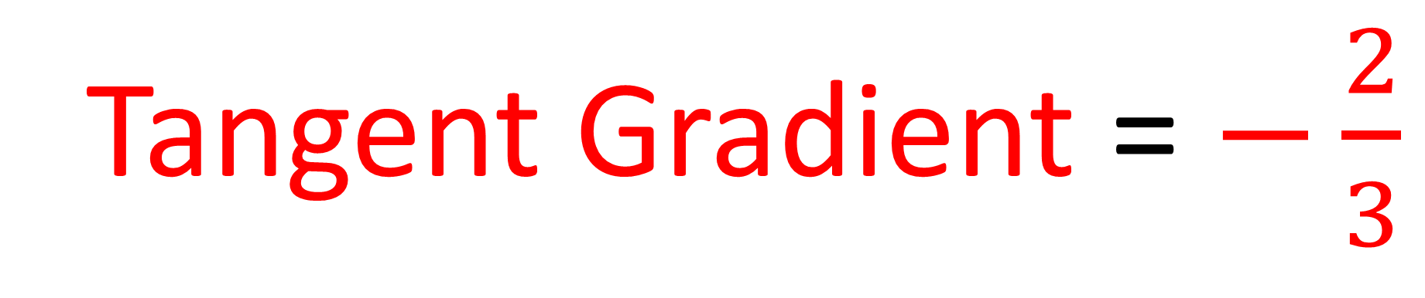
Tangent Gradient = $−\frac{2}{3}$
$$\frac{3}{2}$$
Normal Gradient =

Slide 6
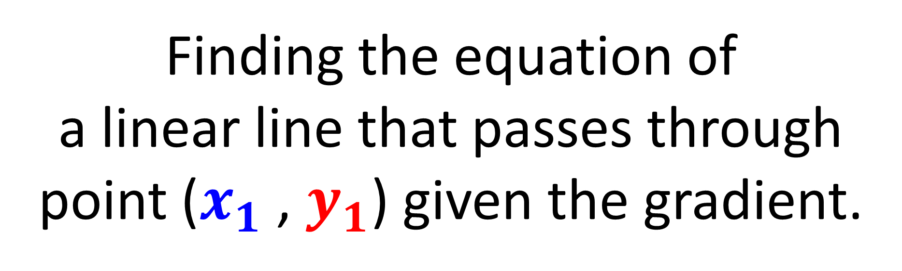
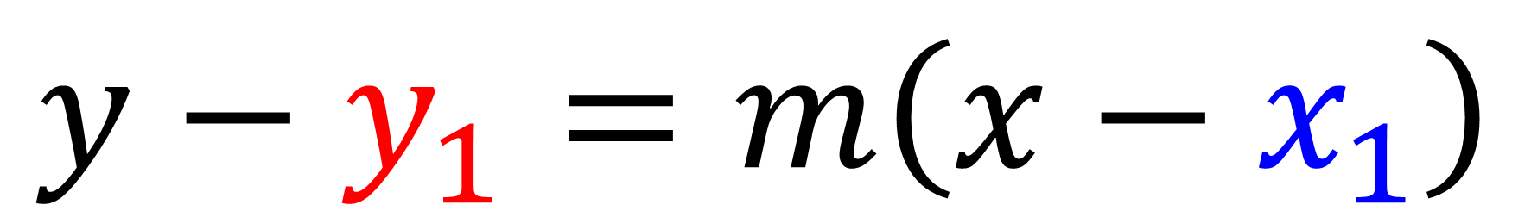
Finding the equation of
a linear line that passes through point ($x_{1}$ , $y_{1}$) given the gradient.
$y−y_{1}=m\left(x−x_{1}\right)$

Slide 7
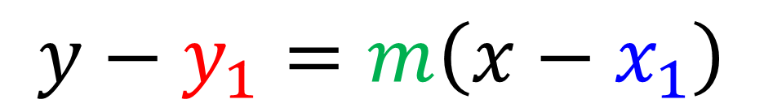
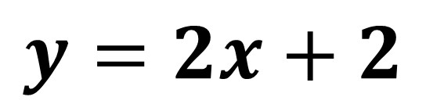
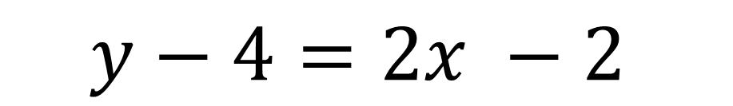
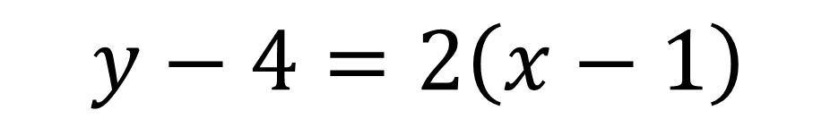
A linear graph has a gradient of 2 and passes through (1,4). Find the equation of the graph.
$y−y_{1}=m\left(x−x_{1}\right)$
$y−4=2\left(x−1\right)$
$y−4=2x −2$
$y=2x+2$

Slide 8
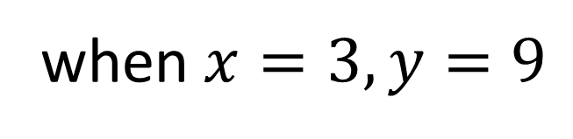
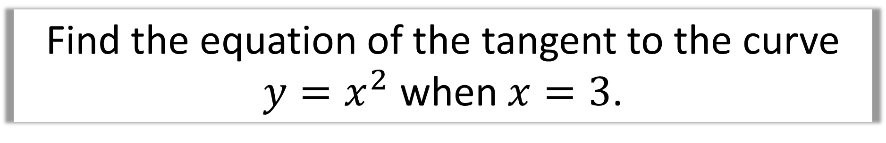
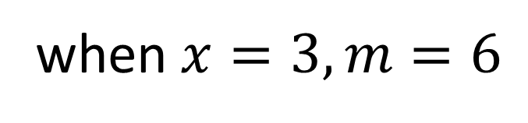
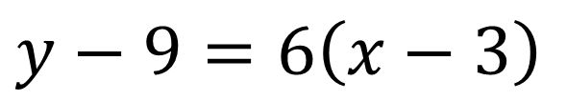

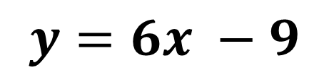


Find the equation of the tangent to the curve
$y=x^{2}$ when $x=3$.
Tangent Gradient
when $x=3, m=6$
$$\frac{dy}{dx}=2x$$
$y$-value
when $x=3,y=9$
tangent
Equation of tangent
$$(3,?)$$
$$y−9=6\left(x−3\right)$$
$$y=6x −9$$

Slide 9

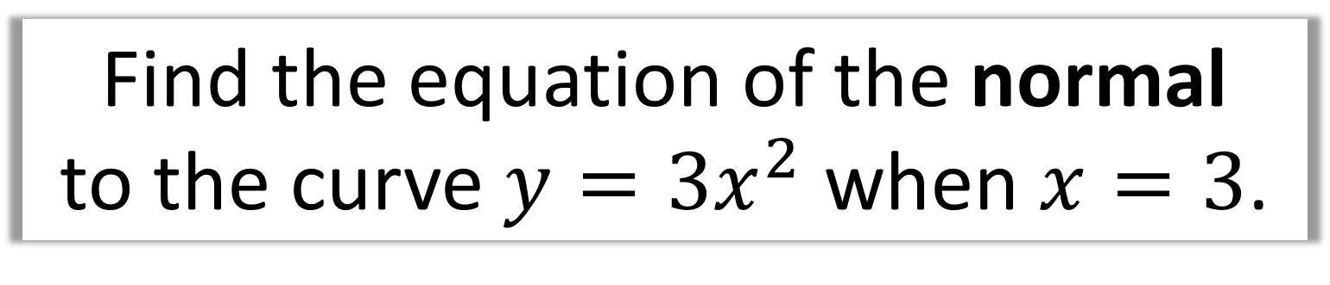
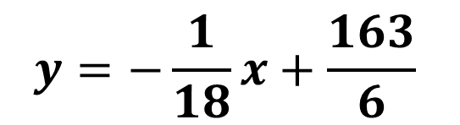
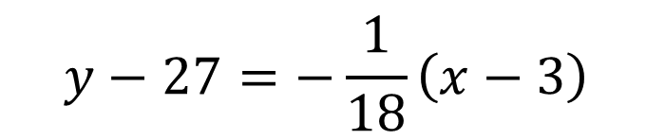
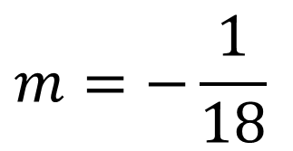


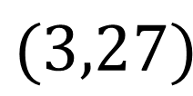
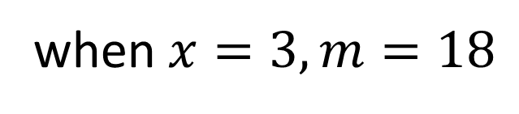
$$Tangent Gradient=$$
$$6$$
Find the equation of the normal
to the curve $y={3x}^{2}$ when $x=3$.
Tangent Gradient
when $x=3, m=18$
Normal Gradient
$$m=−\frac{1}{18}$$
normal
tangent
Normal Eqaution
$$\frac{dy}{dx}=6x$$
$$y−27=−\frac{1}{18}\left(x−3\right)$$
$$(3,27)$$
$$y=−\frac{1}{18}x+\frac{163}{6}$$

Slide 10

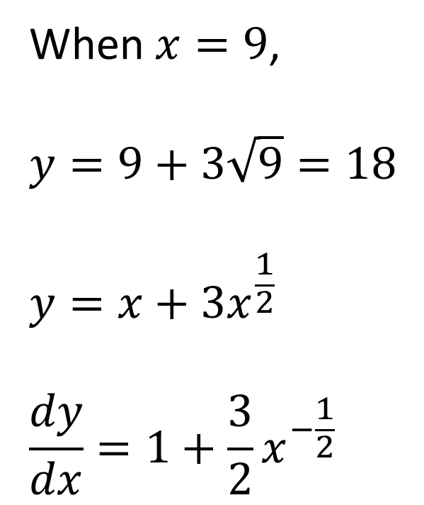

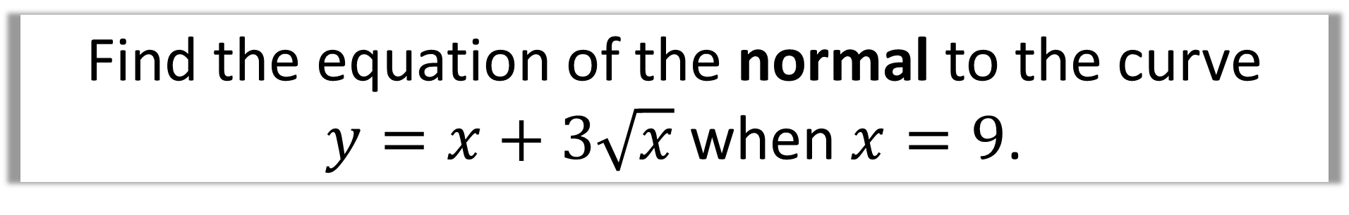
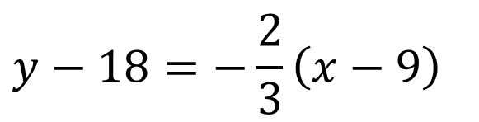
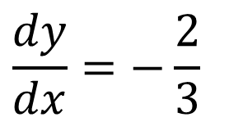
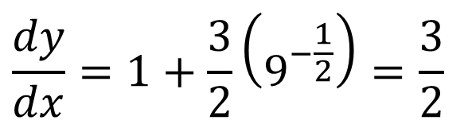
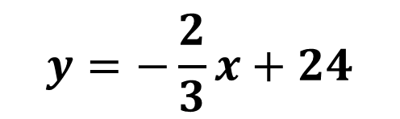
Find the equation of the normal to the curve
$y=x+3\sqrt{x}$ when $x=9$.
When $x=9$,
$$y=9+3\sqrt{9}=18$$
$$y=x+3x^{\frac{1}{2}}$$
$$\frac{dy}{dx}=1+\frac{3}{2}x^{−\frac{1}{2}}$$
Tangent Gradient when $x=9$
$$\frac{dy}{dx}=1+\frac{3}{2}\left(9^{−\frac{1}{2}}\right)=\frac{3}{2}$$
Normal Gradient when $x=9$
$$\frac{dy}{dx}=−\frac{2}{3}$$
$$y−18=−\frac{2}{3}\left(x−9\right)$$
Normal Gradient
$$y=−\frac{2}{3}x+24$$

Slide 11

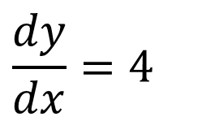
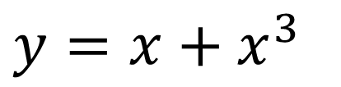
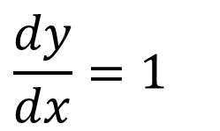

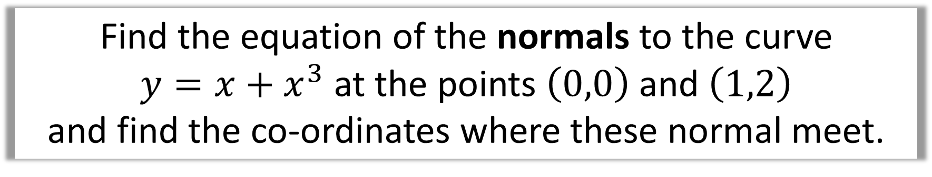
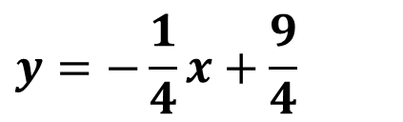
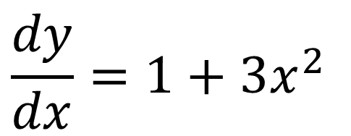
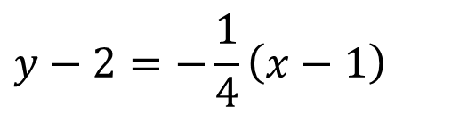

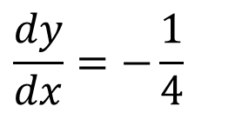
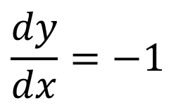



Find the equation of the normals to the curve
$y=x+x^{3}$at the points $\left(0,0\right)$ and $\left(1,2\right)$
and find the co-ordinates where these normal meet.
Tangent Gradient when $x=0$
Tangent Gradient when $x=1$
$$y=x+x^{3}$$
$$\frac{dy}{dx}=1$$
$$\frac{dy}{dx}=4$$
Normal Gradient when $x=0$
Normal Gradient when $x=0$
$$\frac{dy}{dx}=−\frac{1}{4}$$
$$\frac{dy}{dx}=1+3x^{2}$$
$$\frac{dy}{dx}=−1$$
$$y−2=−\frac{1}{4}\left(x−1\right)$$
$$y−0=−1\left(x−0\right)$$
$$y=−\frac{1}{4}x+\frac{9}{4}$$
$$y=−x$$

Slide 12
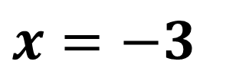
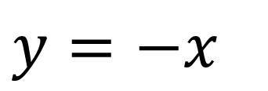
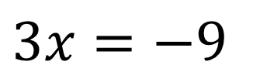
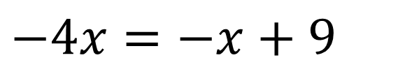
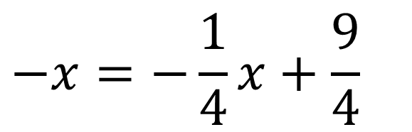
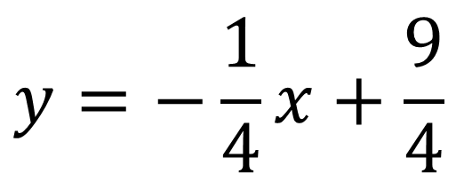
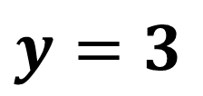
Find the equation of the normals to the curve
$y=x+x^{3}$at the points $\left(0,0\right)$ and $\left(1,2\right)$
and find the co-ordinates where these normal meet.
$$y=−x$$
$$−x=−\frac{1}{4}x+\frac{9}{4}$$
$$y=−\frac{1}{4}x+\frac{9}{4}$$
$$−4x=−x+9$$
$$3x=−9$$
$$x=−3$$
$$y=3$$

Slide 13
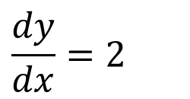
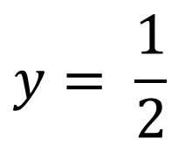
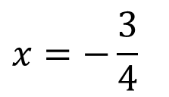














The point P with x co-ordinate $\frac{1}{2}$ lies on the curve with equation $y=2x^{2}.$ The normal to the curve at P intersects the curve at P and Q. Find the co-ordinate of Q.
Tangent Gradient when $x=\frac{1}{2}$
$$2x^{2}=−\frac{1}{2}x+\frac{3}{4}$$
$$y=2x^{2}$$
$$\frac{dy}{dx}=2$$
$$\frac{dy}{dx}=4x$$
$$8x^{2}=−2x+3$$
Normal Gradient when $x=\frac{1}{2}$
$$8x^{2}+2x−3=0$$
$$\frac{dy}{dx}=−\frac{1}{2}$$
$$x= \frac{1}{2}$$
$$x= \frac{1}{2}$$
$$x=−\frac{3}{4}$$
$$y−\frac{1}{2}=−\frac{1}{2}\left(x−\frac{1}{2}\right)$$
$$y= \frac{1}{2}$$
$$(−\frac{3}{4} , \frac{9}{8})$$
$$y=−\frac{1}{2}x+\frac{3}{4}$$

