Slide 1
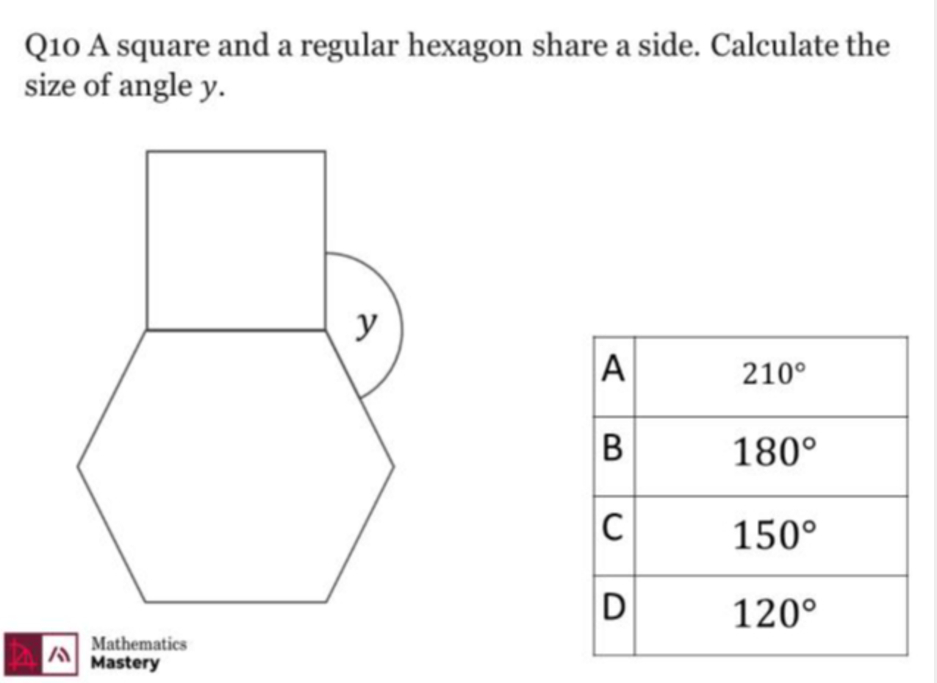
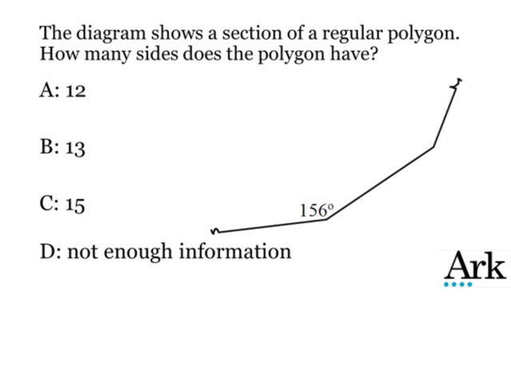
Worst answered question?
Most common wrong answer?

Slide 2
ANSWERS

Slide 3
Worst answered question?

Slide 4

D
They did not think about using the interior angle to get the exterior angle.

Slide 5

A
They found forgot to take it away from 360°.

