Slide 1
Integration
Which Method
Chapter 11
(Part 7 of 12)

Slide 2
Integrating
Which one to use?

Slide 3
Non-Trig Functions
Trig Functions
Standard Function
Reverse Chain Rule
By Parts or By Substitution
Partial Fractions
Improper Algebraic Fractions
Standard Function
Formula Sheet
Reverse Chain Rule
By Parts or By Substitution
Rewrite using Trig Identities

Slide 4
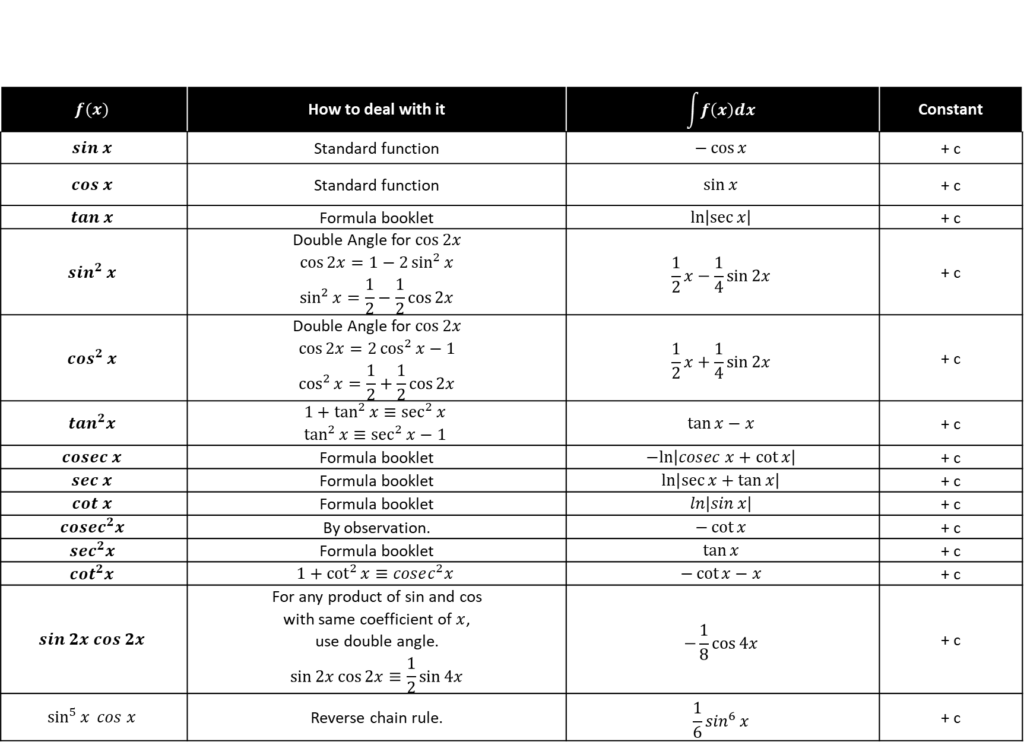
$$f(x)$$ | How to deal with it | $$\int{f\left(x\right)dx}$$ | Constant
$$sin x$$ | Standard function | $$−\cos{x}$$ | + c
$$cos x$$ | Standard function | $$\sin{x}$$ | + c
$$tan x$$ | Formula booklet | $$\ln\left|\sec{x}\right|$$ | + c
$$sin^{2} x$$ | Double Angle for $\cos{2x}$ $$\cos{2x}=1−2\sin^{2}{x} \\ \sin^{2}{x}=\frac{1}{2}−\frac{1}{2}\cos{2x}$$ | $$\frac{1}{2}x−\frac{1}{4}\sin{2x}$$ | + c
$$cos^{2} x$$ | Double Angle for $\cos{2x}$ $$\cos{2x}=2\cos^{2}{x}−1 \\ \cos^{2}{x}=\frac{1}{2}+\frac{1}{2}\cos{2x}$$ | $$\frac{1}{2}x+\frac{1}{4}\sin{2x}$$ | + c
$$tan^{2}x$$ | $$1+\tan^{2}{x}≡\sec^{2}{x} \\ \tan^{2}{x}≡\sec^{2}{x}−1$$ | $$\tan{x}−x$$ | + c
$$cosec x$$ | Formula booklet | $$−ln\left|cosec x+\cot{x}\right|$$ | + c
$$sec x$$ | Formula booklet | $$\ln\left|\sec{x}+\tan{x}\right|$$ | + c
$$cot x$$ | Formula booklet | $$\ln\left|\sin{x}\right|$$ | + c
$$cosec^{2}x$$ | By observation. | $$−\cot{x}$$ | + c
$$sec^{2}x$$ | Formula booklet | $$\tan{x}$$ | + c
$$cot^{2}x$$ | $$1+\cot^{2}{x}≡cosec^{2}x$$ | $$−\cot{x}−x$$ | + c
$$sin 2x cos 2x$$ | For any product of sin and cos with same coefficient of $x$, use double angle. $$\sin{2x}\cos{2x}≡\frac{1}{2}\sin{4x}$$ | $$−\frac{1}{8}\cos{4x}$$ | + c
$$\sin^{5}{x} cos x$$ | Reverse chain rule. | $$\frac{1}{6}\sin^{6}{x}$$ | + c

Slide 5
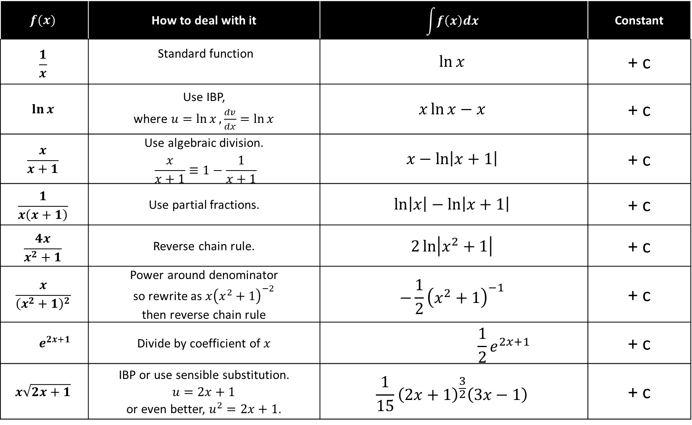
$$f(x)$$ | How to deal with it | $$\int{f\left(x\right)dx}$$ | Constant
$$\frac{1}{x}$$ | Standard function | $$\ln{x}$$ | + c
$$\ln{x}$$ | Use IBP, where $u=\ln{x},\frac{dv}{dx}=\ln{x}$ | $$x\ln{x}−x$$ | + c
$$\frac{x}{x+1}$$ | Use algebraic division. $$\frac{x}{x+1}≡1−\frac{1}{x+1}$$ | $$x−\ln\left|x+1\right|$$ | + c
$$\frac{1}{x\left(x+1\right)}$$ | Use partial fractions. | $$\ln\left|x\right|−\ln\left|x+1\right|$$ | + c
$$\frac{4x}{x^{2}+1}$$ | Reverse chain rule. | $$2\ln\left|x^{2}+1\right|$$ | + c
$$\frac{x}{{\left(x^{2}+1\right)}^{2}}$$ | Power around denominator so rewrite as $x{\left(x^{2}+1\right)}^{−2}$ then reverse chain rule | $$−\frac{1}{2}{\left(x^{2}+1\right)}^{−1}$$ | + c
$$e^{2x+1}$$ | Divide by coefficient of $x$ | $$\frac{1}{2}e^{2x+1}$$ | + c
$$x\sqrt{2x+1}$$ | IBP or use sensible substitution. $u=2x+1$ or even better, $u^{2}=2x+1$. | $$\frac{1}{15}{\left(2x+1\right)}^{\frac{3}{2}}\left(3x−1\right)$$ | + c

