Slide 1
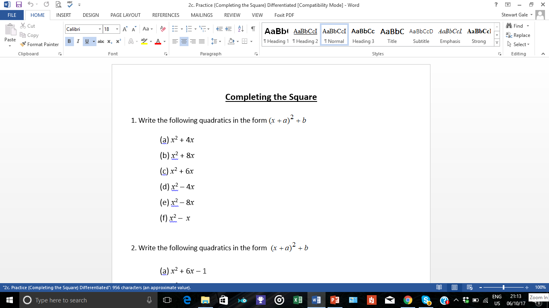
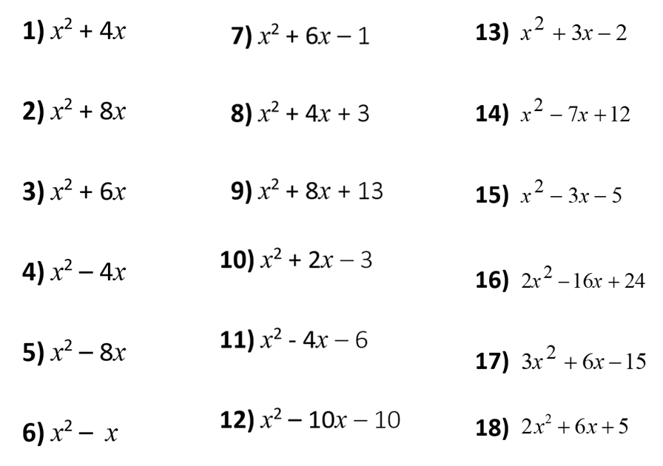

Slide 2
ANSWERS

Slide 3
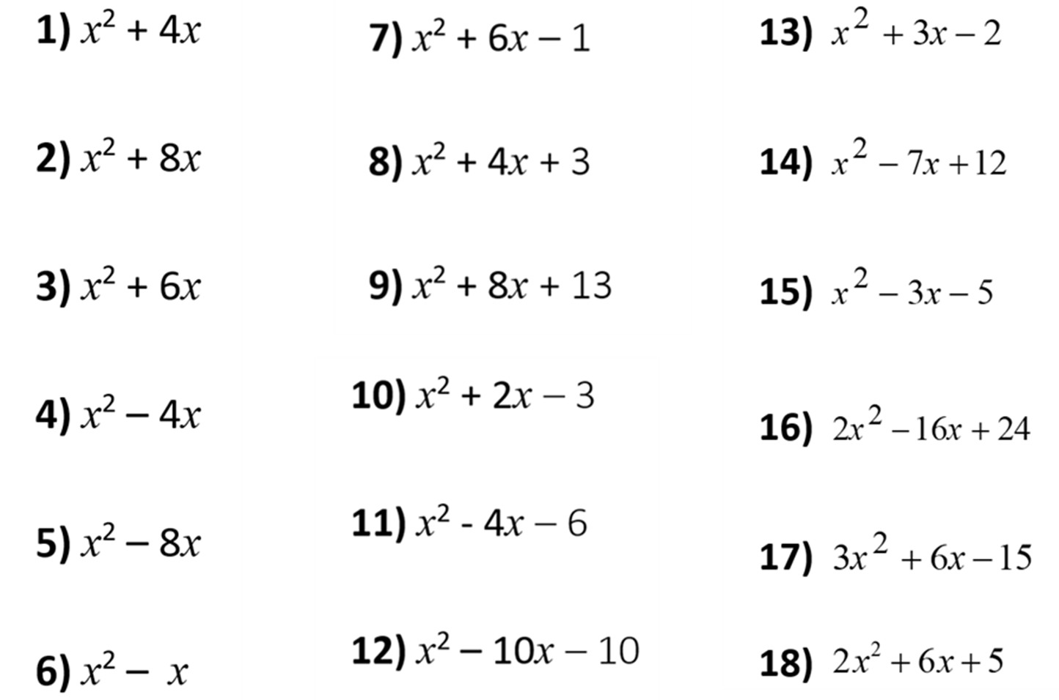

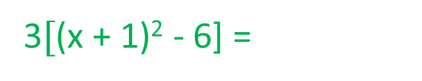
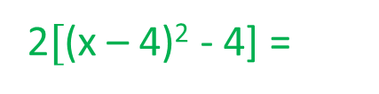
(x + 2)² – 4
(x + 3)² – 10
(x + 1.5)² – 4.25
(x + 4)² – 16
(x + 2)² – 1
(x – 3.5)² – 0.25
(x + 3)² – 9
(x + 4)² – 3
(x - 1.5)² – 7.25
(x – 2)² – 4
(x + 1)² – 4
2$[$(x – 4)² - 4] =
2(x – 4)² - 8
(x - 2)² – 10
(x – 4)² – 16
3(x + 1)² - 18
3$[$(x + 1)² - 6] =
(x – 0.5)² – 0.25
(x - 5)² – 35
2$[$(x + 1.5)² + 0.25] =
2(x + 1.5)² + 0.5

