Slide 1
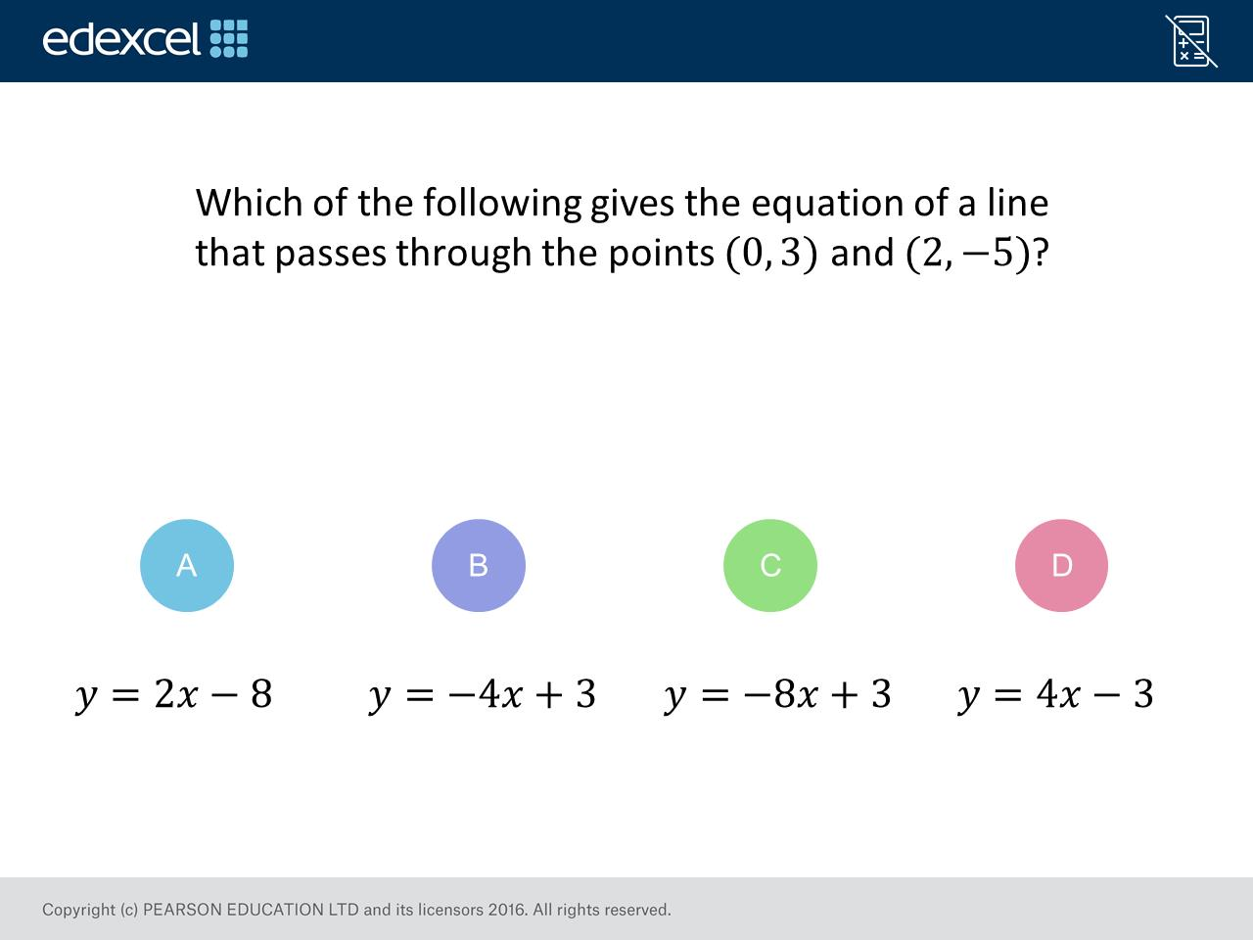
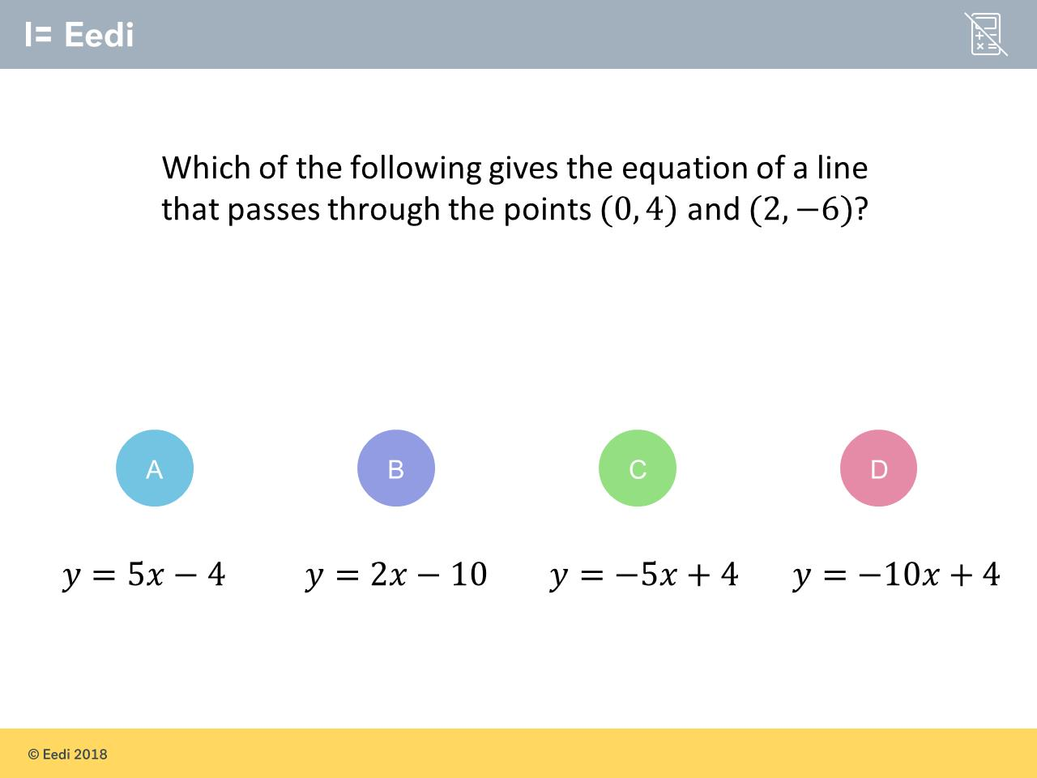
Worst answered question?
Most common wrong answer?

Slide 2
ANSWERS

Slide 3
Worst answered question?

Slide 4
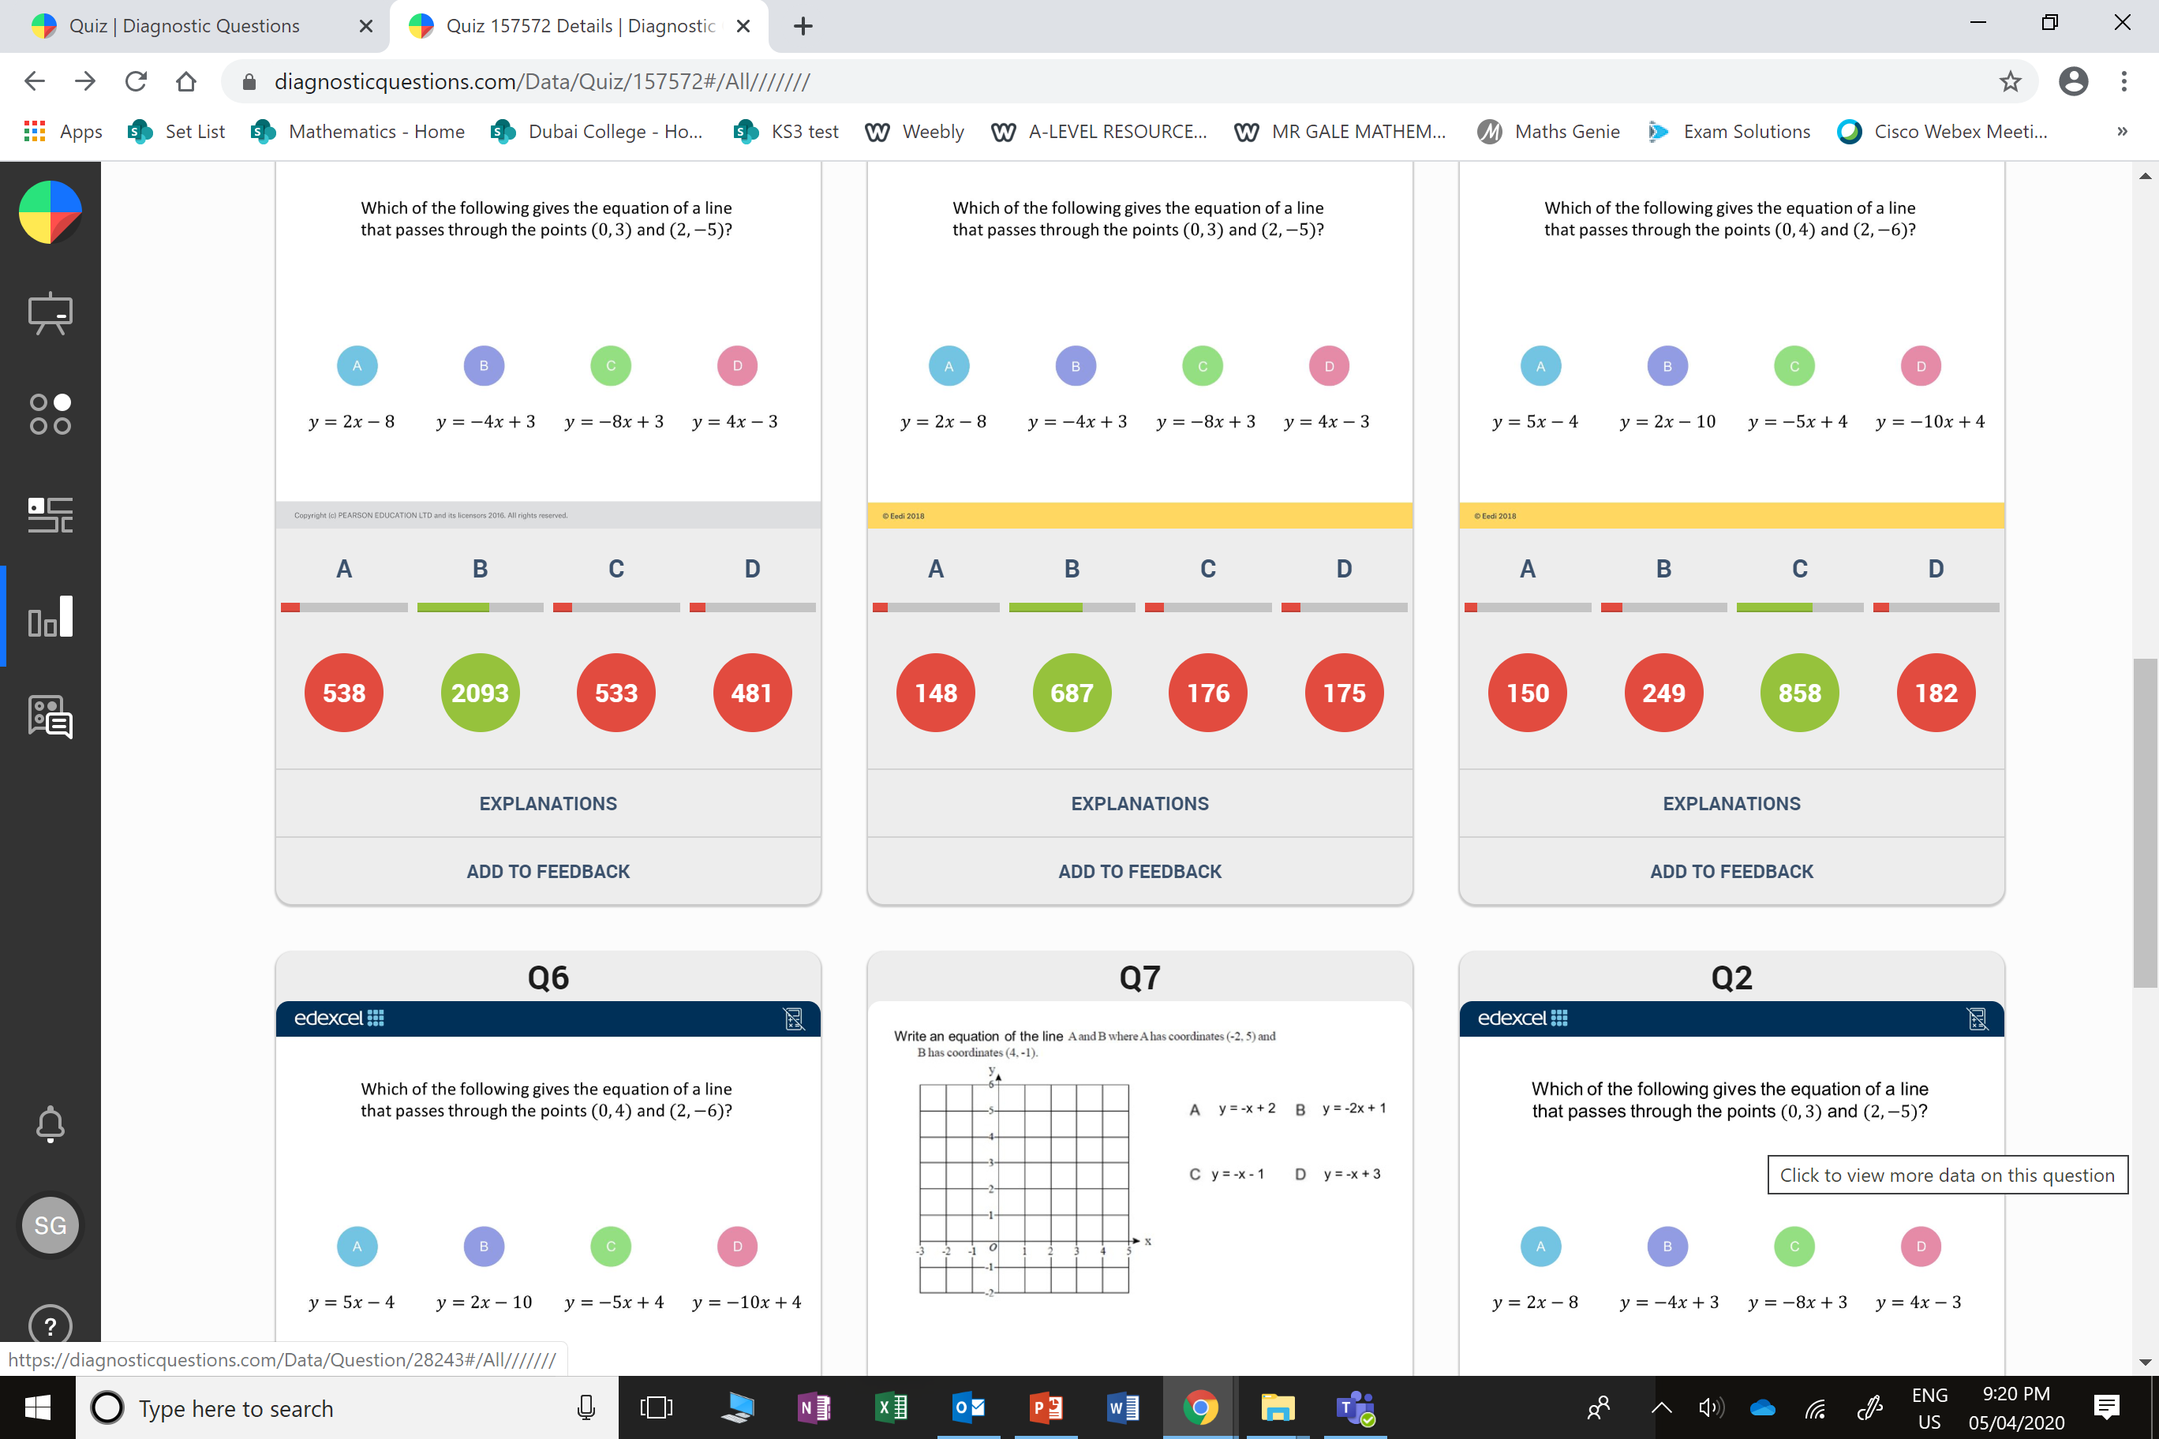
A
The student has incorrectly thought that the change in the 𝑦 values is the 𝑦 intercept

Slide 5
C
The gradient between
the two points is
(-6 -4)/(2- 0) = -10/2 = -5 and the y intercept is 4. This makes the equation of the line y = -5x + 4.

