Slide 1
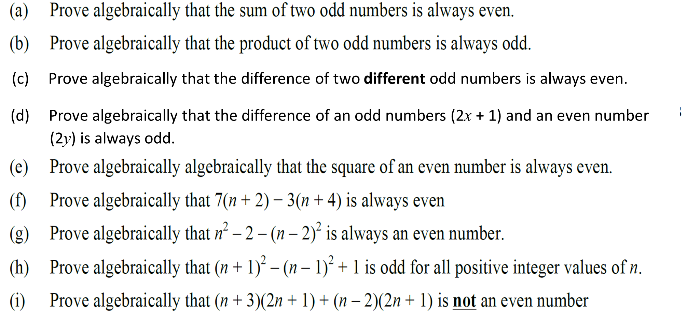
Proofs (ODD and EVENS)

Slide 2
ANSWERS

Slide 3
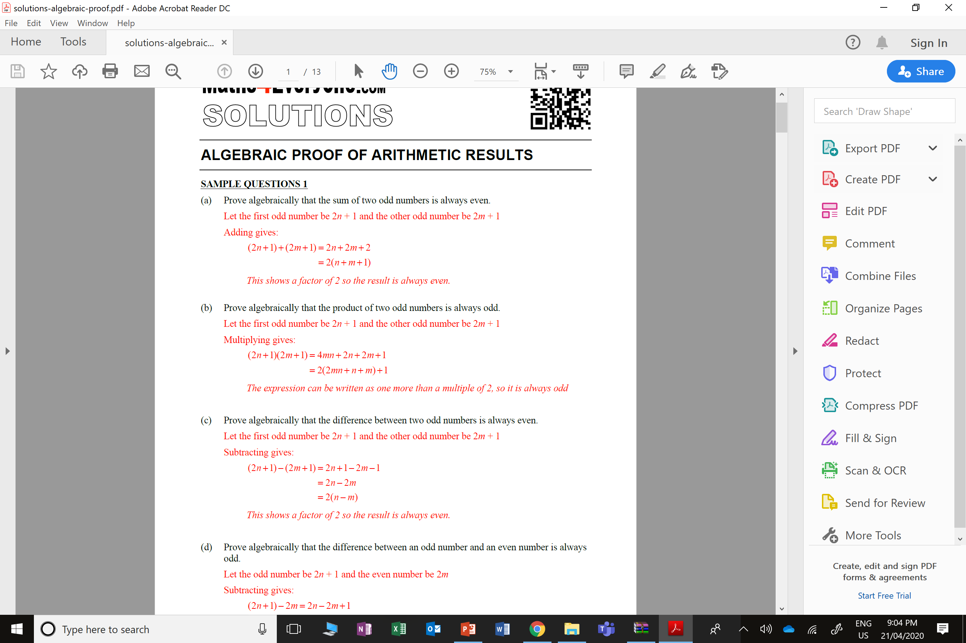
(2x + 1) + (2x + 1) = 4x + 2
= 2(2x +1)
Multiple of 2 so is always an even

Slide 4
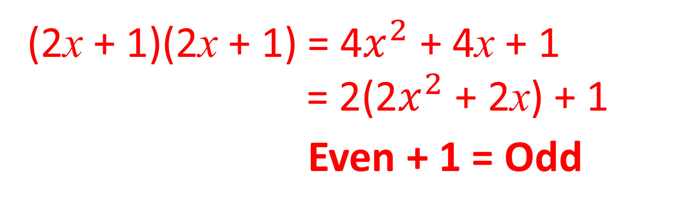
(2x + 1)(2x + 1) = 4$x^{2}$ + 4x + 1
= 2(2$x^{2}$ + 2x) + 1
Even + 1 = Odd

Slide 5
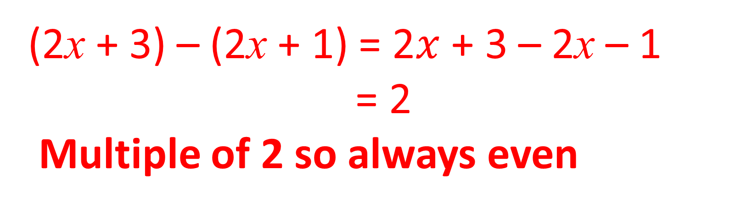
(c) Prove algebraically that the difference of two different odd numbers is always even
(2x + 3) – (2x + 1) = 2$x$ + 3 – 2x – 1
= 2
Multiple of 2 so always even

Slide 6
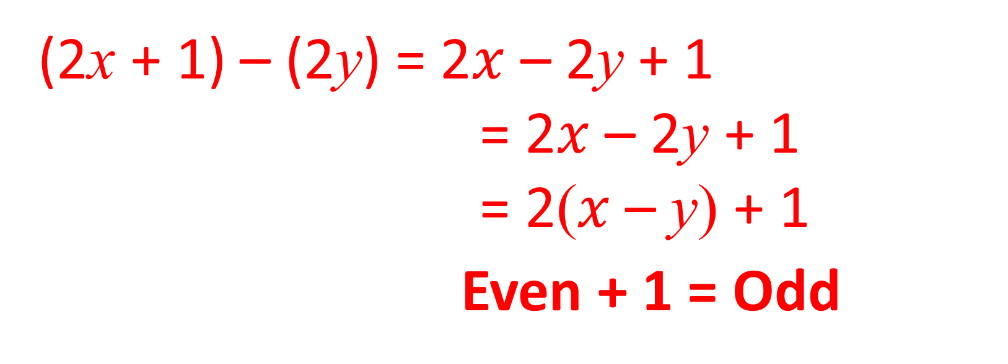
(d) Prove algebraically that the difference of an odd numbers (2x + 1) and
an even number (2y) is always odd
(2x + 1) – (2y) = 2$x$ – 2y + 1
= 2$x$ – 2y + 1
= 2($x$ – y) + 1
Even + 1 = Odd

Slide 7
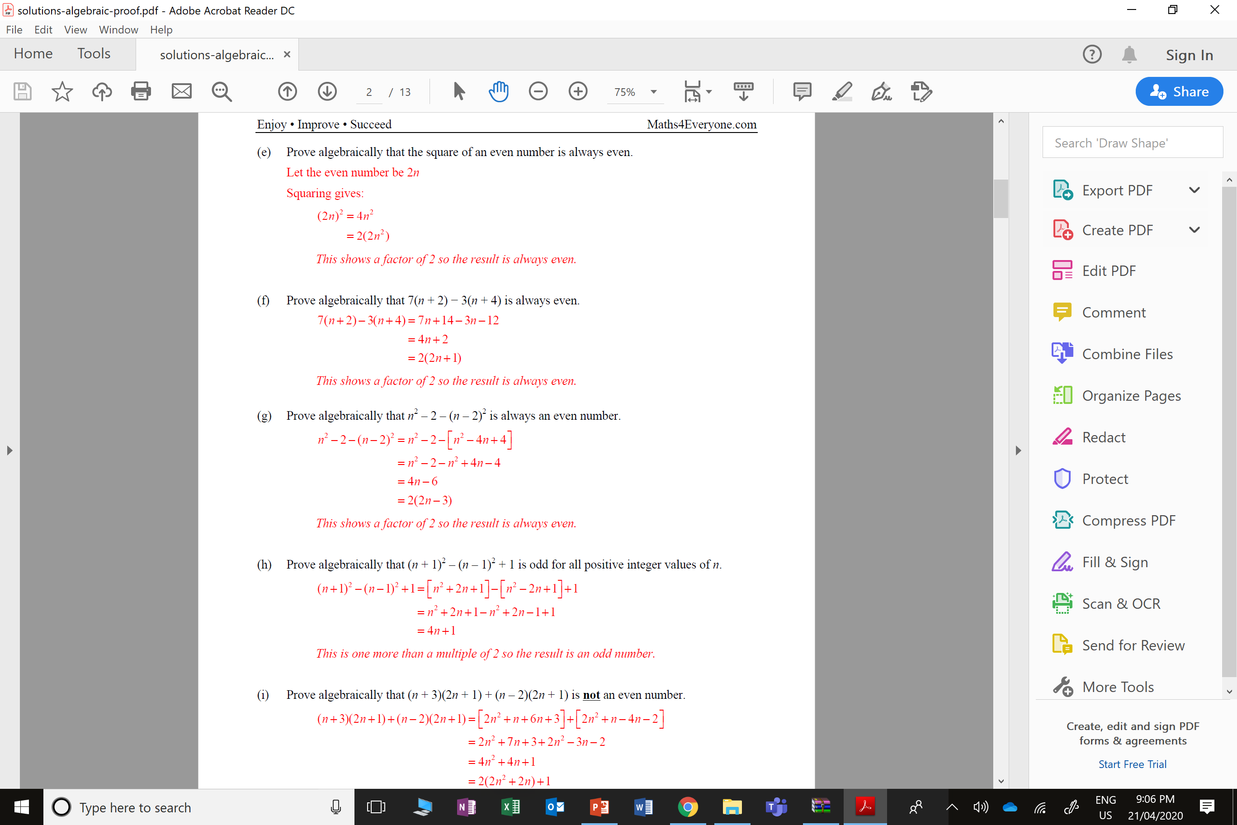
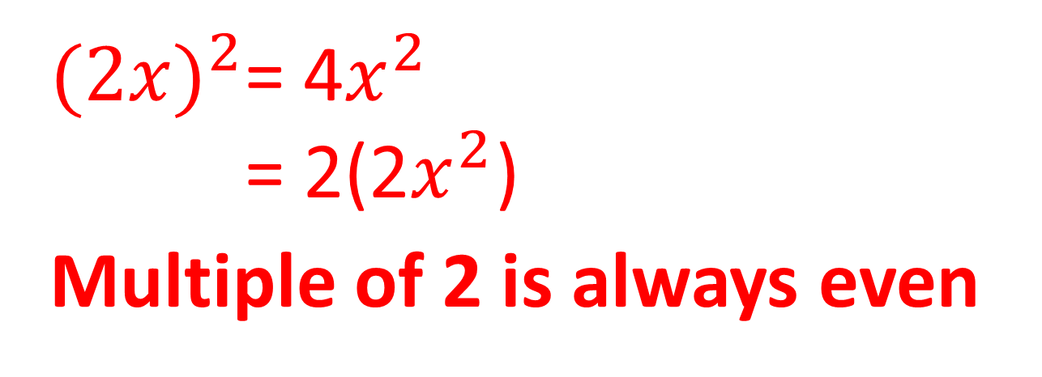
${(2x)}^{2}$= 4$x^{2}$
= 2(2$x^{2}$)
Multiple of 2 is always even

Slide 9
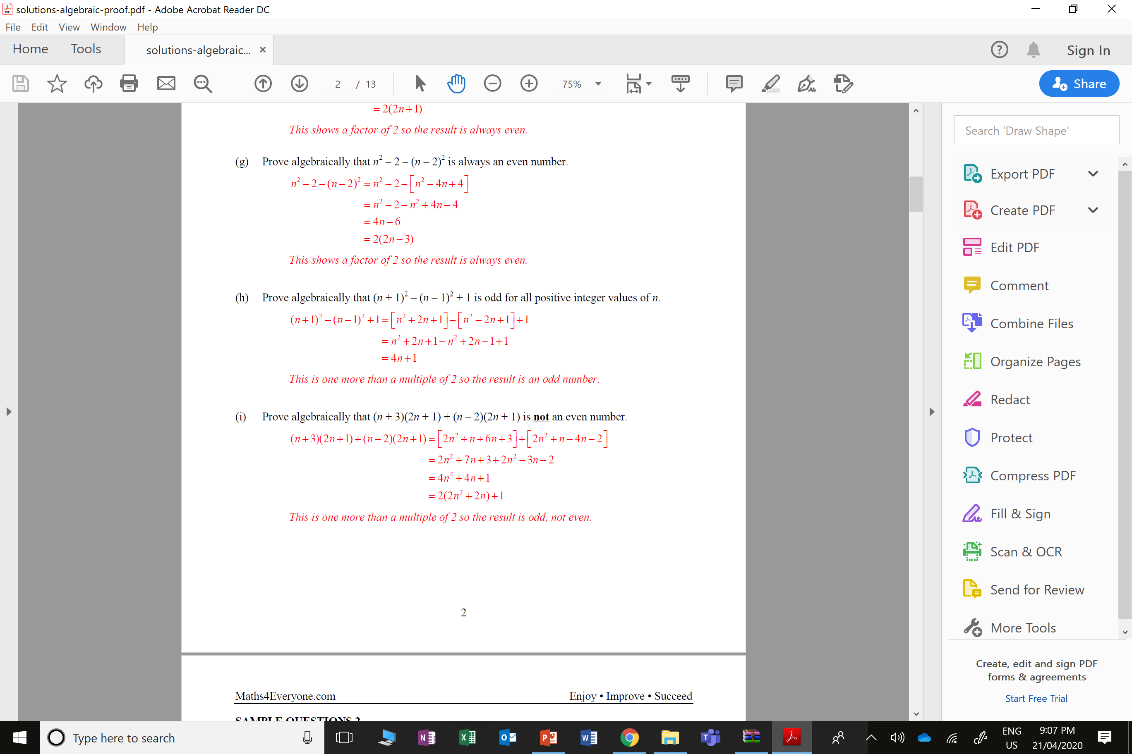

Slide 11
