Slide 1
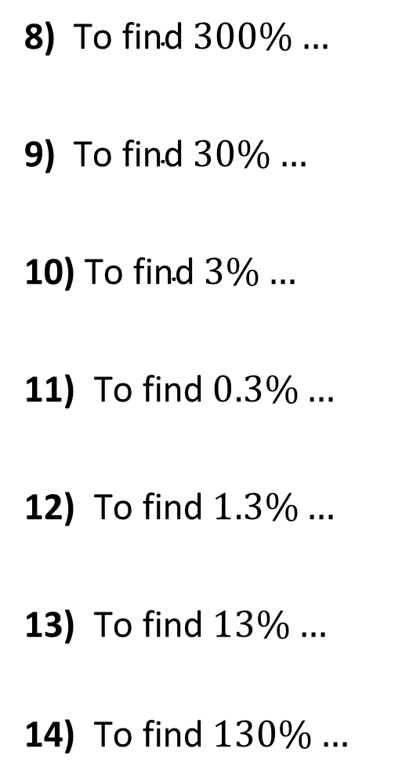
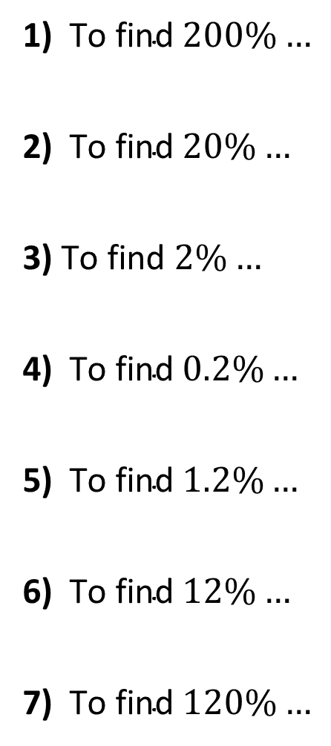
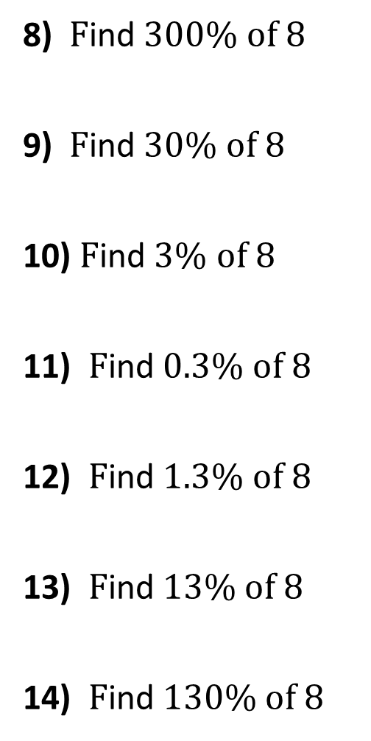
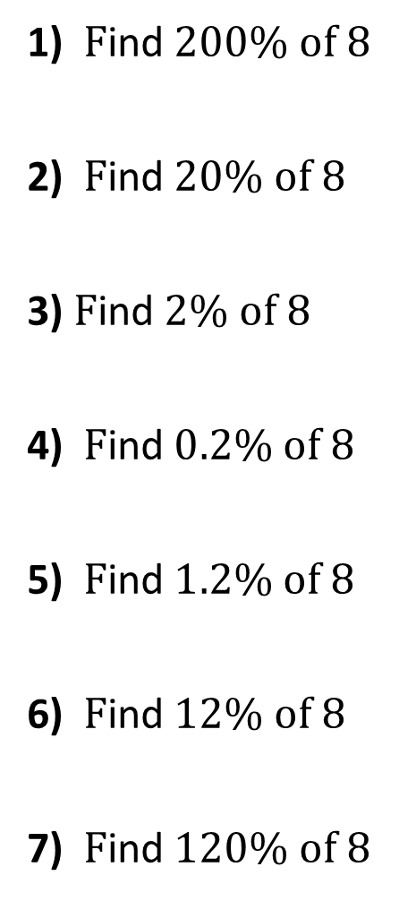
What is the multiplier….
1) $\text{To} \text{find} 200\%…$
2) $\text{To} \text{find} 20\%…$
3) $\text{To} \text{find} 2\%…$
4) $\text{To} \text{find} 0.2\%…$
5) $\text{To} \text{find} 1.2\%…$
6) $\text{To} \text{find} 12\%…$
7) $\text{To} \text{find} 120\%…$
1) $\text{F}\text{ind} 200\% of 8$
2) $\text{F}\text{ind} 20\% of 8$
3) $\text{F}\text{ind} 2\% of 8$
4) $\text{F}\text{ind} 0.2\% of 8$
5) $\text{F}\text{ind} 1.2\% of 8$
6) $\text{F}\text{ind} 12\% of 8$
7) $\text{F}\text{ind} 120\% of 8$
8) $\text{F}\text{ind} 300\% of 8$
9) $\text{F}\text{ind} 30\% of 8$
10) $\text{F}\text{ind} 3\% of 8$
11) $\text{F}\text{ind} 0.3\% of 8$
12) $\text{F}\text{ind} 1.3\% of 8$
13) $\text{F}\text{ind} 13\% of 8$
14) $\text{F}\text{ind} 130\% of 8$
8) $\text{To} \text{find} 300\%…$
9) $\text{To} \text{find} 30\%…$
10) $\text{To} \text{find} 3\%…$
11) $\text{To} \text{find} 0.3\%…$
12) $\text{To} \text{find} 1.3\%…$
13) $\text{To} \text{find} 13\%…$
14) $\text{To} \text{find} 130\%…$

Slide 2
ANSWERS

Slide 3


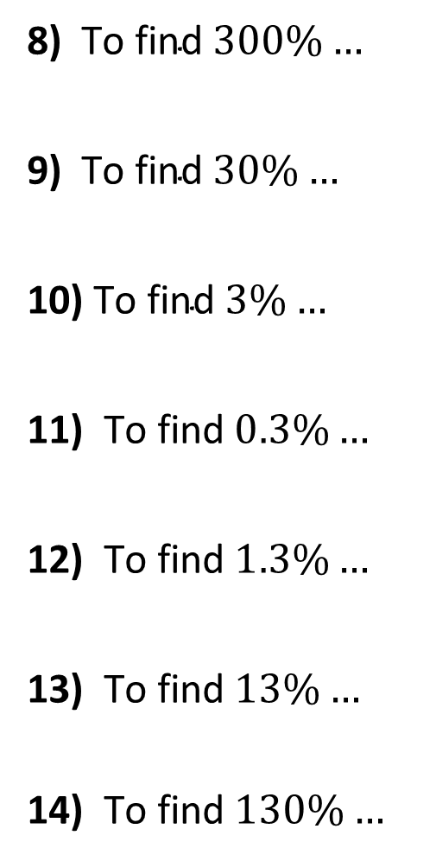



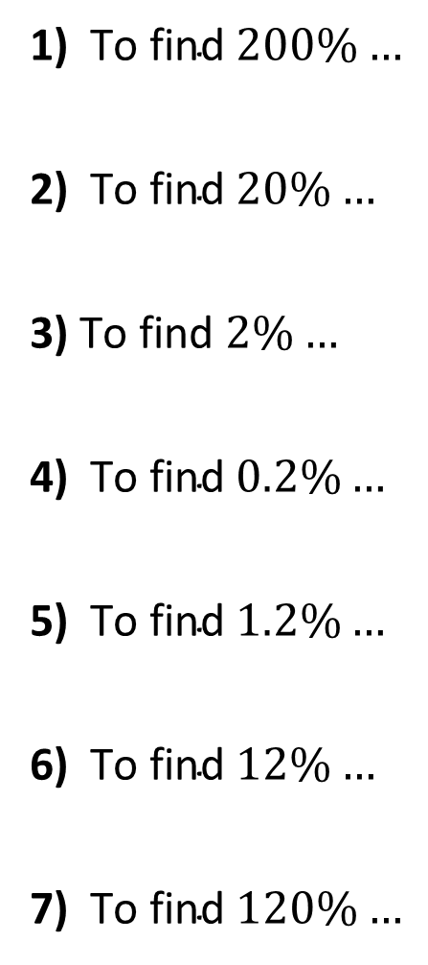









What is the multiplier….
1) $\text{To} \text{find} 200\%…$
2) $\text{To} \text{find} 20\%…$
3) $\text{To} \text{find} 2\%…$
4) $\text{To} \text{find} 0.2\%…$
5) $\text{To} \text{find} 1.2\%…$
6) $\text{To} \text{find} 12\%…$
7) $\text{To} \text{find} 120\%…$
$$×2.00$$
8) $\text{To} \text{find} 300\%…$
9) $\text{To} \text{find} 30\%…$
10) $\text{To} \text{find} 3\%…$
11) $\text{To} \text{find} 0.3\%…$
12) $\text{To} \text{find} 1.3\%…$
13) $\text{To} \text{find} 13\%…$
14) $\text{To} \text{find} 130\%…$
$$×3.00$$
$$×0.20$$
$$×0.30$$
$$×0.02$$
$$×0.03$$
$$×0.002$$
$$×0.003$$
$$×0.012$$
$$×0.013$$
$$×0.12$$
$$×0.13$$
$$×1.20$$
$$×1.30$$

Slide 4
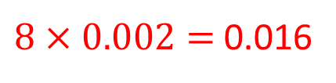

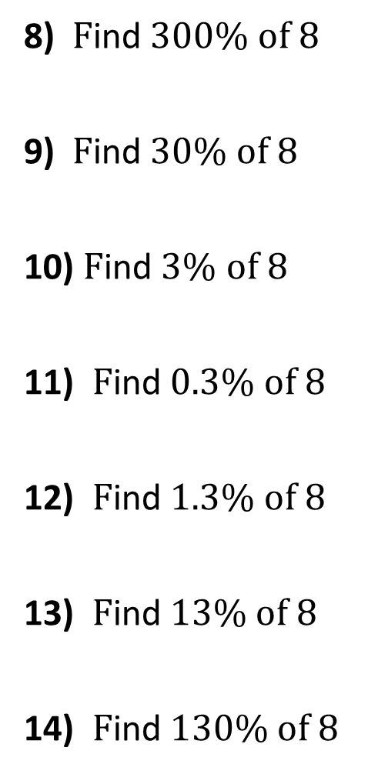



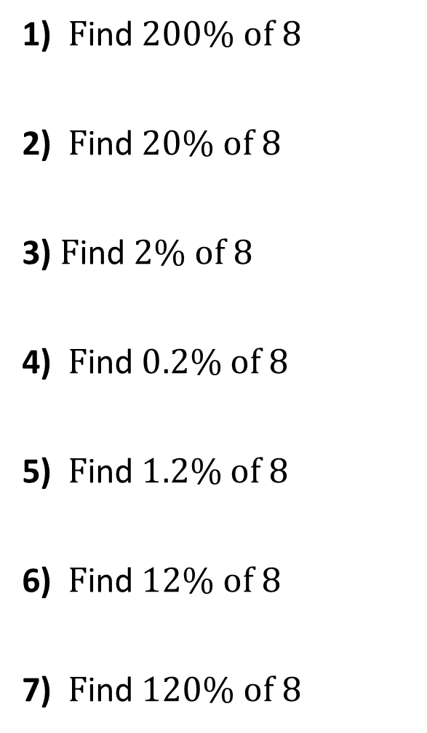


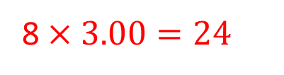



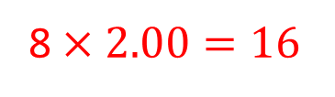


1) $\text{F}\text{ind} 200\% of 8$
2) $\text{F}\text{ind} 20\% of 8$
3) $\text{F}\text{ind} 2\% of 8$
4) $\text{F}\text{ind} 0.2\% of 8$
5) $\text{F}\text{ind} 1.2\% of 8$
6) $\text{F}\text{ind} 12\% of 8$
7) $\text{F}\text{ind} 120\% of 8$
8 $×2.00=16$
8) $\text{F}\text{ind} 300\% of 8$
9) $\text{F}\text{ind} 30\% of 8$
10) $\text{F}\text{ind} 3\% of 8$
11) $\text{F}\text{ind} 0.3\% of 8$
12) $\text{F}\text{ind} 1.3\% of 8$
13) $\text{F}\text{ind} 13\% of 8$
14) $\text{F}\text{ind} 130\% of 8$
8 $×3.00=24$
$8×0.2=1.6$
$8×0.3=2.4$
$$8×0.02=0.16$$
$$8×0.03=0.24$$
$8×0.002=$ 0.016
$$8×0.003=0.024$$
$$8×0.012=0.096$$
$$8×0.013=0.104$$
$$8×0.12=0.96$$
$$8×0.13=1.04$$
$$8×1.20=9.6$$
$$8×1.30=10.4$$

