Slide 1
LO: Plotting
Quadratic Graphs

Slide 2
x = 2
What is the value of the expression?
3x²
= 3(2)²
= 3 x 4
= 12

Slide 3
x = –2
What is the value of the expression?
3x²
= 3(– 2)²
= 3 x 4
= 12

Slide 4
x = 2
What is the value of the expression?
x² – 4x
= (2)² – 4(2)
= 4 – 8
= – 4

Slide 5
x = –2
What is the value of the expression?
x² – 4x
= (– 2)² – 4(– 2)
= 4 + 8
= 12

Slide 6
x = –2
What is the value of the expression?
2x² – 3x – 5
= 2(– 2)² – 3(– 2) – 5
= 8 + 6 – 5
= 9

Slide 7
x = –2
What is the value of the expression?
2 – 3x – 5x²
= 2 – 3(–2) – 5(–2)²
= 2 + 6 - 20
= –12

Slide 8

What does a quadratic graph look like?

Slide 9
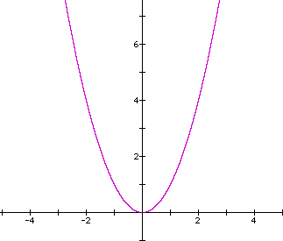
Quadratic graph or Not?
Yes

Slide 10
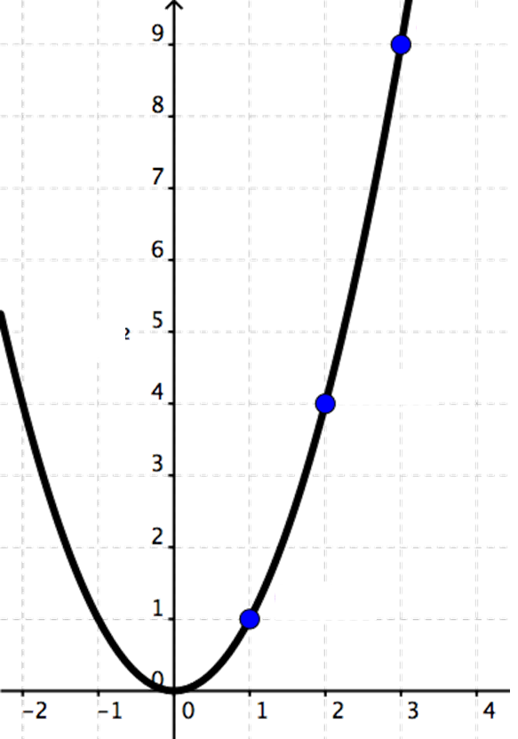
Quadratic graph or Not?
Yes

Slide 11
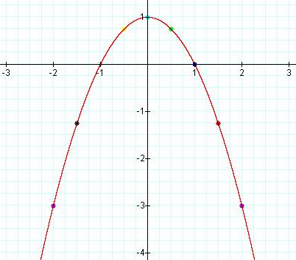
Quadratic graph or Not?
Yes

Slide 12
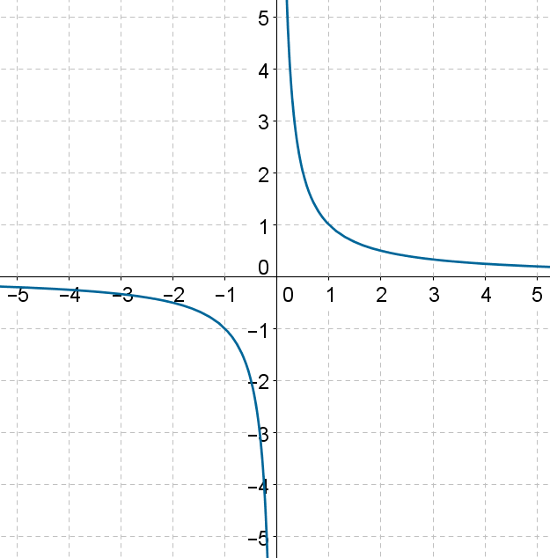
Quadratic graph or Not?
Not

Slide 13
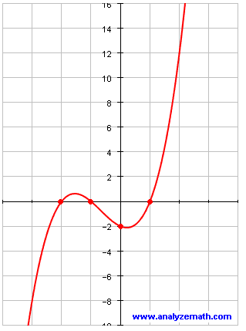
Quadratic graph or Not?
Not

Slide 14
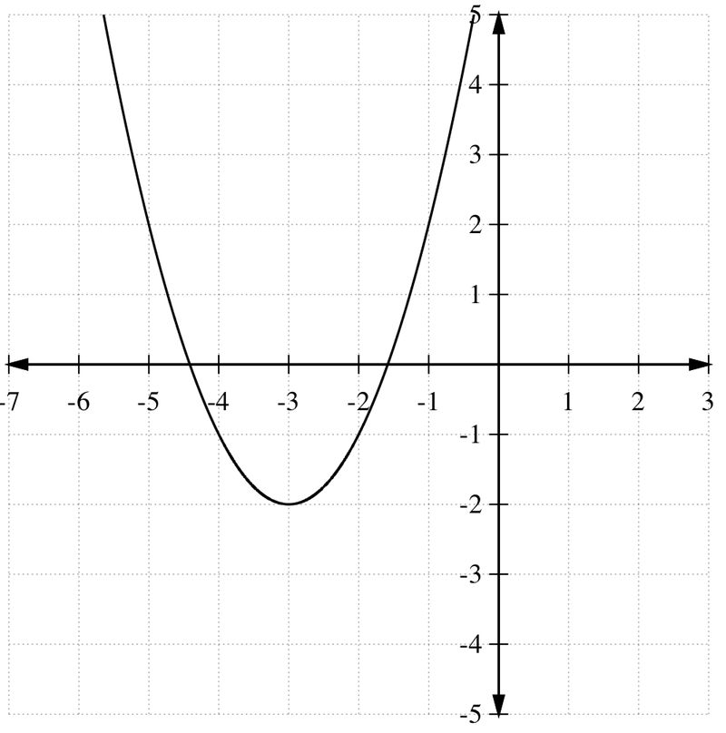
Quadratic graph or Not?
Yes

Slide 15
What makes a quadratic graph
a quadratic graph?
A quadratic graph is a U shaped graph.
A quadratic graph has only one line of symmetry.
A quadratic graph has a turning point.

Slide 16
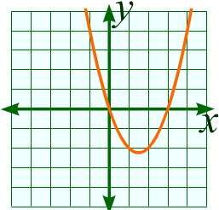
What is the equation of the line of symmetry?
x = 1.5

Slide 17
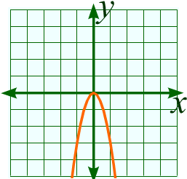
What is the equation of the line of symmetry?
x = 0

Slide 18
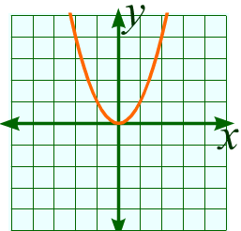
Minimum Turning Point
Maximum Turning Point

Slide 19
Why is this called a minimum turning point?
It is the
lowest point on the graph.
Minimum Turning Point

Slide 20
Why is this called a maximum turning point?
It is the
highest point on the graph.
Maximum Turning Point

Slide 21
What makes a quadratic equation
a quadratic equation?
A quadratic graph equation always contains an x²
and no higher powers.

Slide 22
Quadratic Equations or Not?
y = x³ – 3x² + 6
Not

Slide 23
Quadratic Equations or Not?
y = x² – 3
Yes

Slide 24
Quadratic Equations or Not?
y = x² – 3x
Yes

Slide 25
Quadratic Equations or Not?
y = x² – 3x + 6
Yes

Slide 26
Quadratic Equations or Not?
y = 5x³ – 3x²
Not

Slide 27
Quadratic Equations or Not?
y = 3x – x²
Yes

Slide 28

Quadratics can be found
in real life all around you.
Can you think of any examples of quadratics
in real life?

Slide 29
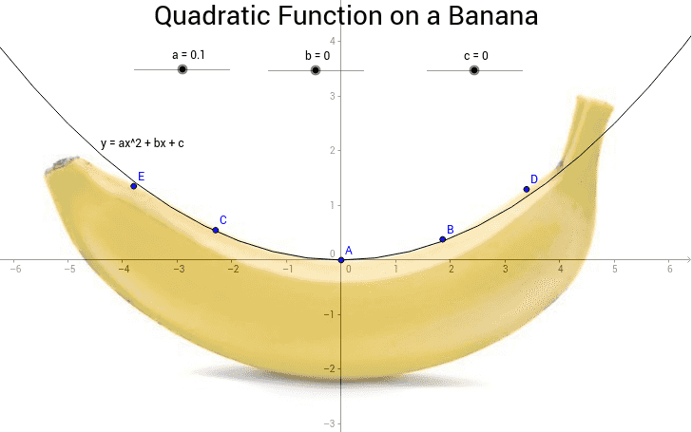

Slide 30
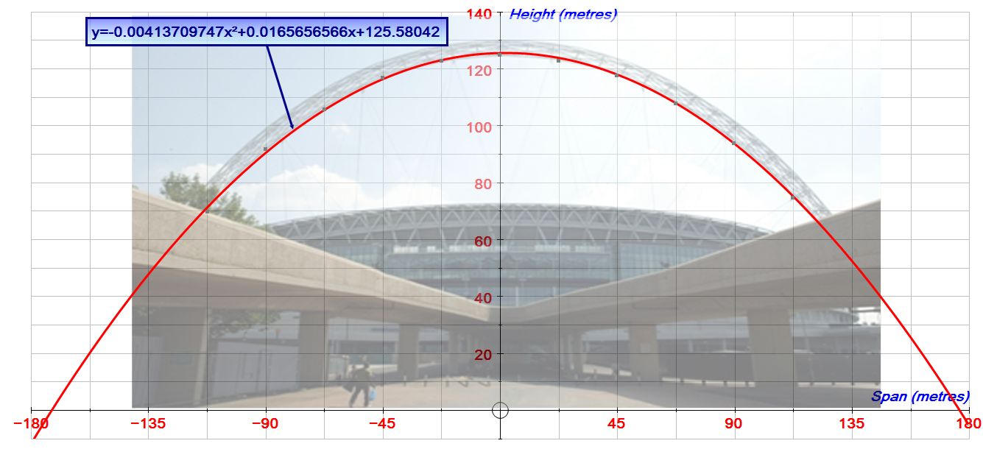

Slide 31
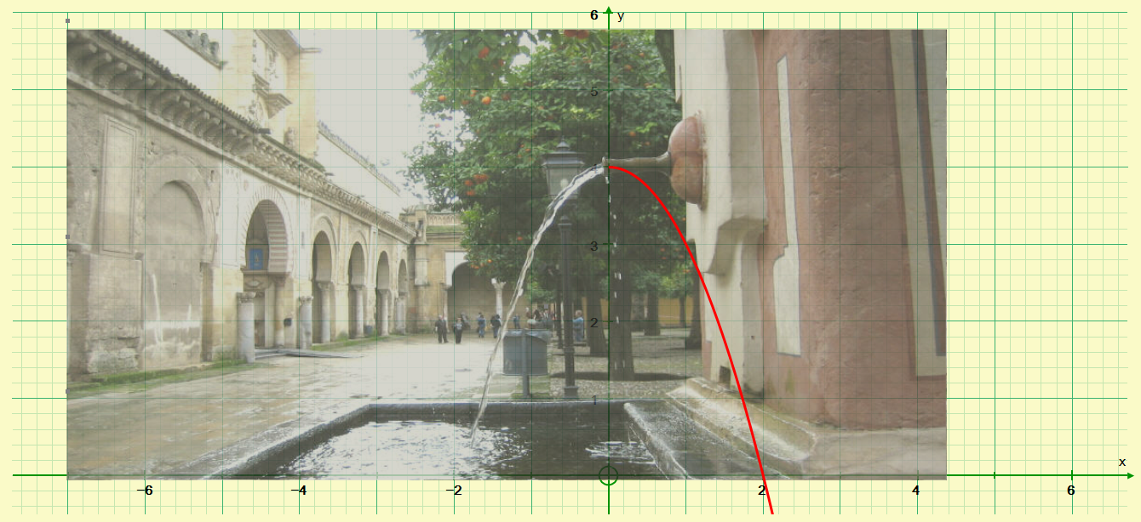

Slide 32
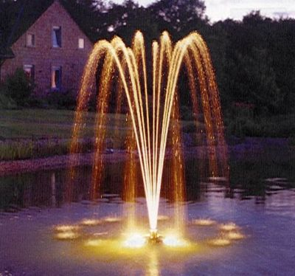

Slide 33


Slide 34
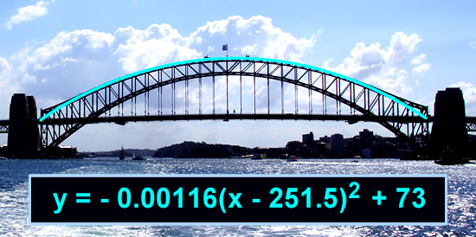

Slide 35
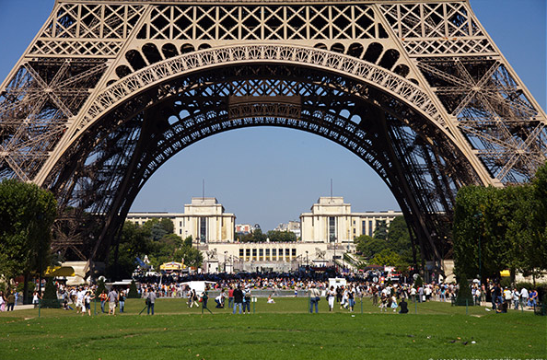

Slide 36
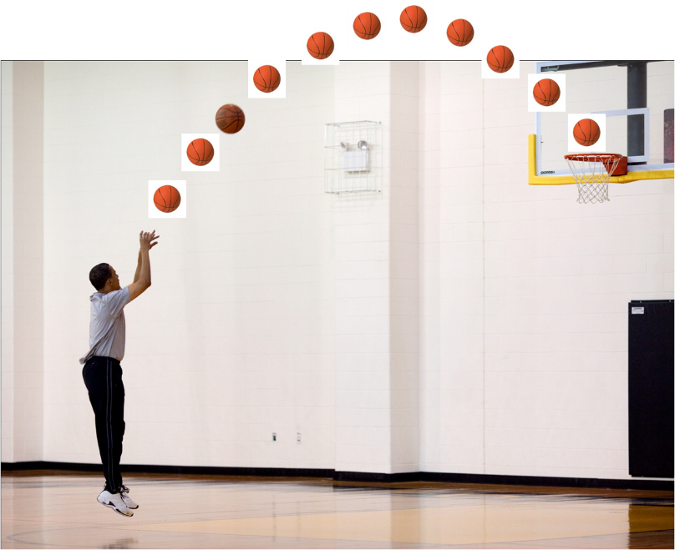

Slide 37
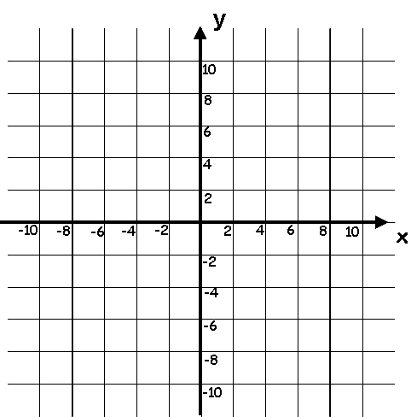
Plot a graph of the equation y = x² + 2x
x | -3 | -2 | -1 | 0 | 1 | 2 | 3
y
3
0
-1
0
3
8
15
y = x² + 2x
By drawing a suitable line on the graph
solve the equation x² + 2x = 4
x = 1.8
x = -3

Slide 38
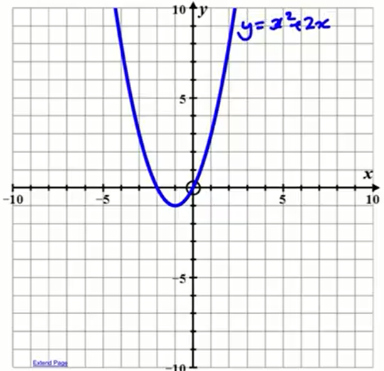
By drawing a suitable line on the graph solve the equation x² + 2x = 3

