Slide 1
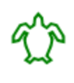
https://www.calormen.com/jslogo/
Use the above website to draw various shapes.
Guide the turtle around the screen to draw the shapes.
Use instructions such as:
Forward 100
Right 90
Left 48

Slide 2
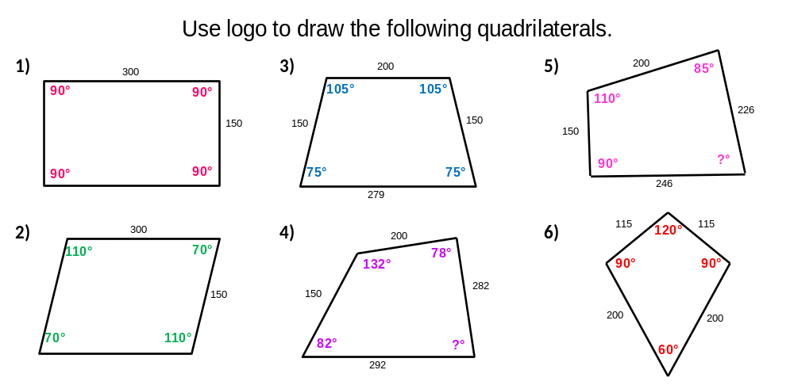
https://www.calormen.com/jslogo/

