Slide 1
LO: Rearrange
Formulae

Slide 2
Solve 2x + 5 = 9
2x + 5 = 4
2x + 5 = 2

Slide 3
Solve 3x – 6 = 9
3x + 5 = 15
2x + 5 = 5

Slide 4
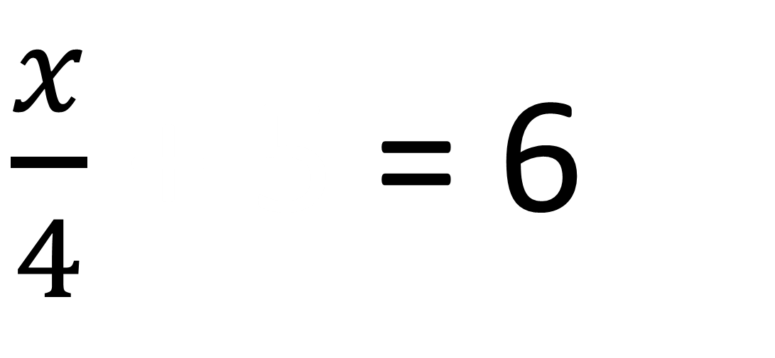
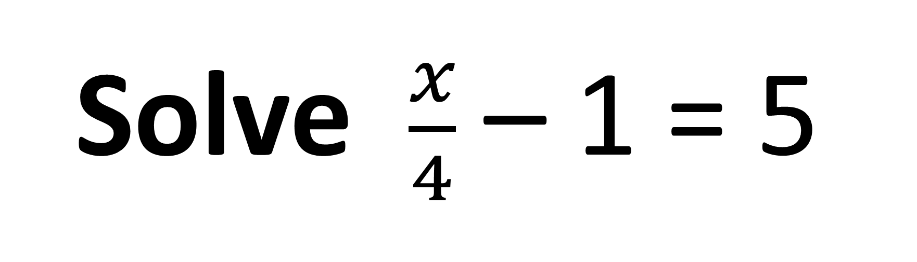
Solve $\frac{x}{4}$ – 1 = 5
$\frac{x}{4}$ + 5 = 6
2x + 5 = 24

Slide 5
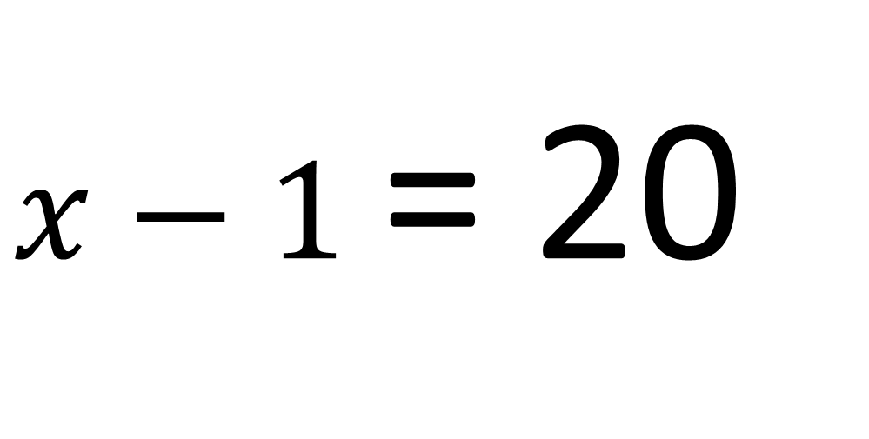
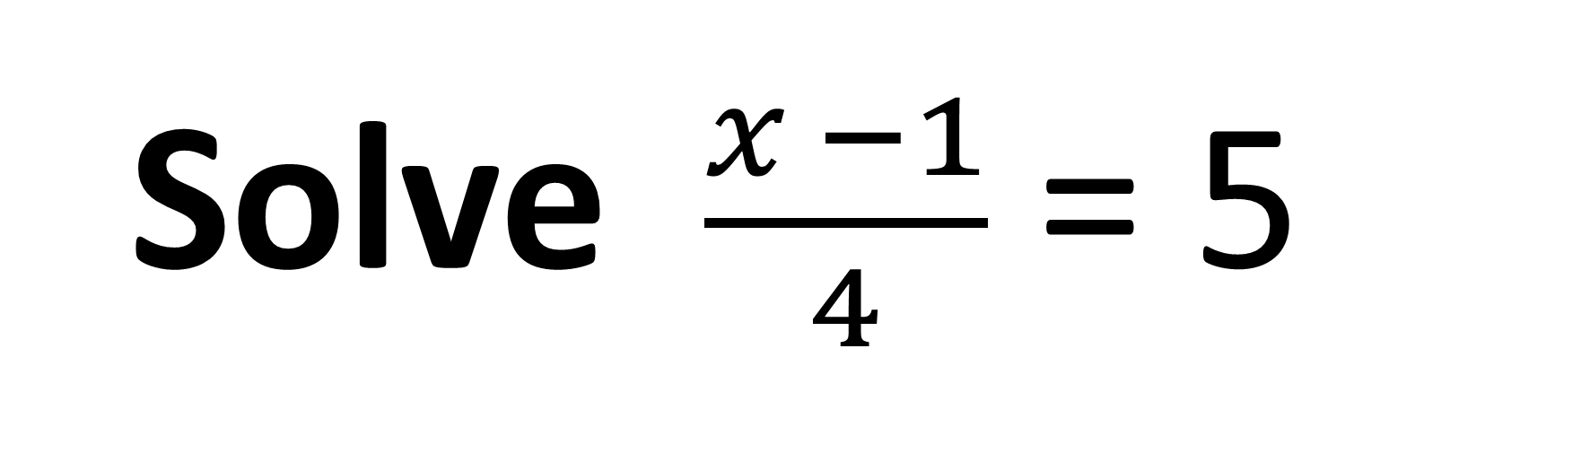
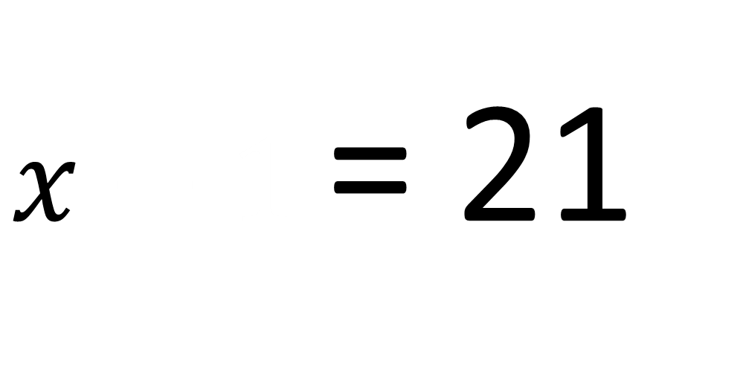
Solve $\frac{x −1}{4}$ = 5
$x−1$ = 20
$x−1$ = 21

Slide 6
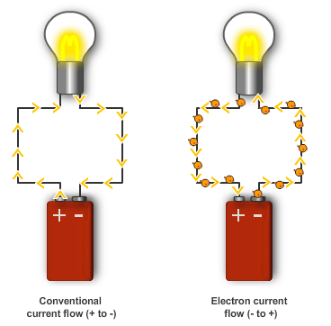
Do you recognise this formula?
V = IR
V = Voltage
I = Current
R = Resistance
Ohm's Law

Slide 7
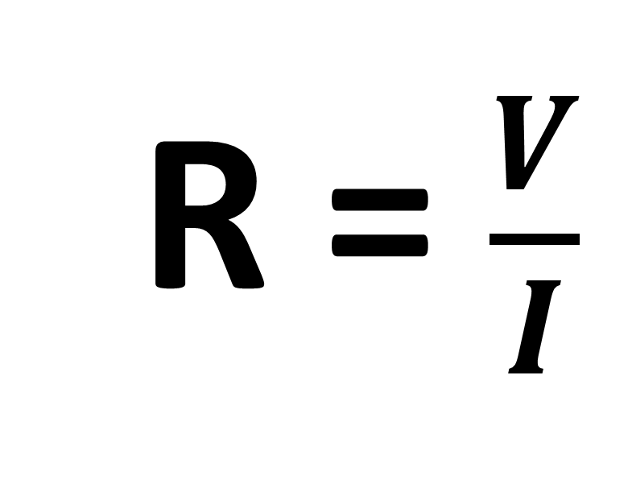
V = IR
How do you calculate
resistance?
R = $\frac{V}{I}$

Slide 8
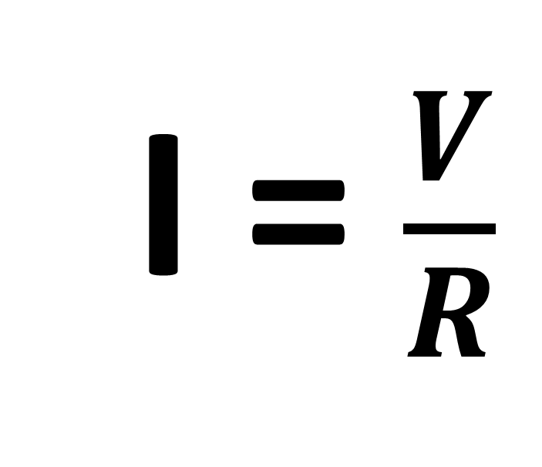
V = IR
How do you calculate
current?
I = $\frac{V}{R}$

Slide 9
What is the subject of the formula?
a = 3b + c
The subject of the formula is a

Slide 10
The "subject" of a formula
is the single variable
that everything else is equal to.

Slide 11
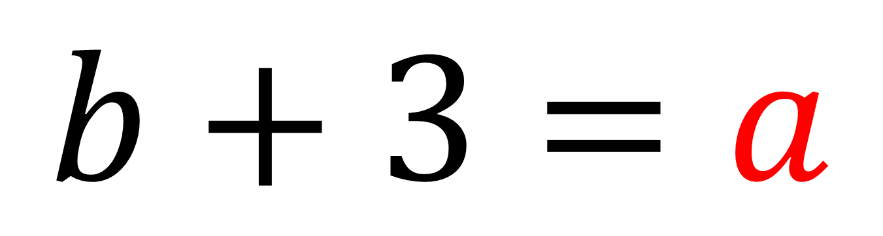
Is a the subject of the formula?
$$b+3=a$$
Yes

Slide 12
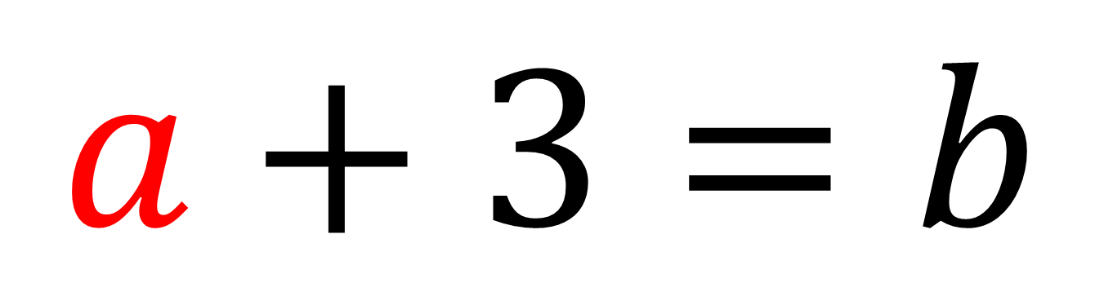
Is a the subject of the formula?
$$a+3=b$$
No

Slide 13
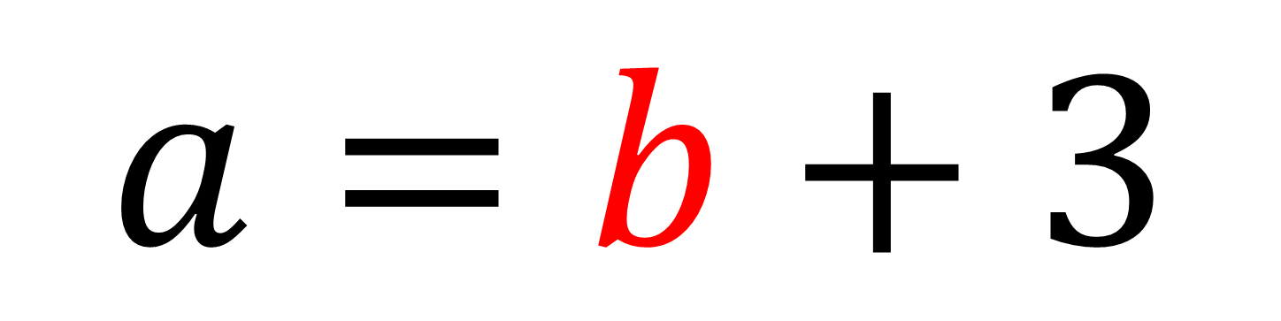
Is a the subject of the formula?
$$a=b+3$$
Yes

Slide 14
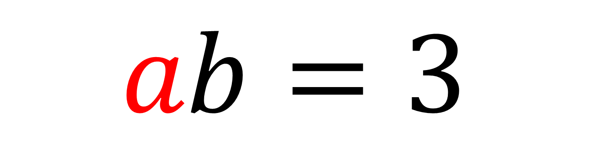
Is a the subject of the formula?
$$ab=3$$
No

Slide 15
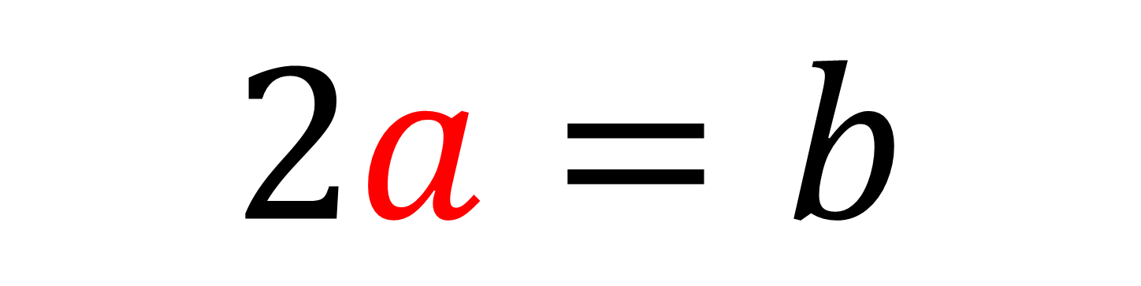
Is a the subject of the formula?
$$2a=b$$
No

Slide 16
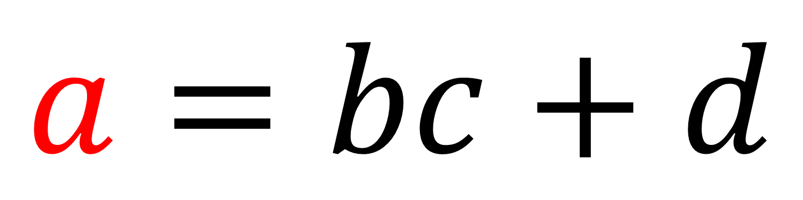
Is a the subject of the formula?
$$a=bc+d$$
Yes

Slide 17
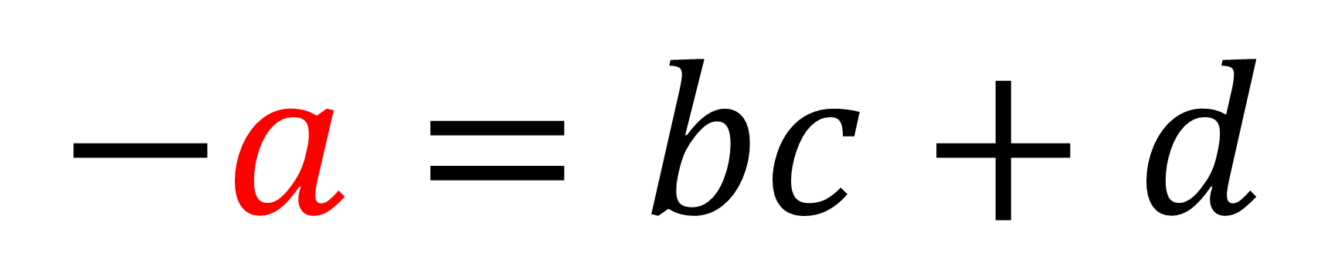
Is a the subject of the formula?
$$−a=bc+d$$
No

Slide 18
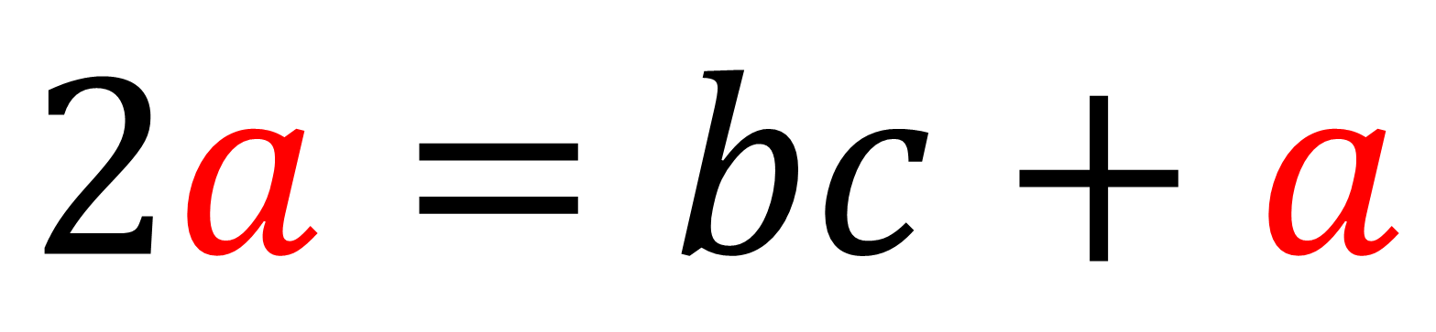
Is a the subject of the formula?
$$2a=bc+a$$
No

Slide 19
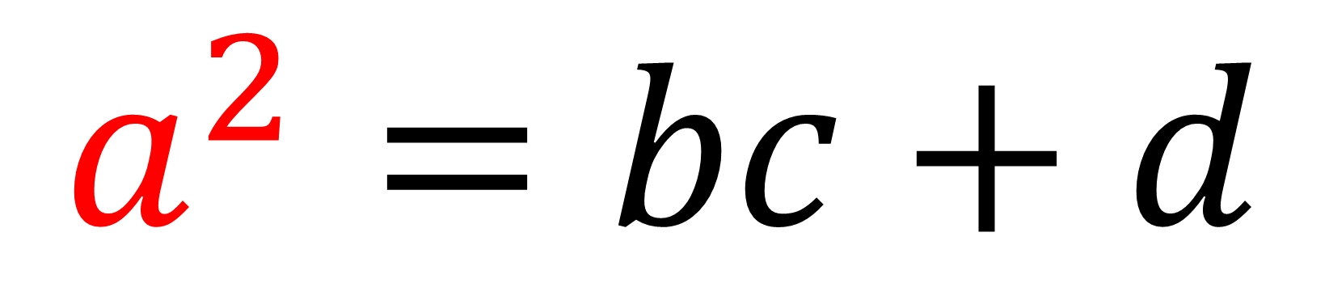
Is a the subject of the formula?
$$a^{2}=bc+d$$
No

Slide 20
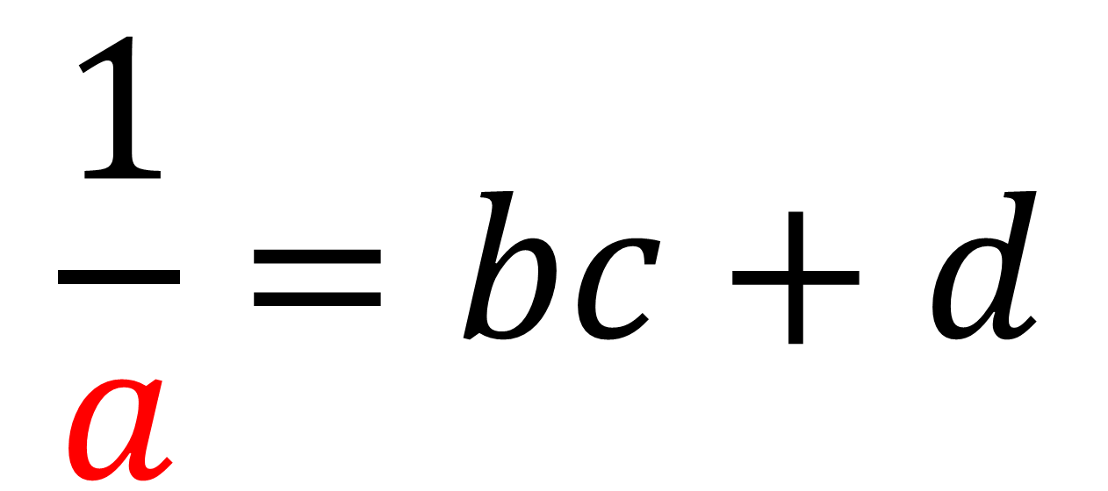
Is a the subject of the formula?
$$\frac{1}{a}=bc+d$$
No

Slide 21
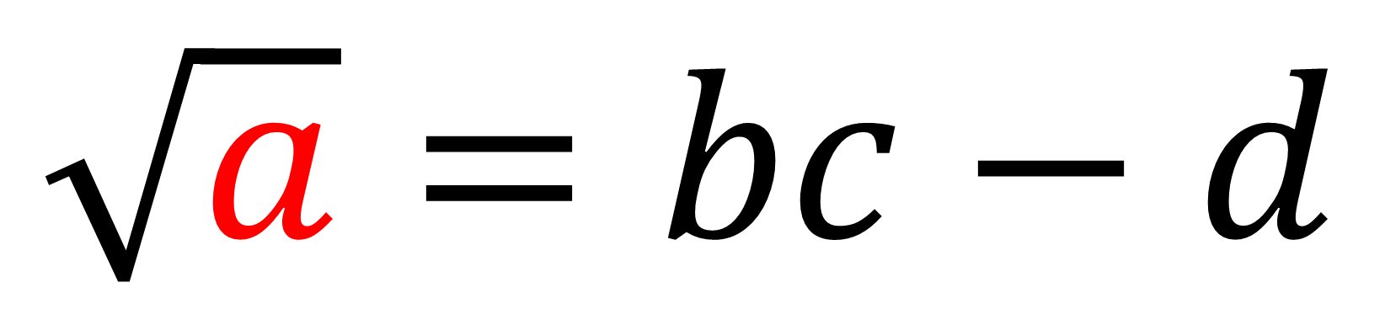
Is a the subject of the formula?
$$\sqrt{a}=bc−d$$
No

Slide 22
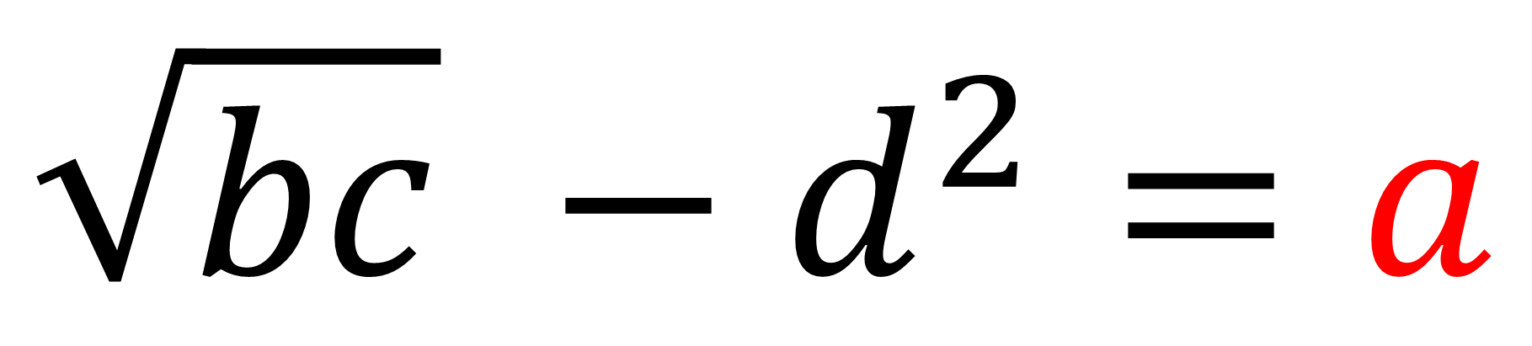
Is a the subject of the formula?
$$\sqrt{bc} −d^{2}=a$$
Yes

Slide 23
Make x the subject
x – y = z
x + y = z + y

Slide 24
Make x the subject
x + y = z
x + y = z – y

Slide 25
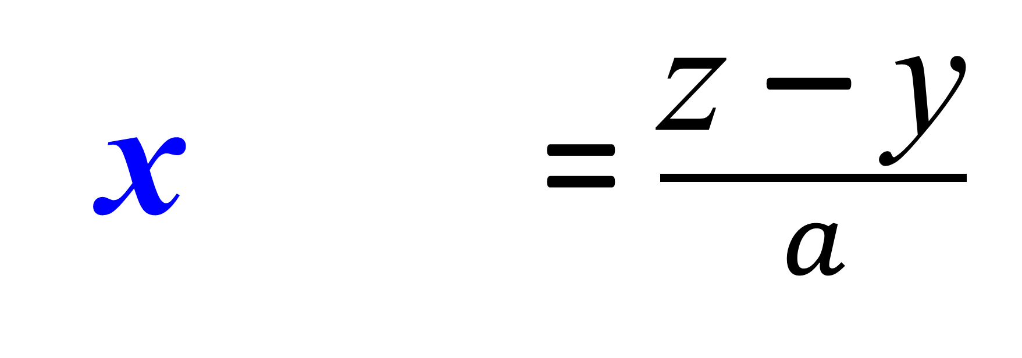
Make x the subject
xa + y = z
xa + y = $\frac{\text{z} \text{–} \text{y}}{a}$

Slide 26
Make x the subject
z = xa + y
xa + y = $\frac{\text{z} \text{–} \text{y}}{a}$

Slide 27
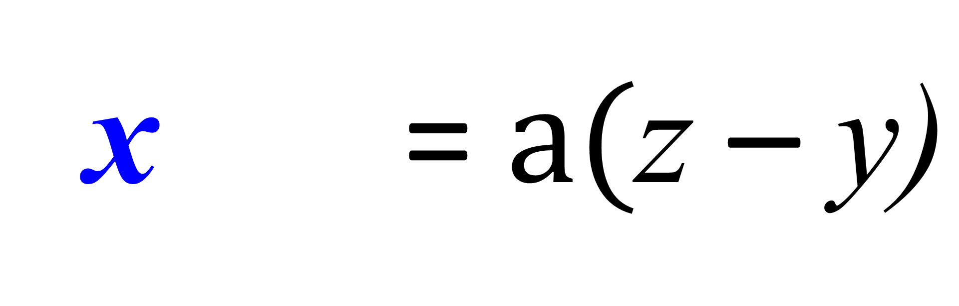
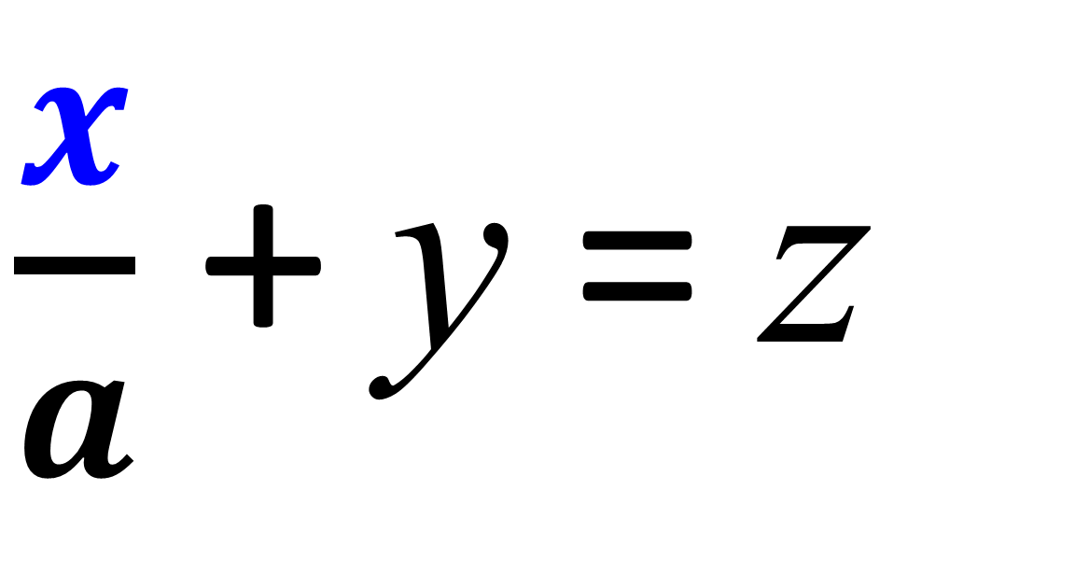
Make x the subject
$\frac{x}{a}$ + y = z
xa + = $a(\text{z} \text{–} \text{y}\text{)}$

Slide 28
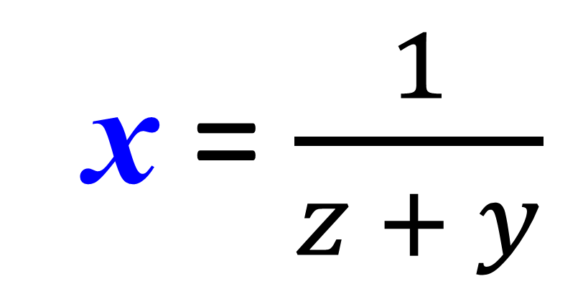
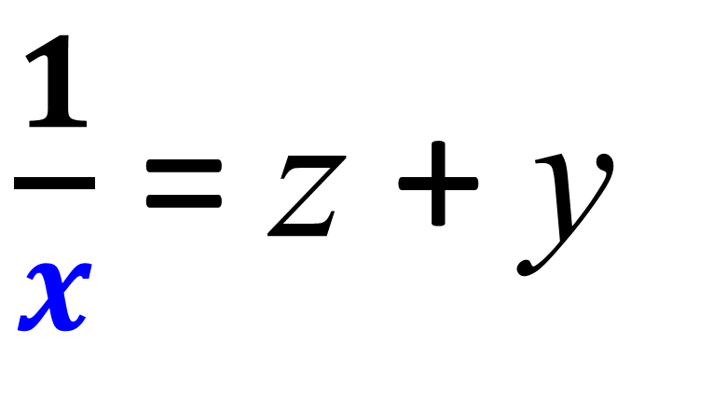
Make x the subject
$\frac{1}{x}$ = z + y
x = $\frac{1}{z + y}$

Slide 29
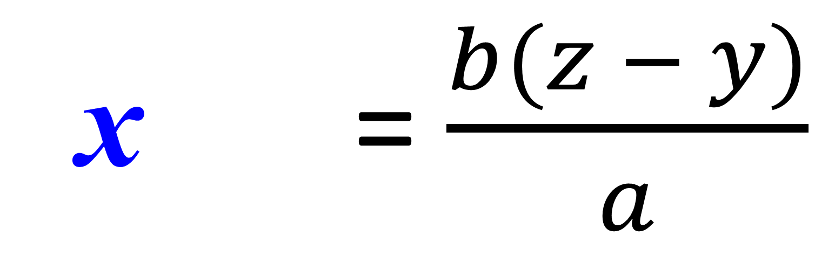
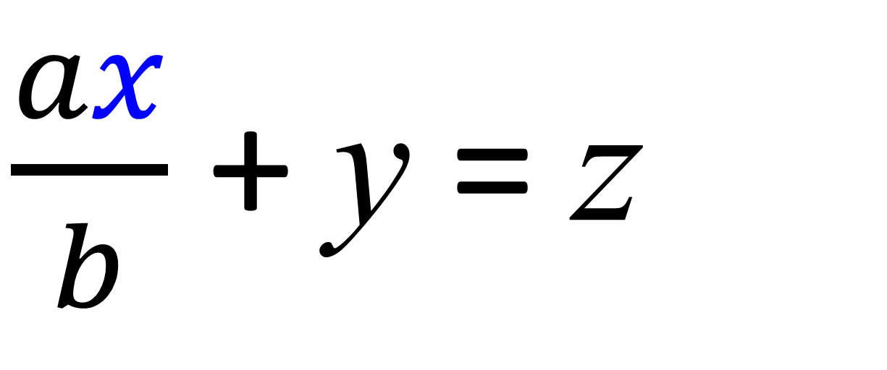
Make x the subject
$\frac{ax}{b}$ + y = z
x + y = $\frac{b(z − y)}{a}$

