Slide 1
FM: Quadratic Sequences

Slide 2
1, 4, 9, 16, 25, 36…….
What do you notice about the difference between each number?
They are not the same.

Slide 3

1st | 2nd | 3rd | 4th | 5th | n
1 | 4 | 9 | 16 | 25
n²
$$n^{2}$$
Quadratic Sequences

Slide 4
1, 4, 9, 16, 25, 36…….
If the 2nd differences are the same then you have a Quadratic Sequence.

Slide 5
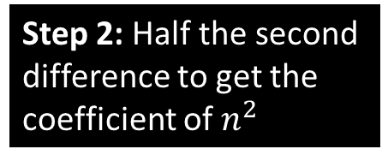
5 |  | 14 |  | 29 |  | 50
Second Difference is
6
Half Second Difference 3n²
Step 1: Find the second difference
1 | 2 | 3 | 4
Step 2: Half the second difference to get the coefficient of $n^{2}$
3n²
3 | 12 | 27 | 48
3n² + 2
5 | 14 | 29 | 50
Step 3: Adjust the sequence as necessary

Slide 6
-1 |  | 5 |  | 15 |  | 29
Second Difference is
4
Half Second Difference 2n²
1 | 2 | 3 | 4
2n²
2 | 8 | 18 | 32
2n² - 3
-1 | 5 | 15 | 29

Slide 7
6 |  | 9 |  | 14 |  | 21
Second Difference is
2
Half Second Difference 1n²
1 | 2 | 3 | 4
1n²
1 | 4 | 9 | 16
1n² + 5
6 | 9 | 14 | 21

Slide 8

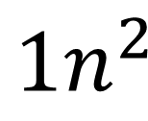
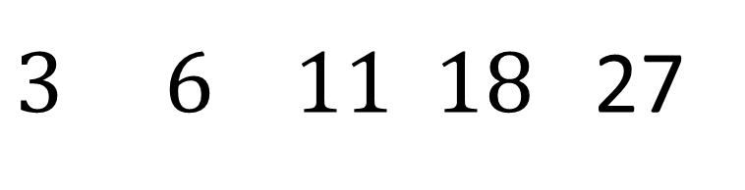


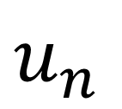


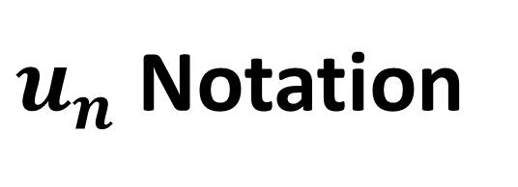

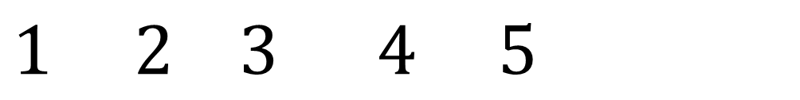

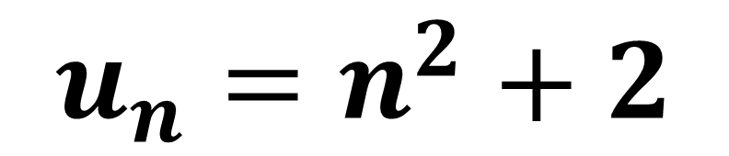
$u_{n}$ Notation
$$n$$
$$1 2 3 4 5$$
$$u_{n}$$
$3 6 11 18$27
$$+3$$
$$+5$$
$$+7$$
$+$2
$+$2
$${1n}^{2}$$
$$1 4 9 16 25$$
Adjust
+2 +2 +2 +2 +2
$$u_{n}=n^{2}+2$$

Slide 9
4 |  | 13 |  | 26 |  | 43
Second Difference is
4
Half Second Difference 2n²
1 | 2 | 3 | 4
2n²
2 | 8 | 18 | 32
Note: The difference is a linear sequence
3n – 1
2 | 5 | 8 | 11
2n² + 3n – 1
4 | 13 | 26 | 43

Slide 10
9 |  | 20 |  | 35 |  | 54
Second Difference is
4
Half Second Difference 2n²
1 | 2 | 3 | 4
2n²
2 | 8 | 18 | 32
5n + 2
7 | 12 | 17 | 22
2n² + 5n + 2
9 | 20 | 35 | 54

Slide 11
7 |  | 18 |  | 35 |  | 58
Second Difference is
6
Half Second Difference 3n²
1 | 2 | 3 | 4
3n²
3 | 12 | 27 | 48
2n + 2
4 | 6 | 8 | 10
3n² + 2n + 2
7 | 18 | 35 | 58

Slide 12

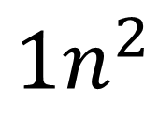
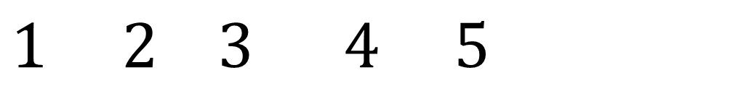

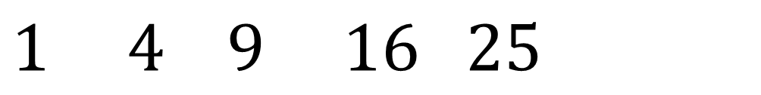
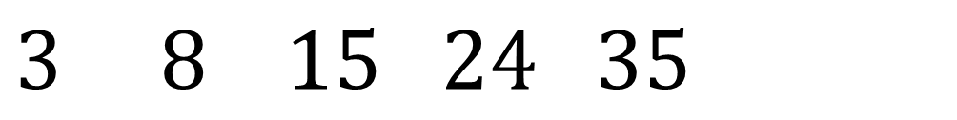
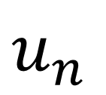


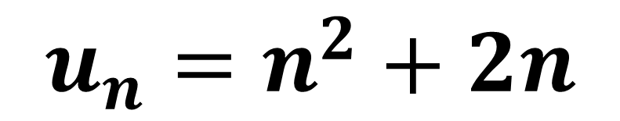
$u_{n}$ Notation
$$n$$
$$1 2 3 4 5$$
$$u_{n}$$
$$3 8 15 24 35$$
$$+5$$
$$+7$$
$+$9
$+$2
$+$2
$${1n}^{2}$$
$$1 4 9 16 25$$
Adjust
+2 +4 +6 +8 +10
$$u_{n}=n^{2}+2n$$

