Slide 1
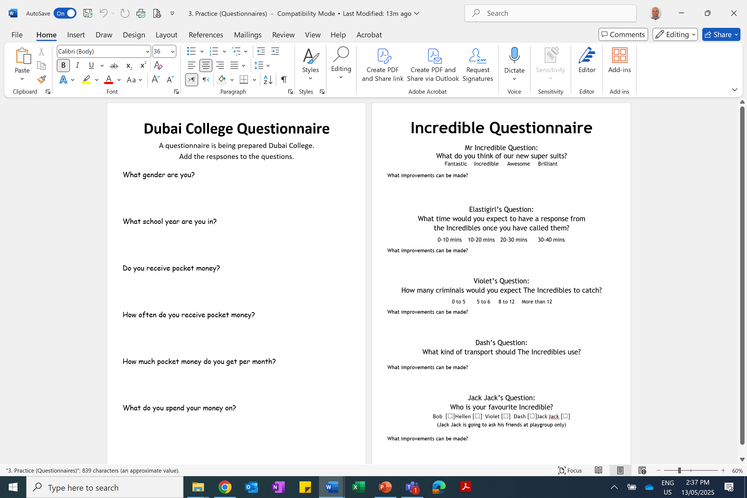

Slide 2
ANSWERS

Slide 3


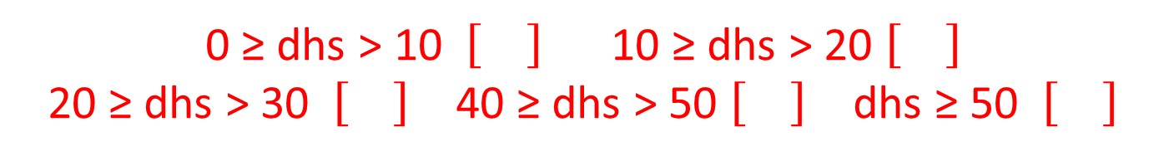



Male Female
Y7 Y8 Y9 Y10
Y11 Y12 Y13
Yes No
Daily Weekly Monthly Yearly Never
0 ≥ dhs > 10 10 ≥ dhs > 20
20 ≥ dhs > 30 40 ≥ dhs > 50 dhs ≥ 50
M$usic \left[\right]$ Liesure
Education Sports Other

Slide 4
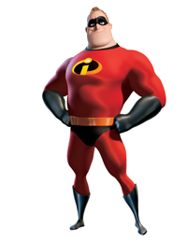

Mr Incredible's Question:
What do you think of our new super suits?
(Choose one option)
Fantastic Incredible Awesome Brilliant
What do you think of our new super suits?
(Choose one option)
Poor OK Good
Very Good Excellent

Slide 5
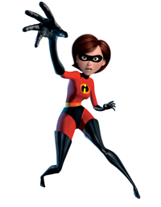
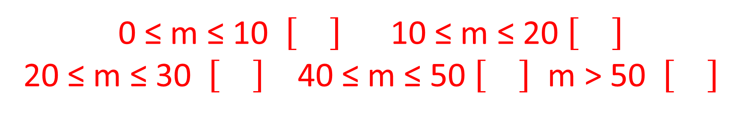
Elastigirl's Question:
What time would you expect to have a response from The Incredibles once you'd called them?
0-10 mins 10-20 mins 20-30 mins 30-40 mins
What time would you expect to have a response from The Incredibles once you'd called them?
0 ≤ m ≤ 10 10 ≤ m ≤ 20
20 ≤ m ≤ 30 40 ≤ m ≤ 50 m > 50

Slide 6
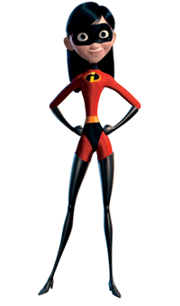
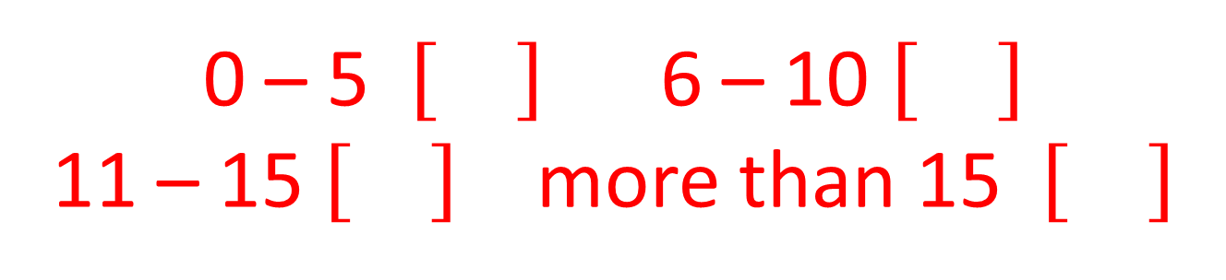
Violet's Question:
How many criminals would you expect
The Incredibles to catch?
0 to 5 5 to 6 8 to 12 More than 12
How many criminals would you expect
The Incredibles to catch in a Month?
0 – 5 6 – 10
11 – 15 more than 15

Slide 7
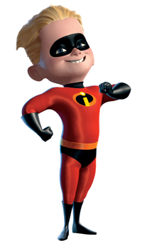

Dash's Question:
What kind of transport should The Incredibles use?
What kind of transformation should
The Incredibles use to get to their missions?
Car Bus Bike
Tank Other

Slide 8
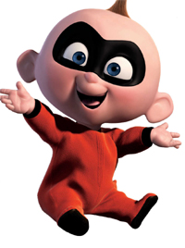

Jack Jack's Question:
Who is your favourite Incredible?
Jack Jack is going to ask his friends at playgroup only.
Bob Hellen Violet
Dash Jack Jack
(Ask all his family and friends)

