Slide 1
LO: Solving Quadratics (Factorising)

Slide 2
What is the value of B?
1230000 x B = 0
0

Slide 3
What is the value of A?
A x -8 = 0
0

Slide 4
What is the value of A?
A(3 + 4²) = 0
0

Slide 5
What is the value of B?
5(B + 2) = 0
-2

Slide 6
What is the value of B?
2(B - 8) = 0
8

Slide 7
What is the value of B?
6(5 - B) = 0
5

Slide 8
What is the value of B?
4(2B - 6) = 0
2x3

Slide 9
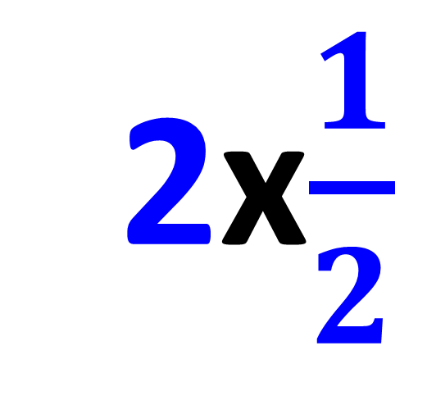
What is the value of B?
5(2B - 1) = 0
2x$\frac{1}{2}$

Slide 10
Solve
(x + 6)(x – 2) = 0
x = –6 or x = 2

Slide 11
Solve
(x + 0)(x – 2) = 0
x = 0 or x = 2

Slide 12
Solve
x(x – 2) = 0
x = 0 or x = 2

Slide 13
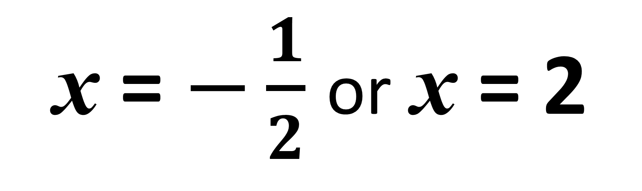
Solve
(2x + 1)(x – 2) = 0
x = $−\frac{1}{2}$ or x = 2

Slide 14
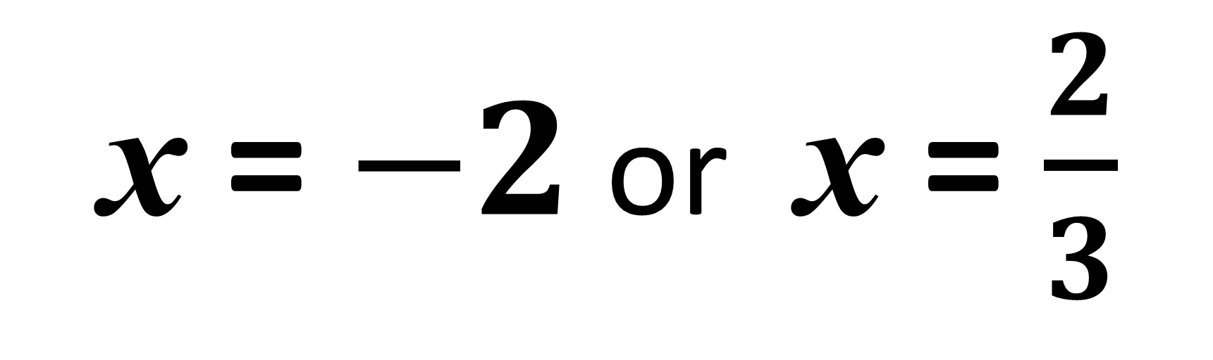
Solve
(2x + 4)(3x – 2) = 0
x = $−2$ or x = $\frac{2}{3}$

Slide 15
Always make sure
your quadratic is in the form
ax² + bx + c = 0
before factorising.

Slide 16
x² + 2x – 15 = 0
(x + 5)(x – 3) = 0
x = –5 or x = 3

Slide 17
x² – 9x + 14 = 0
(x – 2)(x – 7) = 0
x = 2 or x = 7

Slide 18
x² – 7x – 30 = 0
(x + 3)(x – 10) = 0
x = –3 or x = 10

Slide 19
x² + x = 20
x² + x – 20 = 0
(x – 4)(x + 5) = 0
x = 4 or x = –5

Slide 20
x² = 10 – 3x
x² + 3x – 10 = 0
(x – 2)(x + 5) = 0
x = 2 or x = –5

Slide 21
x² + 8x = 0
x² + 8x + 0 = 0
(x + 0)(x + 8) = 0
x = 0 or x = –8

Slide 22
x² – 9 = 0
x² + 0x – 9 = 0
(x + 3)(x – 3) = 0
x = –3 or x = 3

Slide 23
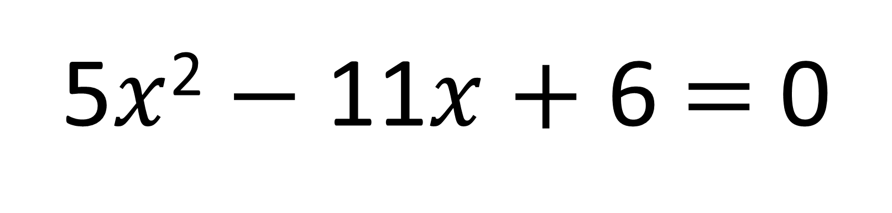
Harder Quadratics
5$x$² $−$ 11$x$ $+$ 6 $=$ 0
What make this quadratic
harder to factorise?

Slide 24
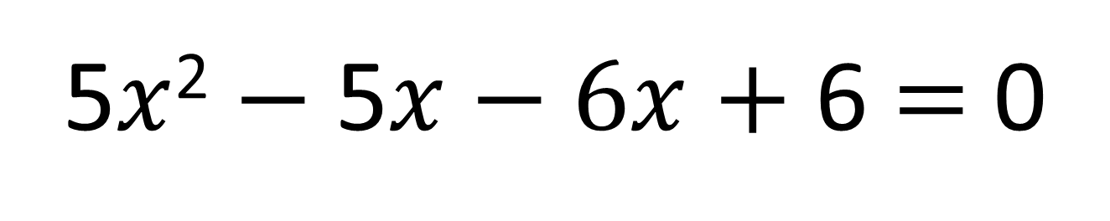
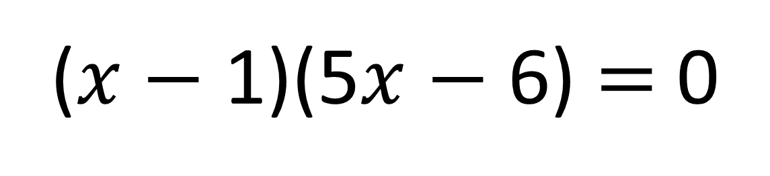

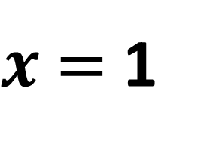

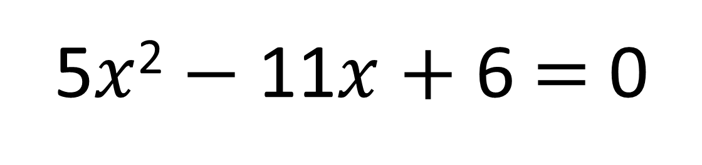
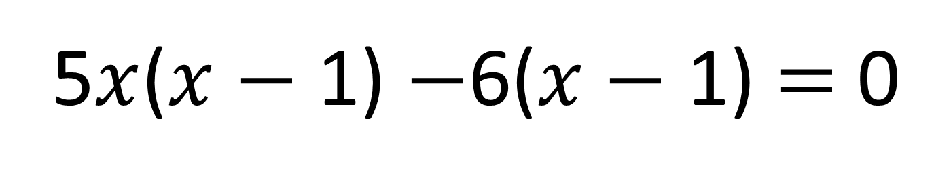
Solve the following quadratic equation by factorising into two brackets.
5$x$² $−$ 11$x$ $+$ 6 $=$ 0
5 $×$ 6 $=$ 30
Factors of 30
1, 30
2, 15
3, 10
5, 6
5$x$² $−$ 5$x−6x$ $+$ 6 $=$ 0
5$x$($x$ $−$ 1) $−$6($x$ $−$ 1) $=$ 0
($x$ $−$ 1)(5$x$ $−$ 6) $=$ 0
6
$x$ $=$ 1
$x$ $=$
5
Notes:
Begin with 2 examples.
Suggested walkthrough…
Ex1 – Complete teacher led
Ex2 – Teacher begins, students finish OR students complete [Judge by student competence]

Slide 25
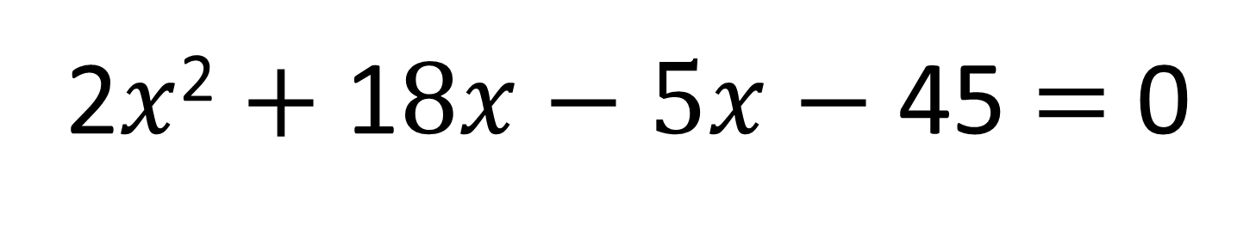
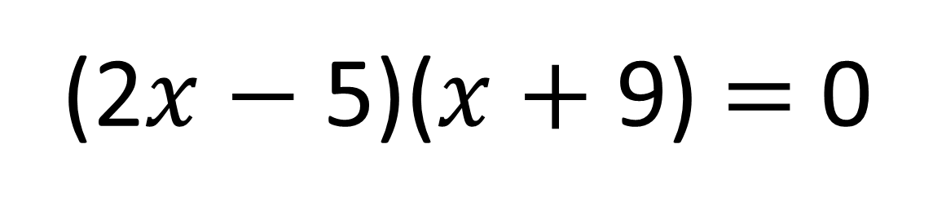

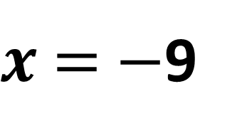

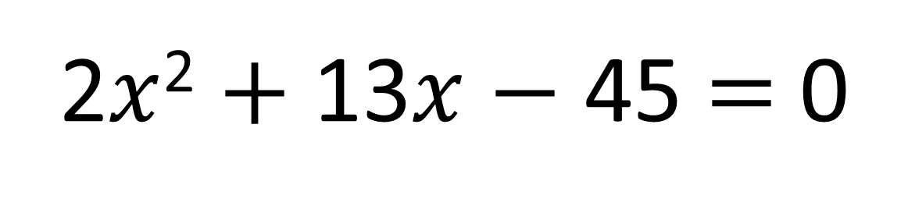
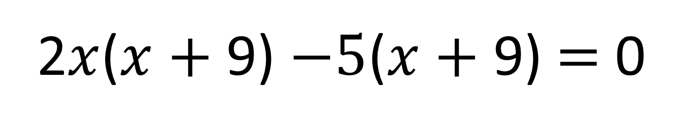
Solve the following quadratic equation by factorising into two brackets.
2$x$² $+$ 13$x$ $−$ 45 $=$ 0
2 $×$ -45 $=$ -90
Factors of 90
11, 90
2, 45
3, 30
5, 18
6, 15
9, 10
2$x$² $+$ 1$8x−5x$ $−$ 45 $=$ 0
2$x$($x$ $+$ 9) $−5$($x$ $+$ 9) $=$ 0
(2$x$ $−$ 5)($x$ $+$9) $=$ 0
5
$x$ $=$
$x$ $=$ $−$9
2
Notes:
Begin with 2 examples.
Suggested walkthrough…
Ex1 – Complete teacher led
Ex2 – Teacher begins, students finish OR students complete [Judge by student competence]

