Slide 1
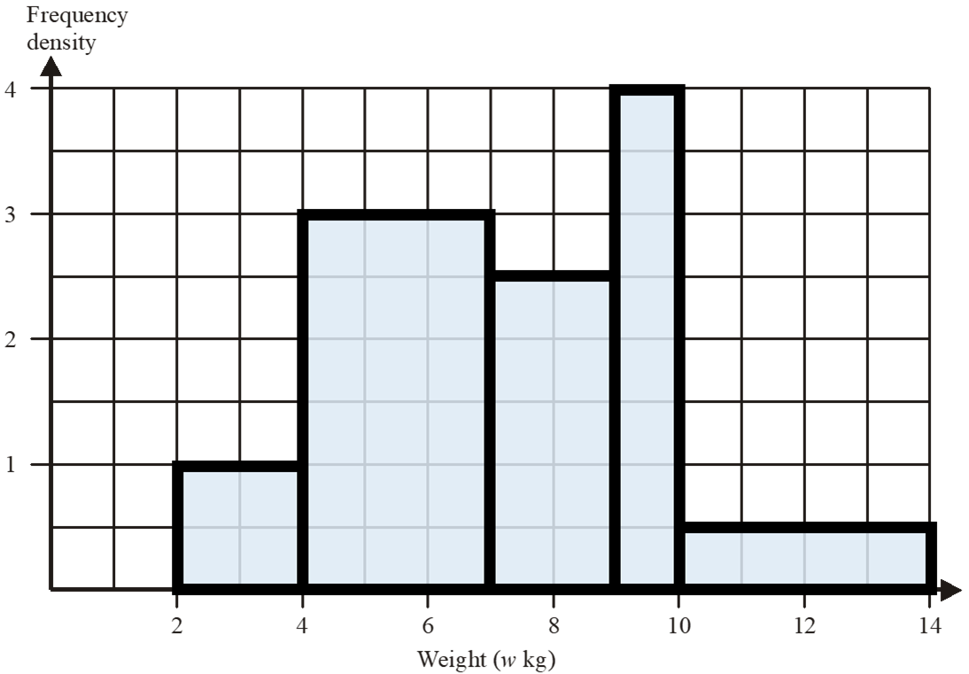
Q1
Weight (w kg) | Frequency
2 ≤ w < 4 | 2
4 ≤ w < 7
7 ≤ w < 9
9 ≤ w < 10
10 ≤ w < 14

Slide 2
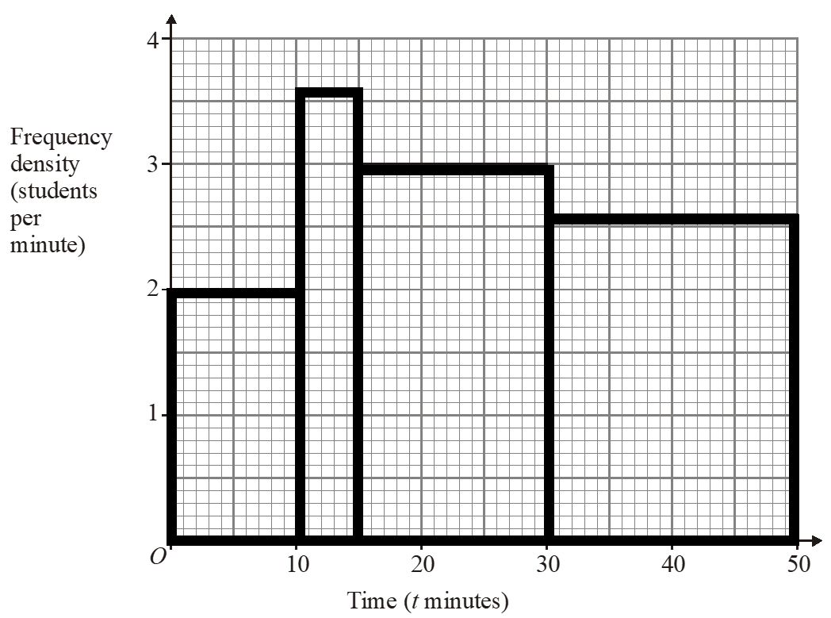
Q2
Time (t minutes) | Frequency
0 < t ≤ 10
10 < t ≤ 15
15 < t ≤ 30
30 < t ≤ 50

Slide 3
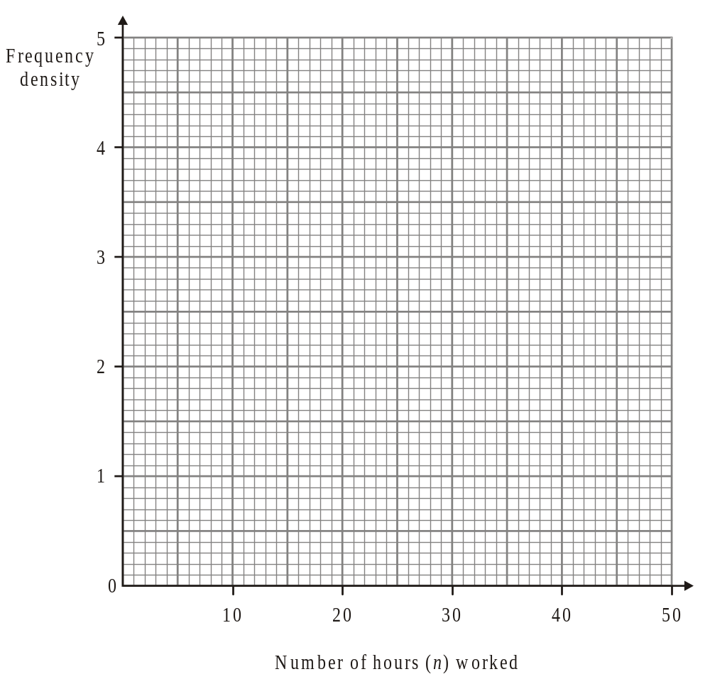
Q3
Number of hours (n) worked | Frequency
0 < n ≤ 5 | 15
5 < n ≤ 15 | 42
15 < n ≤ 35 | 40
35 < n ≤ 50 | 6

Slide 4
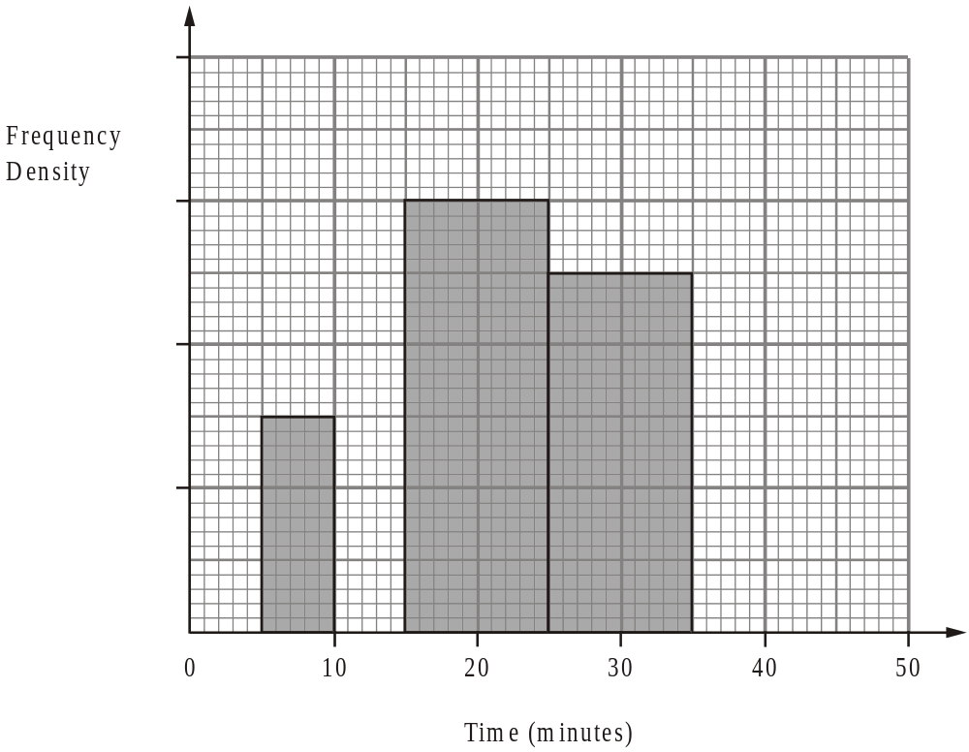
Q4
Time (minutes) | Frequency
5 < x ≤ 10
10 < x ≤ 15 | 20
15 < x ≤ 25
25 < x ≤ 35 | 50
35 < x ≤ 50 | 15

Slide 5
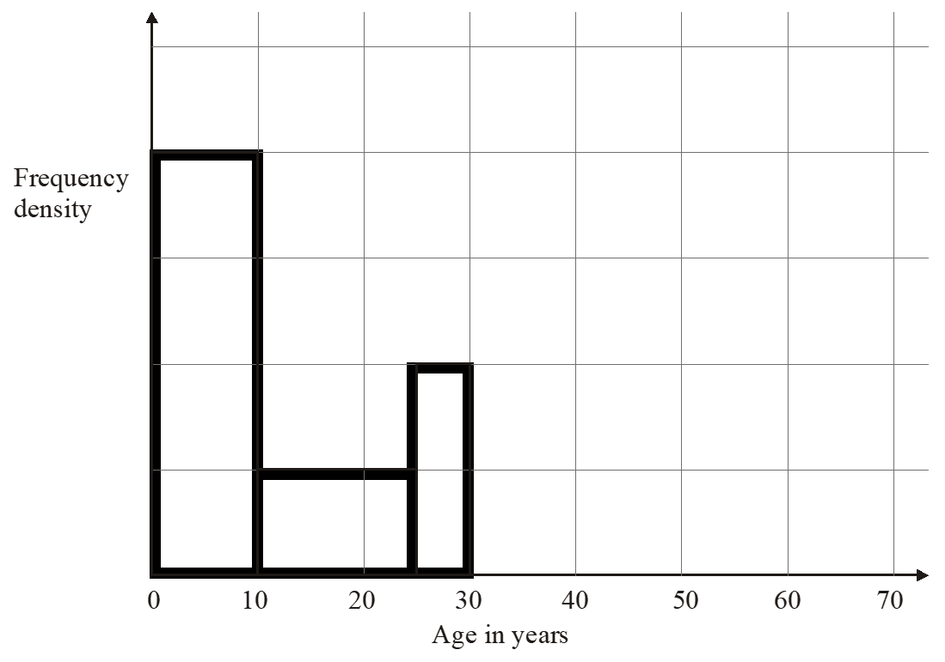
Q5
Age (x) in years | Frequency
0 < x ≤ 10 | 160
10 < x ≤ 25
25 < x ≤ 30
30 < x ≤ 40 | 100
40 < x ≤ 70 | 120

Slide 6
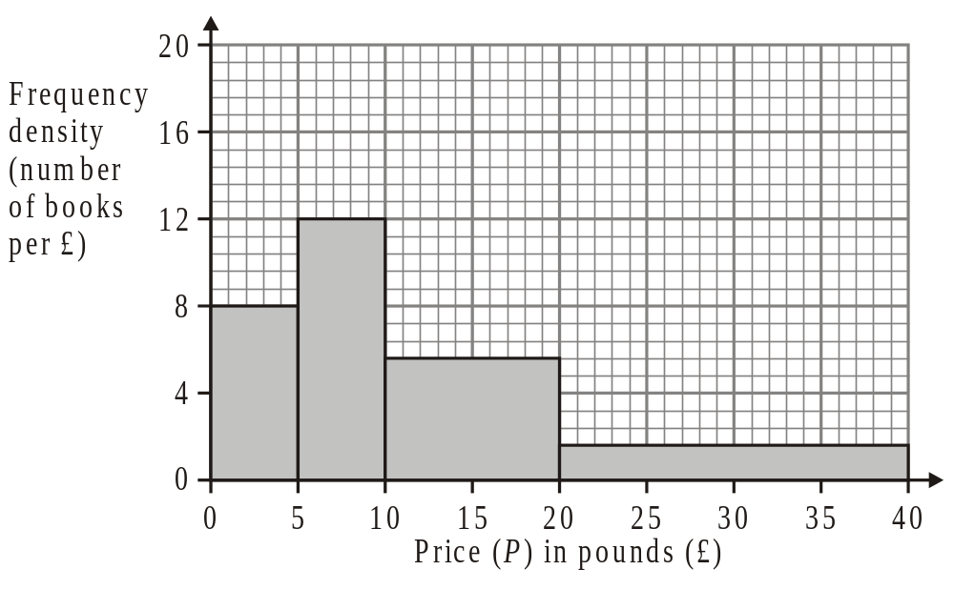
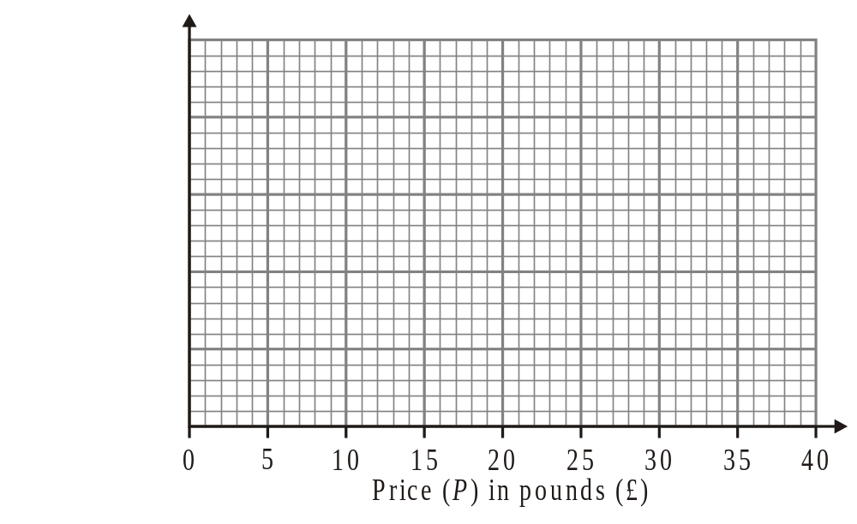
Q6
Price (P) in pounds (£) | Frequency
0 < P ≤ 5
5 < P ≤ 10
10 < P ≤ 20
20 < P ≤ 40
Price (P) in pounds (£) | Frequency
0 < P ≤ 5 | 80
5 < P ≤ 10 | 20
10 < P ≤ 20 | 24
20 < P ≤ 40 | 96

Slide 7
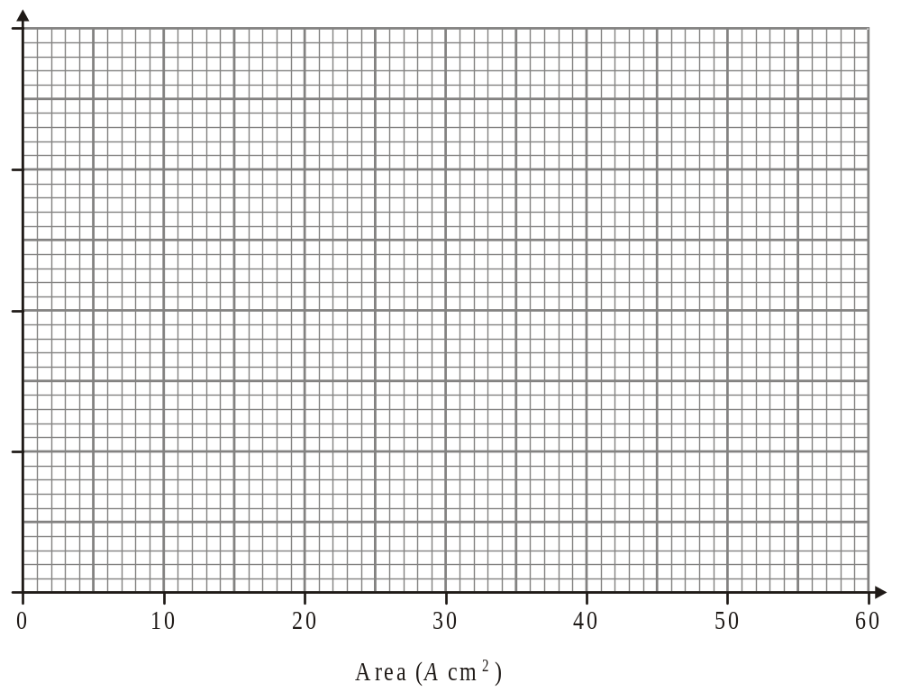
Q7
Area (A cm2) | Frequency
0< A ≤ 10 | 38
10 < A ≤ 25 | 36
25 < A ≤ 40 | 30
40 < A ≤ 60 | 46
(a) Work out an estimate for the mean area of a picture.
.....................................cm2
(4)

Slide 8
ANSWERS

Slide 9
Q1
Weight (w kg) | Frequency
2 ≤ w < 4 | 2
4 ≤ w < 7 | 9
7 ≤ w < 9 | 5
9 ≤ w < 10 | 4
10 ≤ w < 14 | 2

Slide 10
Q2
Time (t minutes) | Frequency
0 < t ≤ 10 | 20
10 < t ≤ 15 | 18
15 < t ≤ 30 | 45
30 < t ≤ 50 | 52

Slide 11
Q3
Number of hours (n) worked | Frequency
0 < n ≤ 5 | 15
5 < n ≤ 15 | 42
15 < n ≤ 35 | 40
35 < n ≤ 50 | 6

Slide 12
Q4
Time (minutes) | Frequency
5 < x ≤ 10 | 15
10 < x ≤ 15 | 20
15 < x ≤ 25 | 60
25 < x ≤ 35 | 50
35 < x ≤ 50 | 15

Slide 13
Q5
Age (x) in years | Frequency
0 < x ≤ 10 | 160
10 < x ≤ 25 | 60
25 < x ≤ 30 | 40
30 < x ≤ 40 | 100
40 < x ≤ 70 | 120

Slide 14
Q6
Price (P) in pounds (£) | Frequency
0 < P ≤ 5 | 40
5 < P ≤ 10 | 60
10 < P ≤ 20 | 56
20 < P ≤ 40 | 32
Price (P) in pounds (£) | Frequency
0 < P ≤ 5 | 80
5 < P ≤ 10 | 20
10 < P ≤ 20 | 24
20 < P ≤ 40 | 96
16
4
2.4
4.8

Slide 15
Q7
Area (A cm2) | Frequency
0< A ≤ 10 | 38
10 < A ≤ 25 | 36
25 < A ≤ 40 | 30
40 < A ≤ 60 | 46
(a) Work out an estimate for the mean area of a picture.
.....................................cm2
(4)
38×5, 36×17.5, 30×32.5, 46×50
= 190, 630, 975, 2300
4095/150 = 27.3

