Slide 1
Trig Functions
Identities sec² cosec²
Chapter 6
(Part 3 of 4)

Slide 2
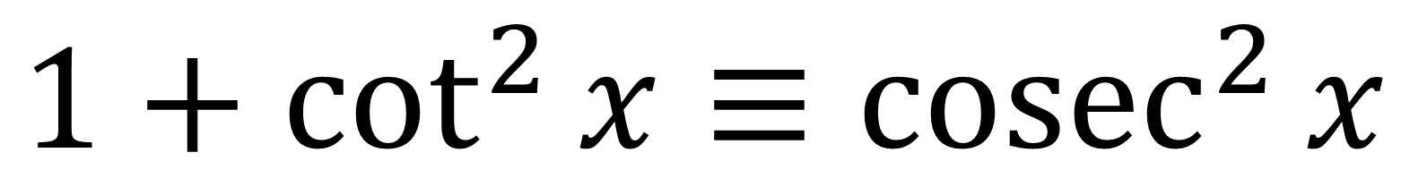

New identities to Learn!
$$\tan^{2}{x}+1≡\sec^{2}{x}$$
$$1+\cot^{2}{x}≡{cosec}^{2}{x}$$

Slide 3

Use this old identity to help you remember the new ones.
$$\sin^{2}{x}+\cos^{2}{x}≡1$$

Slide 4









Dividing by $\cos^{2}{x}$
$$\sin^{2}{x} + \cos^{2}{x} ≡ 1$$
$\frac{\sin^{2}{x}}{\cos^{2}{x}}$
$\frac{\sin^{2}{x}}{\cos^{2}{x}}$
$\frac{\sin^{2}{x}}{\cos^{2}{x}}$
$$\tan^{2}{x}$$
$$+$$
$$1$$
$$≡ \sec^{2}{x}$$

Slide 5






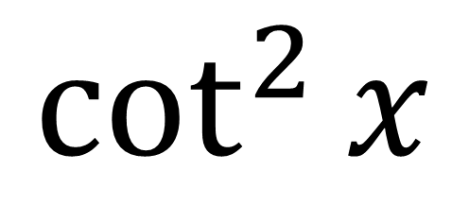

Dividing by $\sin^{2}{x}$
$$\sin^{2}{x} + \cos^{2}{x} ≡ 1$$
$\frac{\sin^{2}{x}}{\sin^{2}{x}}$
$\frac{\sin^{2}{x}}{\sin^{2}{x}}$
$\frac{\sin^{2}{x}}{\sin^{2}{x}}$
$$1$$
$$+$$
$$\cot^{2}{x}$$
$$≡ {cosec}^{2}{x}$$

Slide 6
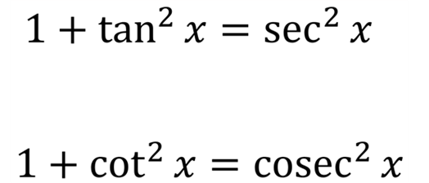
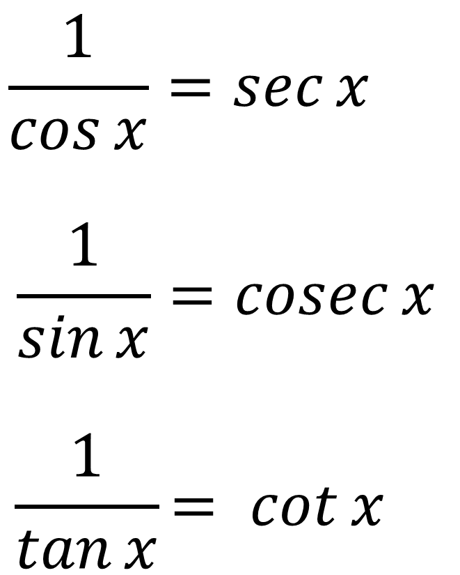
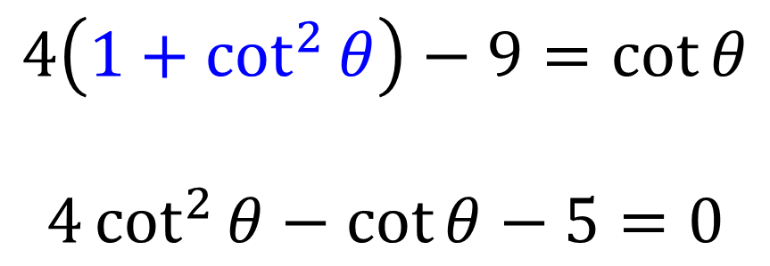
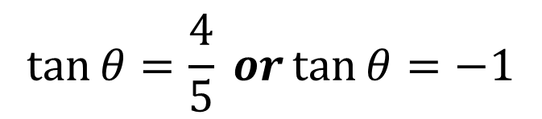
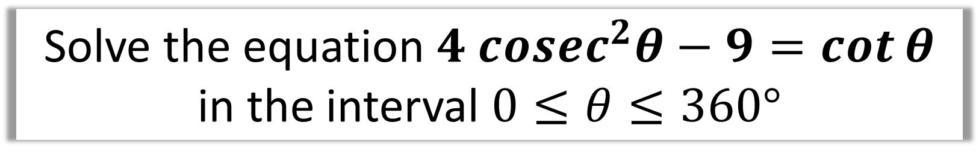
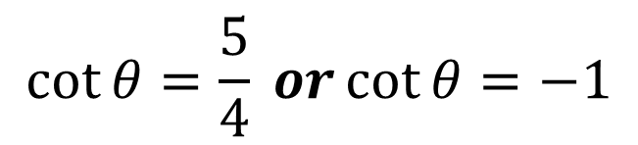

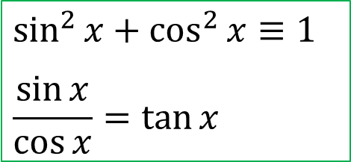
Solve the equation $4 cosec^{2}θ−9=\cot{θ}$
in the interval $0≤θ≤360°$
$$4\left(1+\cot^{2}{θ}\right)−9=\cot{θ}$$
$$4\cot^{2}{θ}−\cot{θ}−5=0$$
$$\cot{θ}=\frac{5}{4} or\cot{θ}=−1$$
$$\tan{θ}=\frac{4}{5} or\tan{θ}=−1$$
$$\sin^{2}{x}+\cos^{2}{x}≡1$$
$$\frac{\sin{x}}{\cos{x}}=\tan{x}$$
$$θ=38.7, 218.7,135°, 315°$$

Slide 7

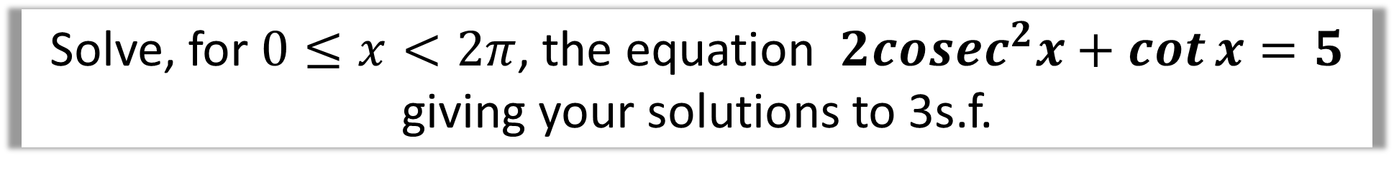
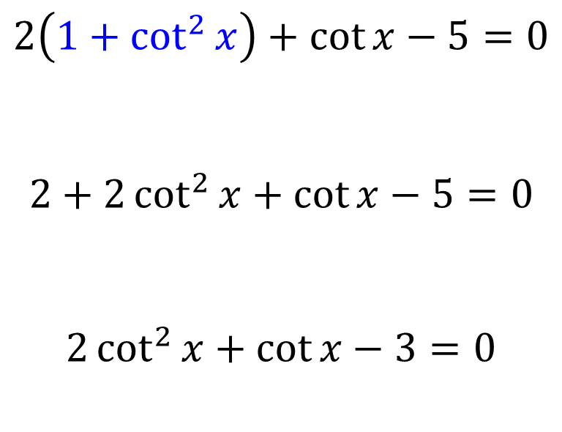
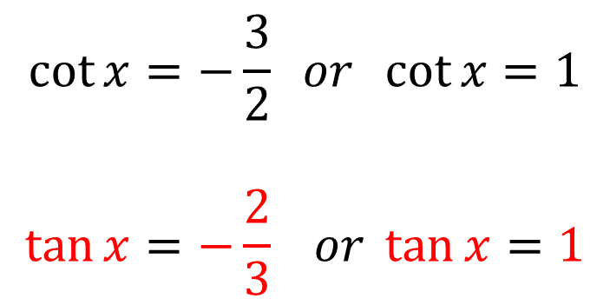
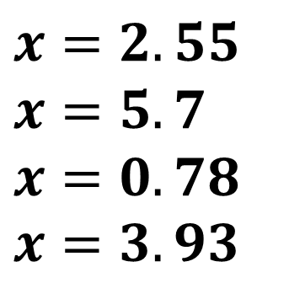
Solve, for $0≤x<2π$, the equation $2cosec^{2}x+\cot{x}=5$
giving your solutions to 3s.f.
$$2\left(1+\cot^{2}{x}\right)+\cot{x}−5=0$$
$$2+2\cot^{2}{x}+\cot{x}−5=0$$
$$2\cot^{2}{x}+\cot{x}−3=0$$
$$\cot{x}=−\frac{3}{2} or \cot{x}=1$$
$$\tan{x}=−\frac{2}{3} or \tan{x}=1$$
$$x=2.55$$
$$x=5.7$$
$$x=0.78$$
$$x=3.93$$
$$\sin^{2}{x}+\cos^{2}{x}≡1$$
$$\frac{\sin{x}}{\cos{x}}=\tan{x}$$

Slide 8

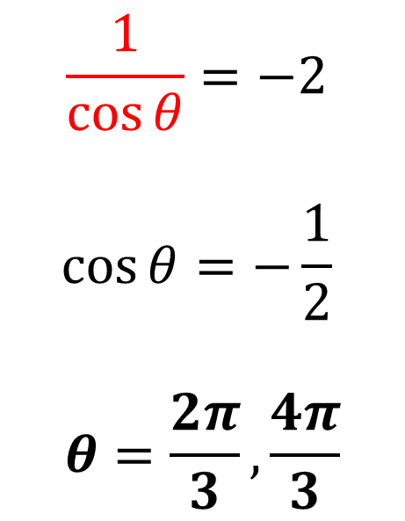

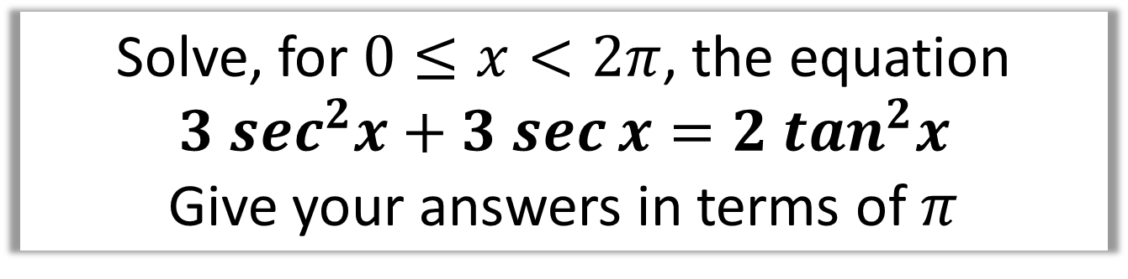

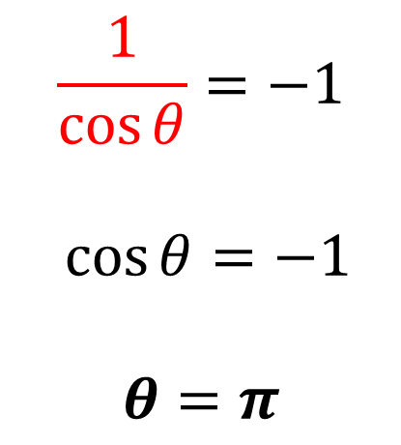
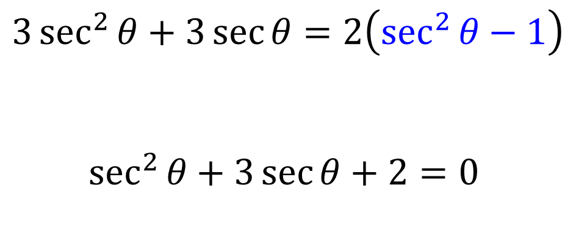

Solve, for $0≤x<2π$, the equation
$$3 sec^{2}x+3 sec{x}=2 \tan^{2}x$$
Give your answers in terms of $π$
$$\sec{θ}=−2$$
$$\sec{θ}=−1$$
$$3\sec^{2}{θ}+3\sec{θ}=2\left(\sec^{2}{θ}−1\right)$$
$$\sec^{2}{θ}+3\sec{θ}+2=0$$
$$\frac{1}{\cos{θ}}=−2$$
$$\cos{θ}=−\frac{1}{2}$$
$$θ=\frac{2π}{3},\frac{4π}{3}$$
$$\frac{1}{\cos{θ}}=−1$$
$$\cos{θ}=−1$$
$$θ=π$$
$$\sec{θ}=−2$$
$$\sec{θ}=−1$$

Slide 9
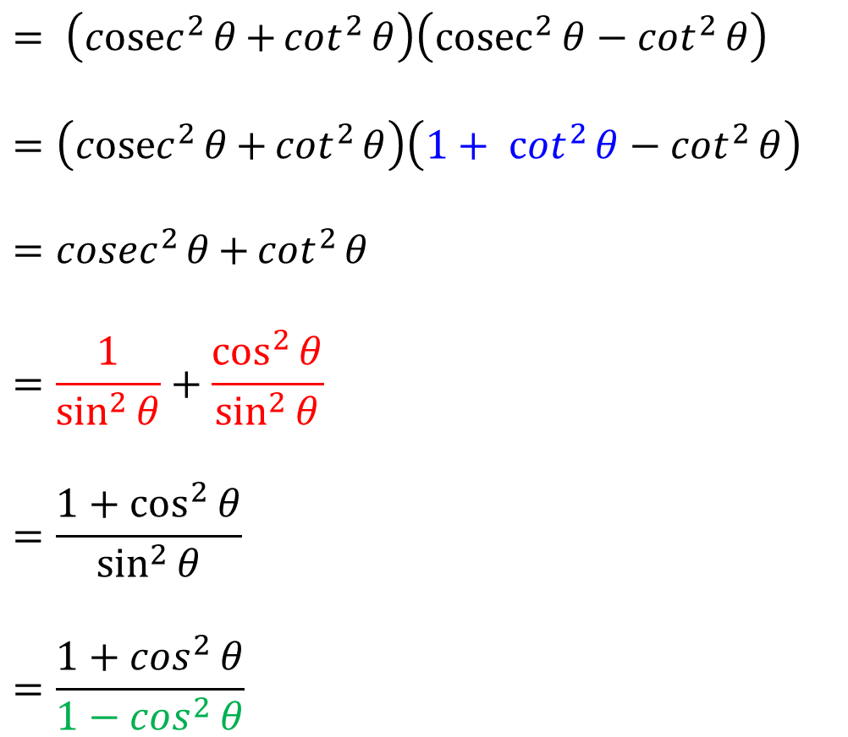
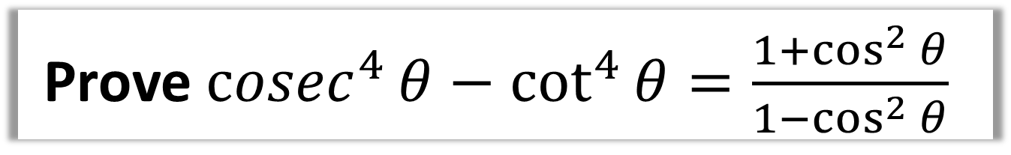

Prove ${cosec}^{4}{θ}−\cot^{4}{θ}=\frac{1+\cos^{2}{θ}}{1−\cos^{2}{θ}}$
$$= \left({cosec}^{2}{θ}{+\cot^{2}{θ}}\right)\left({cosec}^{2}{θ}−\cot^{2}{θ}\right)$$
$$=\left({cosec}^{2}{θ}{+\cot^{2}{θ}}\right)\left({1+ cot}^{2}{θ}−\cot^{2}{θ}\right)$$
$$={cosec}^{2}{θ}{+\cot^{2}{θ}}$$
$$=\frac{1}{\sin^{2}{θ}}+\frac{\cos^{2}{θ}}{\sin^{2}{θ}}$$
$$=\frac{1+\cos^{2}{θ}}{\sin^{2}{θ}}$$
$$=\frac{1+\cos^{2}{θ}}{1−\cos^{2}{θ}}$$
$$\sin^{2}{x}+\cos^{2}{x}≡1$$
$$\frac{\sin{x}}{\cos{x}}=\tan{x}$$

Slide 10
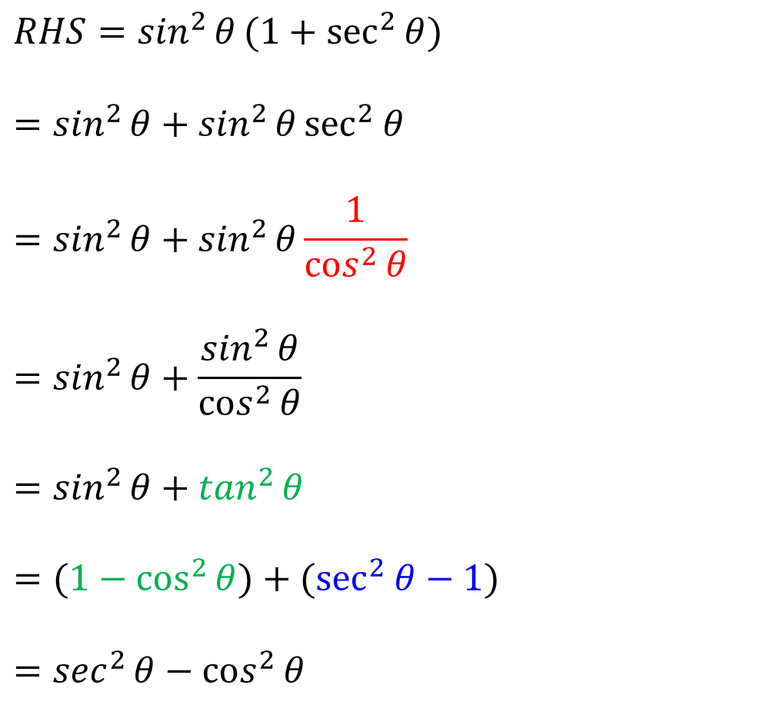
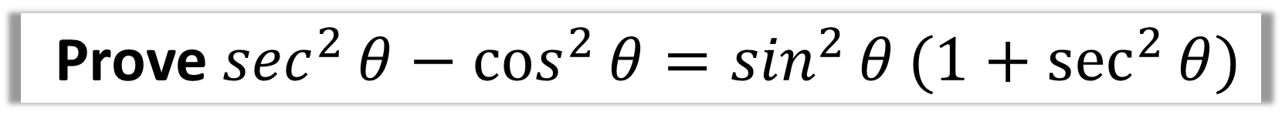

Prove $\sec^{2}{θ}−\cos^{2}{θ}=\sin^{2}{θ}(1+\sec^{2}{θ)}$
$$RHS=\sin^{2}{θ}(1+\sec^{2}{θ)}$$
$$=\sin^{2}{θ}+{\sin^{2}{θ}sec}^{2}{θ}$$
$$=\sin^{2}{θ}+\sin^{2}{θ}\frac{1}{\cos^{2}{θ}}$$
$${=sin}^{2}{θ}+\frac{\sin^{2}{θ}}{\cos^{2}{θ}}$$
$${=sin}^{2}{θ}+\tan^{2}{θ}$$
$$=(1−\cos^{2}{θ)}+(\sec^{2}{θ−1)}$$
$${=sec}^{2}{θ}−\cos^{2}{θ}$$
$$\sin^{2}{x}+\cos^{2}{x}≡1$$
$$\frac{\sin{x}}{\cos{x}}=\tan{x}$$

