Slide 1
LO: Recurring
Decimals as Fractions

Slide 2
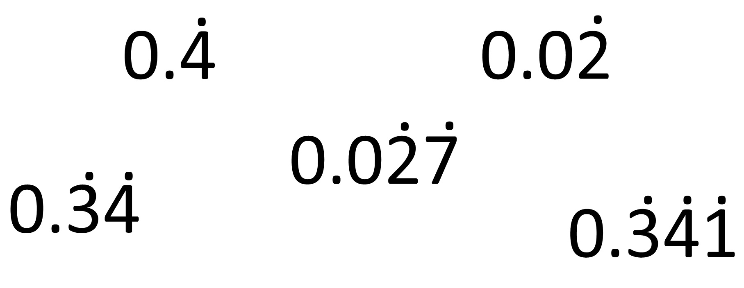
What’s the point(s)?

Slide 3
A recurring decimal is a decimal number with a digit (or group of digits)
that repeats forever.
The part that repeats can also be shown by placing dots over the first and last digits of the repeating pattern.

Slide 4
.
0.4 =
0.444444....

Slide 5
.
0.24 =
0.2444444....

Slide 6
.
.
0.24 =
0.242424......

Slide 7
.
.
0.214 =
0.214214214.....

Slide 8

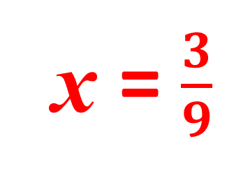
10x =
3.333333…
x =
0.333333…
9x = 3
x = $\frac{3}{9}$

Slide 9

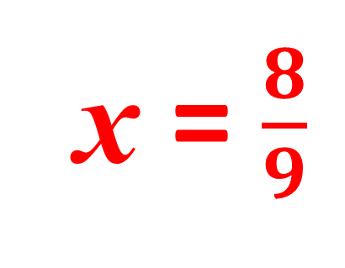
10x =
8.888888…
x = 0.888888…
9x = 8
x = $\frac{8}{9}$

Slide 10

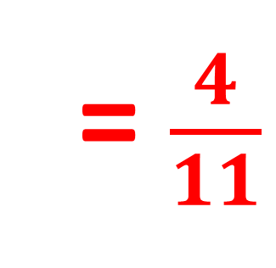
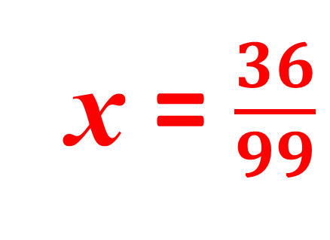
100x =
36.363636…
x = 0.363636…
99x = 36
x = $\frac{36}{99}$
= $\frac{4}{11}$

Slide 11
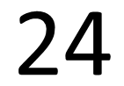
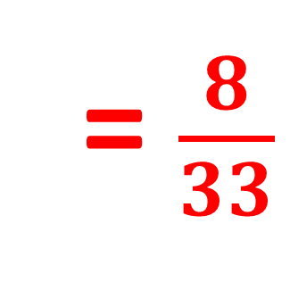
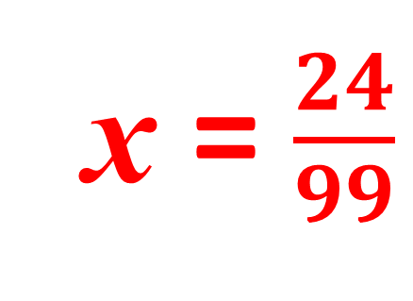
100x =
24.242424…
x = 0.242424…
99x = 24
x = $\frac{24}{99}$
= $\frac{8}{33}$

Slide 12

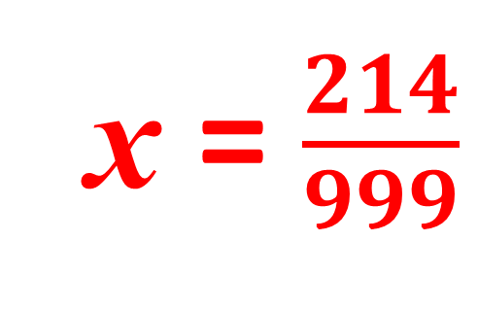
1000x =
214.214214214…
x = 0.214214214…
999x = 214
x = $\frac{214}{999}$

Slide 13

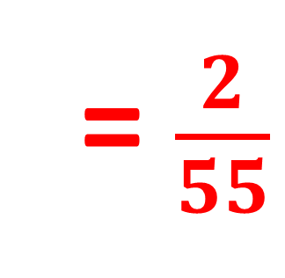
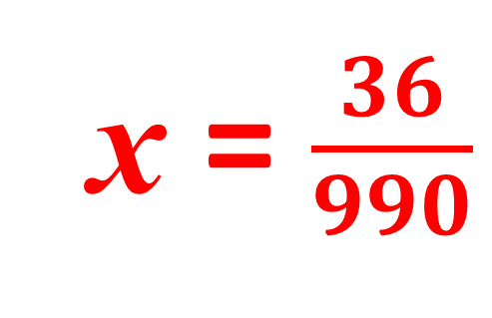
1000x =
36.363636…
10x = 0.363636…
990x = 36
x = $\frac{36}{990}$
= $\frac{2}{55}$

Slide 14
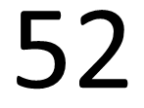
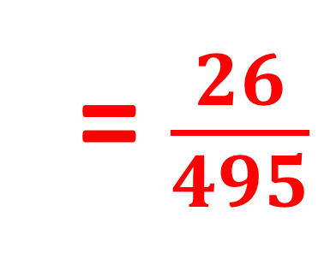
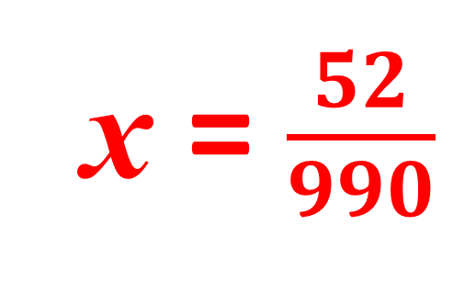
1000x =
52.525252…
10x = 0.525252…
990x = 52
x = $\frac{52}{990}$
= $\frac{26}{495}$

Slide 15

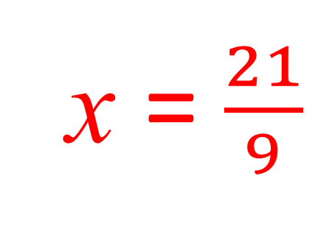
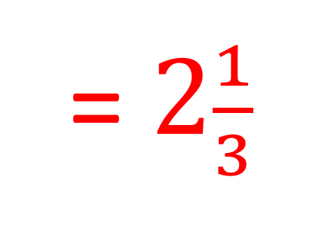
10x =
23.3333333…
x = 2.3333333…
9x = 21
x = $\frac{21}{9}$
= $2\frac{1}{3}$

