Slide 1
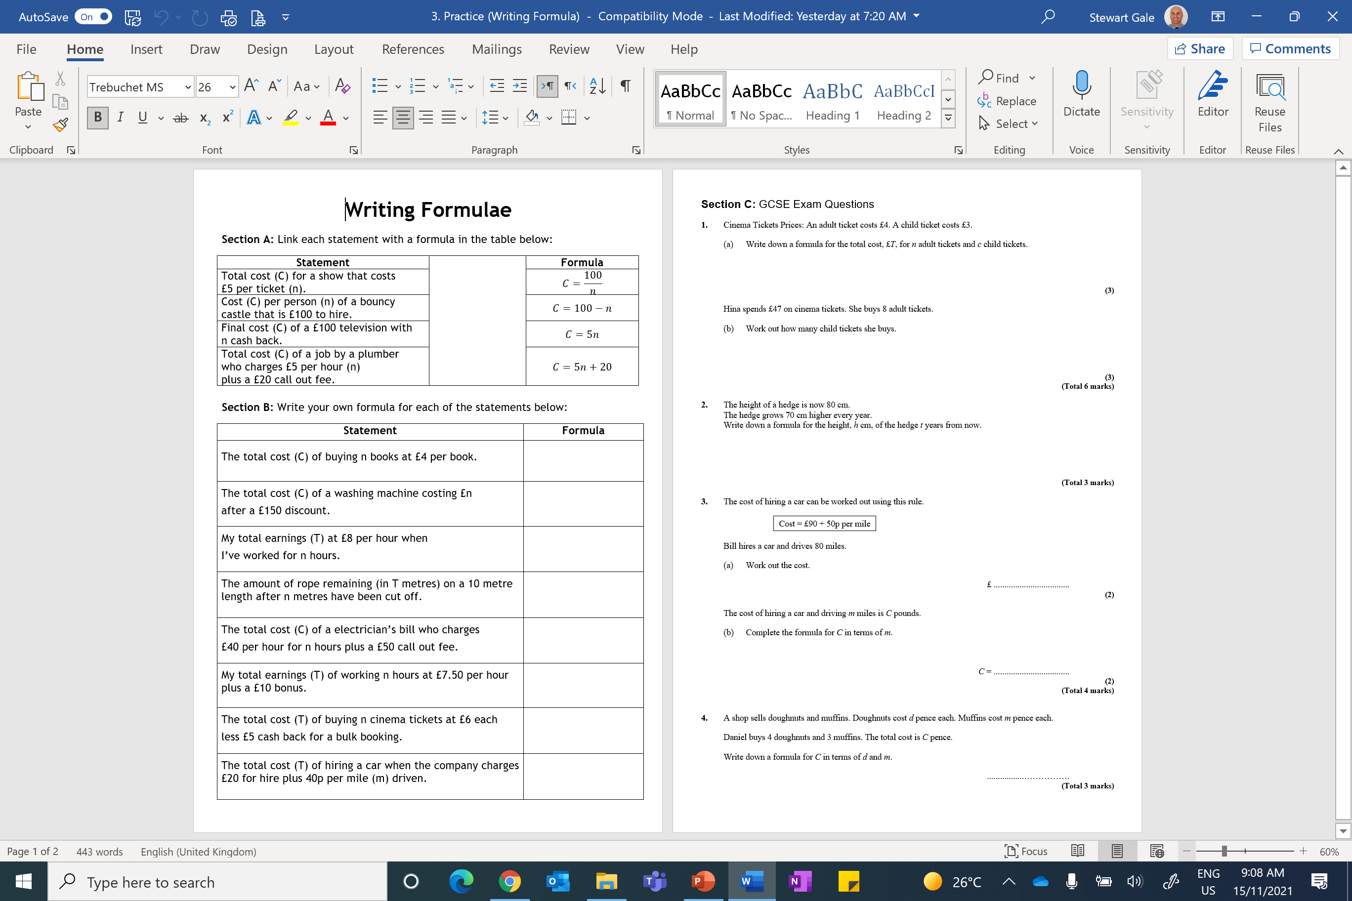

Slide 2
ANSWERS

Slide 3
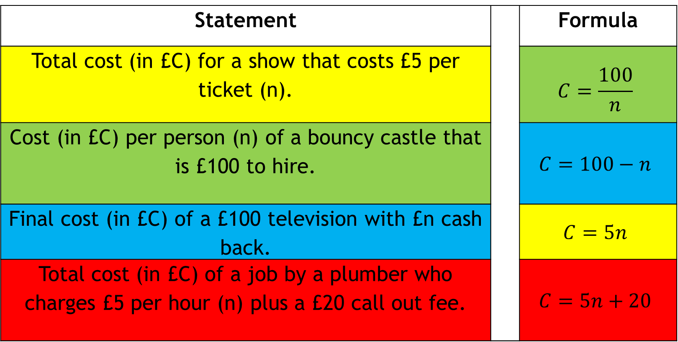
Statement |  | Formula
Total cost (in £C) for a show that costs £5 per ticket (n). |  | $$C=\frac{100}{n}$$
Cost (in £C) per person (n) of a bouncy castle that is £100 to hire. |  | $$C=100−n$$
Final cost (in £C) of a £100 television with £n cash back. |  | $$C=5n$$
Total cost (in £C) of a job by a plumber who charges £5 per hour (n) plus a £20 call out fee. |  | $$C=5n+20$$

Slide 4
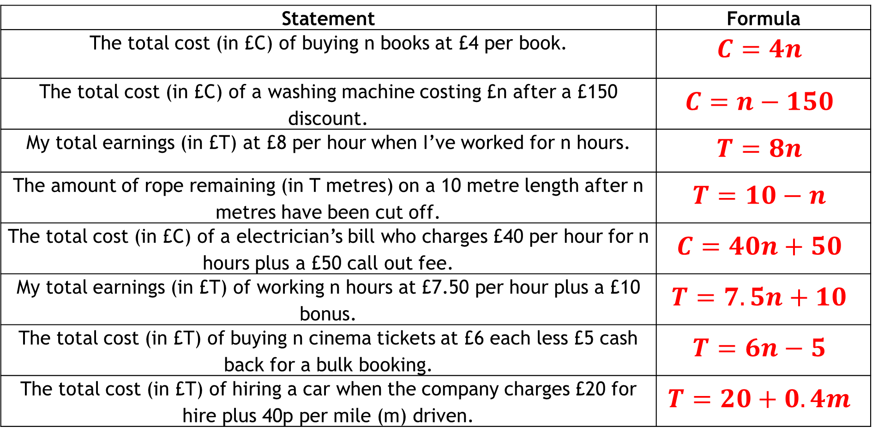
Statement | Formula
The total cost (in £C) of buying n books at £4 per book. | $$C=4n$$
The total cost (in £C) of a washing machine costing £n after a £150 discount. | $$C=n−150$$
My total earnings (in £T) at £8 per hour when I’ve worked for n hours. | $$T=8n$$
The amount of rope remaining (in T metres) on a 10 metre length after n metres have been cut off. | $$T=10−n$$
The total cost (in £C) of a electrician’s bill who charges £40 per hour for n hours plus a £50 call out fee. | $$C=40n+50$$
My total earnings (in £T) of working n hours at £7.50 per hour plus a £10 bonus. | $$T=7.5n+10$$
The total cost (in £T) of buying n cinema tickets at £6 each less £5 cash back for a bulk booking. | $$T=6n−5$$
The total cost (in £T) of hiring a car when the company charges £20 for hire plus 40p per mile (m) driven. | $$T=20+0.4m$$

Slide 5
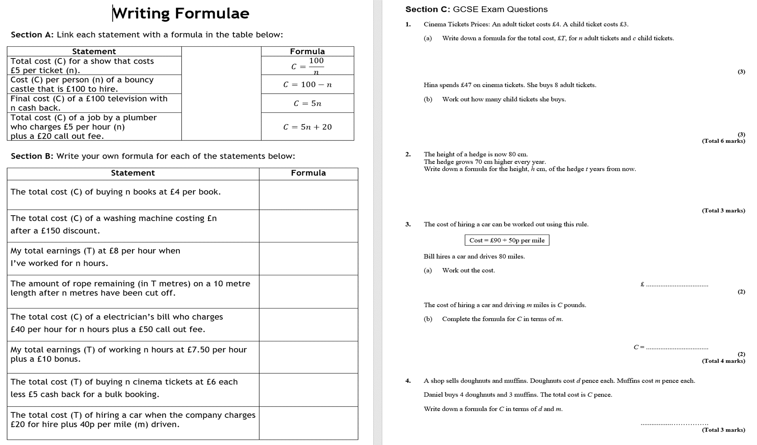
T = 4n + 3c
M1 sight of 4n
M1 sight of 3c
A1 cao
47 = 4 × 8 + 3c
3c = 47 – 32
3c = 15
5

Slide 6
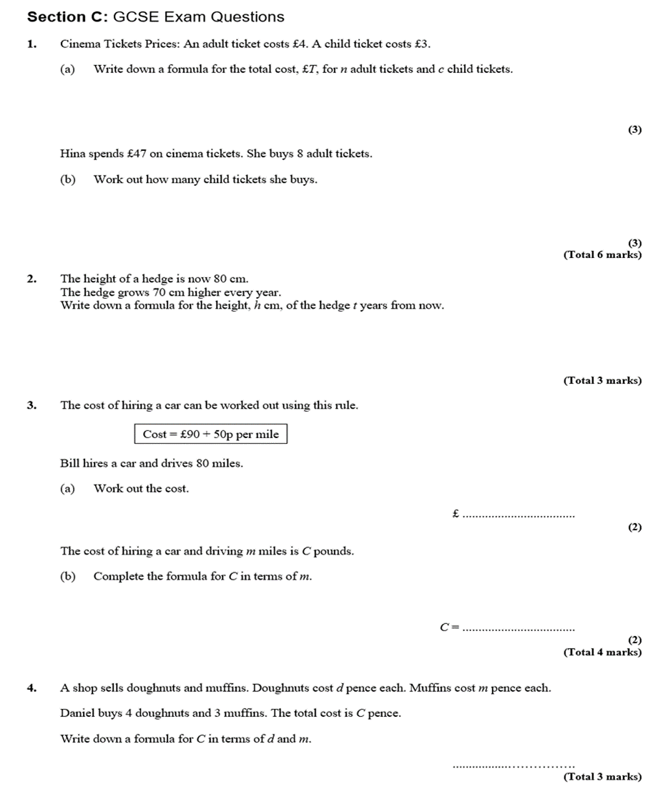
h = 70t + 80
B1 for h = linear expression in t
B2 for 70t + 80
(B1 for 70t)

Slide 7
90 + 80 × 0.50
90 + 40
= £130
90 + 0.5m
B1 for 0.5 m
B1 for 90 + “0.5m”
NB ignore £ signs

Slide 8
C = 4d + 3m
B3 for C = 4d + 3m
[B2 for 4d + 3m only,
B1 for 4d or 3m or C = “4d” + “3m”]

