Slide 1
LO: Frequency
Diagrams

Slide 2
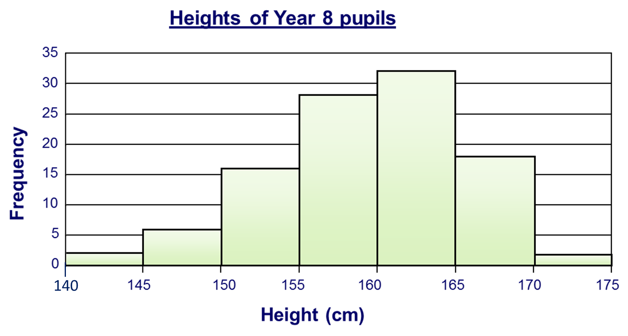
Frequency Diagrams are basically Bar Charts.
What are the difference between
Frequency diagrams and Bar Charts?

Slide 3


Rules of Frequency Diagrams:
Use only continuous Data
(Data where any number is possible)
No gaps between the bars
Continuous Scales
not grouped
80 - 85
86 - 90
80 85 90

Slide 4
Continuous Data or Not
Height of students
in my class
Continuous Data

Slide 5
Continuous Data or Not
Time to
complete a race
Continuous Data

Slide 6
Continuous Data or Not
Students
favourite colours
Not

Slide 7
Continuous Data or Not
Length of
javelin thrown
Continuous Data

Slide 8
Continuous Data or Not
Number of visits
to a museum
Not

Slide 9
What is good about this frequency diagrams?
Time taken to complete a task
30
25
20
Frequency
15
10
5
0
75
80
85
90
95
100
105
110
Times in seconds

Slide 10
What is bad about this frequency diagrams?
30
25
20
15
10
5
0
80 - 85
85 - 90
90 - 95
95 - 100
100 - 105

