Slide 1
FM: Limiting
Sequences

Slide 2
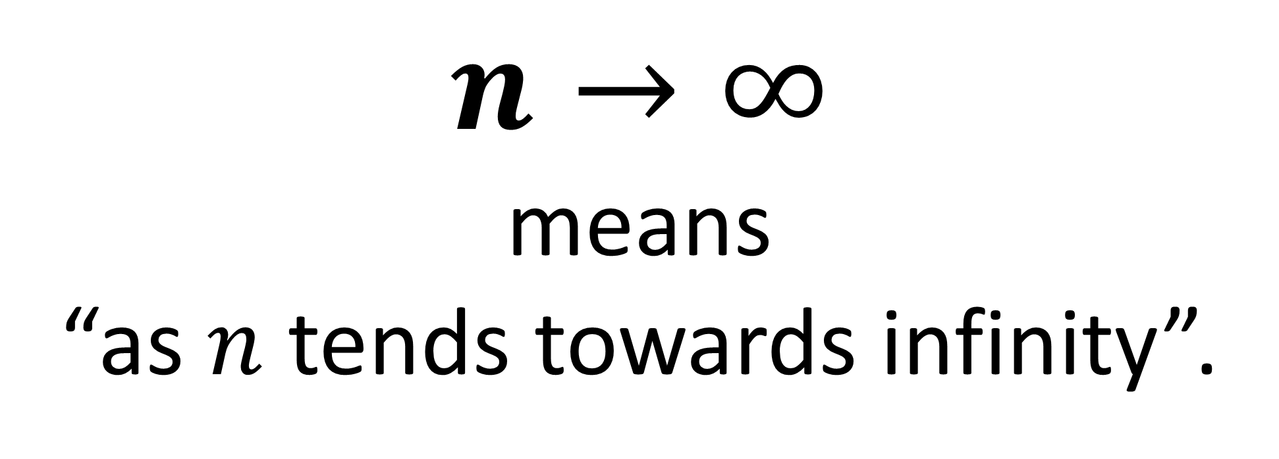
$n→∞$
means
“as $n$ tends towards infinity”.

Slide 3
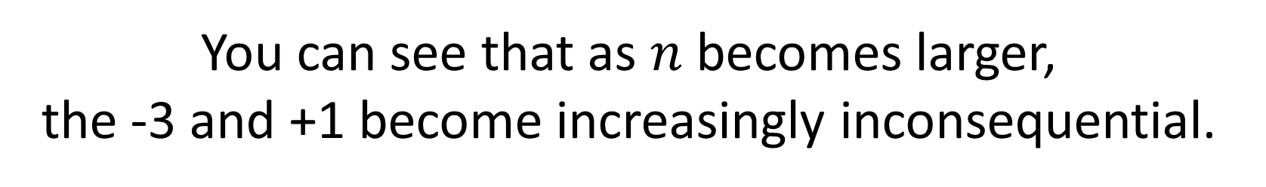
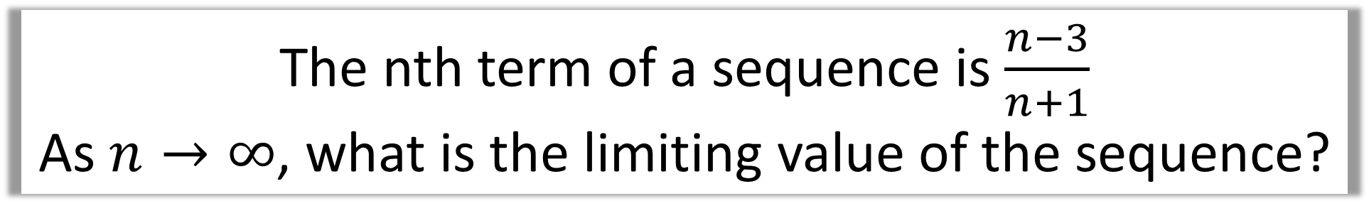
The nth term of a sequence is $\frac{n−3}{n+1}$
As $n→∞$, what is the limiting value of the sequence?
$$−\frac{2}{2}, −\frac{1}{3},\frac{0}{4},\frac{1}{5},\frac{2}{6},\frac{3}{7},\frac{4}{8},\frac{5}{9},\frac{6}{10},\frac{7}{11},\frac{8}{12},\frac{9}{13},\frac{10}{14},\frac{11}{15},\frac{12}{16},\frac{13}{17},\frac{14}{18},\frac{15}{19},\frac{16}{20},\frac{17}{21},…,\frac{97}{101},…$$
The first 20 terms are as following (and the 100th).
What do you notice?
You can see that as $n$ becomes larger,
the -3 and +1 become increasingly inconsequential.
You can say: “As $n$ becomes large$, \frac{n−3}{n+1}→\frac{n}{n} =1$”

Slide 4
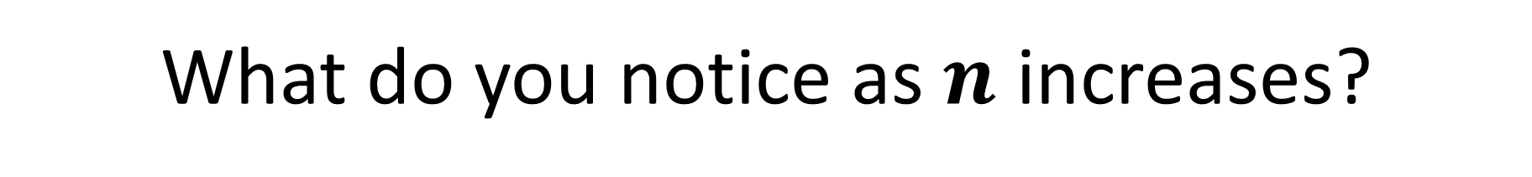
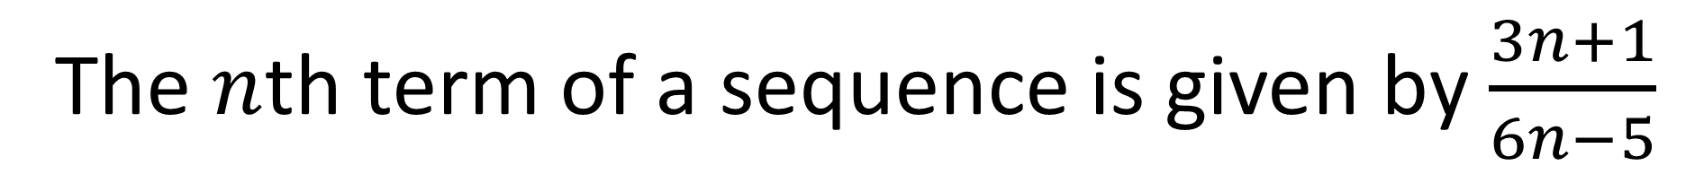
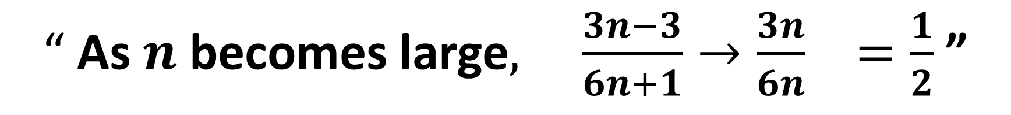
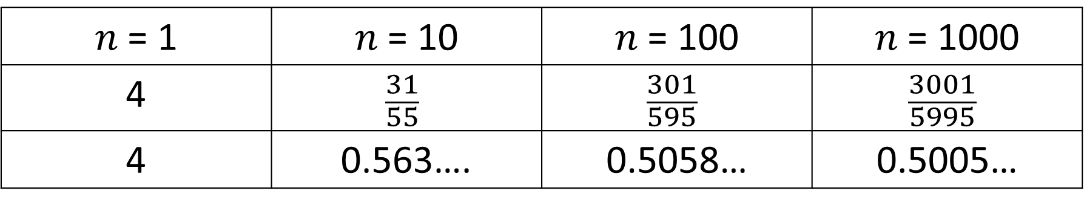
The $n$th term of a sequence is given by $\frac{3n+1}{6n−5}$
What do you notice as $n$ increases?
$n$ = 1 | $n$ = 10 | $n$ = 100 | $n$ = 1000
4 | $$\frac{31}{55}$$ | $$\frac{301}{595}$$ | $$\frac{3001}{5995}$$
4 | 0.563…. | 0.5058… | 0.5005…
“ As $n$ becomes large$, \frac{3n−3}{6n+1}→\frac{3n}{6n} =\frac{1}{2}$ ”

Slide 5
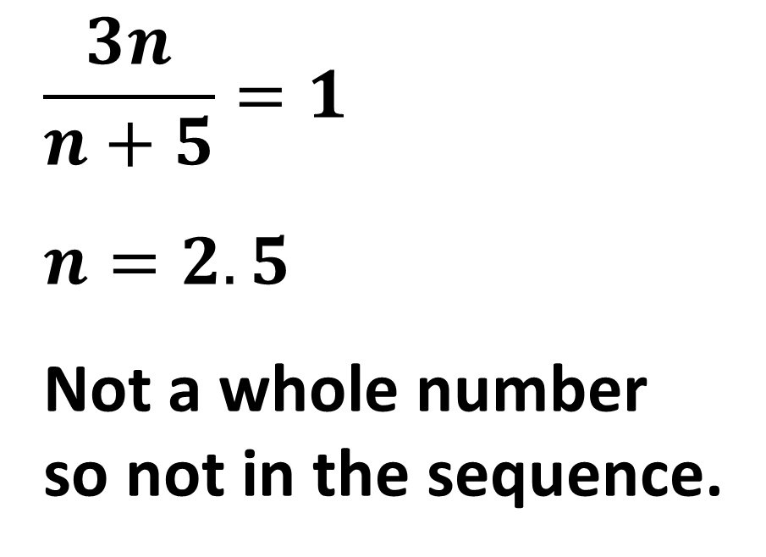
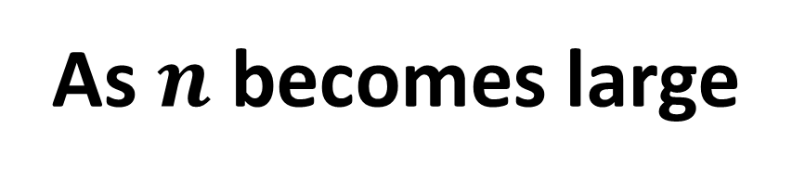
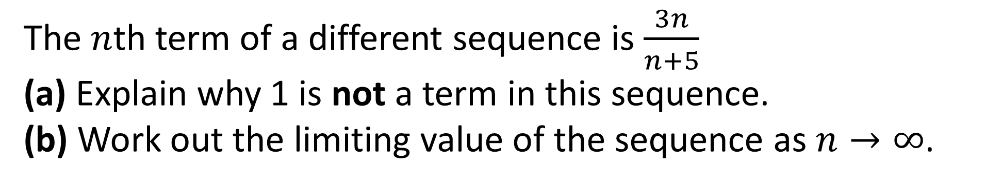

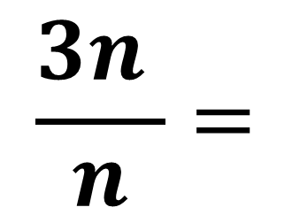
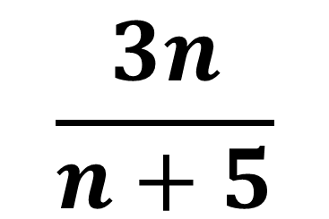
The $n$th term of a different sequence is $\frac{3n}{n+5}$
(a) Explain why 1 is not a term in this sequence.
(b) Work out the limiting value of the sequence as $n→∞$.
$$\frac{3n}{n+5}=1$$
$n=2.5$
Not a whole number
so not in the sequence.
As $n$ becomes large
$$\frac{3n}{n+5}$$
$$\frac{3n }{n}=$$
$$→$$
3

Slide 6
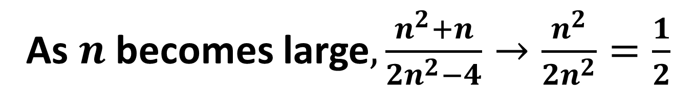

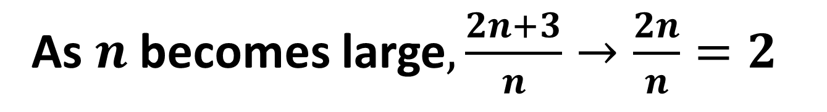
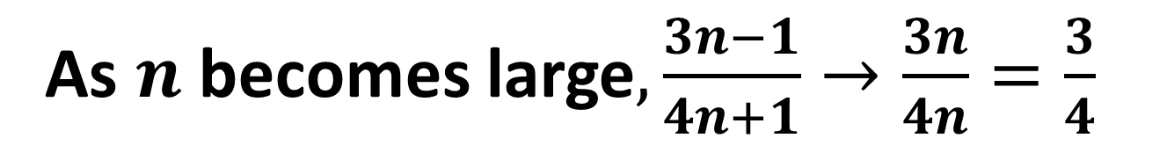
As $n→∞$, what is the limiting value of the sequences with $n$th term:
$\frac{2n+3}{n}$
$\frac{3n−1}{4n+1}$
$\frac{n^{2}+n}{2n^{2}−4}$
As $n$becomes large$,\frac{2n+3}{n}→\frac{2n}{n}=2$
As $n$becomes large$,\frac{3n−1}{4n+1}→\frac{3n}{4n}=\frac{3}{4}$
As $n$becomes large$,\frac{n^{2}+n}{2n^{2}−4}→\frac{n^{2}}{2n^{2}}=\frac{1}{2}$

Slide 7
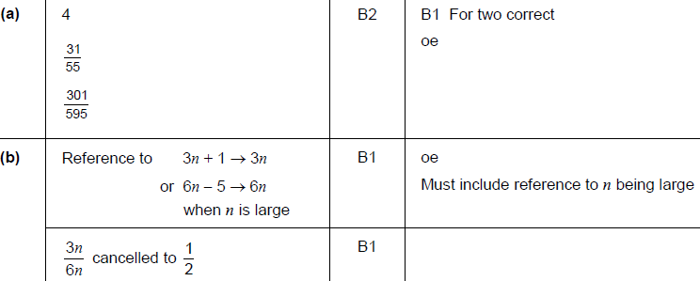
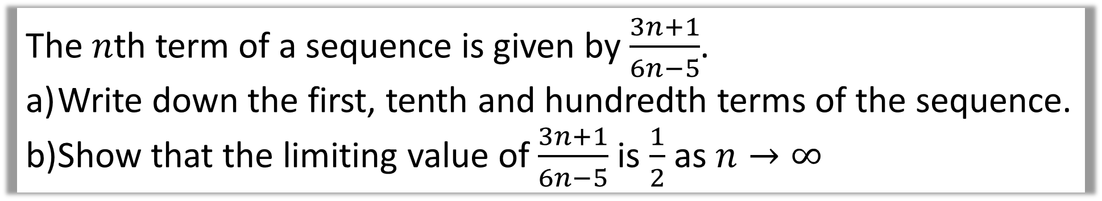
The $n$th term of a sequence is given by $\frac{3n+1}{6n−5}$.
Write down the first, tenth and hundredth terms of the sequence.
Show that the limiting value of $\frac{3n+1}{6n−5}$ is $\frac{1}{2}$ as $n→∞$

