Slide 1

Diagnostic
uestions
Misconceptions

Slide 2
Worst answered question?
A list of positive integers has a median of 8, a mode of 9 and a mean of 10. What is the smallest possible number of integers in the list?
A 5 | B 6
C 7 | D 8
The range of 6 number is 18. 10, 18, 3, 13, ?, ? Which two number are missing?
A 19 and 1 | B 21 and 5
C 17 and 0 | D 22 and 4
40% Incorrect
55% Incorrect

Slide 3
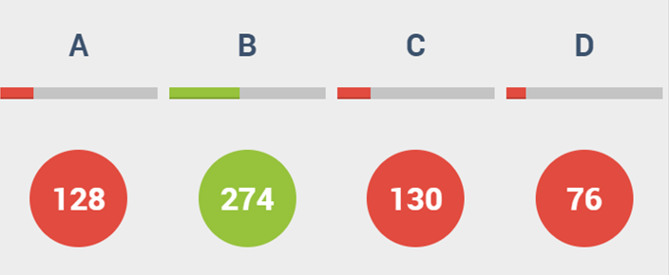
Most common wrong answer?
A list of positive integers has a median of 8, a mode of 9 and a mean of 10. What is the smallest possible number of integers in the list?
A 5 | B 6
C 7 | D 8
C
The student did not realise they could do it in less.

Slide 4
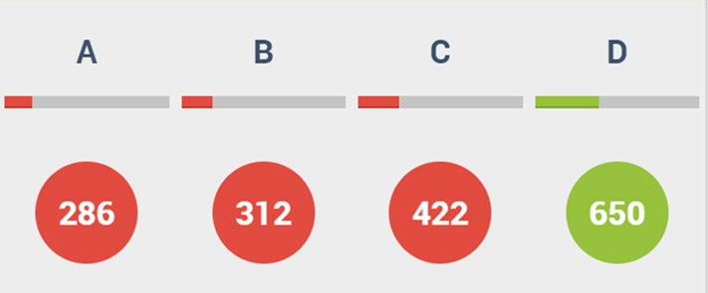
Most common wrong answer?
The range of 6 number is 18. 10, 18, 3, 13, ?, ? Which two number are missing?
A 19 and 1 | B 21 and 5
C 17 and 0 | D 22 and 4
C
The student has picked two numbers that have a range of 18.

