Slide 1
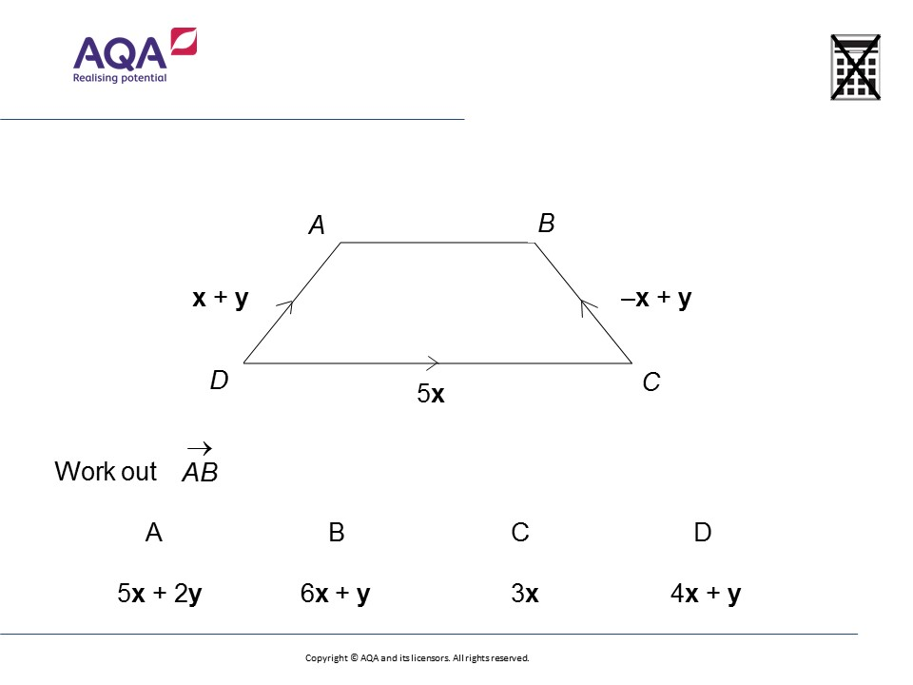
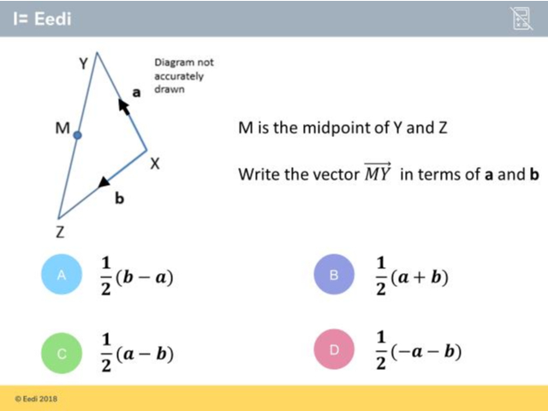
Worst answered question?
Most common wrong answer?

Slide 2
ANSWERS

Slide 3
Worst answered question?

Slide 4
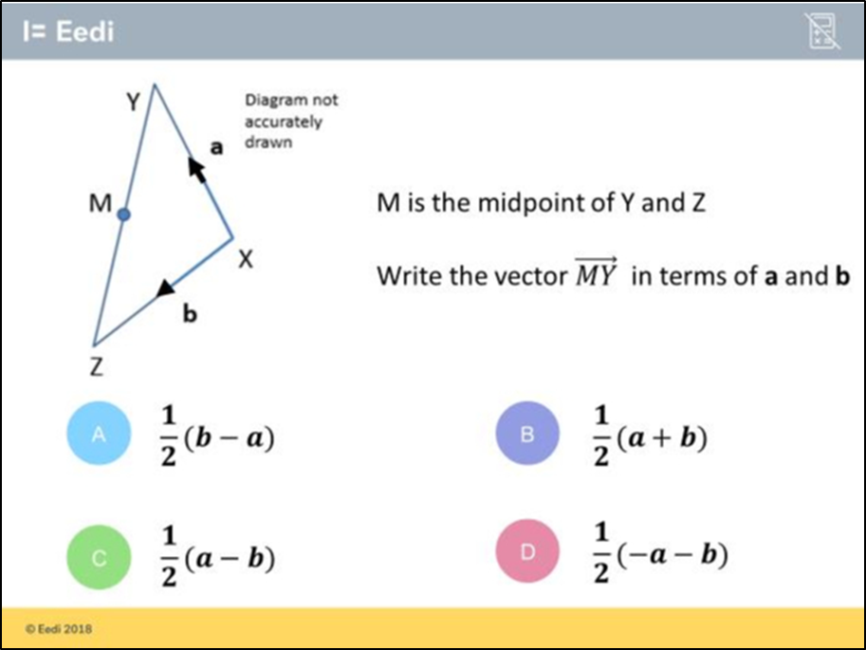
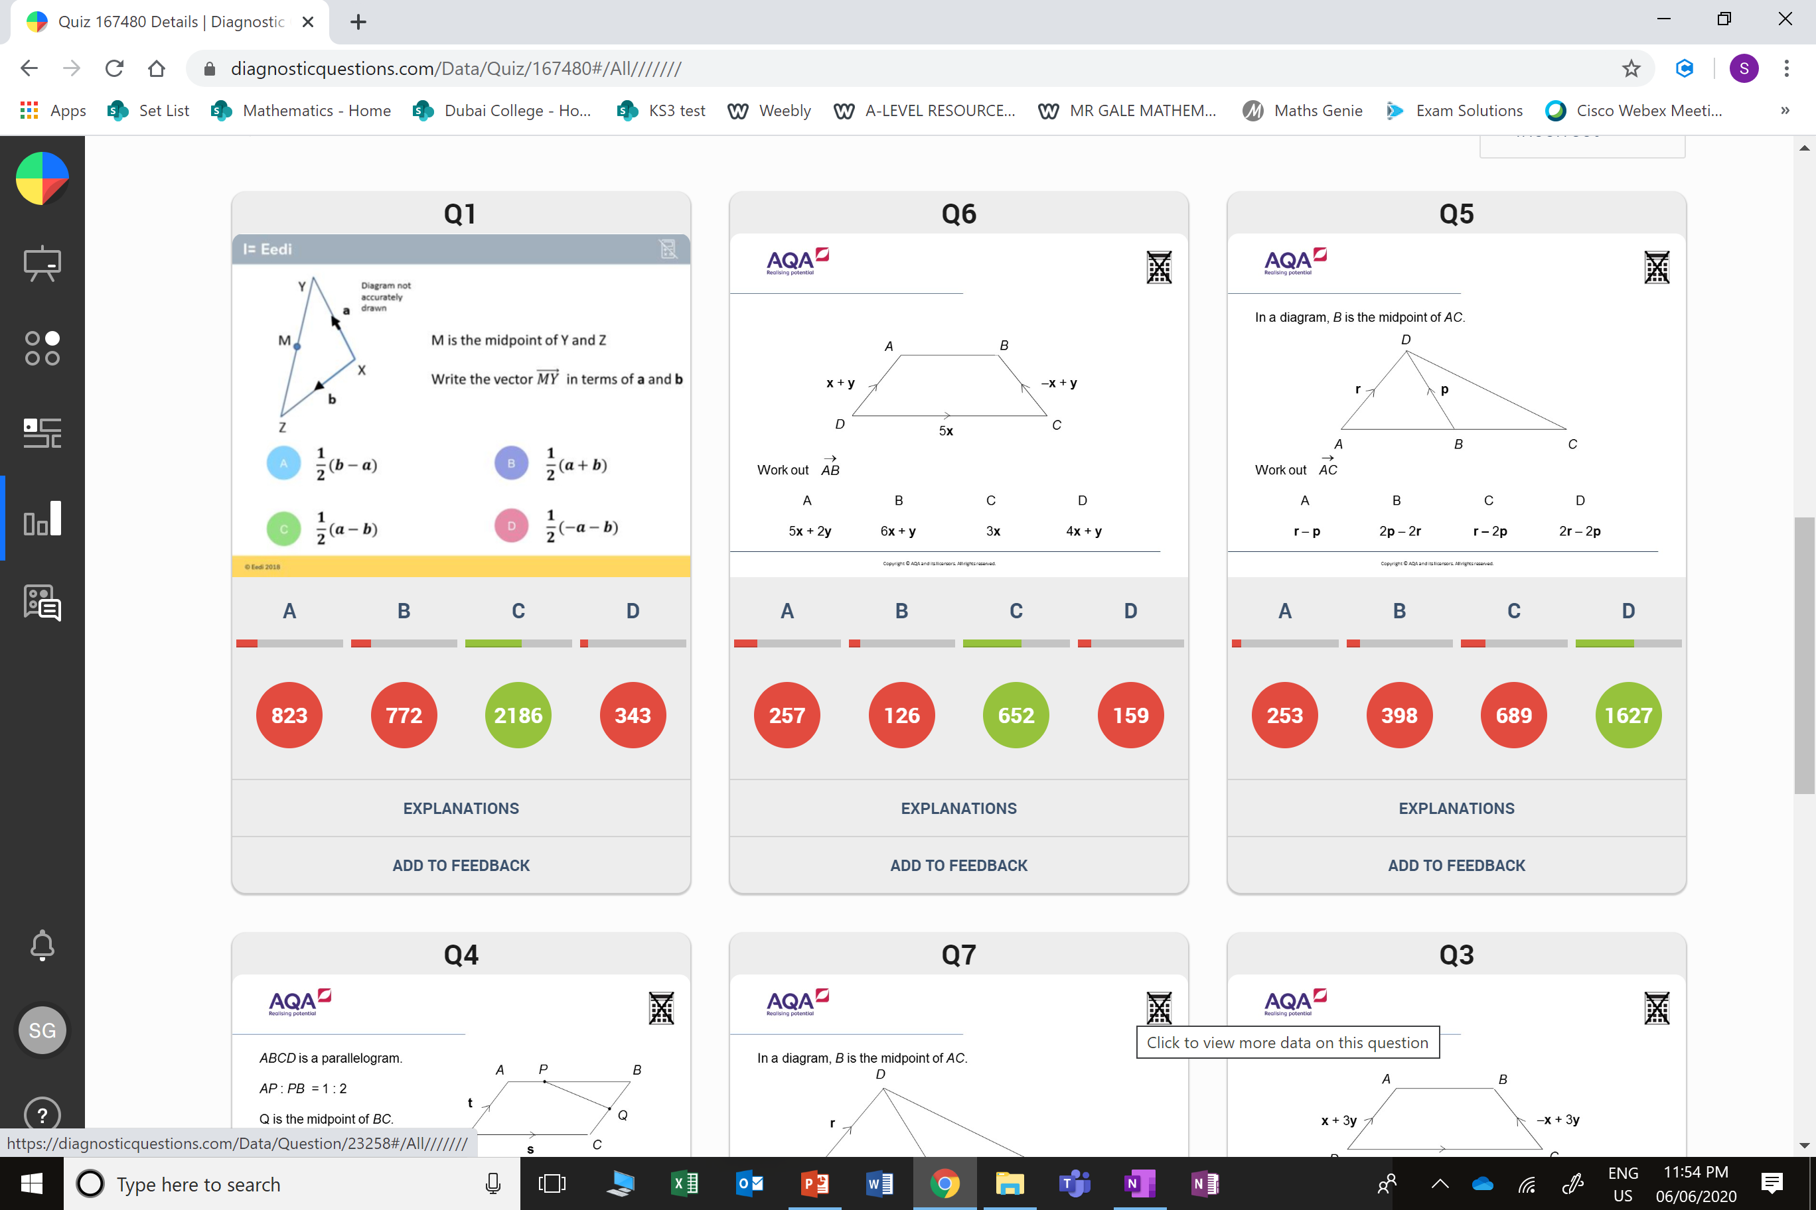
A
The student has given YM rather than MY.

Slide 5
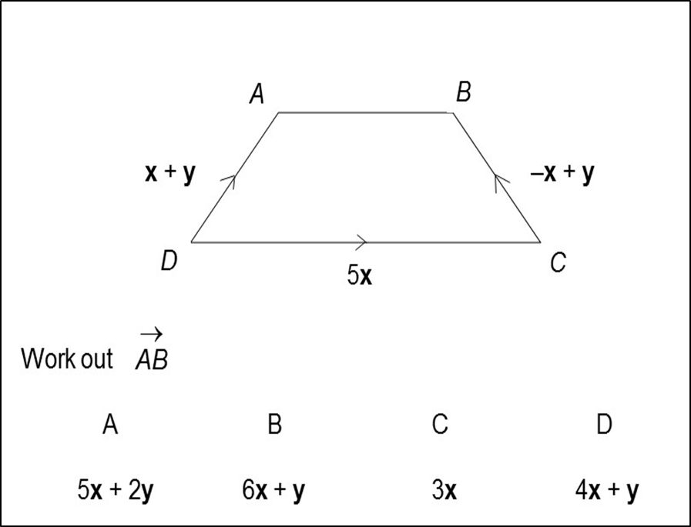
A
They did not take into account the directions of vectors.

