Slide 1
LO: Solving Inequalities
(Double Inequality)

Slide 2
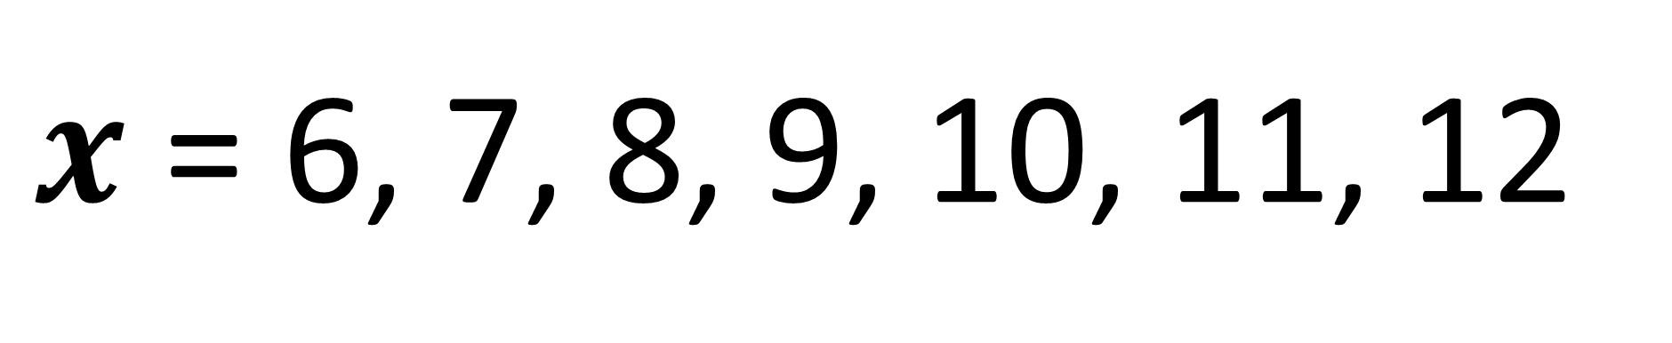

x is an integer.
State all the values of x.
$$5<x≤12$$
$x$ = 6, 7, 8, 9, 10, 11, 12

Slide 3
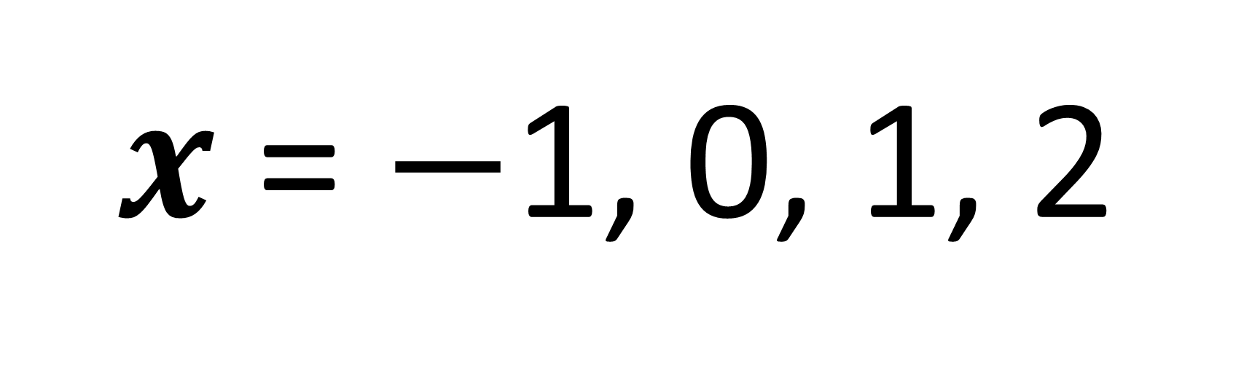
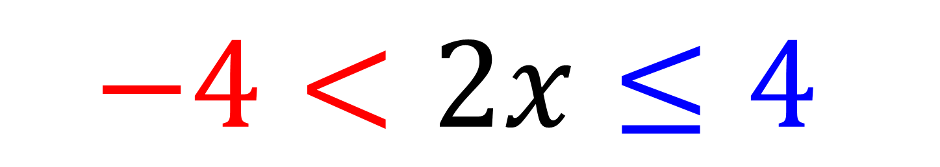
$$−4<2x≤4$$
x is an integer.
State are all the values of x
$2x$ = $−$1, 0, 1, 2

Slide 4
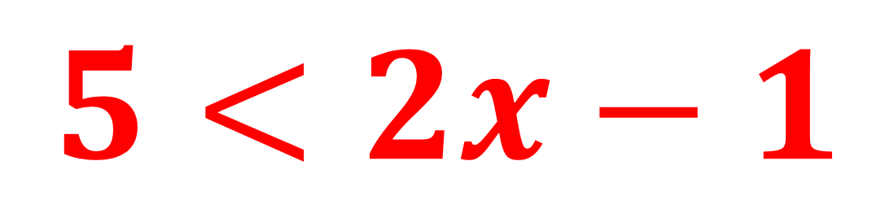
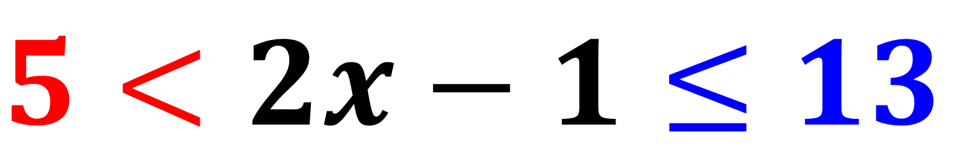
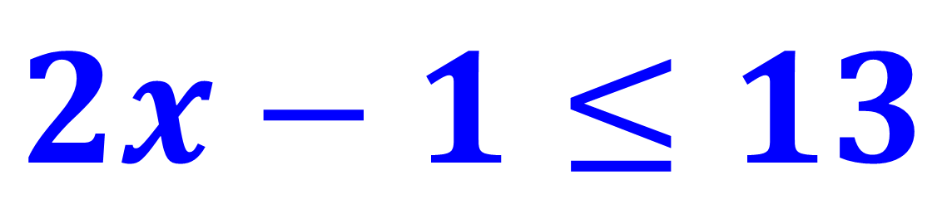
Two questions for the price of one!
$$5<2x−1≤13$$
$$5<2x−1$$
$$2x−1≤13$$

Slide 5
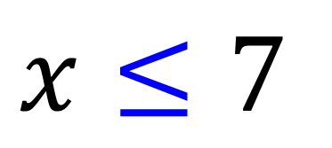
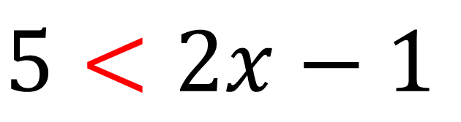

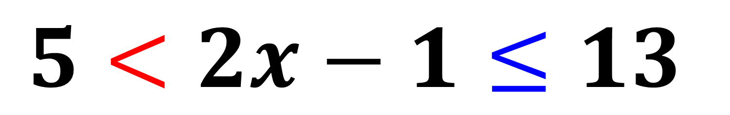
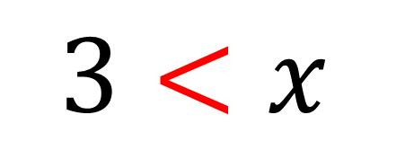
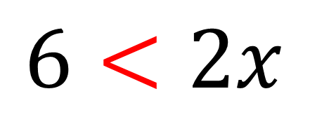
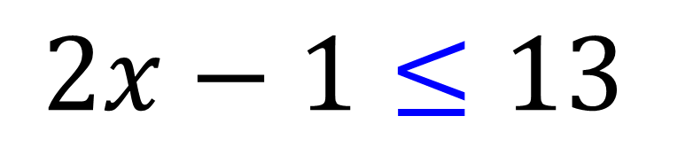

$$5<2x−1≤13$$
$$5<2x−1$$
$$2x−1≤13$$
$$6<2x$$
$$2x≤14$$
$$3<x$$
$$x≤7$$
$$3<x≤7$$

Slide 6
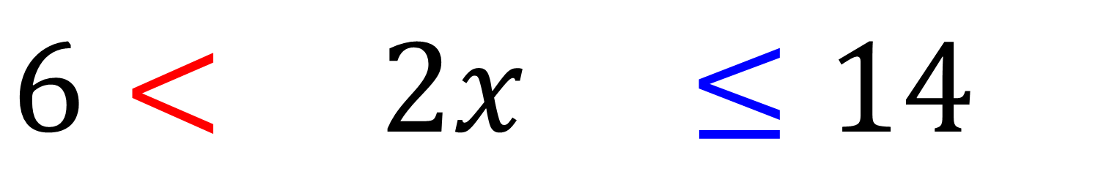
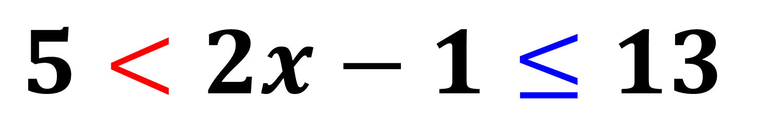
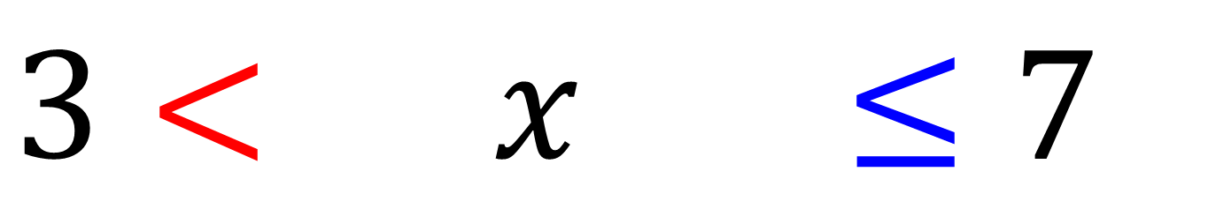
$$5<2x−1≤13$$
$$6< 2x− ≤14$$
$$3< x ≤7$$

Slide 7
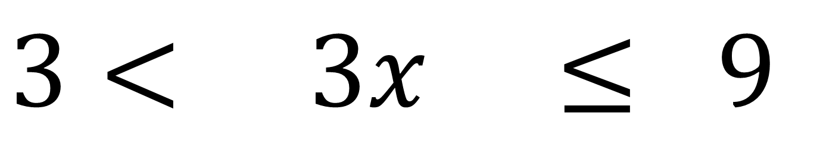
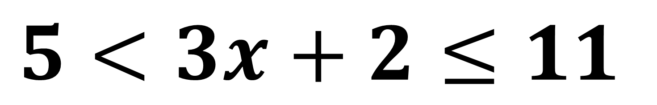
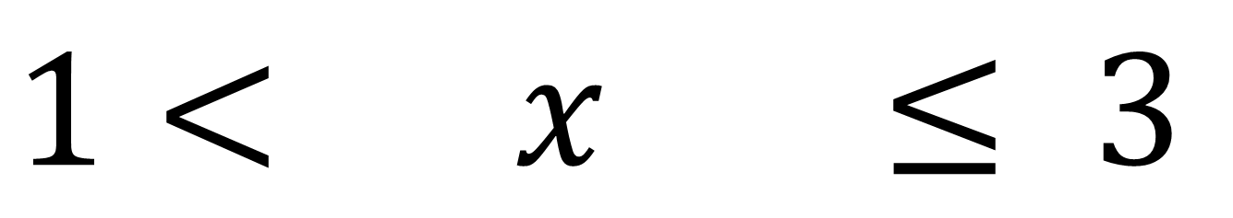
$$5<3x+2≤11$$
$$3< 3x ≤ 9$$
$$1< x ≤ 3$$

Slide 8
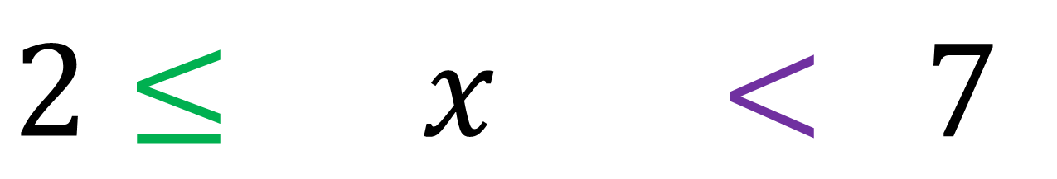
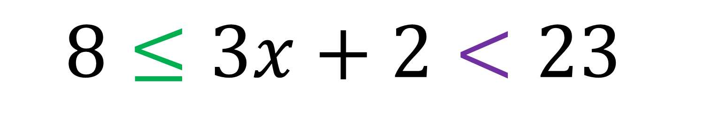
Solve these inequalities and write all the integer values that satisfy them:
$$8≤3x+2<23$$
$$2≤ x < 7$$
Integer values are 2, 3, 4, 5, 6

