Slide 1
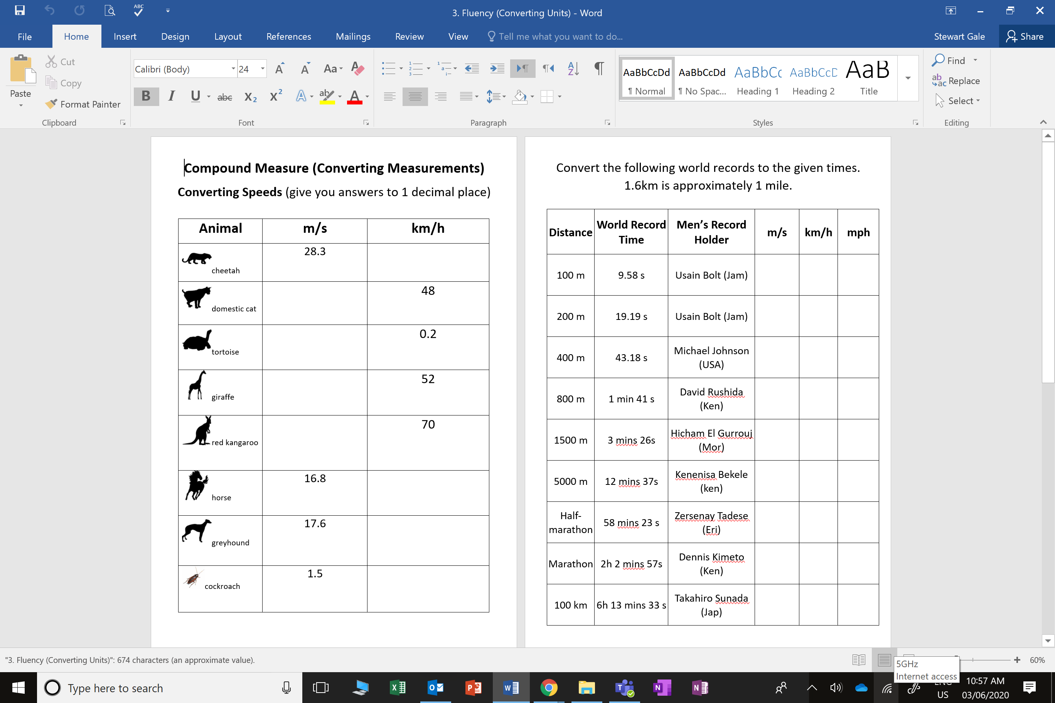

Slide 2
ANSWERS

Slide 3







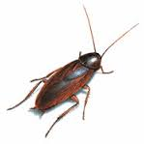

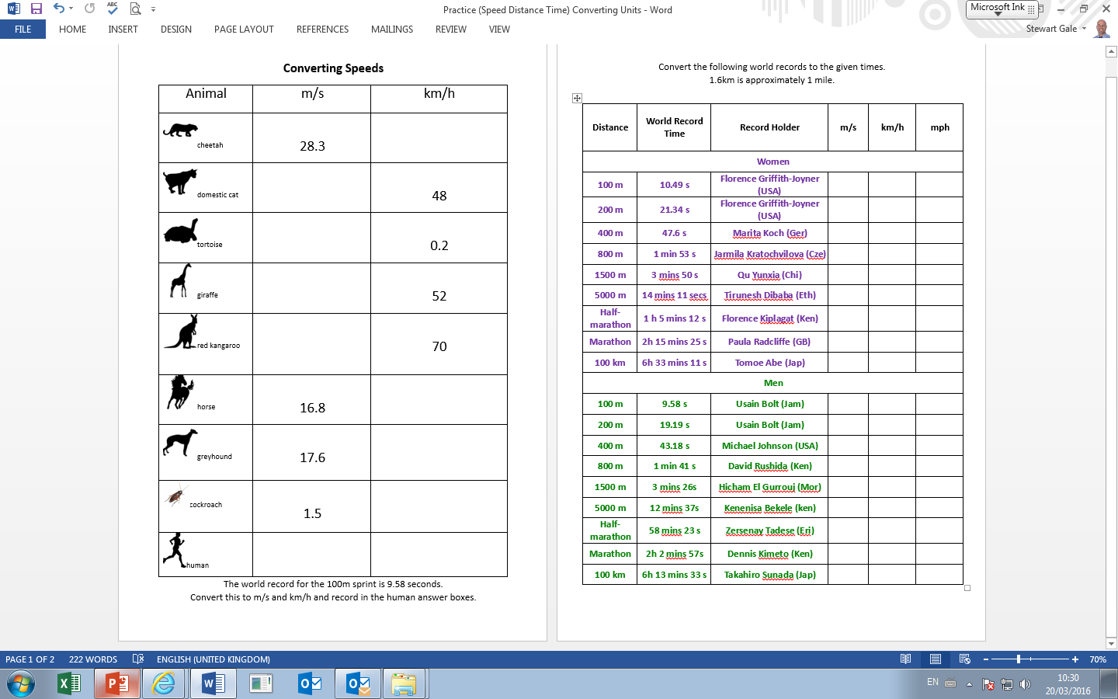
101.9
13.3
Convert the speeds.
(give you answers to 1p.d)
0.05
14.4
m/s = meters per second
19.4
60.5
km/h = kilometres per hour
63.4
5.4
10.4
37.6

Slide 4
Distance | World Record Time | Men’s Record Holder | speed in m/s | convert to km/h | convert to mph
100 m | 9.58 s | Usain Bolt (Jam) | 10.44 | 37.6 | 23.4
200 m | 19.19 s | Usain Bolt (Jam) | 10.42 | 37.5 | 23.3
400 m | 43.18 s | Michael Johnson (USA) | 9.26 | 33.3 | 20.7
800 m | 1 min 41 s | David Rushida (Ken) | 7.92 | 28.5 | 17.7
1500 m | 3 mins 26s | Hicham El Gurrouj (Mor) | 7.28 | 26.2 | 16.3
5000 m | 12 mins 37s | Kenenisa Bekele (ken) | 6.61 | 23.8 | 14.8
Half-marathon | 58 mins 23 s | Zersenay Tadese (Eri) | 6.03 | 21.7 | 13.5
Marathon | 2h 2 mins 57s | Dennis Kimeto (Ken) | 5.78 | 20.8 | 12.9
100 km | 6h 13 mins 33 s | Takahiro Sunada (Jap) | 4.47 | 16.1 | 10.0

