Slide 1
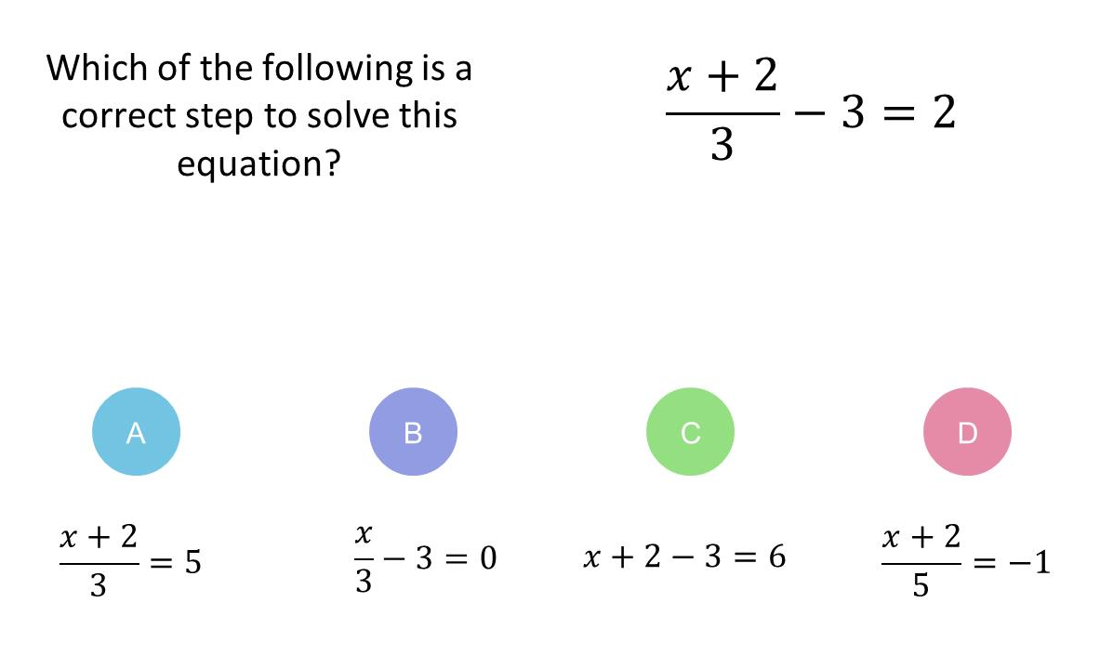
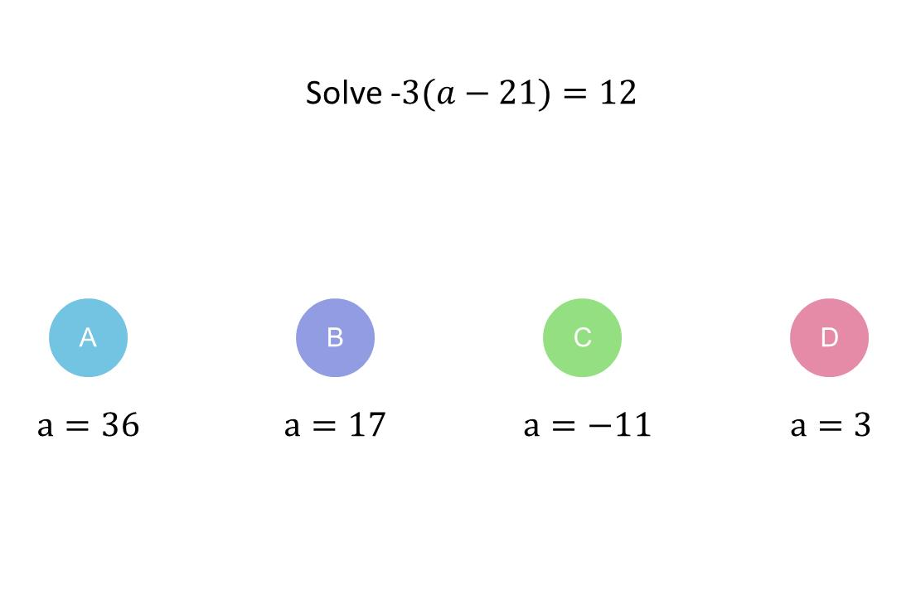
Worst answered question?
Most common wrong answer?

Slide 2
ANSWERS

Slide 3
Worst answered question?

Slide 4
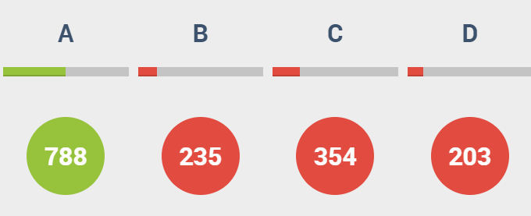
C
They multiplied by 3 first instead of add 3.

Slide 5

C
They multiplied the bracket to get
-3a - 63 = 12 instead of
-3a + 63 = 12.

