Slide 1
LO: Surface Area
of Cones and Spheres

Slide 2
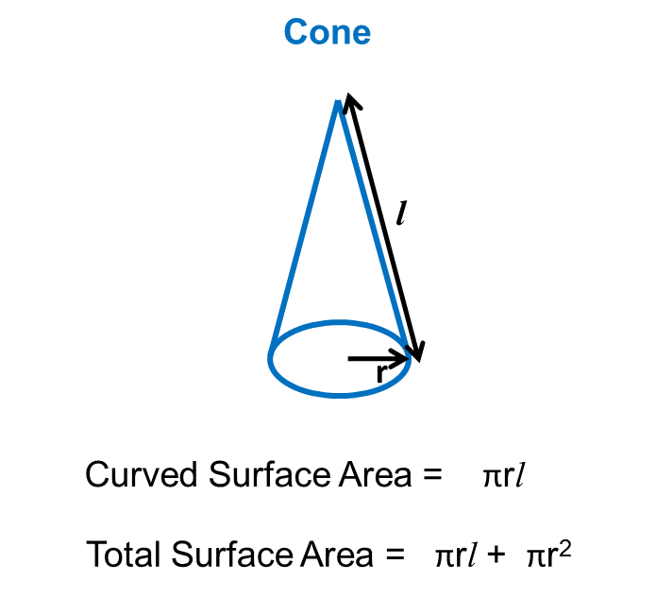
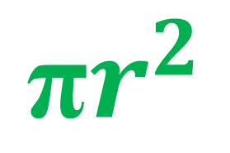
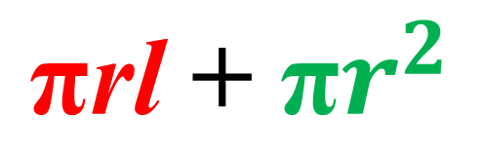
Surface Area (Curved) = πrl
$${\text{π}r}^{2}$$
Surface Area (Base) =
$${\text{π}\text{rl} \text{+ }\text{π}r}^{2}$$
Surface Area (Total) =

Slide 3
Find the total surface area of the cone.
Give you answer in terms of π
Surface Area (Curved) = πrl
5cm
24π cm²
3cm

Slide 4
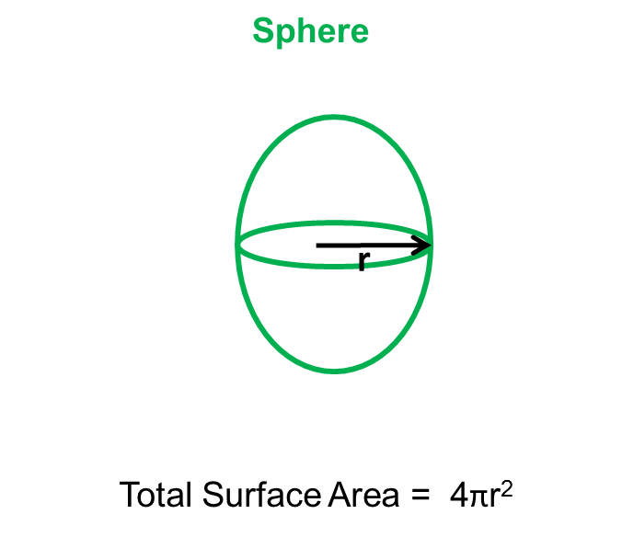
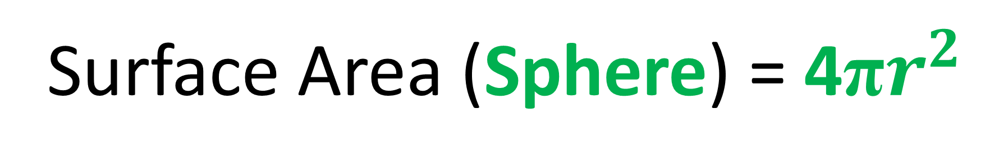

Volume (Sphere) = ${\frac{4}{3}\text{π}r}^{3}$
Surface Area (Sphere) = ${\text{4}\text{π}r}^{2}$

Slide 5
10cm
28.3 cm²
Total Surface Area =

Slide 6
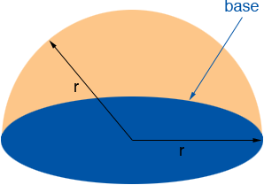
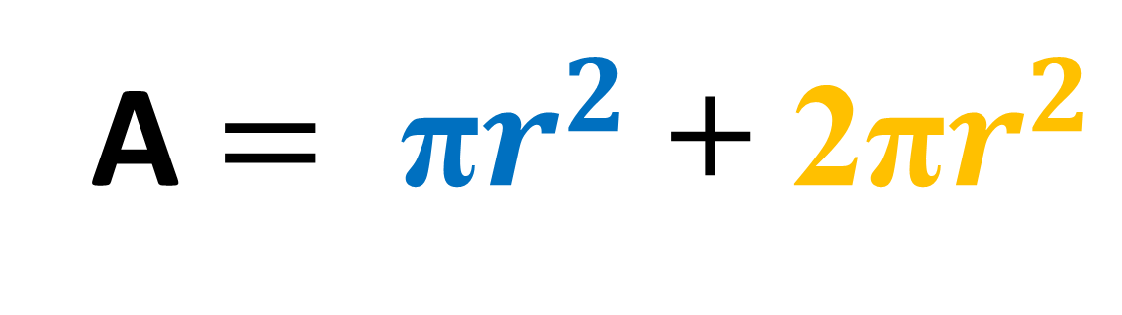
What is the formula for the
surface area?
A $= {{\text{π}r}^{2} \text{+ }\text{2}\text{π}r}^{2}$

